Slide 1
Adaptation to Climate Change:
Challenges for Farmers and Small Towns in the US Midwest
Eugene S. Takle
Professor
Department of Agronomy
Department of Geological and Atmospheric Science
Director, Climate Science Program
Iowa State University
Ames, IA 50011
Rural Communities Workshop
National Climate Assessment
Charleston, SC
13-14 February 2012

Slide 2
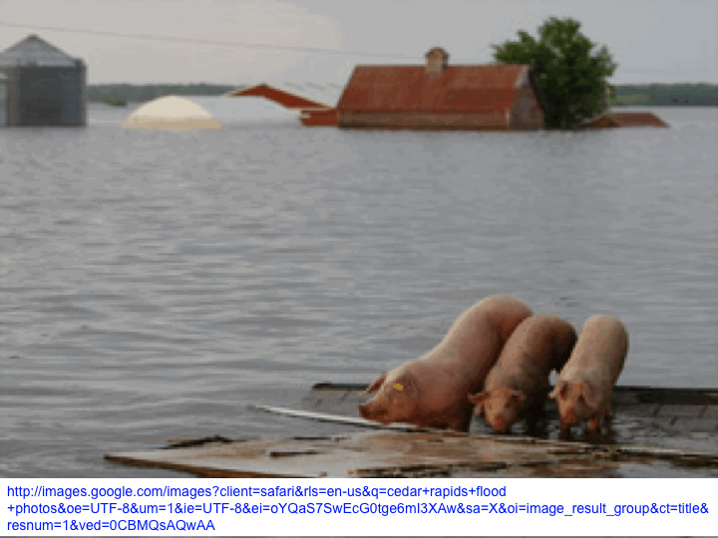
Outline
What are we adapting to?
  Temperature
  Precipitation
  Humidity
Current agricultural adaptation practices
Adaptation challenges for rural communities
Using recent climate records to establish a world view for visioning climate futures
Emergency climate adaptation conference

Slide 3
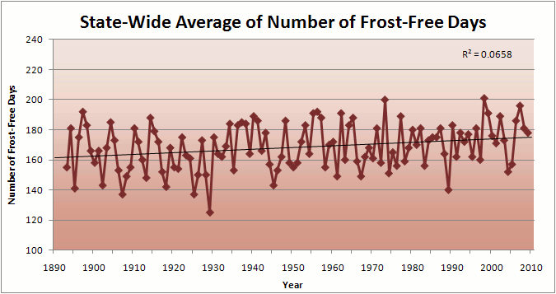
Iowa State-Wide Average Data

Slide 4
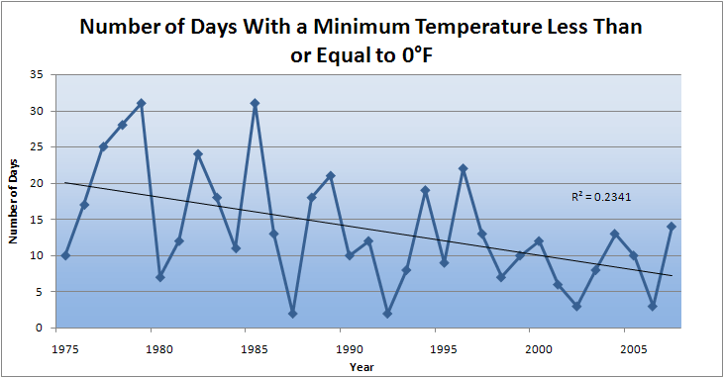
Des Moines Airport Data
Caution: Not corrected for urban heat island effects

Slide 5
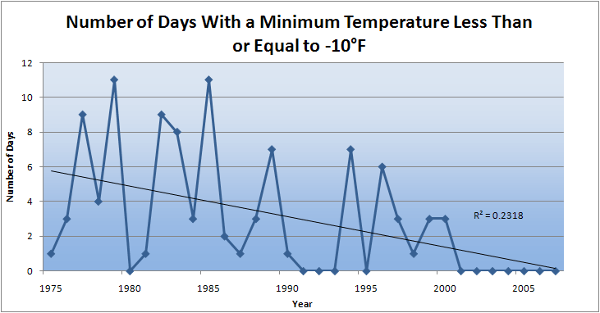
Des Moines Airport Data
Caution: Not corrected for urban heat island effects

Slide 6
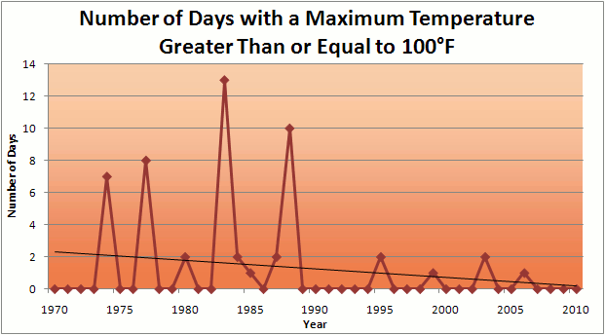
Des Moines Airport Data
1983: 13
1988: 10
1977: 8
1974: 7
2011: 0

Slide 7
Des Moines Airport Data
1983: 13
1988: 10
1977: 8
1974: 7
6 days ≥ 100ºF in the last 23 years
2011: 0

Slide 8
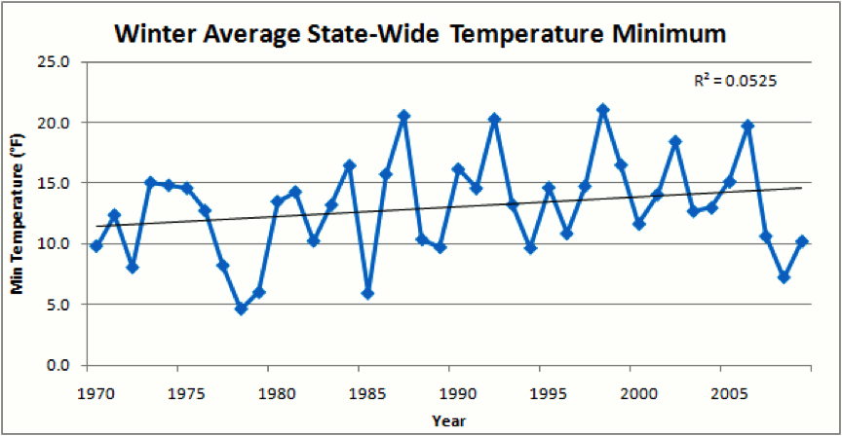
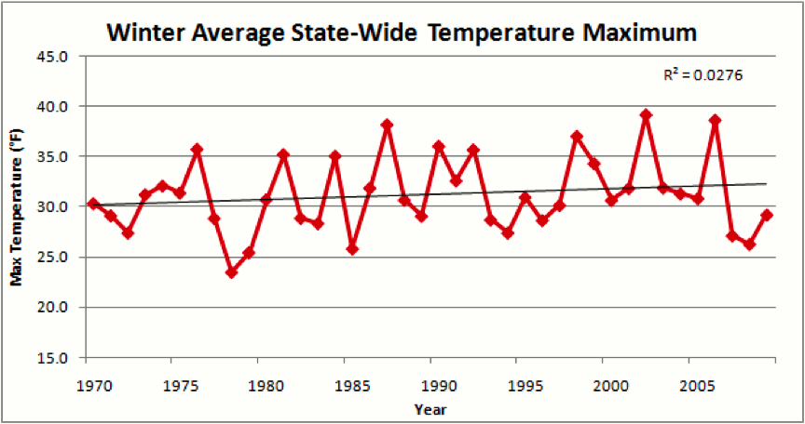
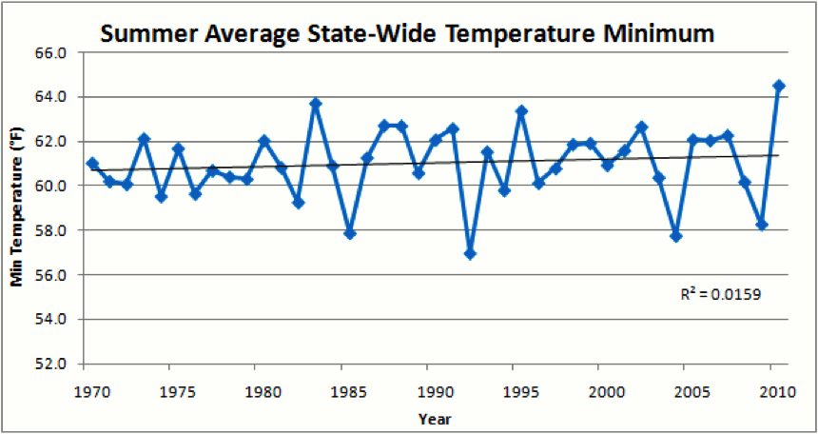
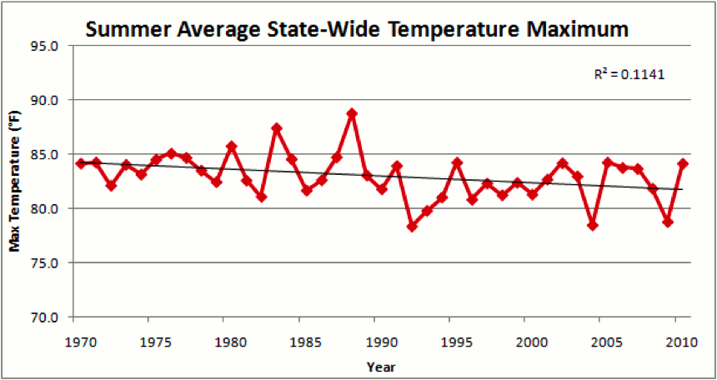

Slide 10
Observed Summer (JJA) Daily Maximum Temperature
Changes (K), 1976-2000
Adapted from Folland et al. [2001]

Slide 11
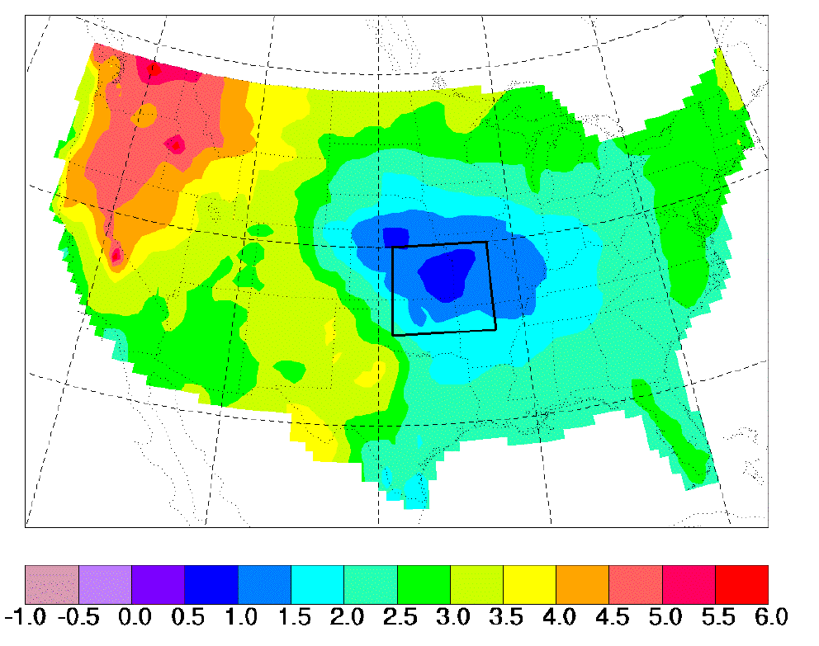
“Warming Hole”
Simulation of changes in daily maximum summertime temperatures between 1990s and 2040s
    Pan, Z., R. W. Arritt, E. S. Takle, W. J. Gutowski, Jr., C. J. Anderson, and M. Segal,2004: Altered hydrologic feedback in a warming climate introduces a “warming hole”. Geophys. Res. Lett.31, L17109, doi:10.1029/2004GL020528.
˚C
ΔT_{max} (JJA)
Notes:
A feature that corresponds to later 20th century trends. Not seen in GCMs. Linked to mesoscale circulation.

Slide 12
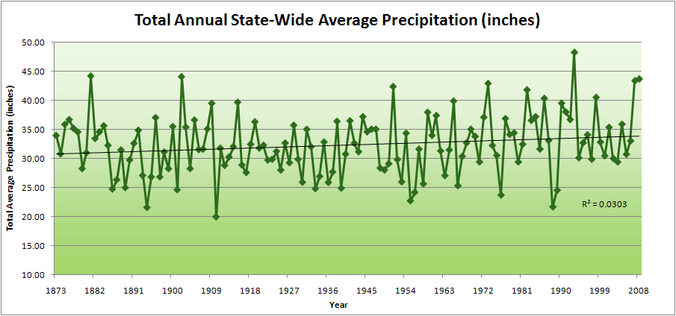
Iowa State-Wide Average Data

Slide 13
Iowa State-Wide Average Data
34.0”
10% increase
30.8”

Slide 14
Iowa State-Wide Average Data
Totals above 40”
2 years
34.0”
10% increase
30.8”

Slide 15
Iowa State-Wide Average Data
Totals above 40”
2 years
8 years
34.0”
10% increase
30.8”

Slide 16
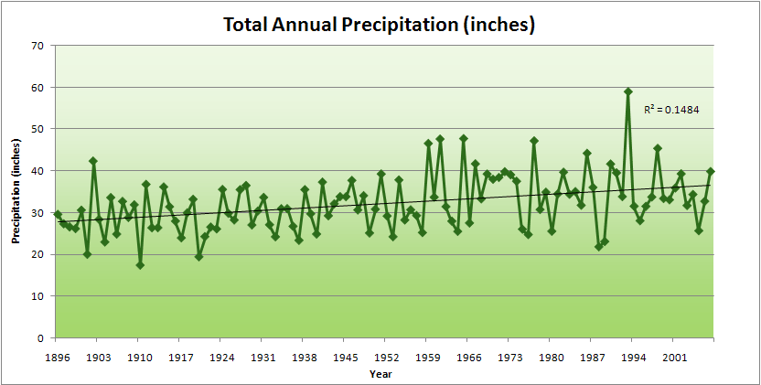
Cedar Rapids Data

Slide 17
Cedar Rapids Data
28.0”
32% increase
37.0”

Slide 18
Cedar Rapids Data
Years with more than 40 inches
11
1
28.0”
32% increase
37.0”

Slide 19
Years with more than 40 inches: 43% Increase
2010 so far

Slide 20
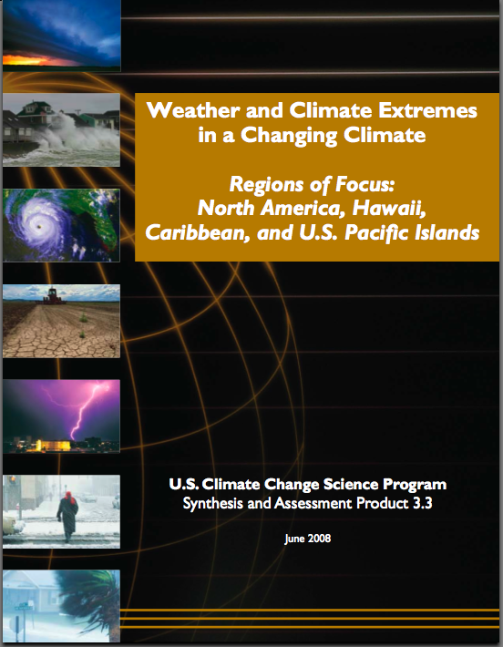
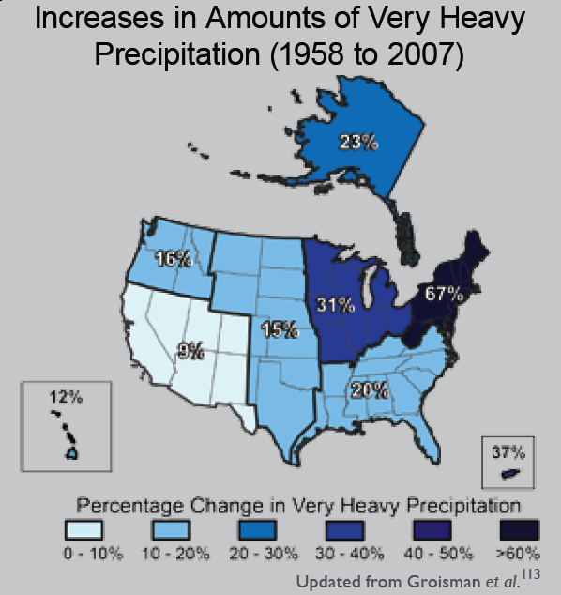
“One of the clearest trends in the United States observational record is an increasing frequency and intensity of heavy precipitation events… Over the last century there was a 50% increase in the frequency of days with precipitation over 101.6 mm (four inches) in the upper midwestern U.S.; this trend is statistically significant “
Karl, T. R., J. M. Melillo, and T. C. Peterson, (eds.), 2009: Global Climate Change Impacts in the United States. Cambridge University Press, 2009, 196pp.

Slide 21
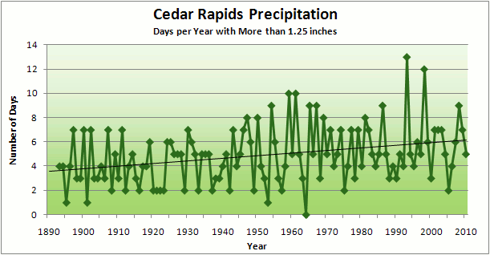
Cedar Rapids Data
3.6 days
67% increase
6.0 days

Slide 22
Cedar Rapids Data
Number of Years with More than 8 Occurrences
0
9
3.6 days
67% increase
6.0 days

Slide 23
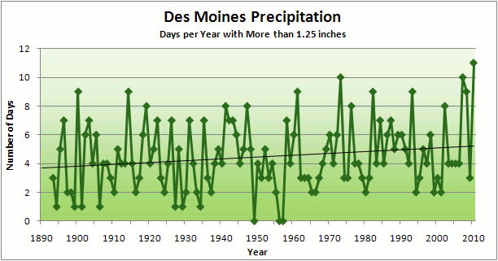
3.7
41% Increase
5.2

Slide 24
Number of Years with More than 8 Occurrences
2
7
3.7
41% Increase
5.2

Slide 25
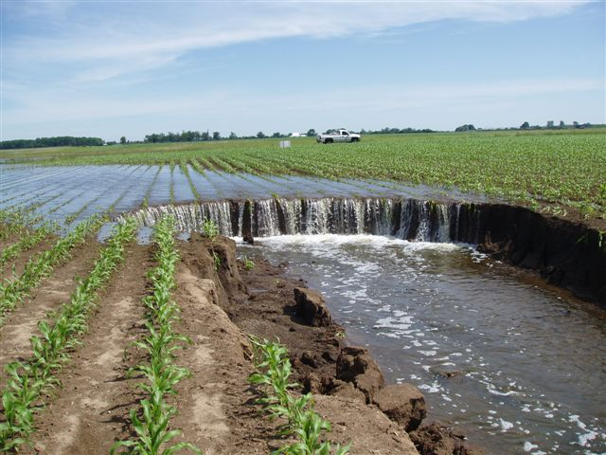
Photo courtesy of RM Cruse

Slide 26
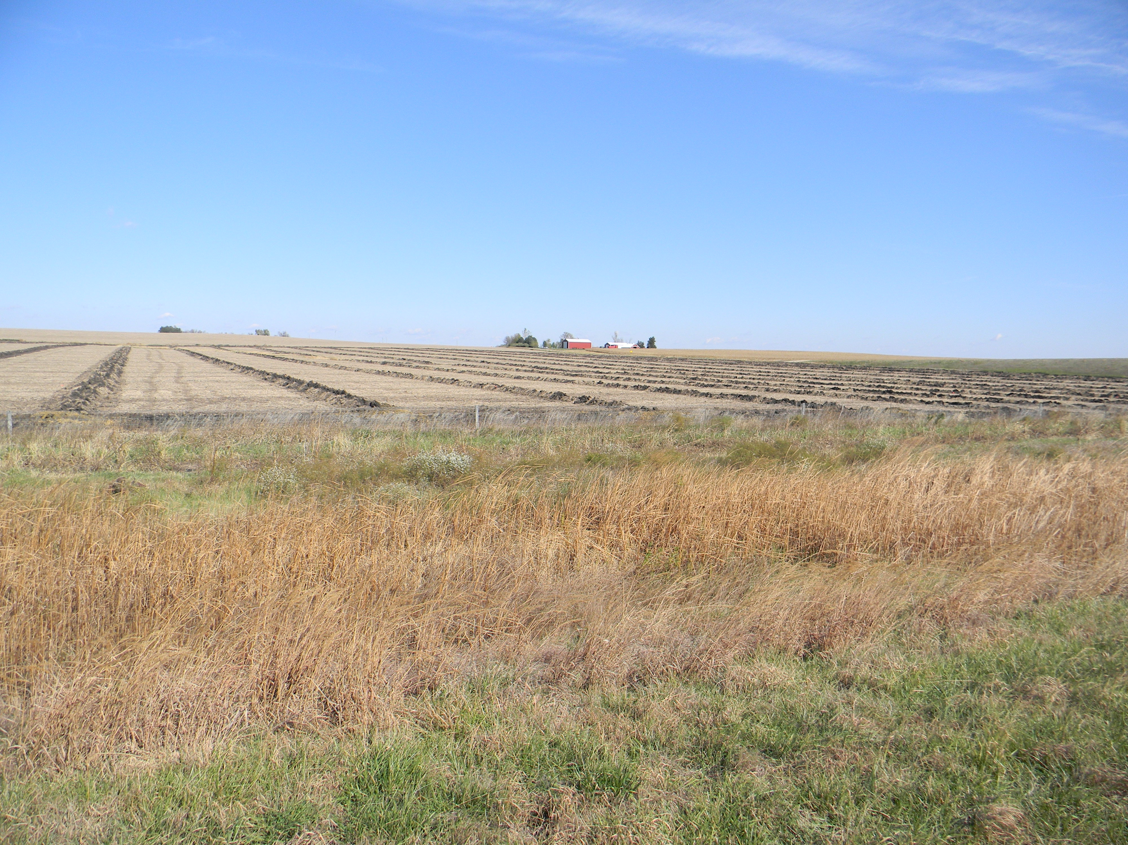

Slide 27
Source: Dwight Burdette
http://www.extension.umn.edu/distribution/cropsystems/dc7740.html

Slide 29
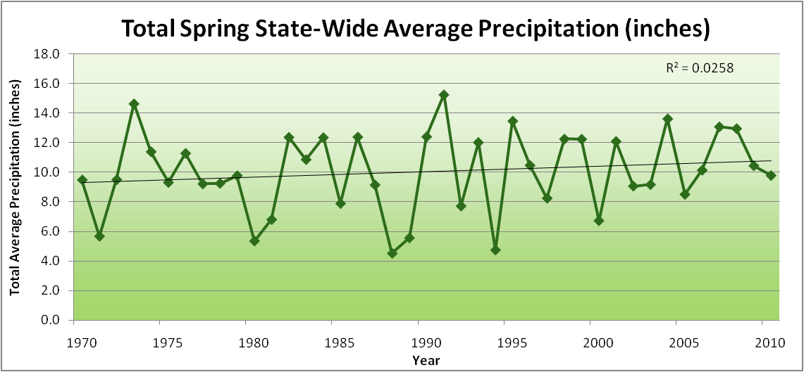
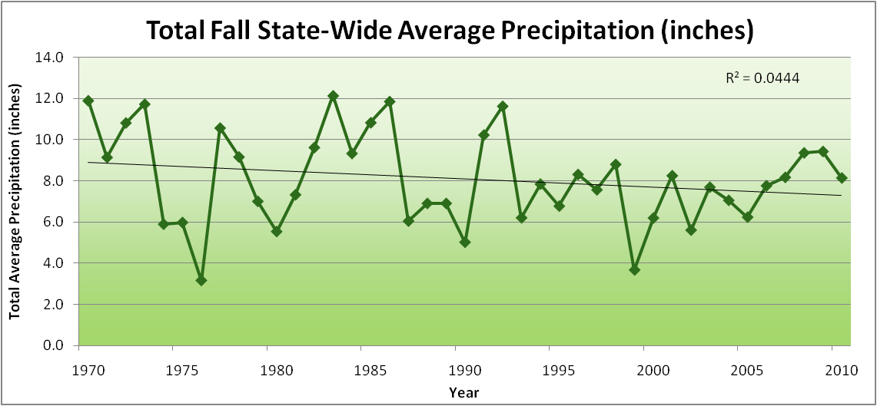
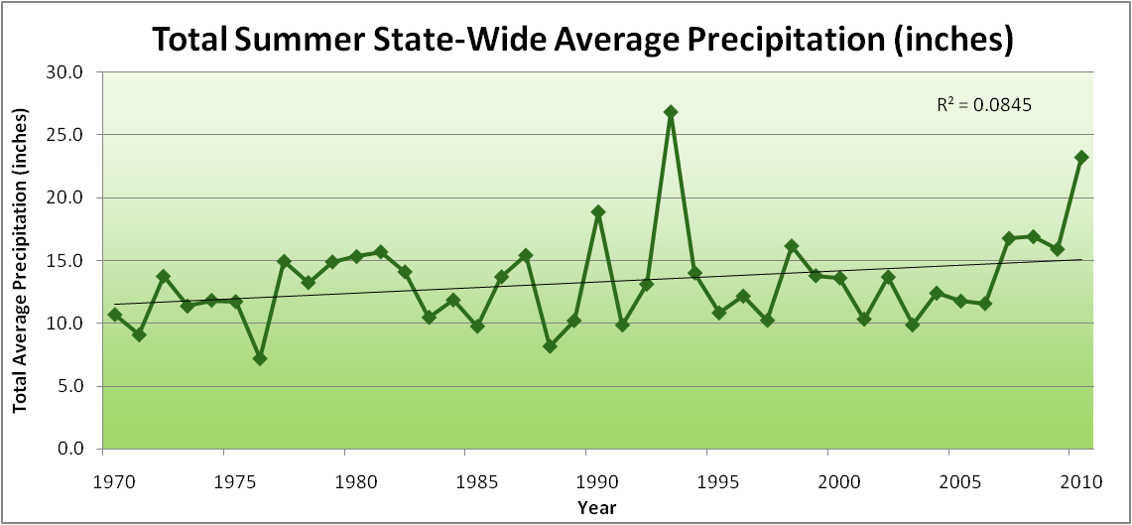
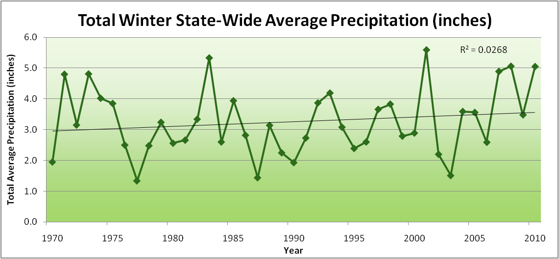
Amplification of the Seasonality of Precipitation
Spring
Fall
Summer
Winter

Slide 30
Amplification of the Seasonality of Precipitation
Spring
Fall
Summer
Winter

Slide 31
Amplification of the Seasonality of Precipitation
Spring
Fall
21.2 => 25.3 inches (22% increase)
12.1 => 10.5 inches (13% decrease)
Summer
Winter

Slide 32
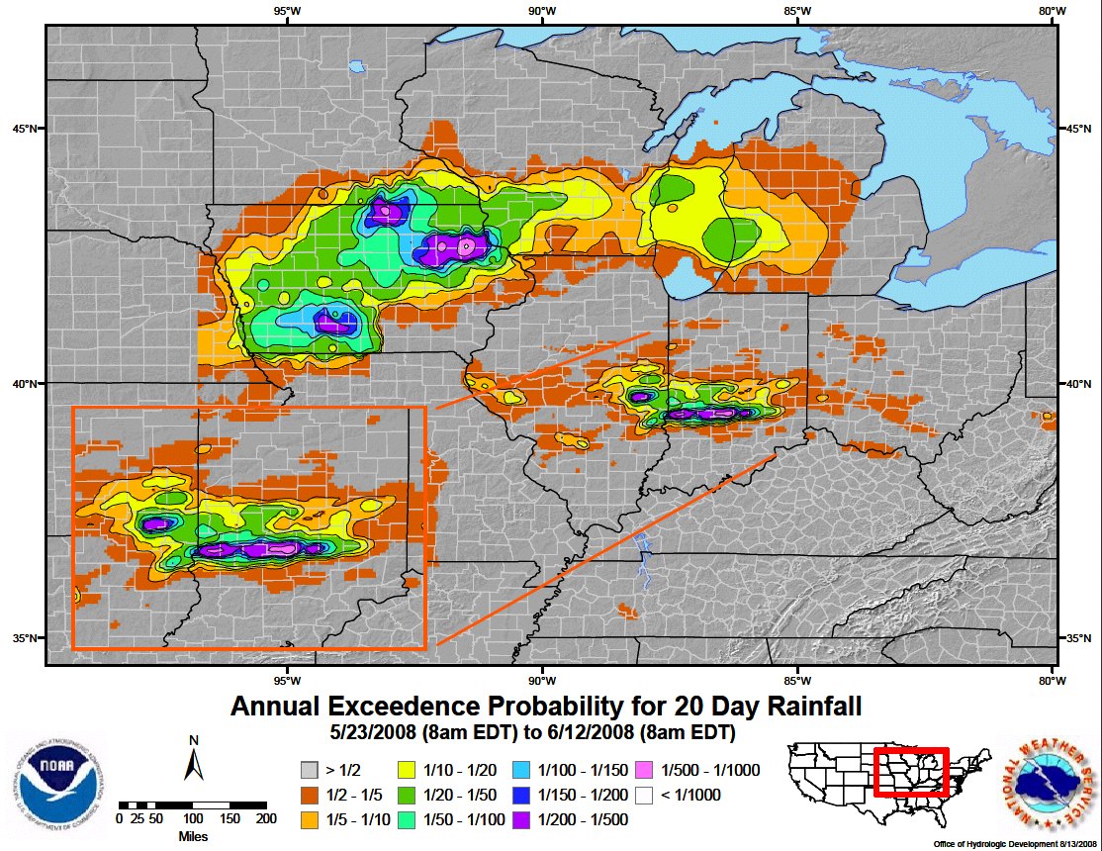

Slide 33
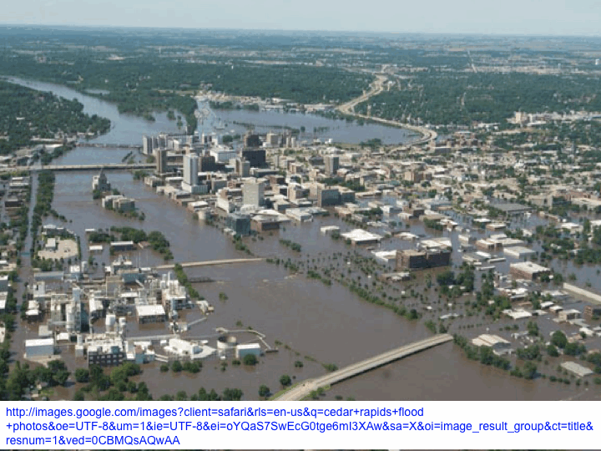

Slide 34
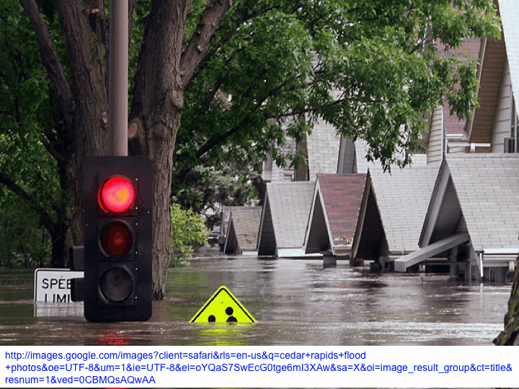

Slide 35
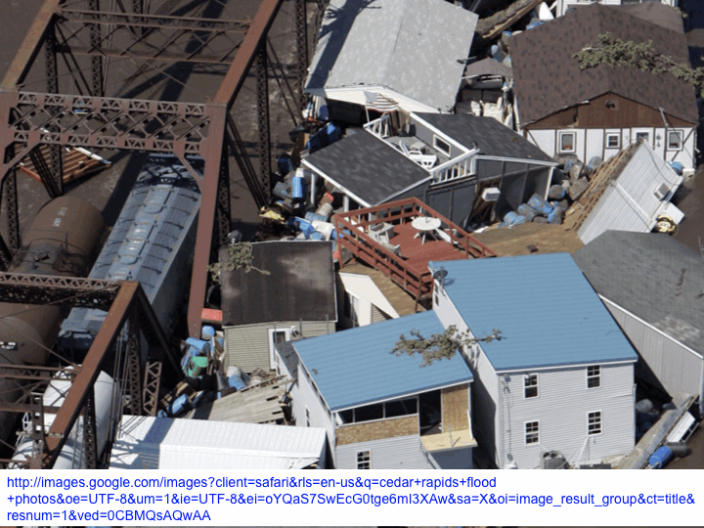

Slide 36
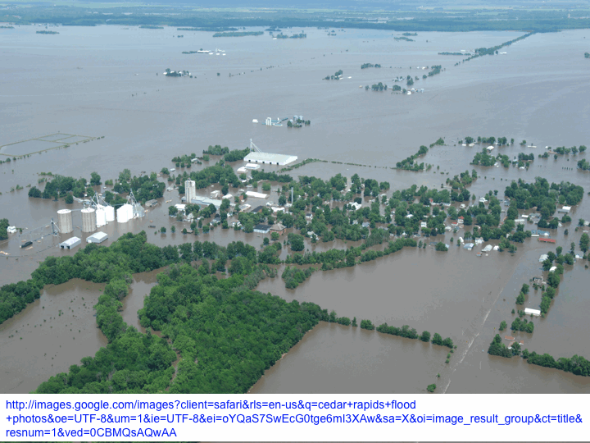

Slide 37
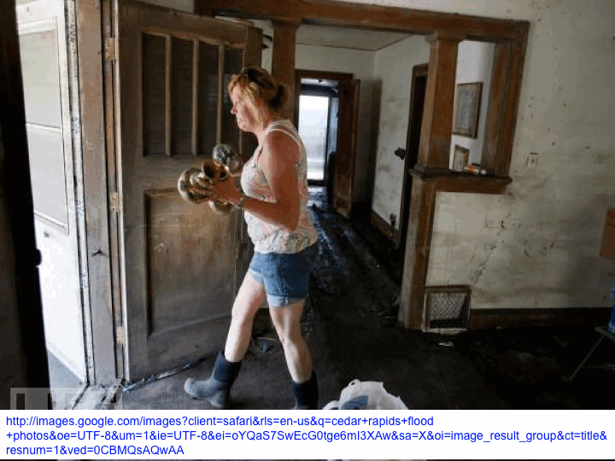

Slide 38
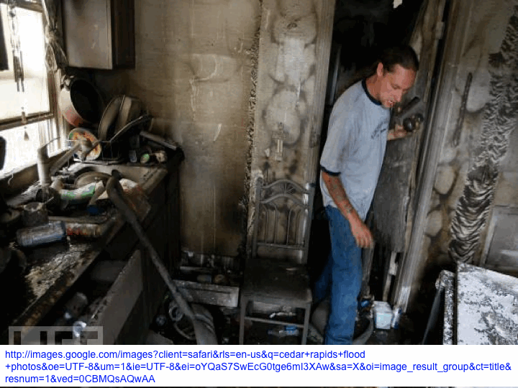

Slide 39
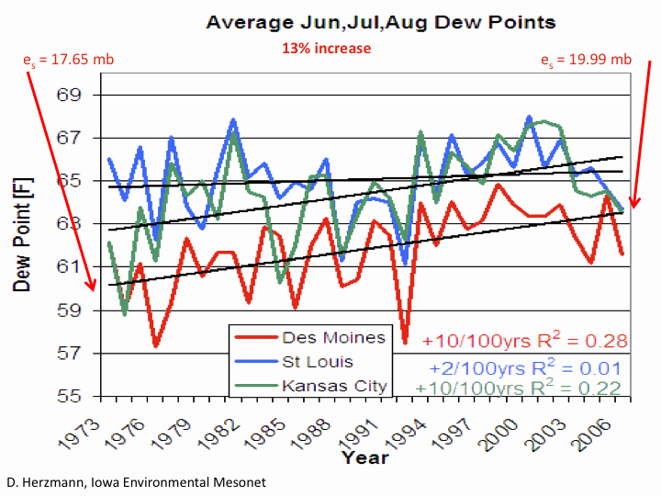

Slide 40
Iowa Agricultural Producers are Adapting to Climate Change:
Longer growing season: plant earlier, plant longer season hybrids, harvest later
Wetter springs: larger machinery enables planting in smaller weather windows
More summer precipitation: higher planting densities for higher yields
Wetter springs and summers: more subsurface drainage tile is being installed, closer spacing, sloped surfaces
Fewer extreme heat events: higher planting densities, fewer pollination failures
Higher humidity: more spraying for pathogens favored by moist conditions. more problems with fall crop dry-down, wider bean heads for faster harvest due to shorter harvest period during the daytime.
Drier autumns: delay harvest to take advantage of natural dry-down conditions, thereby reducing fuel costs
HIGHER YIELDS!!
Is it genetics or climate? Likely some of each.

Slide 42
Iowa Agricultural Producers are Adapting to Climate Change:
Longer growing season: plant earlier, plant longer season hybrids, harvest later
Wetter springs: larger machinery enables planting in smaller weather windows
More summer precipitation: higher planting densities for higher yields
Wetter springs and summers: more subsurface drainage tile is being installed, closer spacing, sloped surfaces
Fewer extreme heat events: higher planting densities, fewer pollination failures
Higher humidity: more spraying for pathogens favored by moist conditions. more problems with fall crop dry-down, wider bean heads for faster harvest due to shorter harvest period during the daytime.
Drier autumns: delay harvest to take advantage of natural dry-down conditions, thereby reducing fuel costs
HIGHER YIELDS!!
Is it genetics or climate? Likely some of each.

Slide 43
Adapting to Climate Change:
Midwest commodity crop producers have adequate resources to adapt to climate change….at least for now
Adaptation is driven by higher profits or preventing profit loss, not ethical considerations
At the same time, Midwest rural communities lack the expertise and resources to adapt to changes in precipitation
In fact the community planners report hostility to planning for climate change

Slide 44
Visioning a Future Climate of the Midwest

Slide 45
Visioning a Future Climate of the Midwest
You are here

Slide 46
Visioning a Future Climate of the Midwest
You are here
Today

Slide 47
Visioning a Future Climate of the Midwest
You are here
Today
Past

Slide 48
Visioning a Future Climate of the Midwest
You are here
Today
Past
Future

Slide 49
Visioning a Future Climate of the Midwest
You are here
?
Today
Past
Future

Slide 50
You be the scientist: For which hypothesis of the future can you find the most evidence?
?
Some Climate Variable (temp, precip, humid)
Today
Past
Future

Slide 51
You be the scientist: For which hypothesis of the future can you find the most evidence?
Some Climate Variable (temp, precip, humid)
Measured past
Today
Past
Future

Slide 52
You be the scientist: For which hypothesis of the future can you find the most evidence?
Some Climate Variable (temp, precip, humid)
Future will return to something in the past
Measured past
Today
Past
Future

Slide 53
You be the scientist: For which hypothesis of the future can you find the most evidence?
Future will be like average of the past
Some Climate Variable (temp, precip, humid)
Future will return to something in the past
Measured past
Today
Past
Future

Slide 54
You be the scientist: For which hypothesis of the future can you find the most evidence?
Future will be like today
Future will be like average of the past
Some Climate Variable (temp, precip, humid)
Future will return to something in the past
Measured past
Today
Past
Future

Slide 55
You be the scientist: For which hypothesis of the future can you find the most evidence?
Current trend will continue
Future will be like today
Future will be like average of the past
Some Climate Variable (temp, precip, humid)
Future will return to something in the past
Measured past
Today
Past
Future

Slide 56
You be the scientist: For which hypothesis of the future can you find the most evidence?
What does the best available science have to say?
Current trend will continue
Future will be like today
Future will be like average of the past
Some Climate Variable (temp, precip, humid)
Future will return to something in the past
Measured past
Today
Past
Future

Slide 57
You be the scientist: For which hypothesis of the future can you find the most evidence?
Based on climate models, climate scientists overwhelmingly agree that the future will be more extreme than today
Current trend will continue
Future will be like today
Future will be like average of the past
Some Climate Variable (temp, precip, humid)
Future will return to something in the past
Measured past
Today
Past
Future

Slide 58
You be the scientist: For which hypothesis of the future can you find the most evidence?
Future will be more extreme than today
Current trend will continue
Future will be like today
Future will be like average of the past
Some Climate Variable (temp, precip, humid)
Future will return to something in the past
Measured past
Today
Past
Future

Slide 59
You be the scientist: For which hypothesis of the future can you find the most evidence?
Some Climate Variable (temp, precip, humid)
Measured past
Today
Past
Future

Slide 60
Best Available Science
A Prudent View of the Future
Some Climate Variable (temp, precip, humid)
Measured past
Today
Past
Future

Slide 61
For More Information:
Climate Science Program
Iowa State University
http://climate.engineering.iastate.edu/
http://www.meteor.iastate.edu/faculty/takle/
gstakle@iastate.edu
Iowa Flood Center
University of Iowa
http://www.iowafloodcenter.org/
witold-krajewski@uiowa.edu

