Slide 1
Climate Change and Implications for Midwest Agriculture
Eugene S. Takle and Christopher J. Anderson
Department of Agronomy
Climate Science Program
Iowa State University
Ames, IA 50011
gstakle@iastate.edu
Regional Climate Modeling to Improve Climate Variability and Change Projections at the Local Scale
27th Conference on Hydrology
93rd American Meteorological Society Annual Meeting

Slide 2
Overview
Coupling RCMs to impacts models
Model coupling and uncertainty (streamflow example)
Impacts examples: Lessons learned
NARCCAP data
Food Security

Slide 3
Impacts Examples: (Lessons Learned)
Streamflow (uncertainty, thresholds)*
Subsurface tile drainage
Wind energy
Solar energy
Soil carbon
Extreme precipitation
Extreme wind speeds (wind speed declines, role in ET)
Roadway design (time series scenarios, appropriate use of past climate)
Building energy use (changing national standards)*
Animal agriculture (dairy production, breeding success)
Mycotoxin (sequence of specific climate impacts; multiple impact models)
Crop yield (timing and amount of precipitation)*

Slide 4
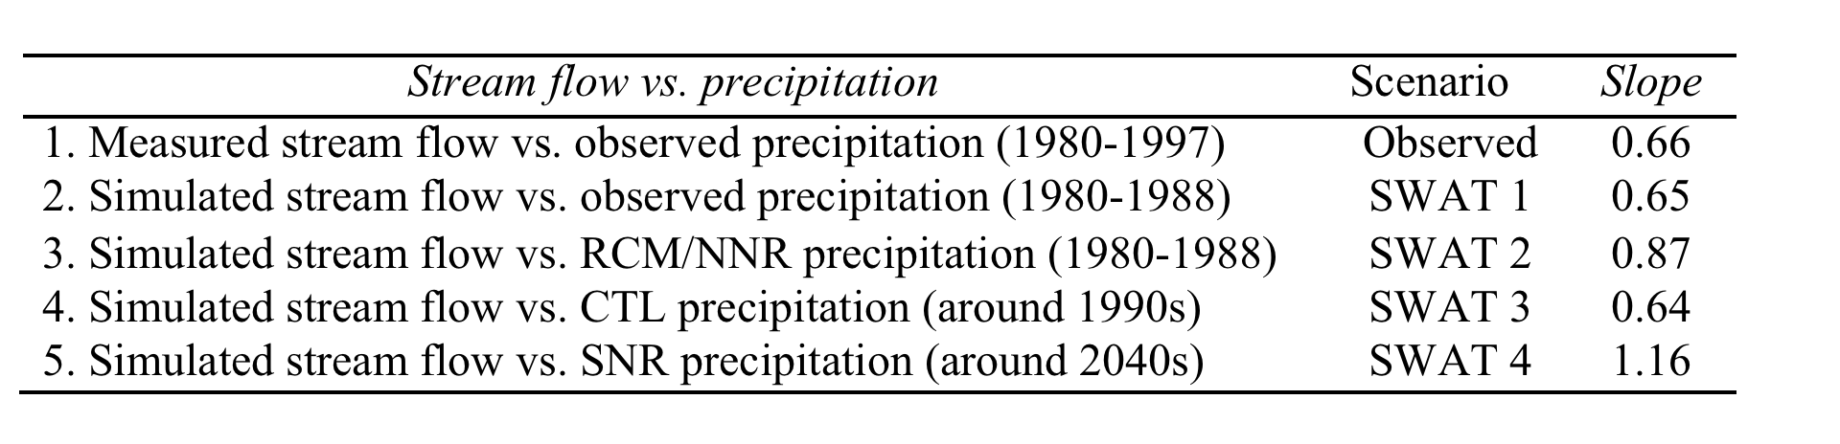
Characterizing and Quantifying Uncertainty

Slide 5
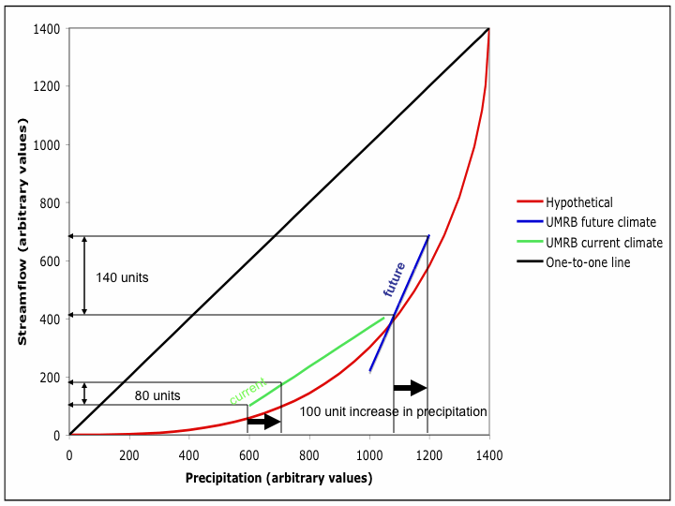
Streamflow vs. Precipitation

Slide 6
Impacts Examples: (Lessons Learned)
Streamflow (uncertainty, thresholds)*
Subsurface tile drainage
Wind energy
Solar energy
Soil carbon
Extreme precipitation
Extreme wind speeds (wind speed declines, role in ET)
Roadway design (time series scenarios, appropriate use of past climate)
Building energy use (changing national standards)*
Animal agriculture (dairy production, breeding success)
Mycotoxin (sequence of specific climate impacts; multiple impact models)
Crop yield (timing and amount of precipitation)*

Slide 7
Climate Change Impact on Building Energy Use
Mason City, Iowa
Atlanta, Georgia

Slide 8
Impacts Examples: (Lessons Learned)
Streamflow (uncertainty, thresholds)*
Subsurface tile drainage
Wind energy
Solar energy
Soil carbon
Extreme precipitation
Extreme wind speeds (wind speed declines, role in ET)
Roadway design (time series scenarios, appropriate use of past climate)
Building energy use (changing national standards)*
Animal agriculture (dairy production, breeding success)
Mycotoxin (sequence of specific climate impacts; multiple impact models)
Crop yield (timing and amount of precipitation)*

Slide 9
2011
2012

Slide 10
Iowa State-Wide Average
Totals above 40”
1 year
5 years
3 years
7 years
2012
Totals below 25”

Slide 11
Des Moines, IA Airport Data
1983: 13
11 days in 2012
1988: 10
1977: 8
1974: 7
6 days ≥ 100ºF in 23 years

Slide 12
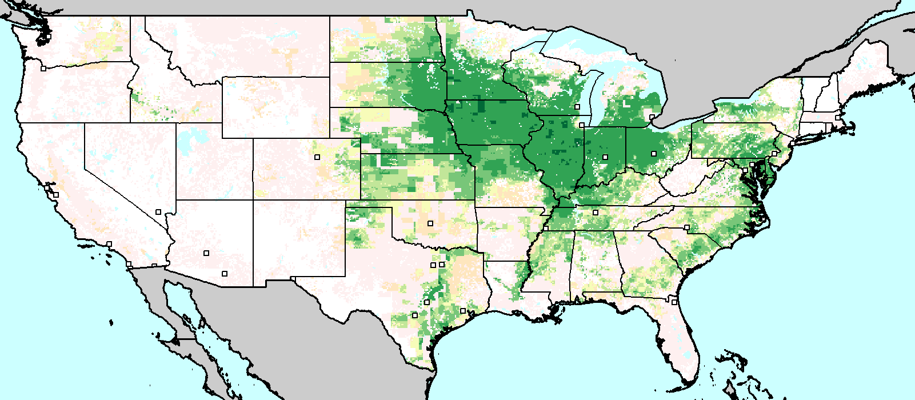
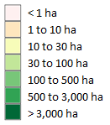
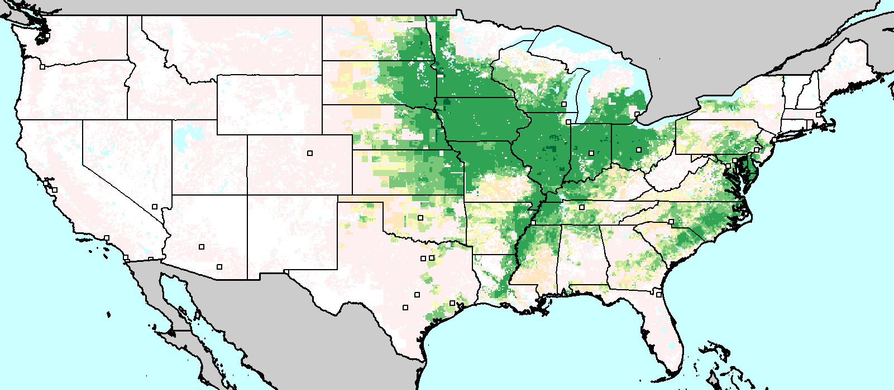
Harvest Area (2000) for Maize and Soybeans
Soybeans
Maize

Slide 13
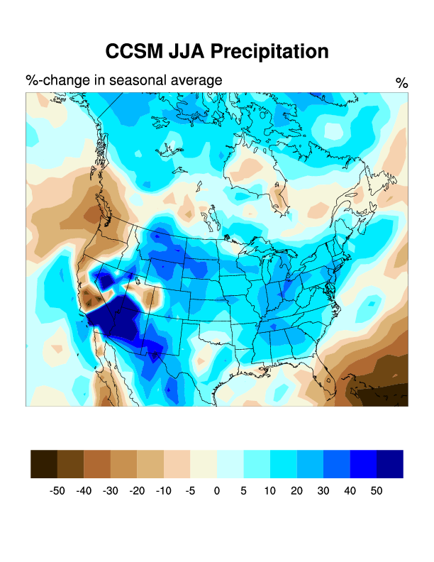
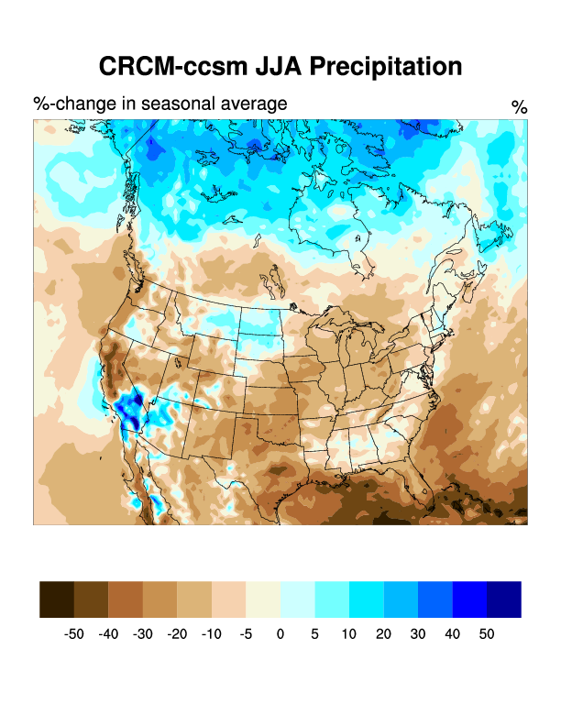
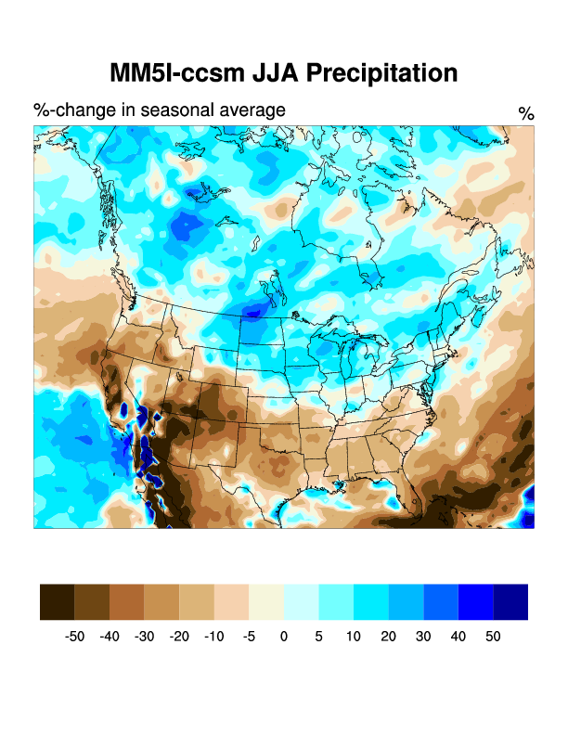
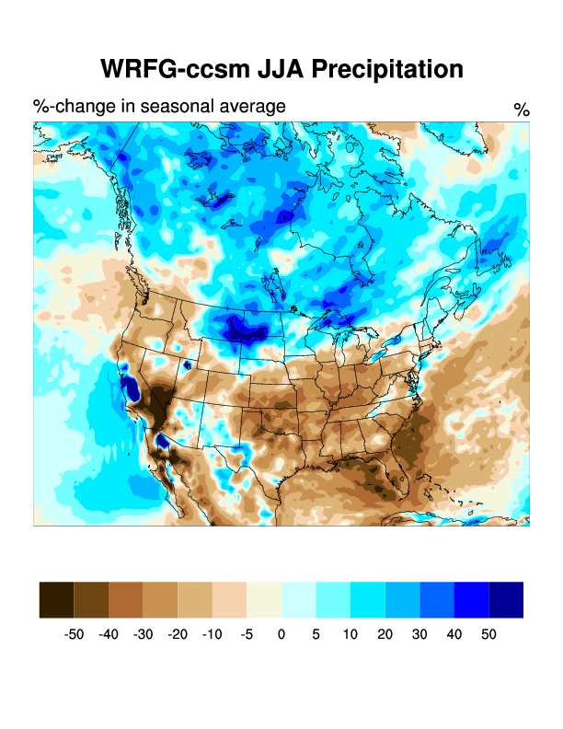
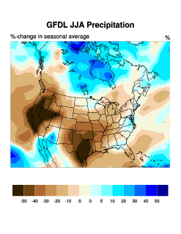
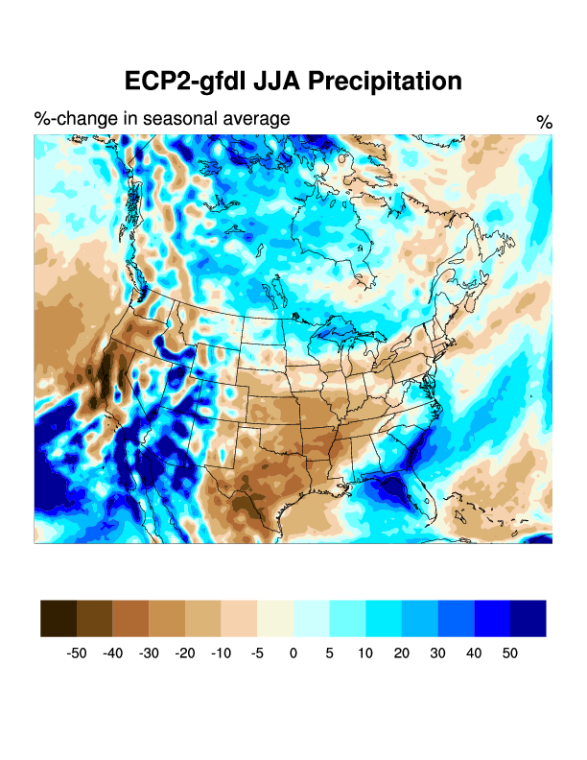
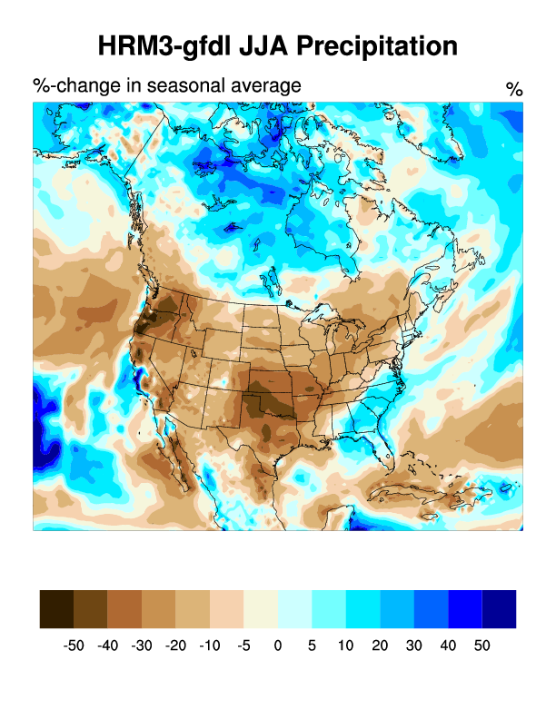
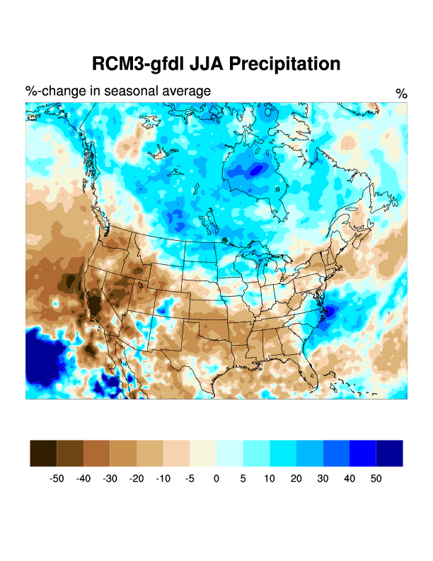
NARCCAP Change in JJA Precipitation

Slide 14
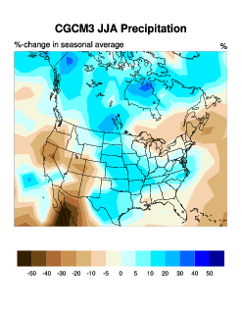
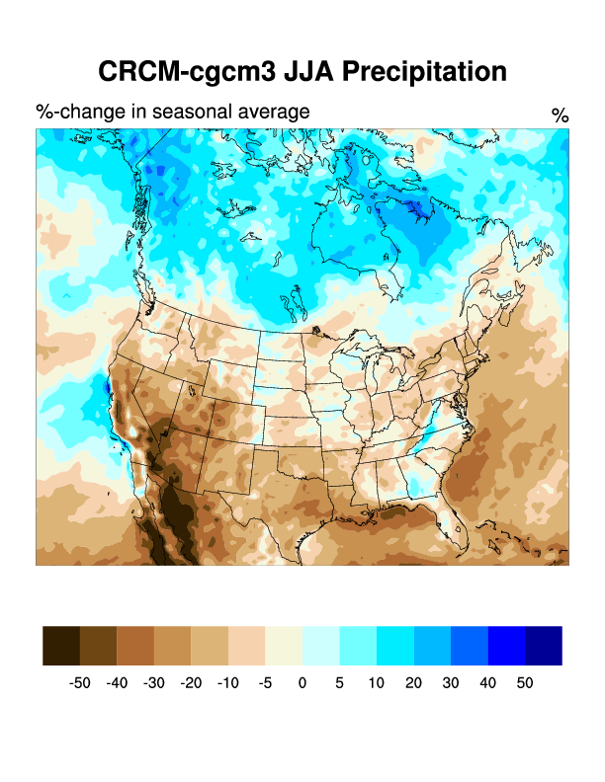
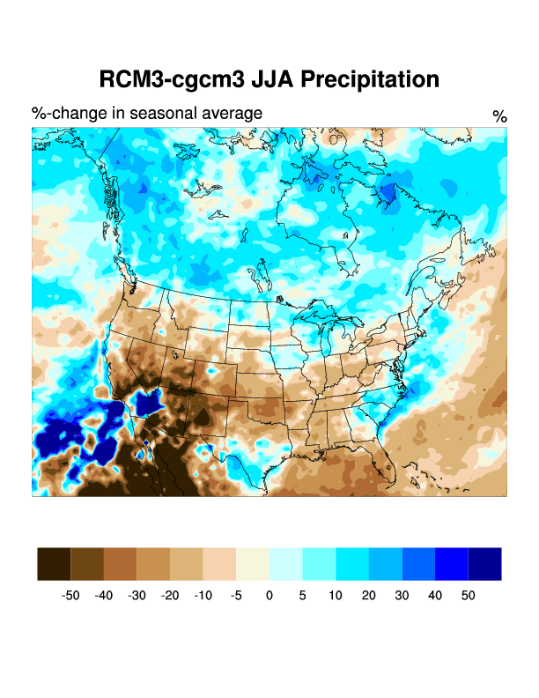
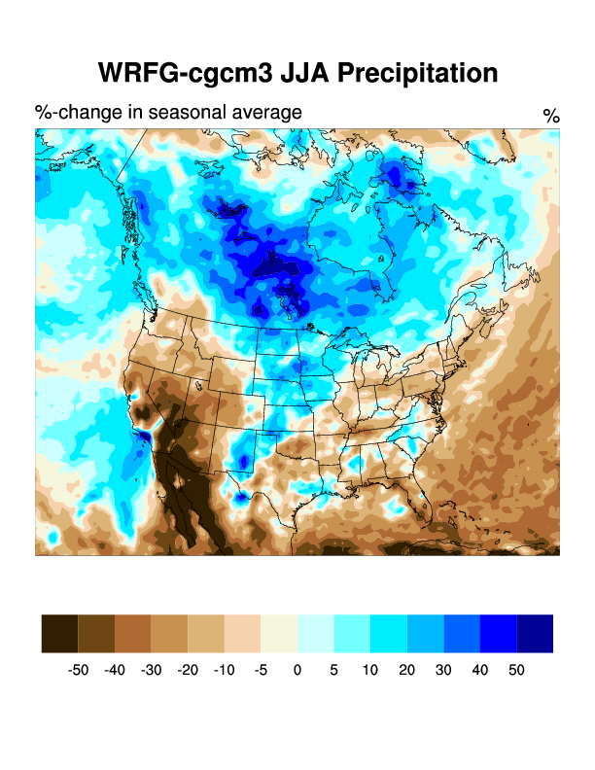
NARCCAP Change in JJA Precipitation

Slide 15
Changes in Precipitation Simulated by Four GCM Future Scenario Climates (2050-2000)
Takle, ES, D Gustafson, R Beachy, GC Nelson, D Mason-D’Croz, and A Palazzo, 2011: US Food Security and Climate Change: Agriculture Futures. Int’l Conf. on Climate Change and Food Security. Chinese Academy of Agriculural Sciences, Beijing, China.

Slide 16
Changes in Simulated Maize Yields Under Four GCM Future Scenario Climates (2050-2000)
Takle, ES, D Gustafson, R Beachy, GC Nelson, D Mason-D’Croz, and A Palazzo, 2011: US Food Security and Climate Change: Agriculture Futures. Int’l Conf. on Climate Change and Food Security. Chinese Academy of Agriculural Sciences, Beijing, China.

Slide 17
Changes in Simulated Soybean Yields Under Four GCM Future Scenario Climates (2050-2000)
Takle, ES, D Gustafson, R Beachy, GC Nelson, D Mason-D’Croz, and A Palazzo, 2011: US Food Security and Climate Change: Agriculture Futures. Int’l Conf. on Climate Change and Food Security. Chinese Academy of Agriculural Sciences, Beijing, China.

Slide 18
Summary
Pay attention to model uncertainty before jumping to conclusions about climate change
Each impacts model seems to bring its own set of climate model interpretation issues
Evaluation of mid-century food security is complex and needs both high resolution climate and pest/pathogen modeling in addition to crop modeling

Slide 19
For More Information:
Climate Science Program
Iowa State University
http://climate.engineering.iastate.edu/
http://www.meteor.iastate.edu/faculty/takle/
gstakle@iastate.edu

