Slide 1
Why Is Iowa Getting So Many Floods?
Eugene S. Takle
Professor
Department of Agronomy
Department of Geological and Atmospheric Science
Director, Climate Science Program
Iowa State University
Ames, IA 50011
gstakle@iastate.edu
28 September 2010

Slide 2
A collaborative analysis produced by the
Climate Science Program
Iowa State University
and the
Iowa Flood Center
University of Iowa
Funding supplied by the Iowa Flood Center

Slide 3
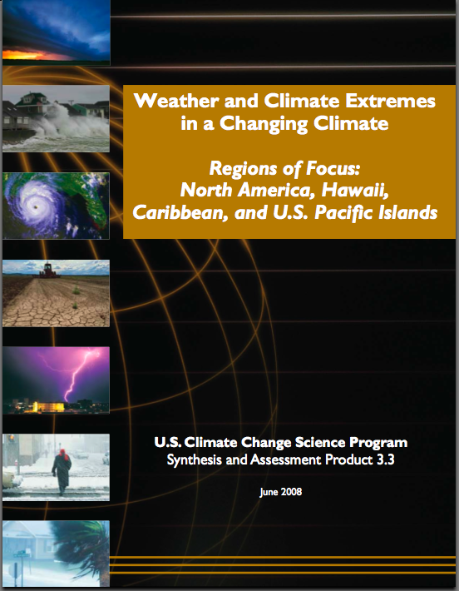
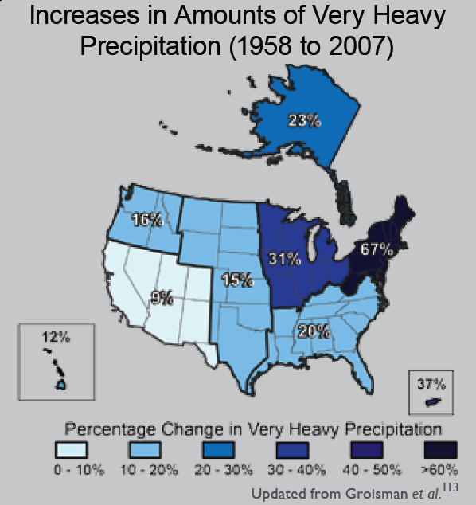
“One of the clearest trends in the United States observational record is an increasing frequency and intensity of heavy precipitation events… Over the last century there was a 50% increase in the frequency of days with precipitation over 101.6 mm (four inches) in the upper midwestern U.S.; this trend is statistically significant “
Karl, T. R., J. M. Melillo, and T. C. Peterson, (eds.), 2009: Global Climate Change Impacts in the United States. Cambridge University Press, 2009, 196pp.

Slide 4
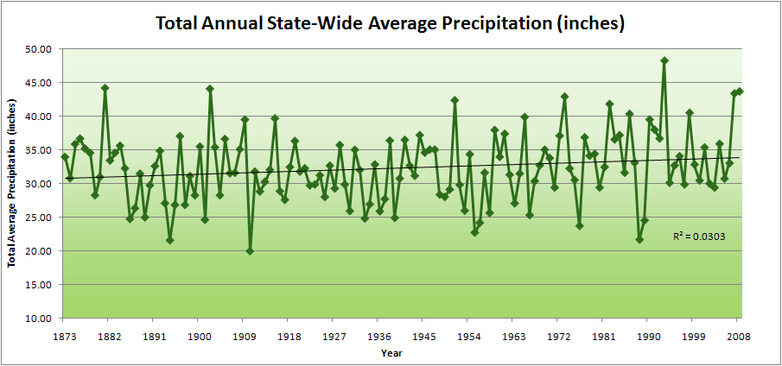
Iowa State-Wide Average Data

Slide 5
Iowa State-Wide Average Data
34.0”
8% increase
31.5”

Slide 6
Iowa State-Wide Average Data
Totals above 40”
2 years

Slide 7
Iowa State-Wide Average Data
Totals above 40”
8 years
2 years

Slide 8
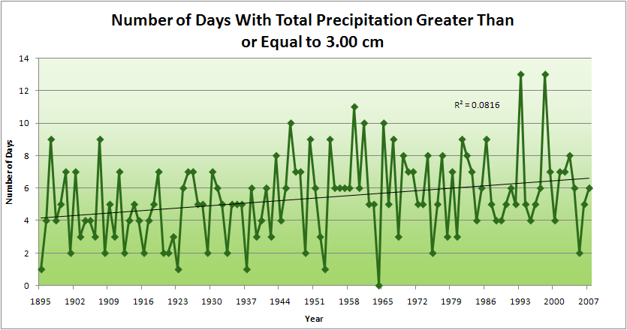
Cedar Rapids Data
Years having more than 8 days
13
2
4.2 days
57% increase
6.6 days

Slide 9
2010 so far

Slide 10
Years with more than 40 inches: 43% Increase
2010 so far

Slide 11
2010 through Sept 27
3.7
41% Increase
5.2

Slide 12
Years having more than 8 days
2010 through Sept 27
7
350% Increase
2
3.7
41% Increase
5.2

Slide 13
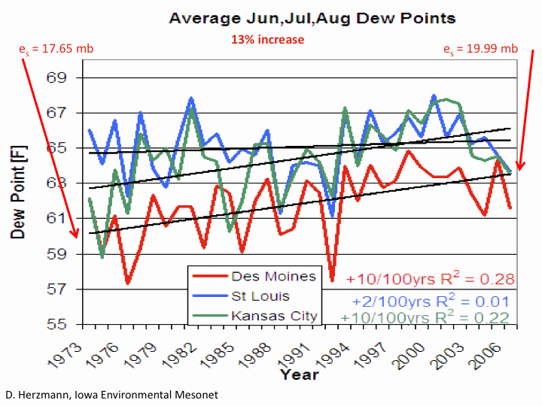

Slide 14
Storm Tracks Across Iowa
(Mesoscale Convective Complexes)
Mar-May
June
Takle, E. S., 1995: Variability of Midwest summertime
precipitation. In G. R. Carmichael, G. E. Folk, and J. L. Schnoor,
ed., Preparing for Global Change: A Midwestern Perspective.
Academic Publishing bv, Amsterdam, p . 43-59.
July
Aug-Sep

Slide 15
Storm Tracks Across Iowa
(Mesoscale Convective Complexes)
Mar-May
June
July
Aug-Sep

Slide 16
Storm Tracks Across Iowa
(Mesoscale Convective Complexes)
Mar-May
June
July
Aug-Sep

Slide 17
Storm Tracks Across Iowa
(Mesoscale Convective Complexes)
Mar-May
June
July
Aug-Sep

Slide 18
Storm Tracks Across Iowa
(Mesoscale Convective Complexes)
Mar-May
June
July
Aug-Sep

Slide 19
Orientation of Iowa Rivers
and Drainage Basins
Courtesy Iowa Flood Center http://www.iowafloodcenter.org/

Slide 20
Orientation of Iowa Rivers
and Drainage Basins
Courtesy Iowa Flood Center http://www.iowafloodcenter.org/

Slide 21
Drainage basins
Storm tracks
Rivers
Mar-May
June
July
Aug-Sep

Slide 22
9 Aug 2010

Slide 23
9 Aug 2010

Slide 24
10 Aug 2010
Courtesy Iowa Flood Center
http://www.iowafloodcenter.org/

Slide 25
10 Aug 2010
Courtesy Iowa Flood Center
http://www.iowafloodcenter.org/

Slide 26
Why Small Changes in Rainfall Produce Much More Flooding
13% increase in atmospheric moisture in June-July-August
~10% increase in average precipitation in Iowa
~3 to 7-fold increase in high-precipitation events, mostly in June-July-August, that lead to runoff
Iowa rivers and watersheds are oriented NW-SE
Rainfall patterns turn from SW-NE in March-May to W-E or NW-SE in mid summer
More frequent floods are the result of one or more of the following
More rain
More intense rain events
More rain in the summer
Rainfall patterns more likely to align with streams and watersheds
Streams amplify changes in precipitation by a factor of 2-4
AND: more subsurface drainage tile has been installed

Slide 27
So What About the Future?
2010-2020: Rainfall is likely to be similar to the last decade
2020-2040: Days with heavy rainfall will be mixed with dry periods
Beyond 2040: Days with heavier rainfall than present will result in increase of streamflow of 20% or more

Slide 28
For More Information:
Climate Science Program
Iowa State University
http://climate.engineering.iastate.edu/
gstakle@iastate.edu
Iowa Flood Center
University of Iowa
http://www.iowafloodcenter.org/
witold-krajewski@uiowa.edu

