Slide 1
Climate Effects on Agriculture
Jerry L. Hatfield and Eugene S. Takle
Convening Lead Authors
Agriculture Chapter
National Climate Assessment
gstakle@iastate.edu
News from the National Climate Assessment, Hot off the Press
25th Conference on Climate Variability and Change
93rd American Meteorological Society Annual Meeting
9 January 2013

Slide 2
+2-3ºC
+1-2ºC
+1-2ºC
+4-5ºC
Projected US summer surface temperature changes from a 16-model ensemble

Slide 3
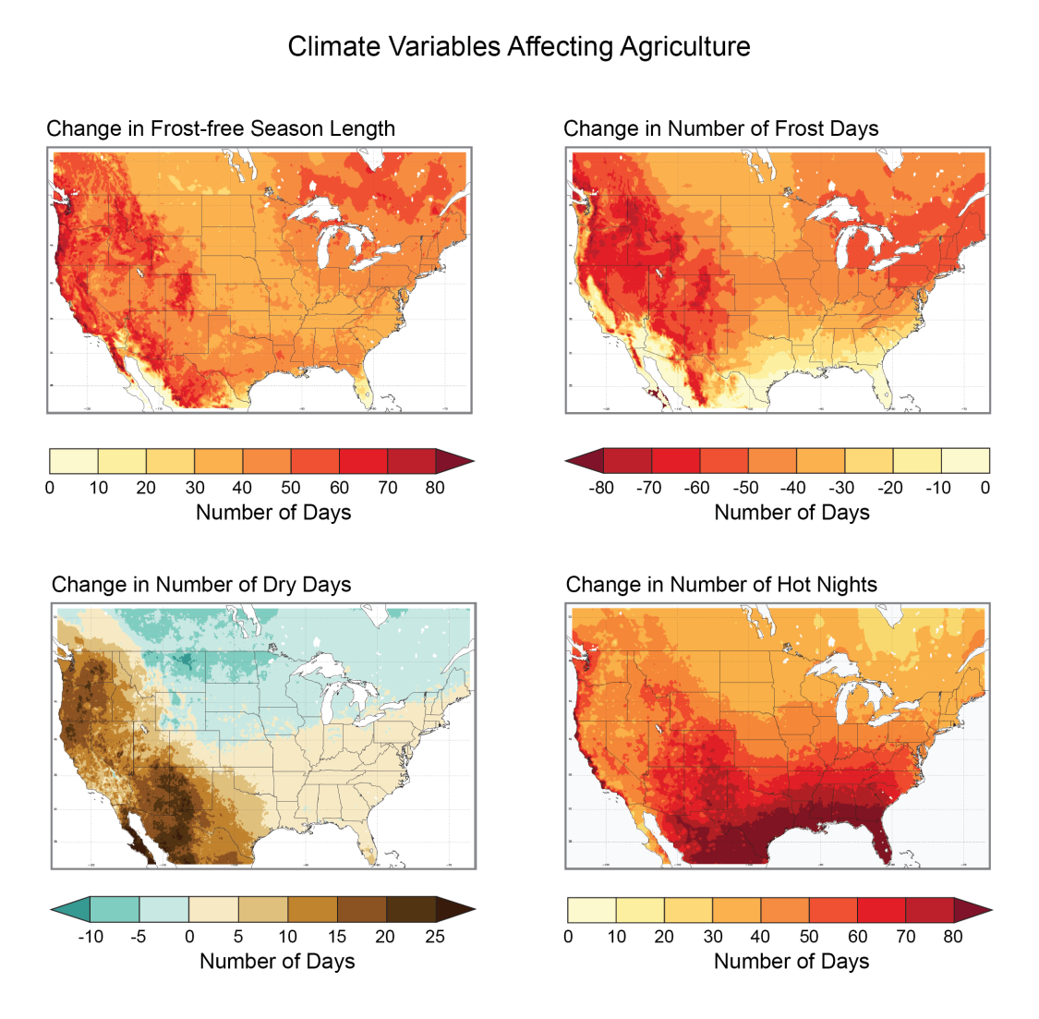
Climate changes are both favorable and unfavorable to agriculture
Lengthening of the growing season
higher yields of commodity crops
Reduction in number of frost days
reduced chilling hours
reduced frost damage to some crops
Number of dry days increases is east, west and south, decreases in north
increased number of field work days
increased moisture stress, pathogens
Increase in number of hot nights
reduced grain weight
reduced weight gain in meat animals

Slide 4
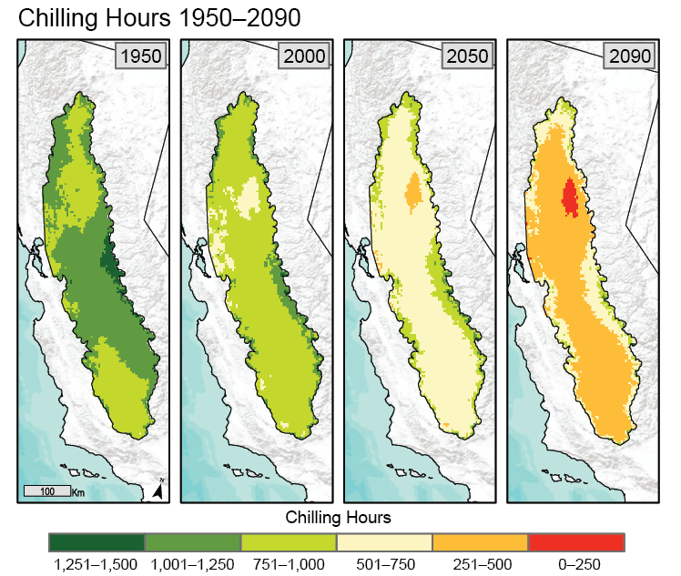
Changes in Climate Relevant to Plant Stress
A2 Climate scenario
Chilling hours for fruit production
Number of chilling hours is projected to decrease over the next 100 years.
Trees and grapes differ in their chilling requirements:
grapes: 90
peaches 225
apples 400
cherries 900

Slide 5
Percent Changes in Crop Yield with
Projected Changes in Annual Mean Temperature
(not water or nutrient limited)
California Central Valley
Some crops are already near temperature thresholds for yield decline
Lee, J., S. DeGryze, and J. Six. 2011. Effect of climate change on field crop production in the California’s Central Valley. Climatic Change. 109(Suppl):S335-S353

Slide 6
Projected Yield Changes for California Crops
Simulations using the DAYCENT model while ensuring water supplies and nutrients were maintained at adequate levels under low (B1) and medium-high (A2) emissions scenarios.
Lee, J., S. DeGryze, and J. Six. 2011. Effect of climate change on field crop production in the California’s Central Valley. Climatic Change. 109(Suppl):S335-S353

Slide 7
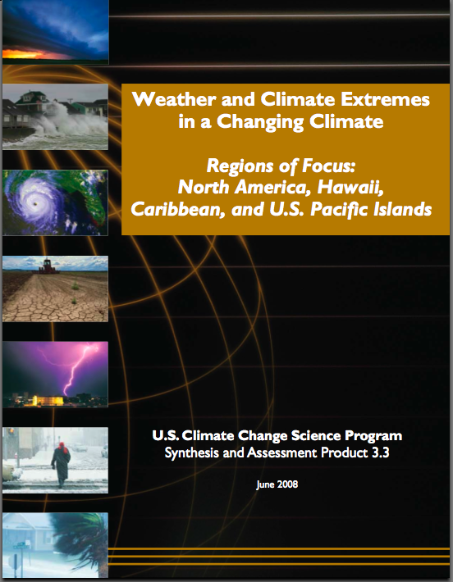
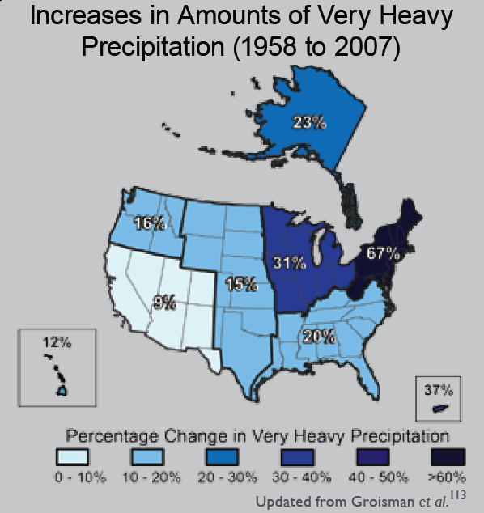
“One of the clearest trends in the United States observational record is an increasing frequency and intensity of heavy precipitation events… Over the last century there was a 50% increase in the frequency of days with precipitation over 101.6 mm (four inches) in the upper midwestern U.S.; this trend is statistically significant “
Karl, T. R., J. M. Melillo, and T. C. Peterson, (eds.), 2009: Global Climate Change Impacts in the United States. Cambridge University Press, 2009, 196pp.

Slide 8
Iowa State-Wide Average Data
Totals above 40”
1 year
5 years
3 years
7 years
2012
Totals below 25”

Slide 9
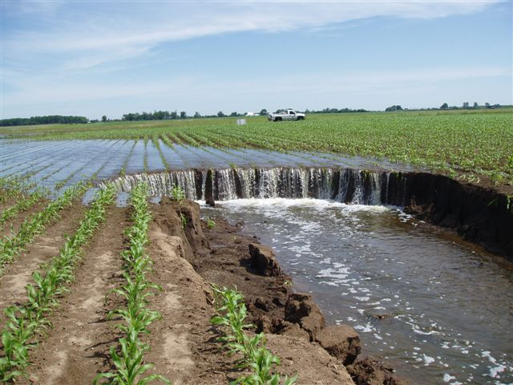
Photo courtesy of RM Cruse

Slide 10
Current Adaptations Enable Producers to Maintain High Yields (Iowa Example):
Longer growing season: plant earlier, plant longer season hybrids, harvest later
Wetter springs: larger machinery enables planting in smaller weather windows
More summer precipitation: higher planting densities for higher yields
Wetter springs and summers: more subsurface drainage tile is being installed, closer spacing, sloped surfaces
Fewer extreme heat events: higher planting densities, fewer pollination failures
Higher humidity: more spraying for pathogens favored by moist conditions. more problems with fall crop dry-down, wider bean heads for faster harvest due to shorter harvest period during the daytime.
Drier autumns: delay harvest to take advantage of natural dry-down conditions, thereby reducing fuel costs
Future Climate Change Will Demand New Innovations for Successful Adaptation

Slide 11
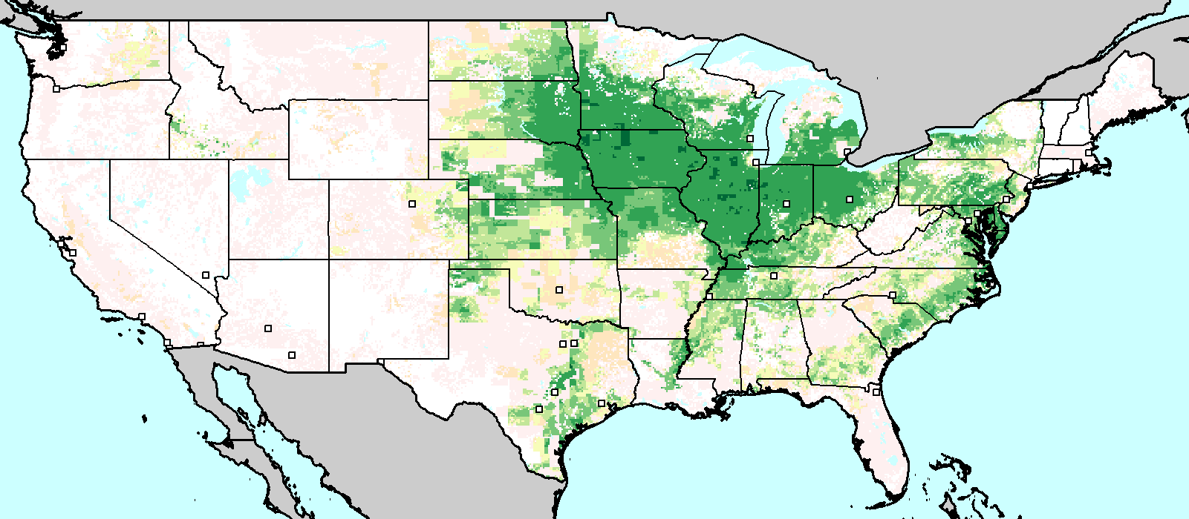
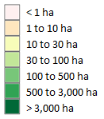
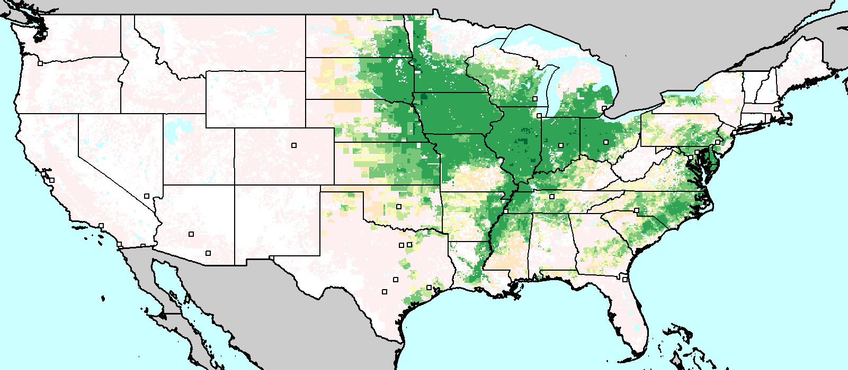
Harvest Area (2000) for Maize and Soybeans
Soybeans
Maize

Slide 12
Changes in Simulated Maize Yields Under Four GCM Future Scenario Climates (2050-2000)
Takle, ES, D Gustafson, R Beachy, GC Nelson, D Mason-D’Croz, and A Palazzo, 2011: US Food Security and Climate Change: Agriculture Futures. Int’l Conf. on Climate Change and Food Security. Chinese Academy of Agriculural Sciences, Beijing, China.

Slide 13
Changes in Simulated Soybean Yields Under Four GCM Future Scenario Climates (2050-2000)
Takle, ES, D Gustafson, R Beachy, GC Nelson, D Mason-D’Croz, and A Palazzo, 2011: US Food Security and Climate Change: Agriculture Futures. Int’l Conf. on Climate Change and Food Security. Chinese Academy of Agriculural Sciences, Beijing, China.

Slide 14
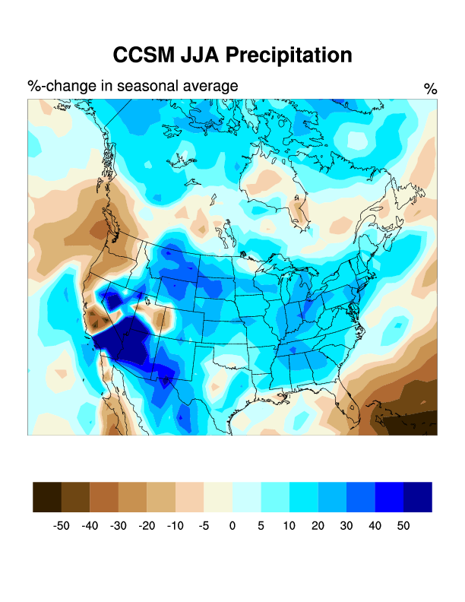
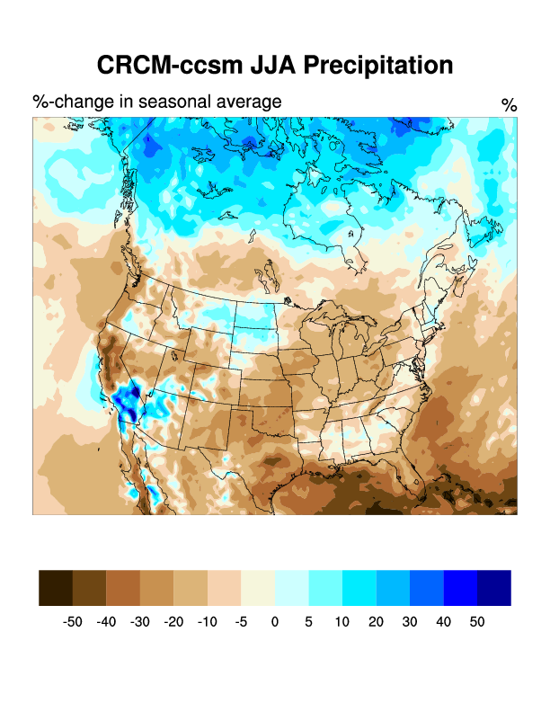
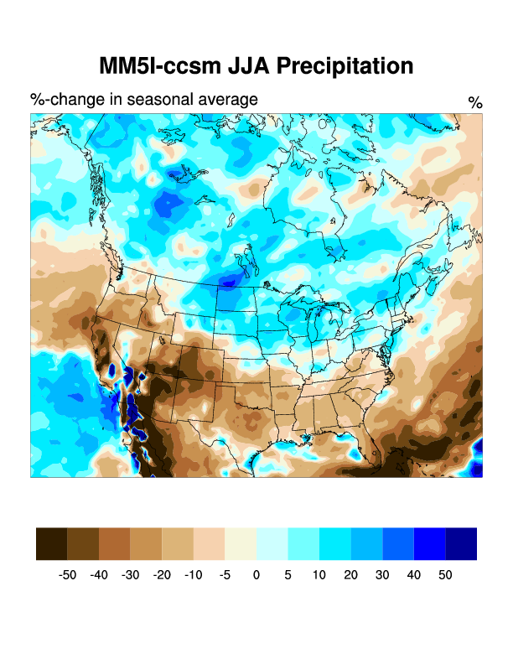
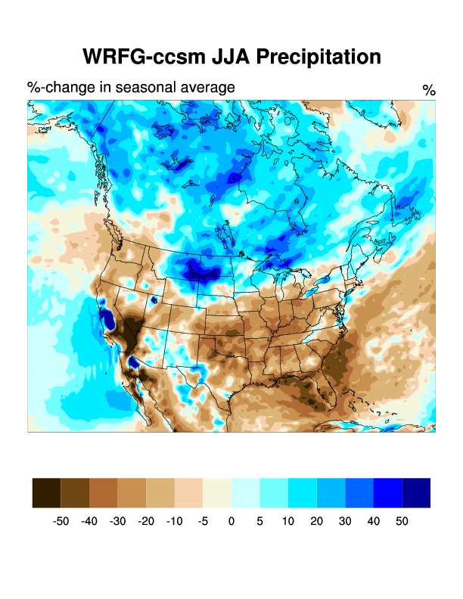
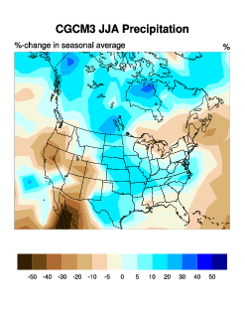
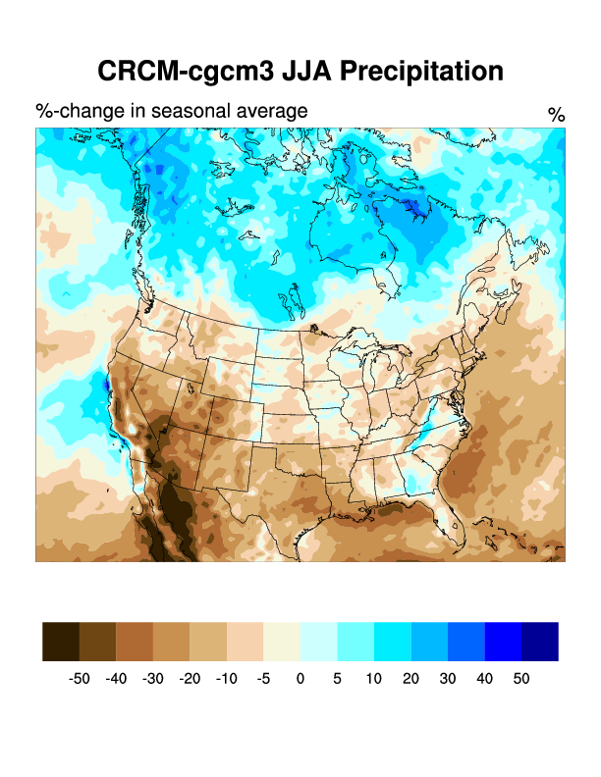
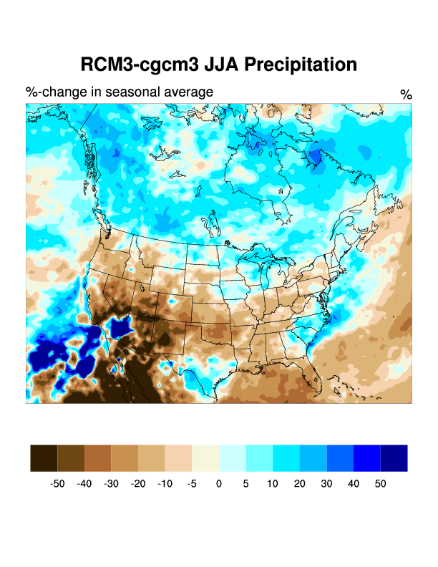
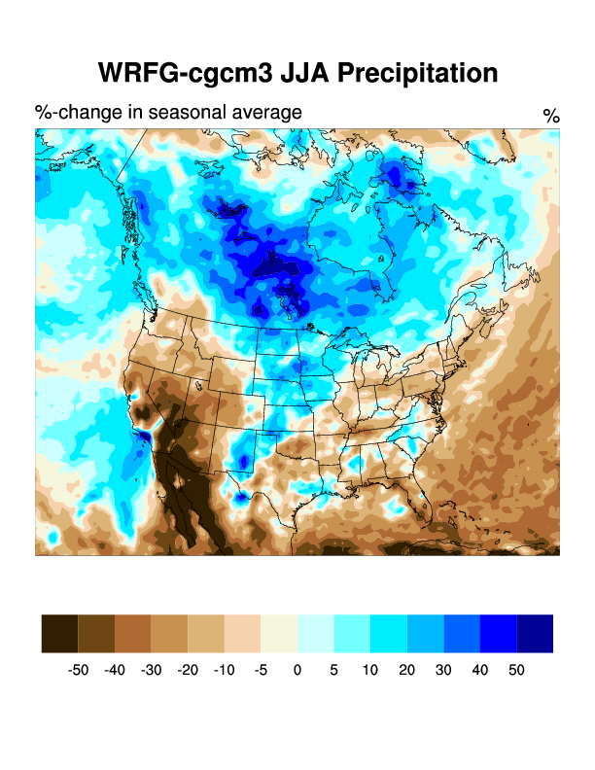
NARCCAP Change in JJA Precipitation

Slide 15
Summary
Some but not all near-term climate changes are detrimental
Some pests and pathogens are favored under climate change
Extreme events have long-term impact on agricultural assets as well as production declines
Marginal areas of current production regions will experience challenges to local socioeconomic systems
Ongoing research seeks to understand impacts of US agriculture on future US and global food security

