Slide 1
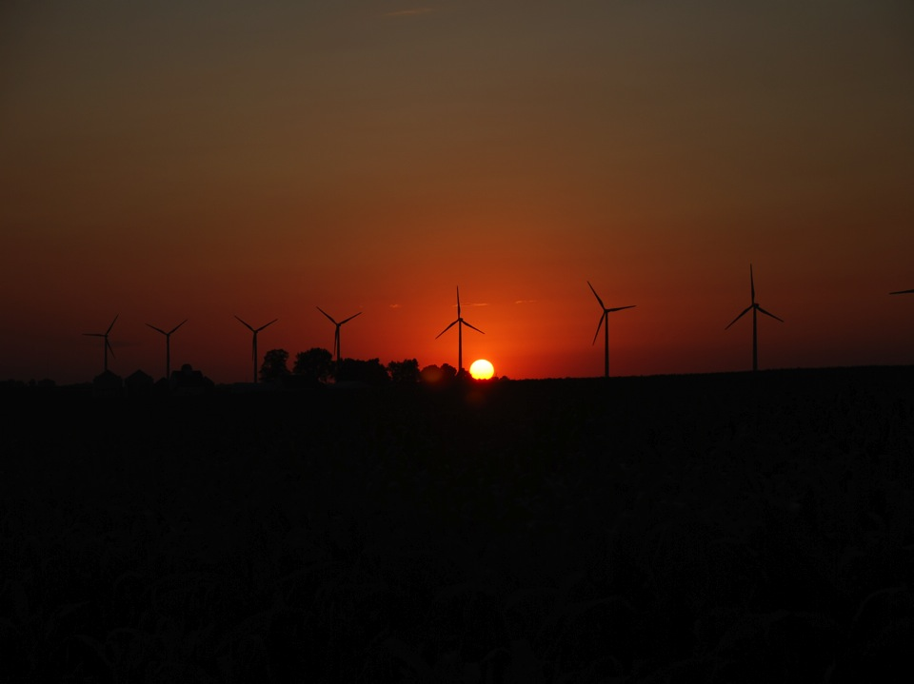
CWEX: Overview of Results From Crop/Wind-Energy Experiments in Iowa
Eugene S. Takle
Data and Analysis by Dan Rajewski, Erin Jackson, Renee Walton, and Russ Doorenbos
Undergraduate student participation was supported by funding from an NSF REU program under grant 1063048. Data analysis was supported in part by the National Science Foundation under the State of Iowa EPSCoR Grant 1101284.
Photo by Lisa Brasche

Slide 2
Outline
CWEX overview
Wakes
Wind shear

Slide 3
CWEX Current Activities
Began as a study of crop-turbine interactions
  Impact of individual turbines and lines of turbines on surface conditions
  Bull. Amer. Meteorol. Soc., 94, 655-672.
Current measurements and data analysis focus on properties of the turbine layer and its near environment
  Aerodynamics of the lowest 300 m: above-rotor layer, rotor (wake) layer, and sub-rotor layer
  Mesoscale impact of the windfarm

Slide 4
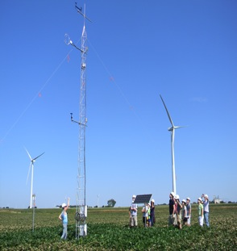
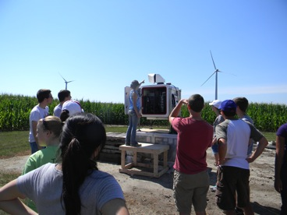
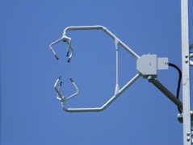
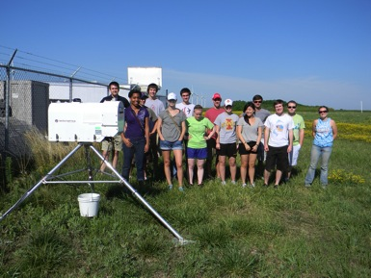
CWEX Instrument Deployment

Slide 5
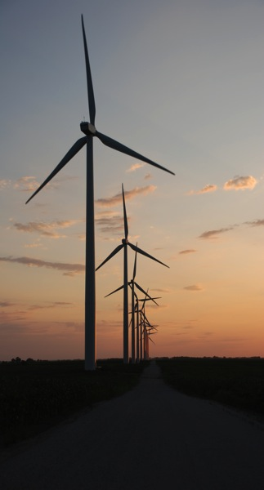
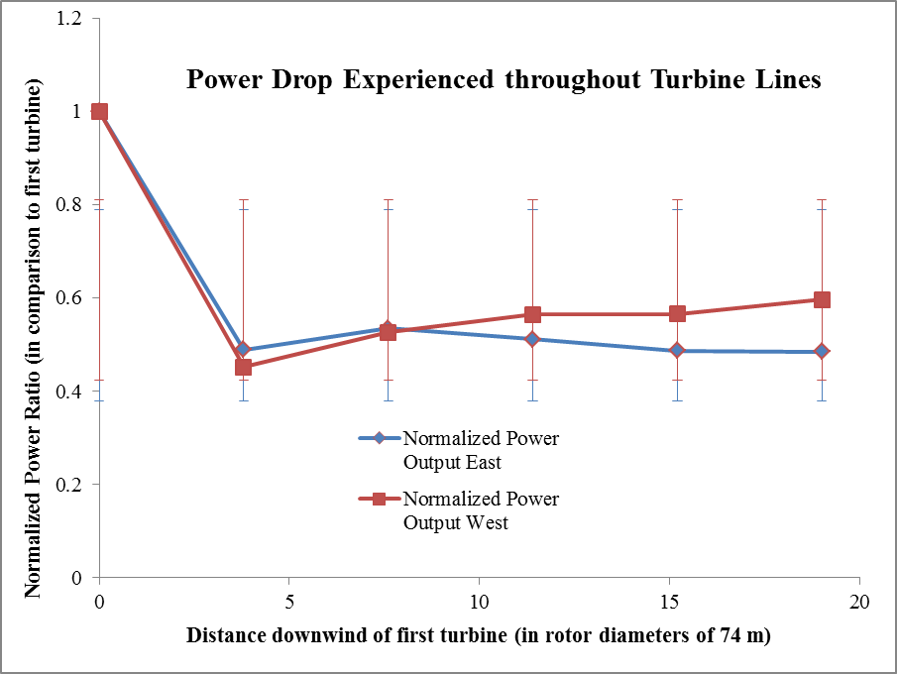
Turbine Wakes
Power produced from a line of turbines under wake conditions. East (90° ± 10°) and west (270° ± 10°) wind events.

Slide 6
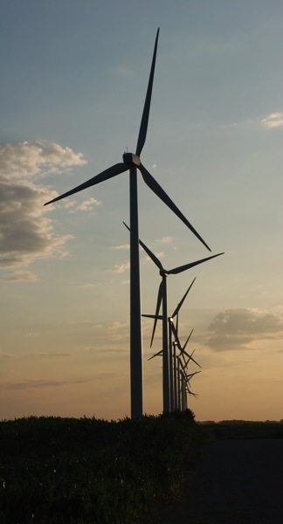
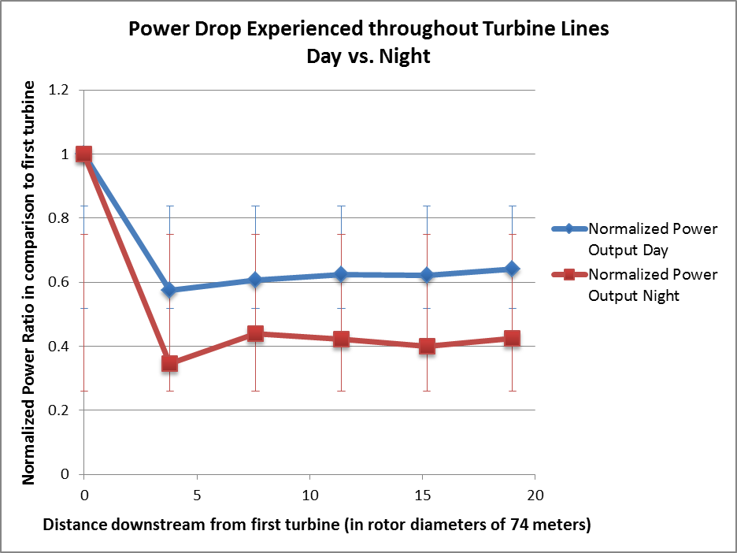
Turbine Wakes
Power produced from a line of turbines under wake conditions - day vs. night.

Slide 7
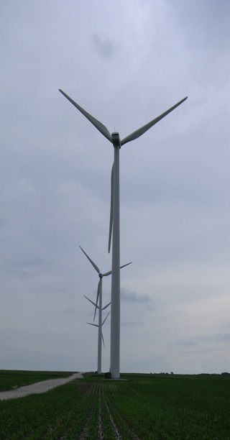
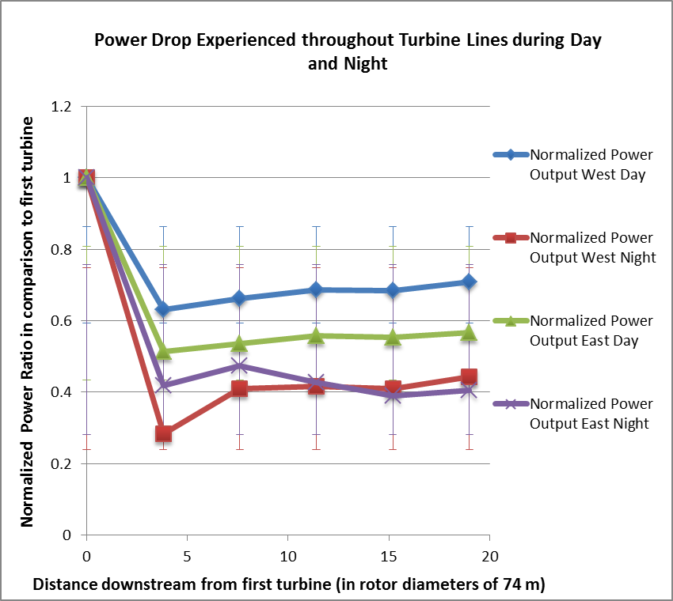
Turbine Wakes
Power produced from a line of turbines under wake conditions. East (90° ± 10°) and west (270° ± 10°) wind events – day vs night.

Slide 8
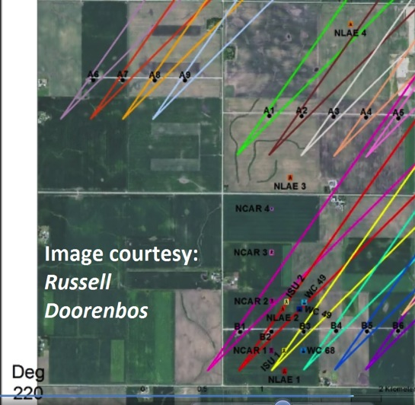
Single Turbine Wakes
July – Aug 2011.
Assumed +/- 5º wake expansion

Slide 9
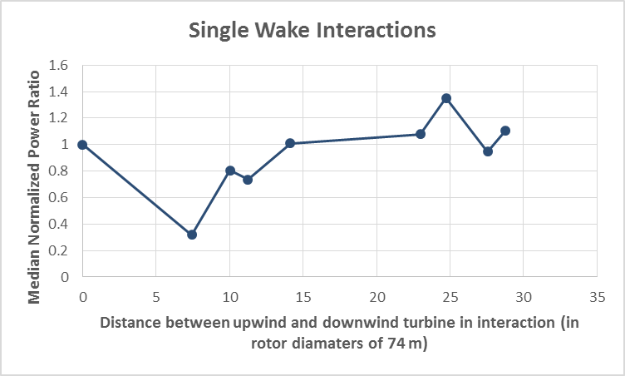
Single Turbine Wakes
P_{N} >1.0
Mean normalized power as a function of downwind distance. All wind speeds were > 3 m/s. 56% of wake power ratios > 1.0 were at night (2000-0800 LST)

Slide 10
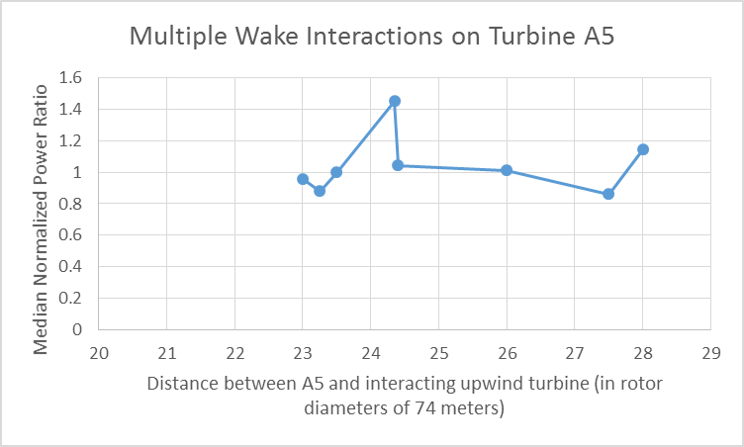
Multiple Turbine Wakes
P_{N} >1.0
Mean normalized power as a function of downwind distance for turbine A5. 48% of events with P>1.0 occurred at night (2000-0800 LST). Note: target turbine 7-10 m higher elevation than point of wake origin. Slope =10/1850= 0.0055.

Slide 11
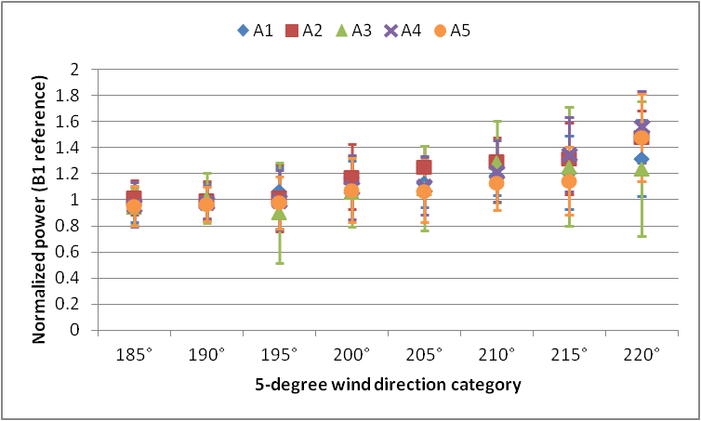
Stable surface conditions
Multiple Turbine Wakes
Stronger wind
speeds on the outside of the B1-B6 wake aggregate for SW winds
Evidence of speed-up between/outside
of turbine wakes (e.g. Hirsch and Schroeder 2013)

Slide 12
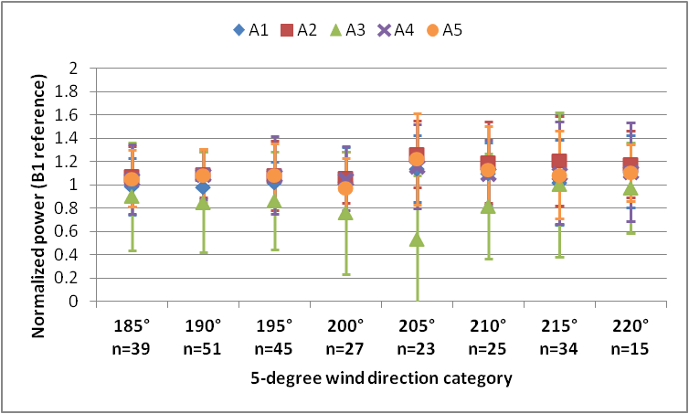
Neutral surface conditions
Multiple Turbine Wakes
Weak overspeeding at most locations
Large speed
deficit at A3
for SSW wind

Slide 13
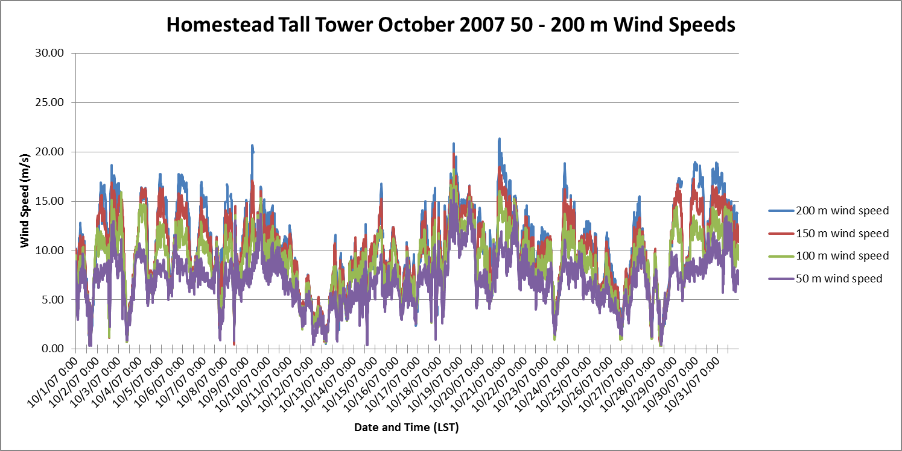
High Wind Shear in Above-Rotor Layer

Slide 14
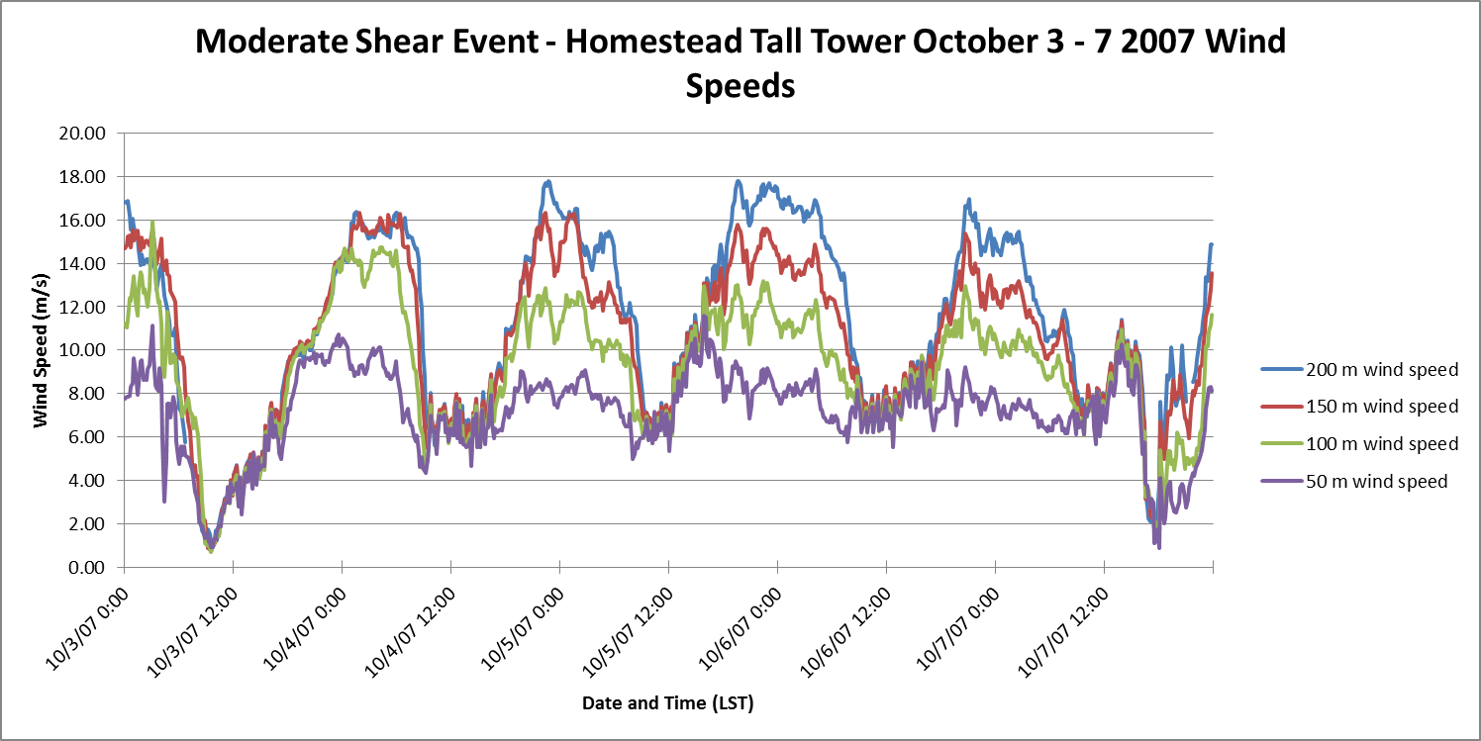
High Wind Shear in Above-Rotor Layer

Slide 15
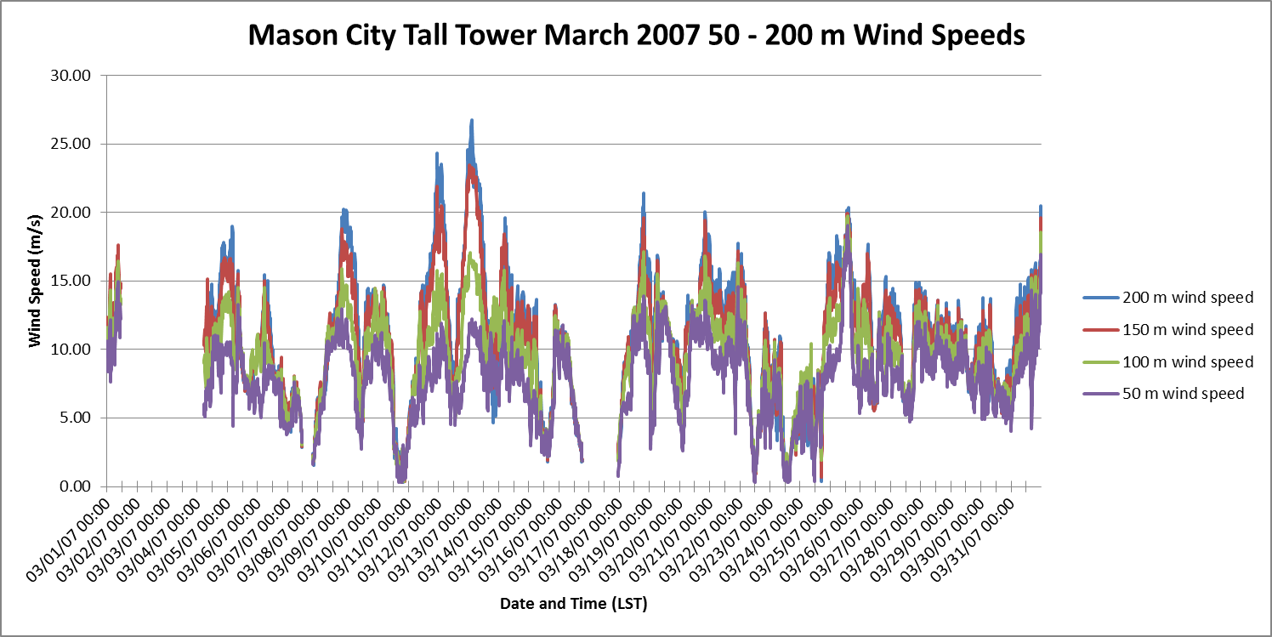
High Wind Shear in Above-Rotor Layer

Slide 16
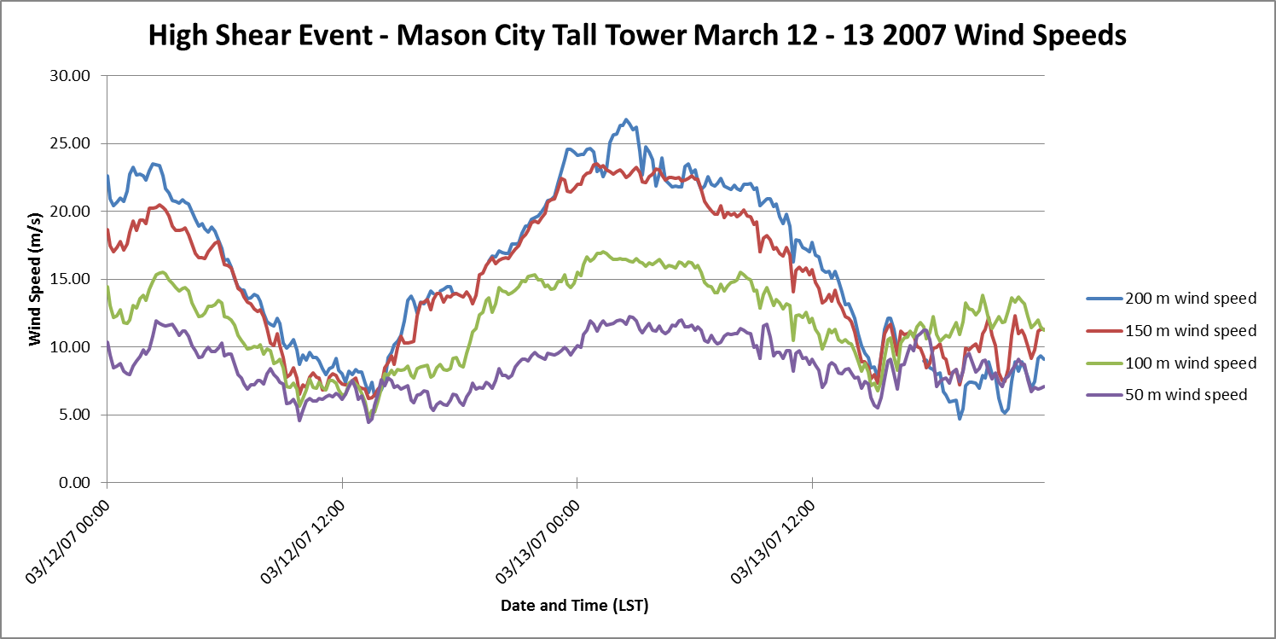
High Wind Shear in Above-Rotor Layer

Slide 17
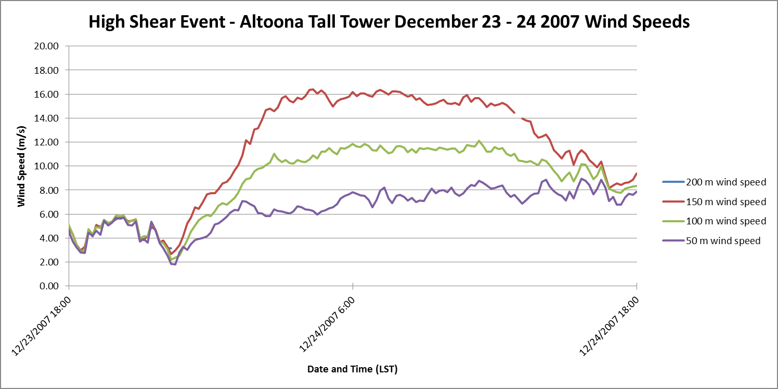
High Wind Shear in Above-Rotor Layer

Slide 18
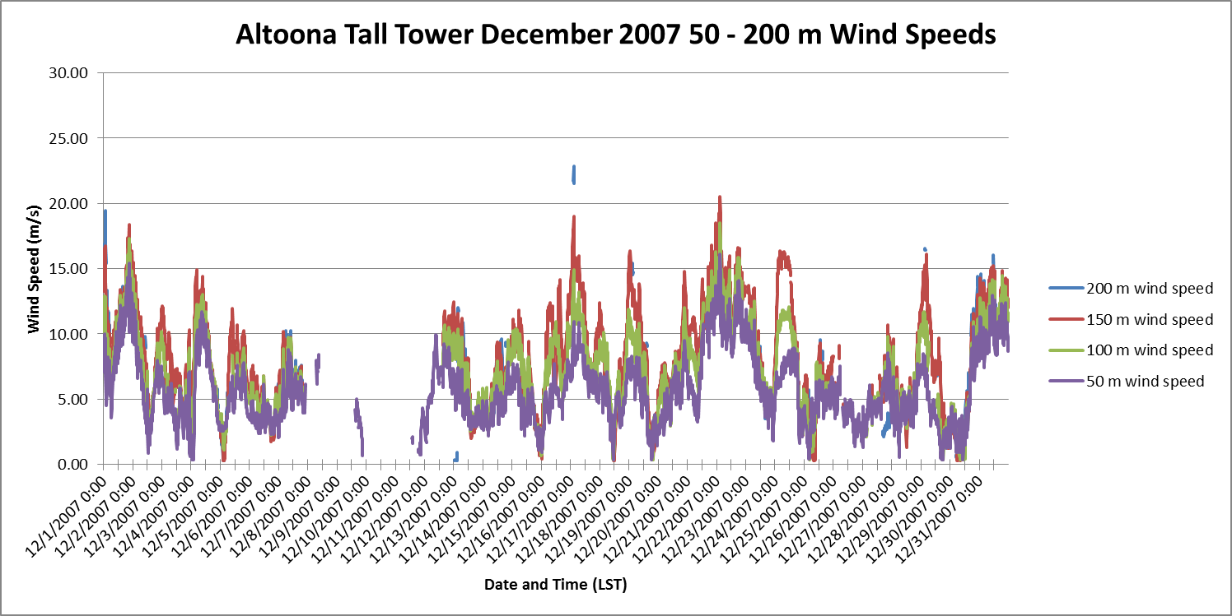
High Wind Shear in Above-Rotor Layer

Slide 19
Summary
The near turbine wake (<5 D) for this Iowa wind farm shows characteristics similar to those reported by Barthelmie et al. for European off-shore conditions
Observations of the far turbine wake (>15 D) clearly show conditions where the turbine layer winds deeper in the wind farm are higher than at its upwind boundary
High wind speeds associated with the nocturnal low-level jet create high wind speeds and strong vertical wind shear in the above-rotor layer
There is some evidence that the wind shear created by the turbine wake may create sufficient turbulence to entrain high-speed wind from the above-turbine layer into the rotor layer
We need to learn more about the dynamics of the above-rotor layer

Slide 20
Power Law Exponent

