Slide 1
Climate Change Impacts on Iowa:
Summary and Expansion on the 1 January 2011 Report to the Iowa Legislature
Eugene S. Takle
Professor
Department of Agronomy
Department of Geological and Atmospheric Science
Director, Climate Science Program
Iowa State University
Ames, IA 50011
Atmospheric Science Seminar
Iowa State University
11 January 2011

Slide 2
Outline
Legislative history leading up to this report
    Emissions report
    Olson Amendment to focus on climate impacts on Iowa
Details of the report
Policy recommendations

Slide 3
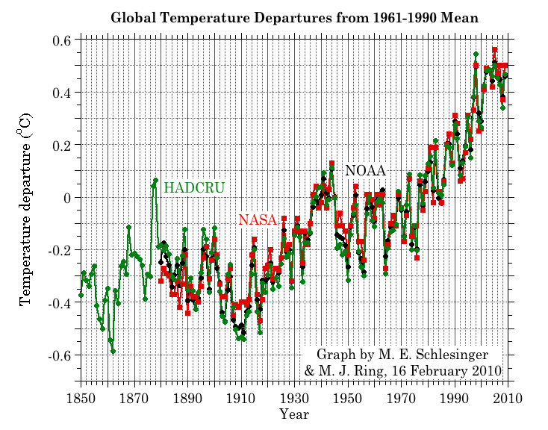
Three separate analyses of the temperature record – Trends are in close agreement
Don Wuebbles

Slide 4
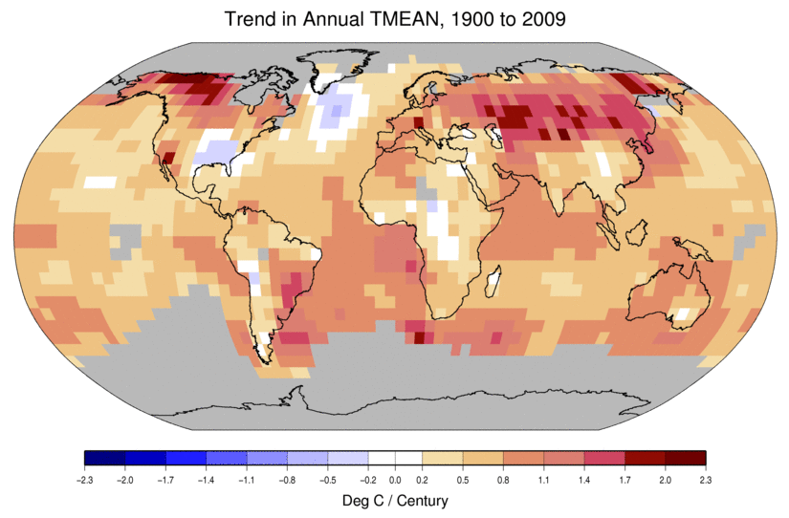
Temperature Changes are Not
Uniform Around the Globe
From Tom Karl, NOAA NCDC

Slide 5
2000-2009

Slide 6
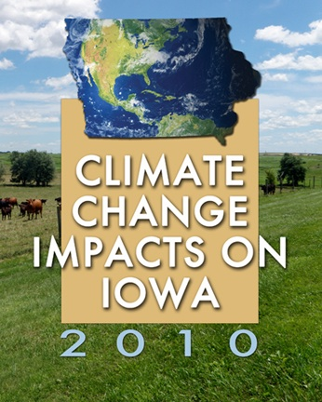
Image courtesy of NASA/GSFC

Slide 8
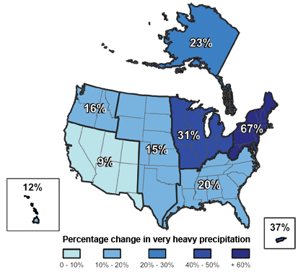
Climate changes are underway in the U.S. and are projected to grow
Temperature rise
Sea-level rise
Increase in heavy downpours
Rapidly retreating glaciers
Thawing permafrost
Lengthening growing
season
Lengthening ice-free season
in the ocean and on lakes
and rivers
Earlier snowmelt
Changes in river flows
Plants blooming earlier; animals, birds and fish moving northward
Don Wuebbles

Slide 9
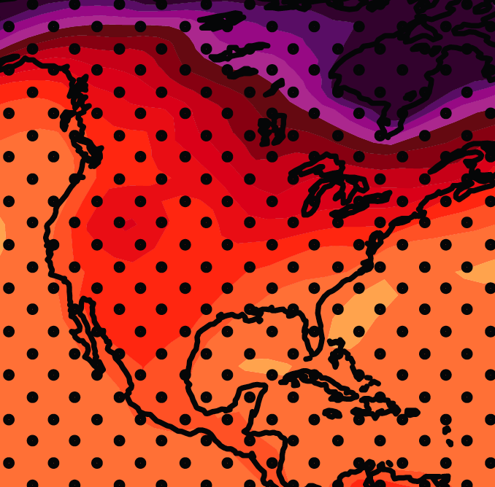
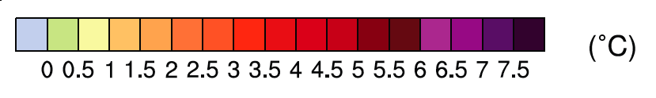
December-January-February Temperature Change
7.2ºF
6.3ºF
A1B Emission Scenario
2080-2099 minus1980-1999

Slide 10
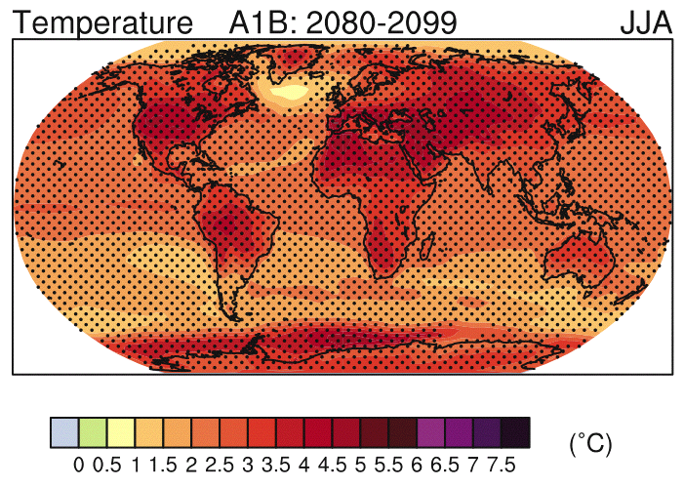
IPCC 2007

Slide 11
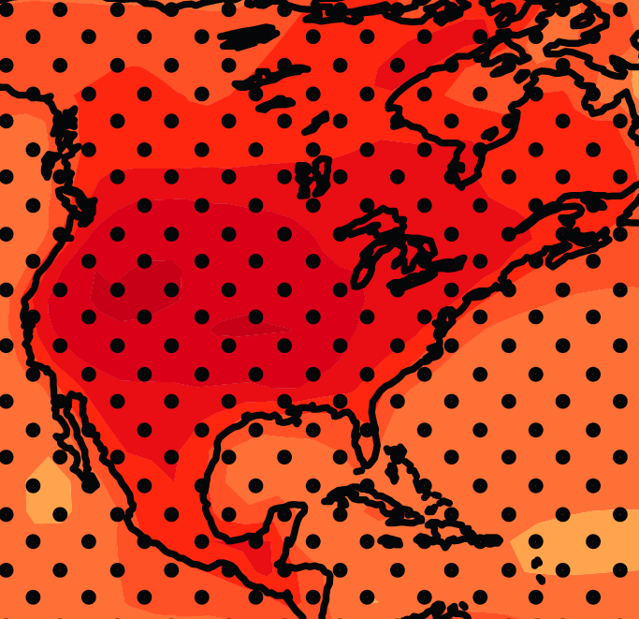
June-July-August Temperature Change
4.5ºF
5.4ºF
A1B Emission Scenario
2080-2099 minus1980-1999

Slide 12
June-July-August Temperature Change
4.5ºF
5.4ºF
A1B Emission Scenario
2080-2099 minus1980-1999
Not the direction of current trends

Slide 13
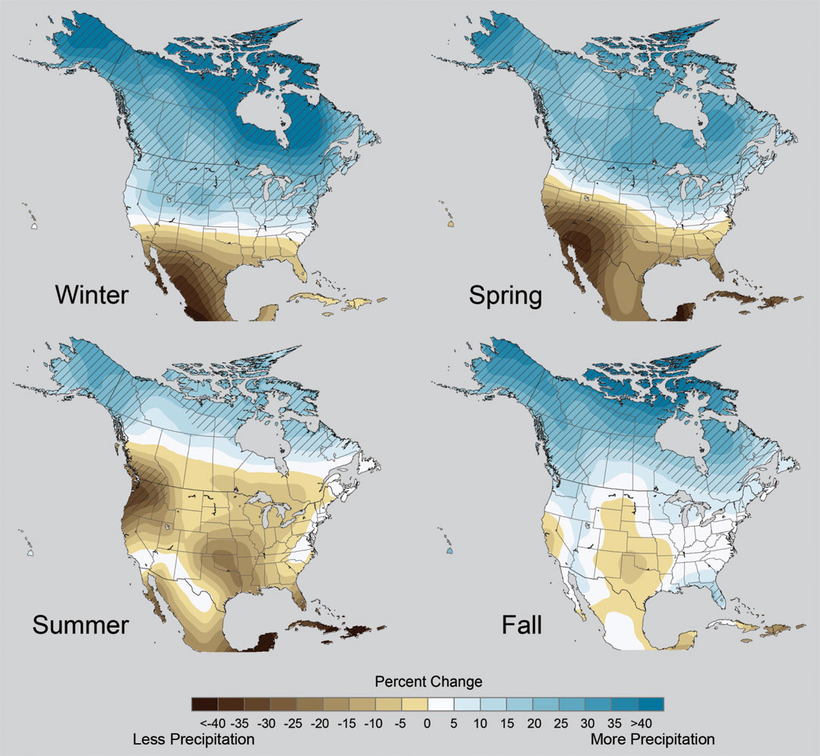
Projected Change in Precipitation: 2081-2099
Midwest: Increasing winter and spring precipitation, with drier summers
More frequent and intense periods of heavy rainfall
Unstippled regions indicate reduced confidence
Relative to 1960-1990
NOTE: Scale Reversed
Don Wuebbles

Slide 15
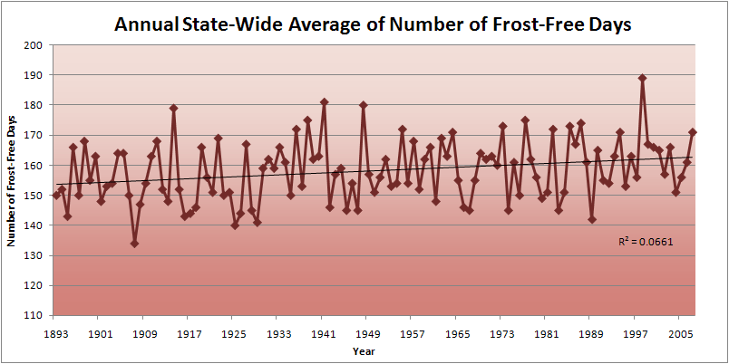
Iowa State-Wide Average Data

Slide 18
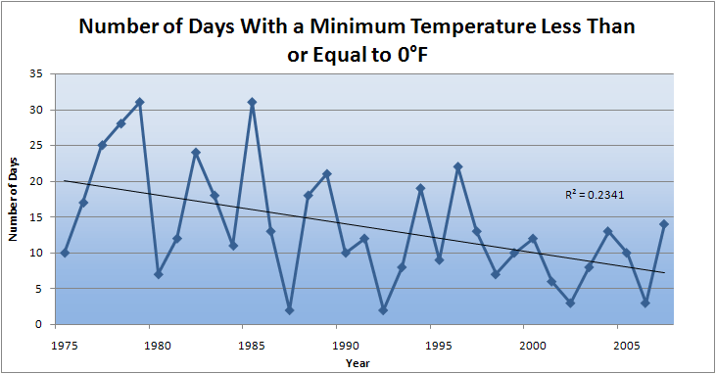
Des Moines Airport Data
Caution: Not corrected for urban heat island effects

Slide 19
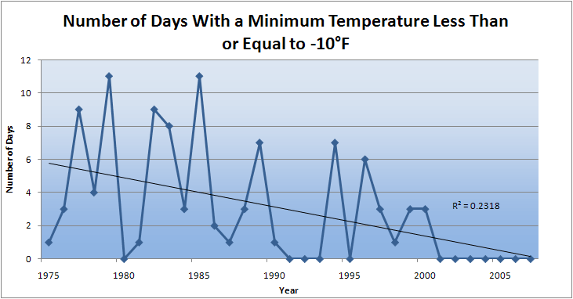
Des Moines Airport Data
Caution: Not corrected for urban heat island effects

Slide 20
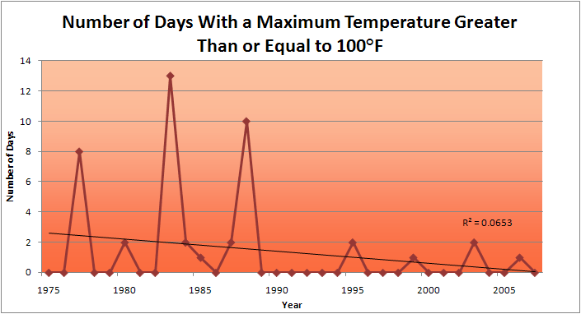
Des Moines Airport Data
1983: 13
1988: 10
1977: 8
2009: 0
2010: 0

Slide 21
Des Moines Airport Data
1983: 13
1988: 10
6 days ≥ 100ºF in the last 22 years
1977: 8
2009: 0
2010: 0

Slide 23
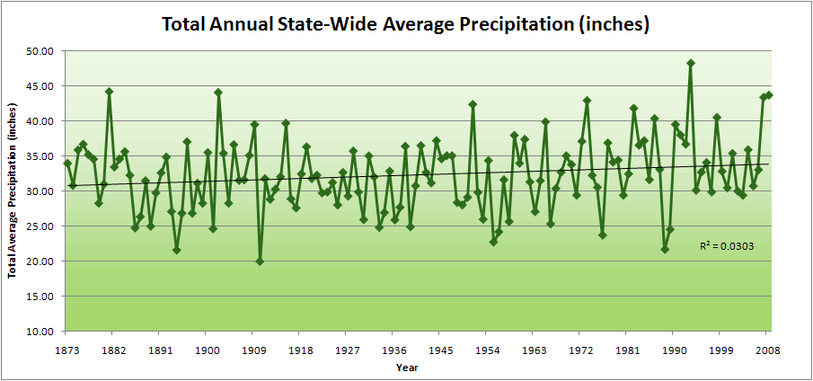
Iowa State-Wide Average Data

Slide 24
Iowa State-Wide Average Data
34.0”
10% increase
30.8”

Slide 25
Iowa State-Wide Average Data
Totals above 40”
2 years

Slide 26
Iowa State-Wide Average Data
Totals above 40”
8 years
2 years

Slide 27
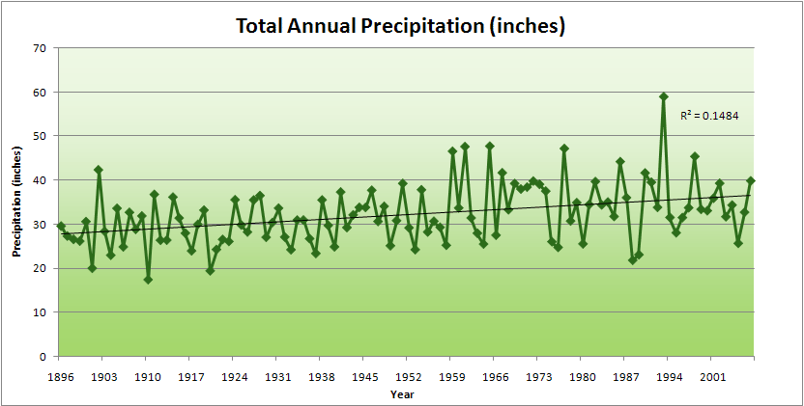
Cedar Rapids Data

Slide 28
Cedar Rapids Data
28.0”
32% increase
37.0”

Slide 29
Cedar Rapids Data
Years with more than 40 inches
11
1
28.0”
32% increase
37.0”

Slide 30
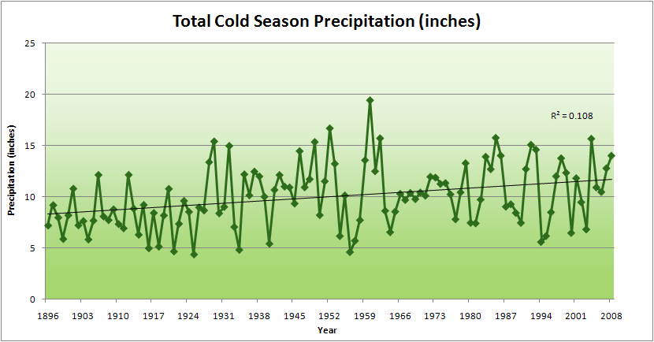
Cedar Rapids Data
51% increase
11.8”
7.8”

Slide 31
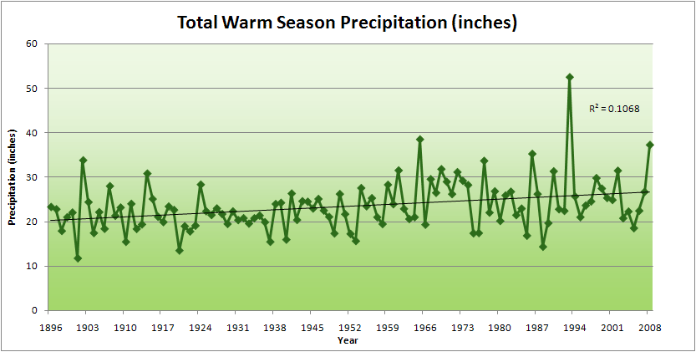
Cedar Rapids Data
34% increase
26.8”
20.2”

Slide 32
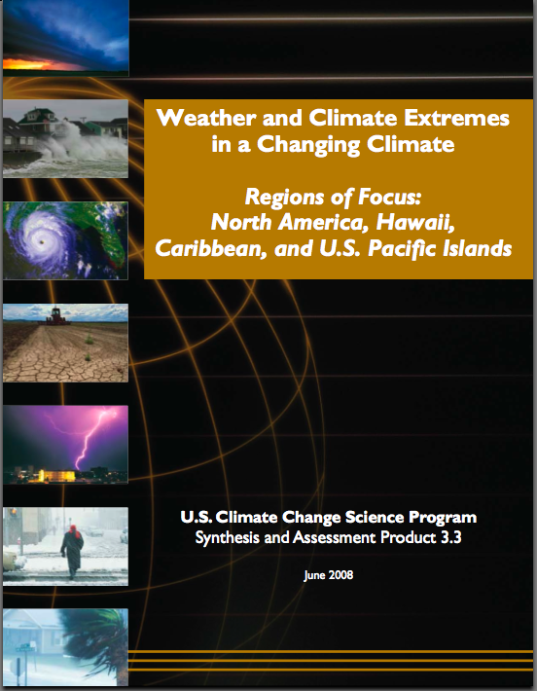
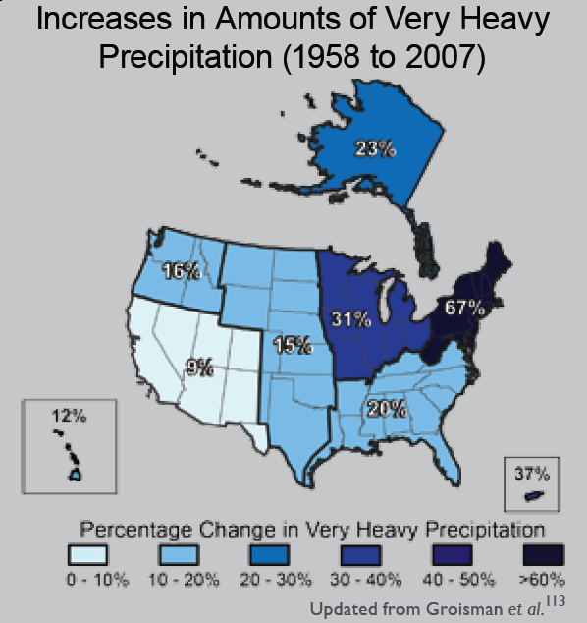
“One of the clearest trends in the United States observational record is an increasing frequency and intensity of heavy precipitation events… Over the last century there was a 50% increase in the frequency of days with precipitation over 101.6 mm (four inches) in the upper midwestern U.S.; this trend is statistically significant “
Karl, T. R., J. M. Melillo, and T. C. Peterson, (eds.), 2009: Global Climate Change Impacts in the United States. Cambridge University Press, 2009, 196pp.

Slide 33
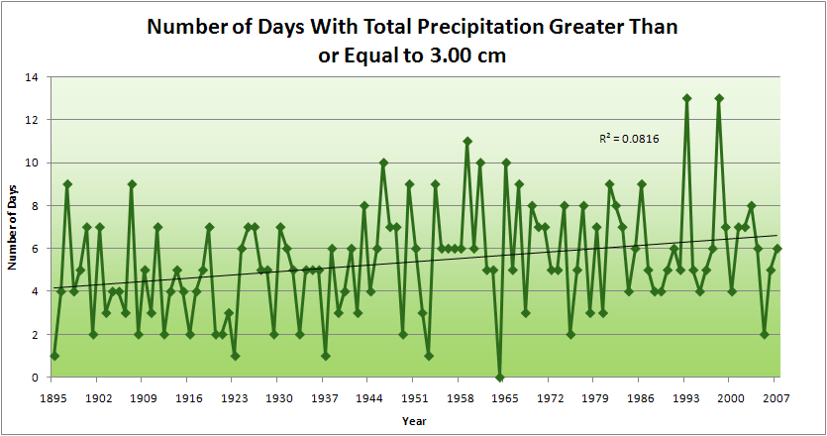
Cedar Rapids Data
4.2 days
57% increase
6.6 days

Slide 34
Cedar Rapids Data
Years having more than 8 days
13
2
4.2 days
57% increase
6.6 days

Slide 35
Years with more than 40 inches: 43% Increase
2010 so far

Slide 36
2010 through Sept 27
3.7
41% Increase
5.2

Slide 37
Years having more than 8 days
2010 through Sept 27
7
350% Increase
2
3.7
41% Increase
5.2

Slide 38
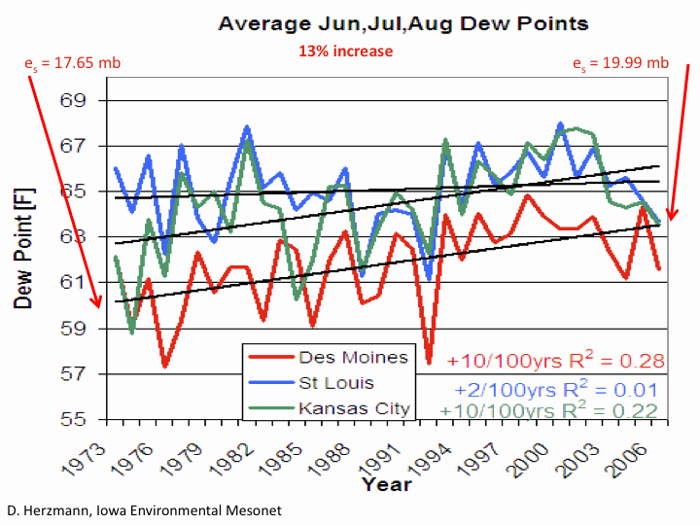

Slide 41
Iowa Agricultural Producers are Adapting to Climate Change:
Longer growing season: plant earlier, plant longer season hybrids, harvest later
Wetter springs: larger machinery enables planting in smaller weather windows
More summer precipitation: higher planting densities for higher yields
Wetter springs and summers: more subsurface drainage tile is being installed, closer spacing, sloped surfaces
Fewer extreme heat events: higher planting densities, fewer pollination failures
Higher humidity: more spraying for pathogens favored by moist conditions. more problems with fall crop dry-down, wider bean heads for faster harvest due to shorter harvest period during the daytime.
Drier autumns: delay harvest to take advantage of natural dry-down conditions
HIGHER YIELDS!!
Is it genetics or climate? Likely some of each.

Slide 42
Other Agricultural Impacts:
Carbon dioxide fertilization in field studies: corn - little or none, soybeans – up to 14%
Waterlogged soils in spring: shallow root system more prone to disease, nutrient deficiencies and drought later on; delayed planting
More frequent rains: delayed fertilizer application
More intense rain events: more soil erosion
More humid conditions, dew: plant disease, sudden death syndrome
More weeds, invasive species
Water quality: loss of nitrate fertilizer, more sediment, runoff from manure application
Animal agriculture: reduced milk production, reduced weight gain, increased mortality

Slide 43
US Average Yield Trends (bu/acre)

Slide 45
First Day of Fall 4-inch Soil Temperature < 50ºF
(Ames, IA)

Slide 46
Nitrate Loss Through Subsurface Tile Drainage
Annual Precipitation (inches)

Slide 48


Slide 53
Questions?

