Slide 1
Climate Change of Importance to Agriculture: What Does the Science Say?
Eugene S. Takle
Professor
Department of Agronomy
Department of Geological and Atmospheric Science
Director, Climate Science Program
Iowa State University
Ames, IA 50011
25 x 25 Alliance
Media Presentation
2 April 2013

Slide 2
Global CO₂ and Mean Temperature
NOAA
NASA

Slide 3
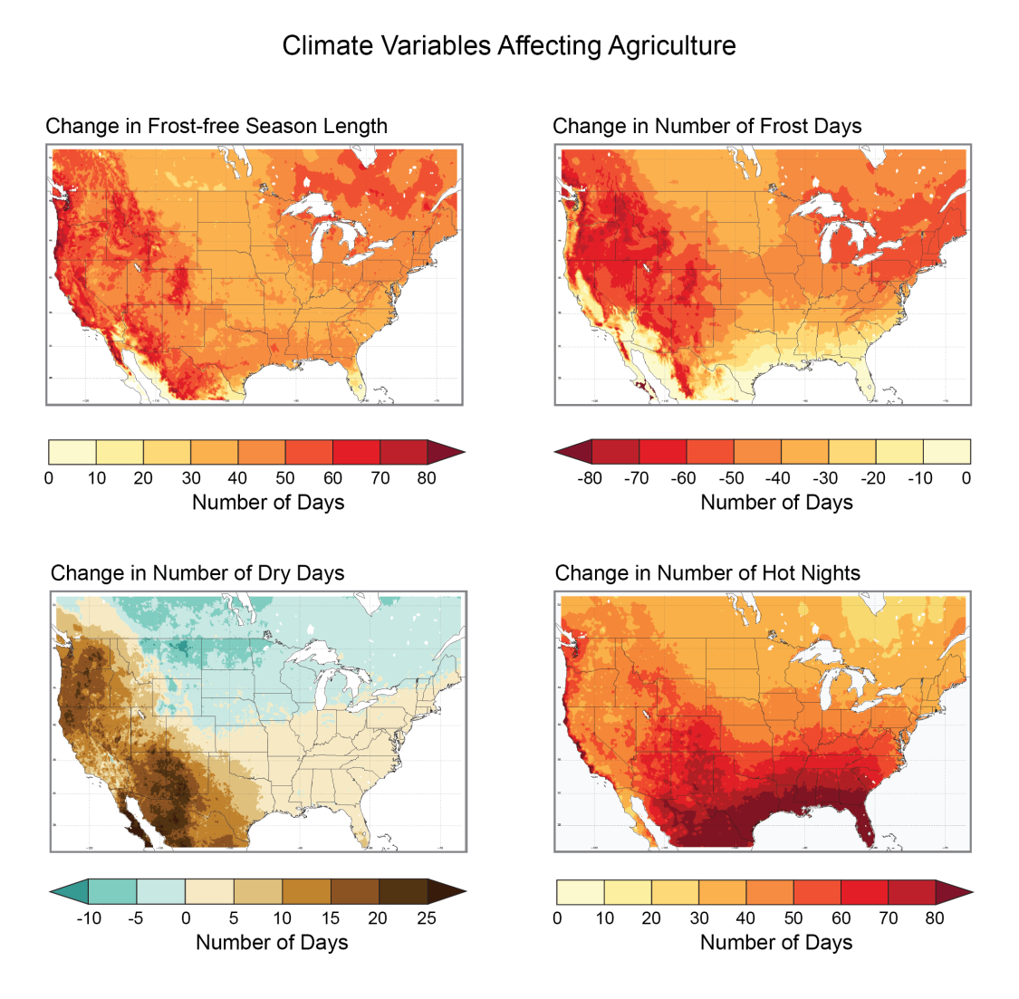
Recent climate changes have been both favorable and unfavorable to agriculture
Future conditions will challenge agriculture’s ability to adapt
Lengthening of the growing season
Higher yields of commodity crops
Reduction in number of frost days
Reduced chilling hours for fruit crops in CA
Reduced frost damage to some crops
Number of dry days
increases in east, west and south
Increased moisture stress
Increased frequency/intensity of heat waves
decreases in north
Fewer days for field work
More humidity, pests and pathogens
Increase in number of hot nights
reduced grain weight
reduced weight gain in meat animals
A2 scenario 2100
National Climate Assessment draft Agriculture Chapter

Slide 4
Key Messages from the National Climate Assessment Agriculture Chapter
Climate disruptions to agricultural production have increased in the recent past and are projected to increase further over the next 25 years. By mid-century and beyond, these impacts will be increasingly negative on most crops and livestock.
Agriculture has been able to adapt to recent changes in climate; however, increased innovation will be needed to ensure the rate of adaptation of agriculture and the associated socioeconomic system can keep pace with future climate change.
National Climate Assessment draft Agriculture Chapter
Notes:
With this next round of assessment, we will maintain a focus on synthesizing the best-available science while also looking to provide that science to users in such a way that it can support decisions about how we prepare for and respond to climate change.
In order to achieve this, we have set our sights on creating a process that reaches beyond the federal government to include state, local, and tribal governments, the business community, academic institutions, non-profit organizations, and many others that contribute to and use assessments.

Slide 5
Iowa State-Wide Average Data
2012

Slide 6
Iowa State-Wide Average Data
Totals above 40”
3 years
5 years
2012
1990-2011 highly favorable precip for crops

Slide 7
Iowa State-Wide Average Data
Totals above 40”
3 years
5 years
5 years
7 years
2012
Totals below 25”

Slide 8
Cedar Rapids, Iowa Data
28.0”
39% increase
39.0”

Slide 9
Cedar Rapids, Iowa Data
Years with more than 40 inches
18
2

Slide 10
Cedar Rapids, Iowa Data

Slide 11
Cedar Rapids, Iowa Data
Creates runoff

Slide 12
Cedar Rapids, Iowa Data
3.6 days
69% increase
6.1 days

Slide 13
Cedar Rapids, Iowa Data
Number of Years with More than 8 Occurrences
0
9

Slide 14
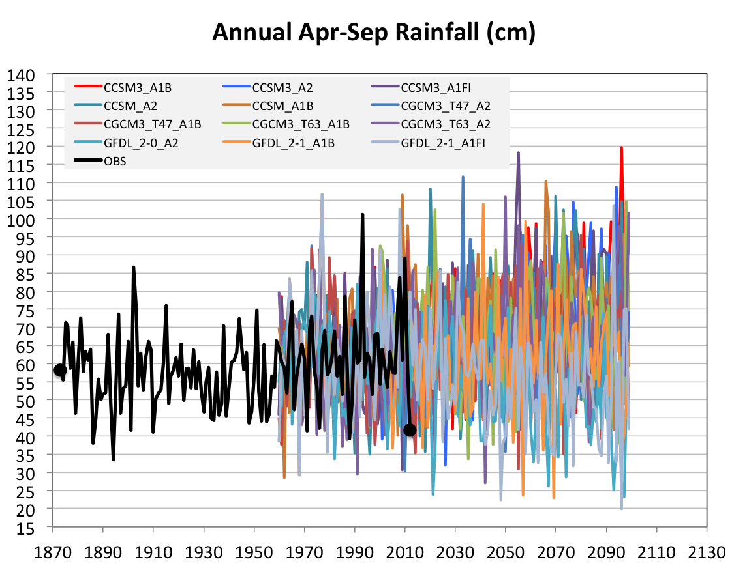
Projected Future Variability in Growing Season Precipitation for Iowa
More extreme high precip years
More extreme low precip years
CJ Anderson, ISU

Slide 15
Future Variability in Growing Season Precipitation for Iowa
More extreme high precip years
Lines drawn by eye
More extreme low precip years
CJ Anderson, ISU

Slide 16
Sustaining agricultural production without depleting natural resources will become increasingly difficulty with increasing levels of climate change

Slide 17
For More Information:
Climate Science Program
Iowa State University
http://climate.engineering.iastate.edu/
http://www.meteor.iastate.edu/faculty/takle/
gstakle@iastate.edu

