Slide 1
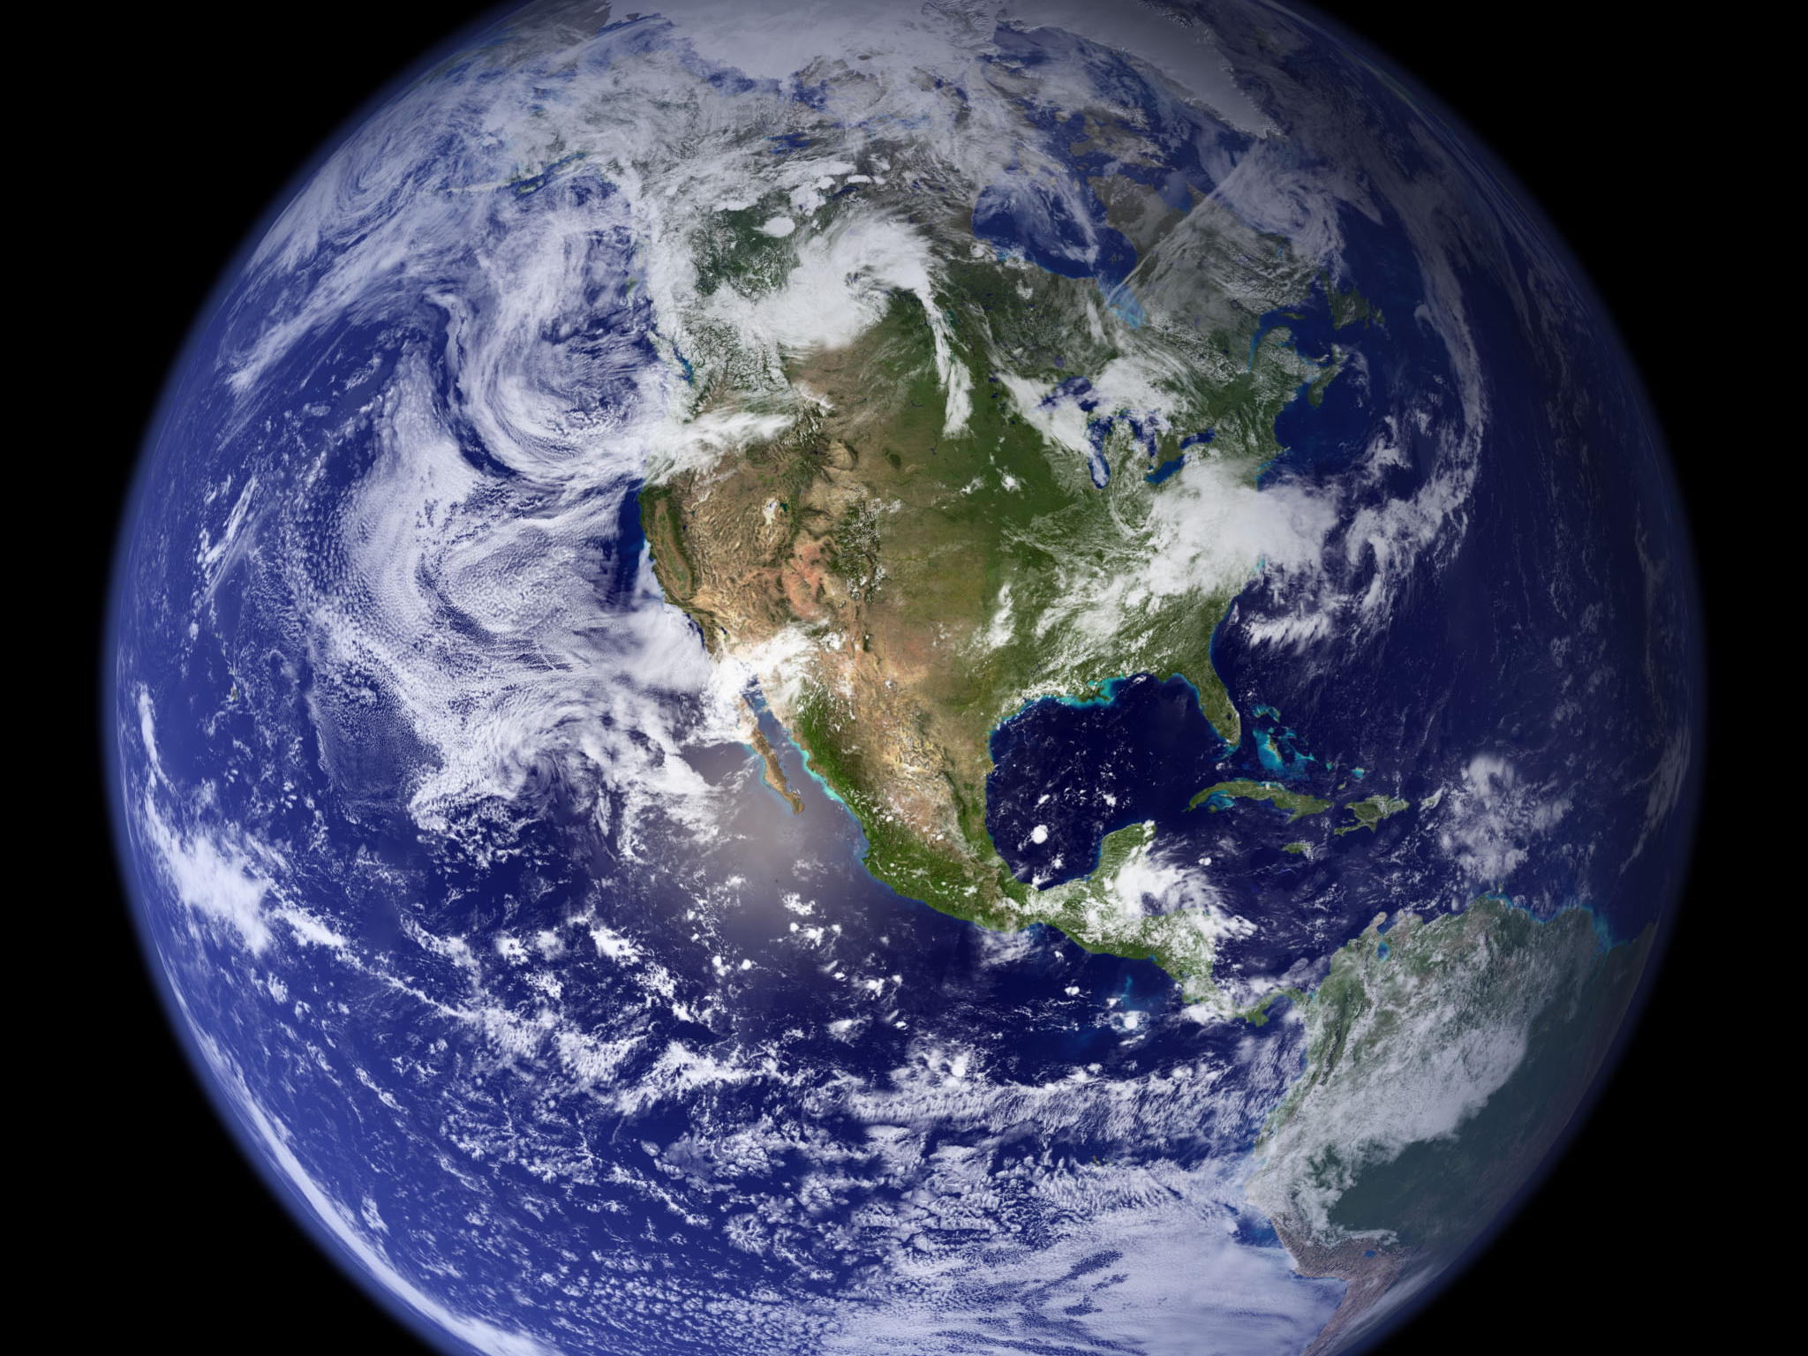
Image courtesy of NASA/GSFC

Slide 2
Will Climate Change Impact the Sustainability of Iowa Farms?
Eugene S. Takle
Professor
Department of Agronomy
Department of Geological and Atmospheric Science
Director, Climate Science Program
Iowa State University
Ames, IA 50011
2011 Shivvers Lecture
Iowa State University
6 February 2011

Slide 3
Outline
Observed global changes in carbon dioxide and temperature
Projected future changes in global and US temperatures and precipitation
Climate change challenge to sustainability: The Iowa example
Projecting into the future: You be the scientist

Slide 4
Climate change is one of the most important issues facing humanity
The scientific evidence clearly indicates that our climate is changing, and that human activities have been identified as a dominant contributing cause
Human actions of the next two decades will have significant impacts on the productivity, natural resiliency, and human habitability of major parts of the Earth at the end of this century
Notes:
No disagreement in peer reviewed literature
Powerful statements from every major professional science society and organization in the world
Powerful statements from the National Academies of Sciences (the leadership in science) for every major country
G8 + 5 other countries, May 2009: “The need for urgent action to address climate change is now indisputable.”

Slide 5
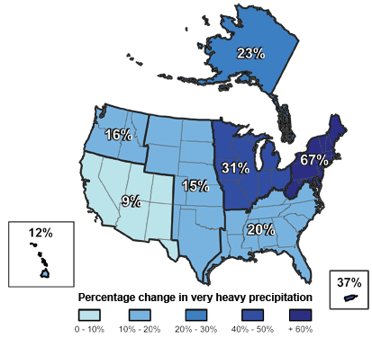
Climate changes are underway in the U.S. and are projected to grow
Temperature rise
Sea-level rise
Increase in heavy downpours
Rapidly retreating glaciers
Thawing permafrost
Lengthening growing season
Lengthening ice-free season in the ocean and on lakes and rivers
Earlier snowmelt
Changes in river flows
Plants blooming earlier; animals, birds and fish moving northward
Don Wuebbles

Slide 6
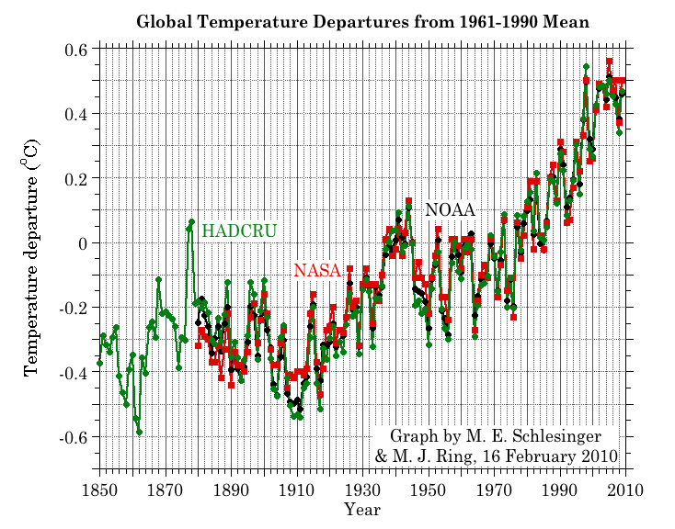
Three separate analyses of the temperature record – Trends are in close agreement
2010 has tied 2005 as the warmest year on record since 1880

Slide 7
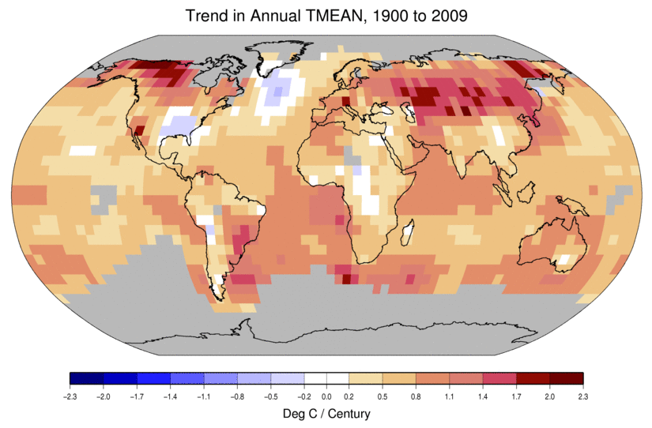
Temperature Changes are Not Uniform Around the Globe
From Tom Karl, NOAA NCDC

Slide 8
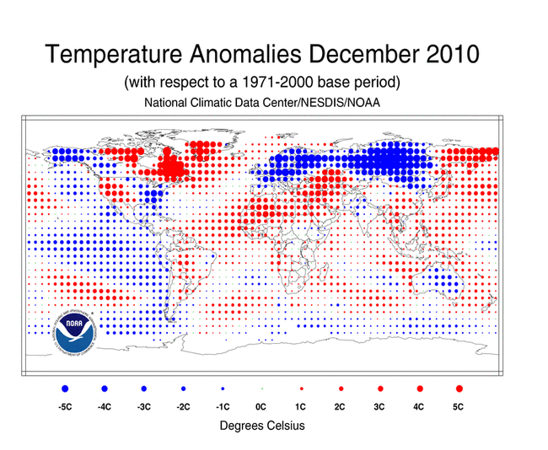

Slide 9
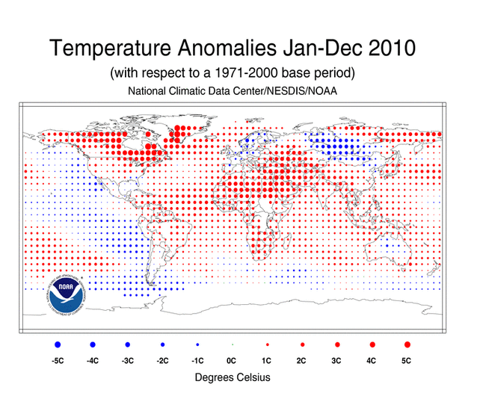

Slide 10
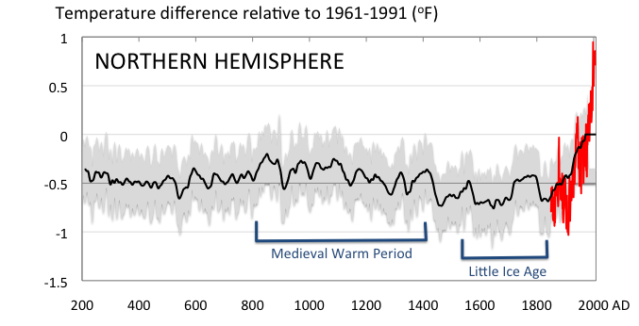
Conditions today are unusual in the context of the last 2,000 years …
Don Wuebbles

Slide 11
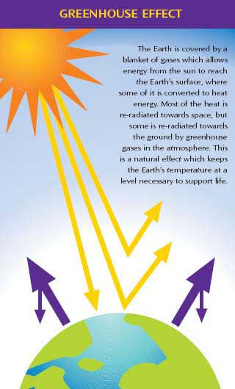
Why does the Earth warm? 1. Natural causes
THE GREENHOUSE EFFECT…
…is 100% natural.
Heat is trapped in the atmosphere.
…sustains life on Earth.
Keeps average temperatures at 12.8ºC (55ºF), instead of –29ºC (-20ºF).
Don Wuebbles

Slide 12
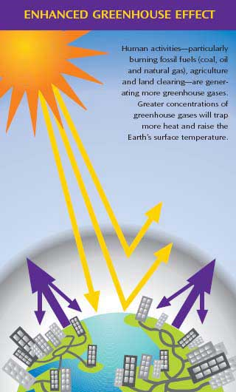
Why does the Earth warm? 2. Human causes
THE ENHANCED GREENHOUSE EFFECT
(or GLOBAL WARMING)
… is primarily human-induced: We’re increasing heat-trapping gases in the atmosphere.
… is like wrapping an extra blanket around the Earth.
Don Wuebbles

Slide 13
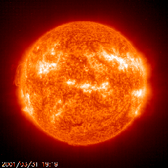
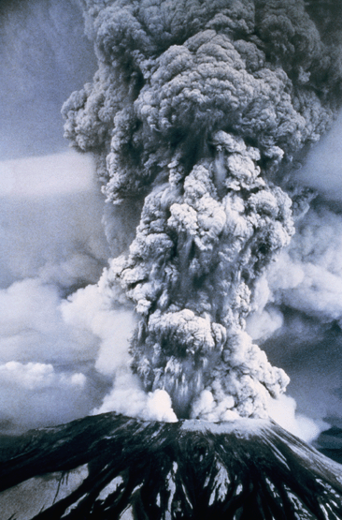
Natural factors affect climate
Variations in the energy
received from the sun
Variations in the Earth's orbit
(Milankovic effect)
Stratospheric
aerosols from
energetic
volcanic eruptions
Chaotic interactions in
the Earth's climate
(for example, El Nino, NAO)
Don Wuebbles

Slide 14
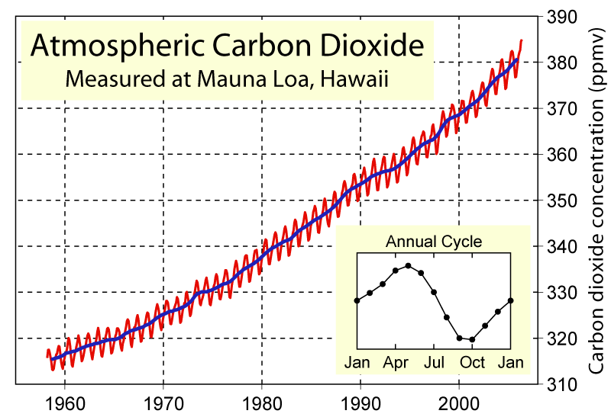
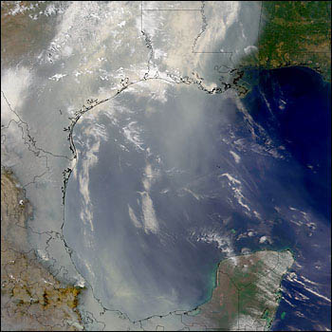
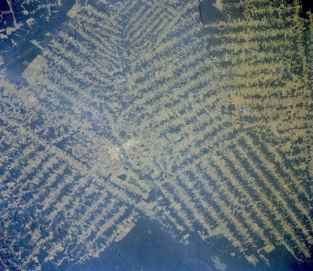
Non-natural mechanisms
Changes in atmospheric concentrations of radiatively important gases
Changes in aerosol particles from burning fossil fuels and biomass
Changes in the reflectivity (albedo) of the Earth’s surface
Don Wuebbles

Slide 15
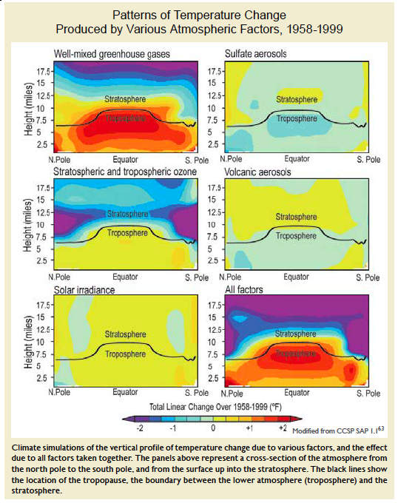
Warming of the Lower and Upper Atmosphere Produced by Natural and Human Causes
Karl, T. R., J. M. Melillo, and T. C. Peterson, (eds.), 2009: Global Climate Change Impacts in the United States. Cambridge University Press, 2009, 196pp.

Slide 16
Warming of the Lower and Upper Atmosphere Produced by Natural and Human Causes
Note that greenhouse gases have a unique temperature signature, with strong warming in the upper troposphere, cooling in the lower stratosphere and strong warming at the surface over the North Pole. No other warming factors have this signature.
Karl, T. R., J. M. Melillo, and T. C. Peterson, (eds.), 2009: Global Climate Change Impacts in the United States. Cambridge University Press, 2009, 196pp.

Slide 17
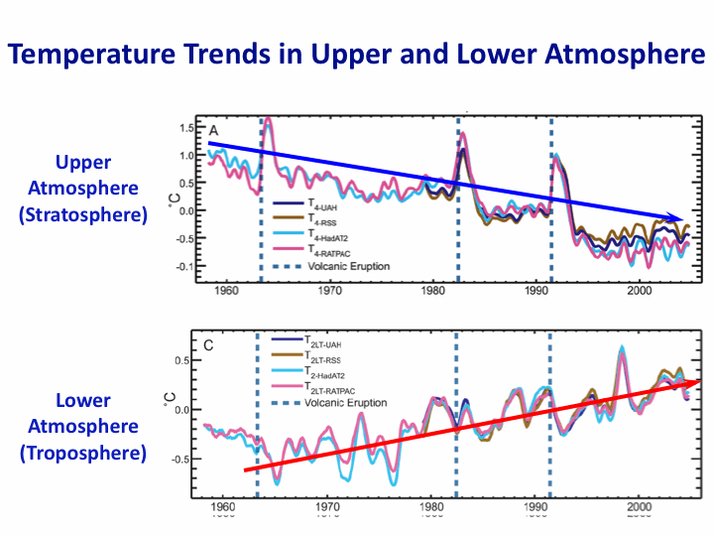
Warming of the Lower and Upper Atmosphere Produced by Natural and Human Causes
Note that greenhouse gases have a unique temperature signature, with strong warming in the upper troposphere, cooling in the lower stratosphere and strong warming at the surface over the North Pole. No other warming factors have this signature.
Karl, T. R., J. M. Melillo, and T. C. Peterson, (eds.), 2009: Global Climate Change Impacts in the United States. Cambridge University Press, 2009, 196pp.

Slide 18
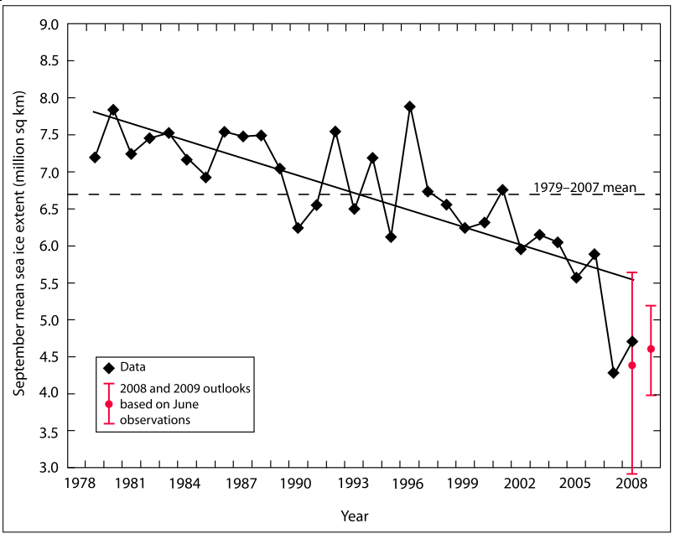
Warming of the Lower and Upper Atmosphere Produced by Natural and Human Causes
Note that greenhouse gases have a unique temperature signature, with strong warming in the upper troposphere, cooling in the lower stratosphere and strong warming at the surface over the North Pole. No other warming factors have this signature.

Slide 19
Many lines of evidence for conclusion of a “discernible human influence”
“Basic physics” evidence
Physical understanding of the climate system and the heat-trapping properties of greenhouse gases
Qualitative analysis evidence
Qualitative agreement between observed climate changes and model predictions of human-caused climate changes (warming of oceans, land surface and troposphere, water vapor increases, etc.)
Paleoclimate evidence
Reconstructions of past climates enable us to place the warming of the 20th century in a longer-term context
Fingerprint evidence
Rigorous statistical comparisons between modeled and observed patterns of climate change
Don Wuebbles

Slide 20
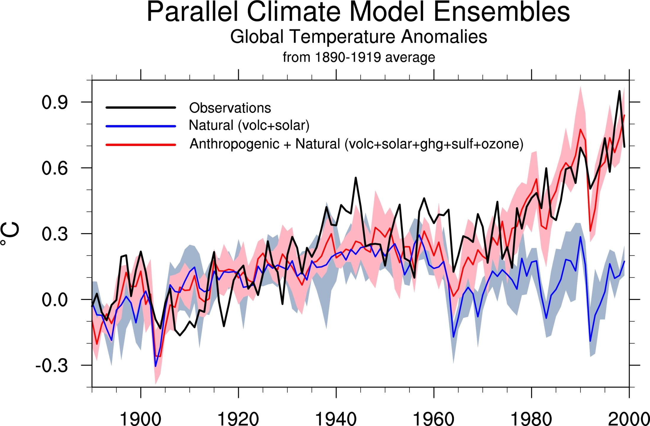
Climate models: Natural processes do not account for
observed 20th century warming after 1965

Slide 21
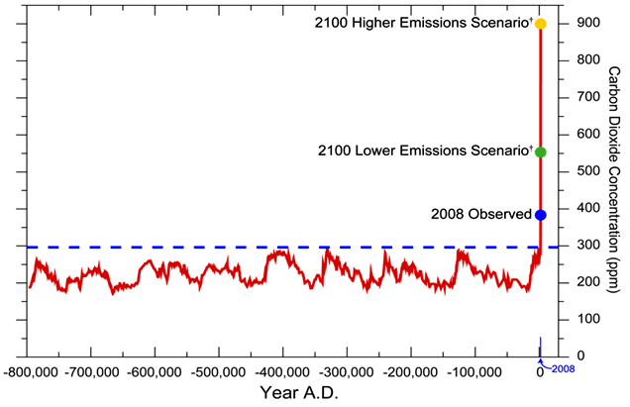
We have Moved Outside the Range of Historical Variation
800,000 Year Record of Carbon Dioxide Concentration
Don Wuebbles

Slide 22
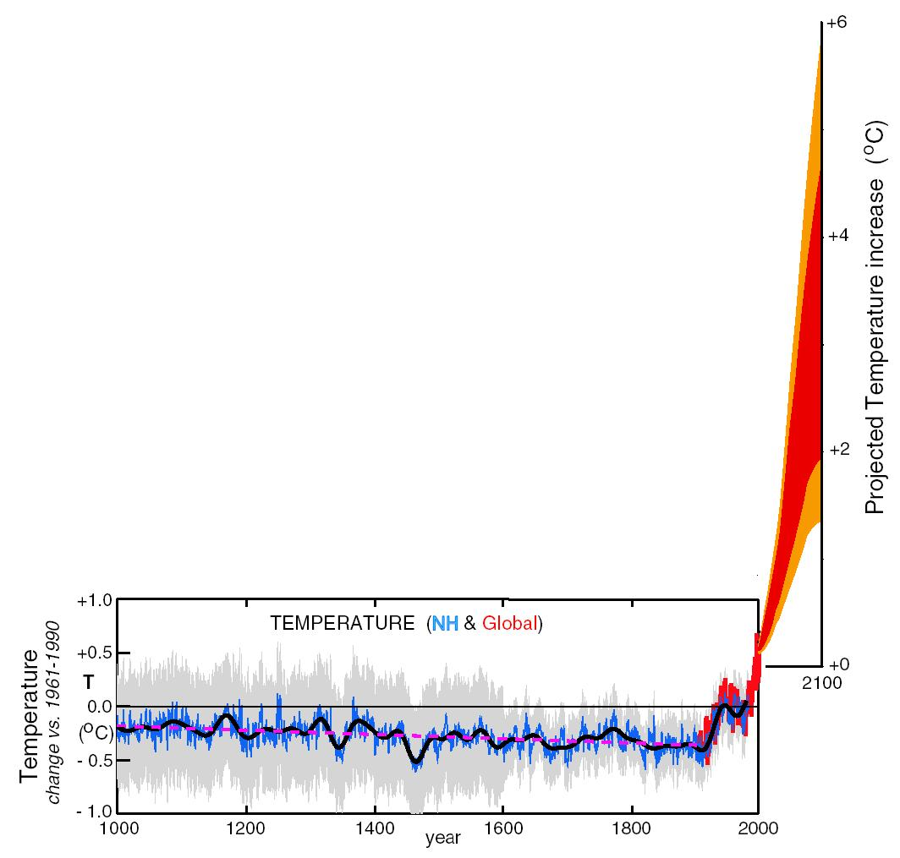
What can we expect in the future?
Don Wuebbles

Slide 23
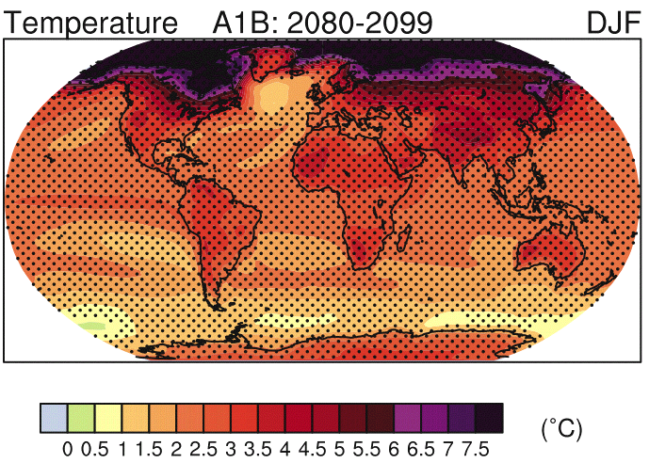
IPCC 2007

Slide 24
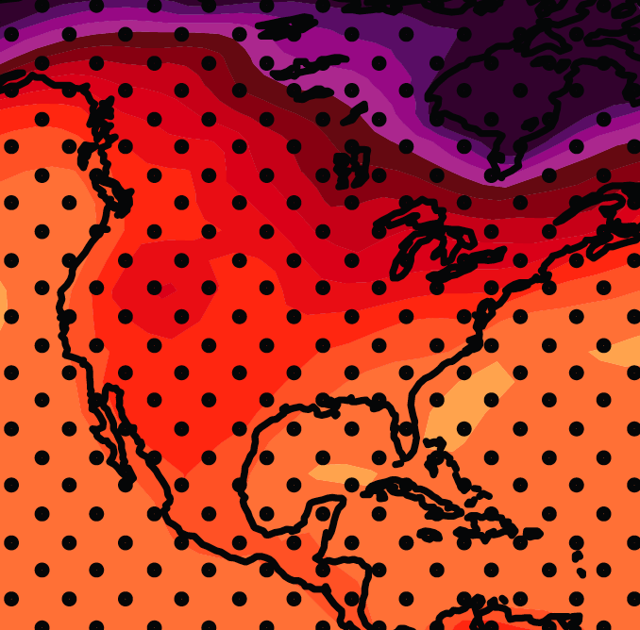
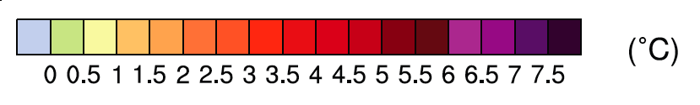
December-January-February Temperature Change
7.2ºF
6.3ºF
A1B Emission Scenario
2080-2099 minus1980-1999

Slide 25
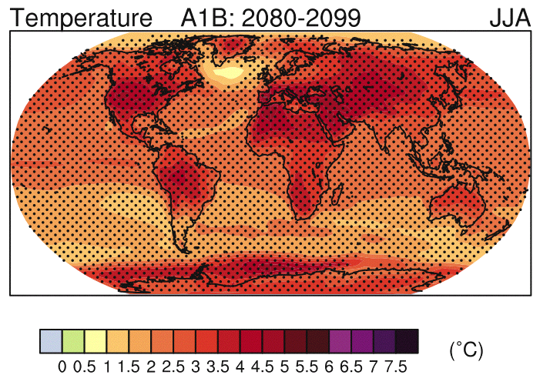
IPCC 2007

Slide 26
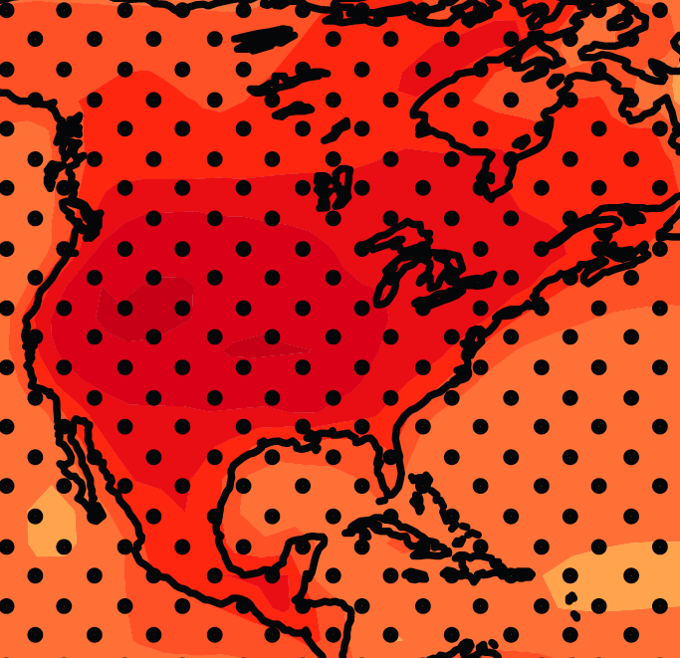
June-July-August Temperature Change
4.5ºF
5.4ºF
A1B Emission Scenario
2080-2099 minus1980-1999

Slide 27
June-July-August Temperature Change
4.5ºF
5.4ºF
A1B Emission Scenario
2080-2099 minus1980-1999
Not the direction of current trends

Slide 28
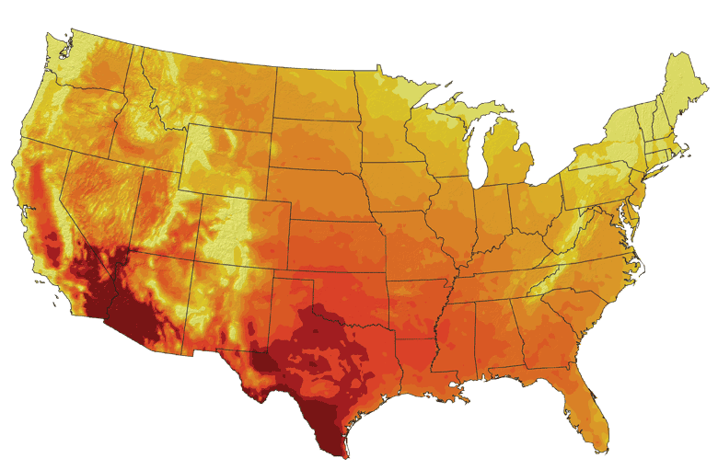
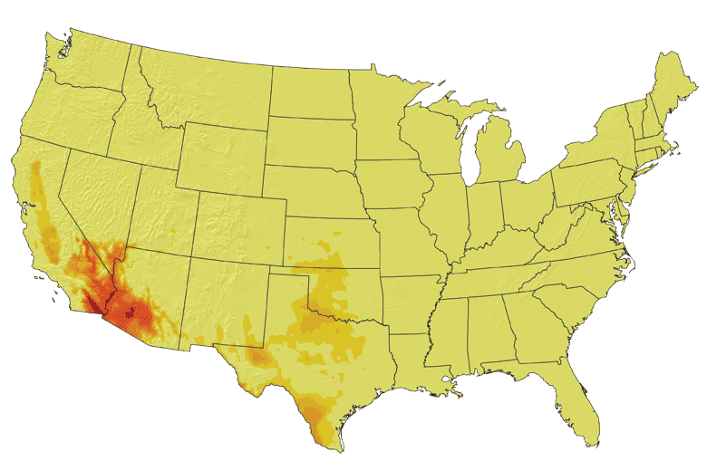
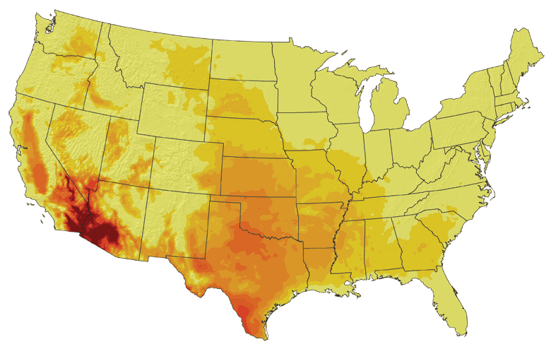
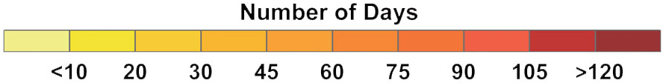
Increases in very high temperatures will have
wide-ranging effects
Higher Emissions Scenario, 2080-2099
Number of Days Over 100ºF
Recent Past, 1961-1979
Average:
30-60 days
Lower Emissions Scenario, 2080-2099
Average:
10-20 days
Don Wuebbles

Slide 29
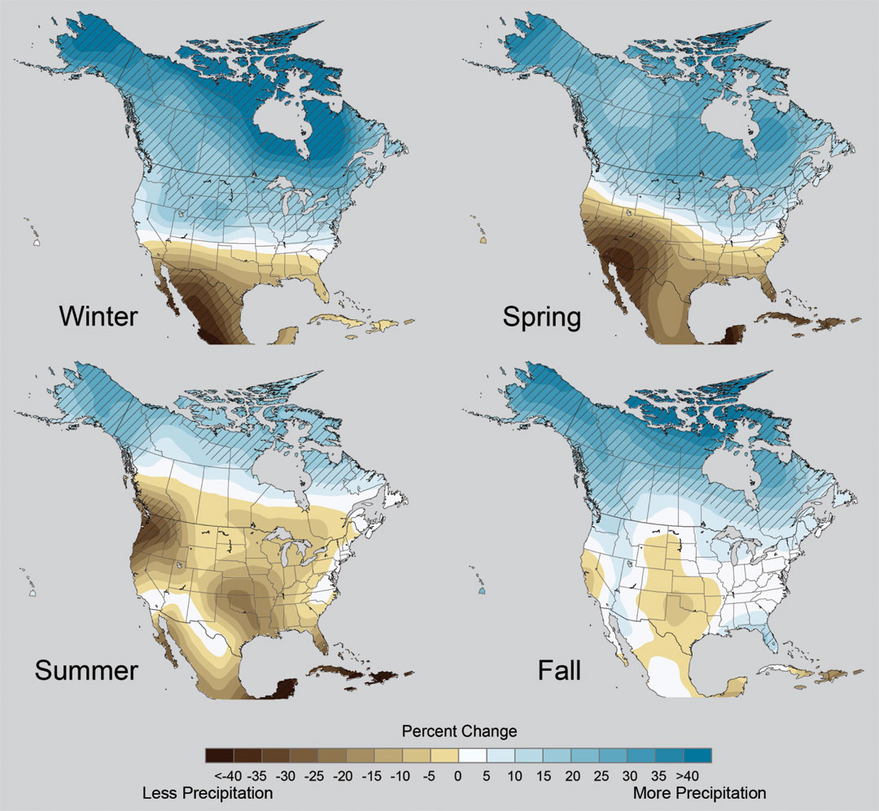
Projected Change in Precipitation: 2081-2099
Midwest: Increasing winter and spring precipitation, with drier summers
More frequent and intense periods of heavy rainfall
Unstippled regions indicate reduced confidence
Relative to 1960-1990
NOTE: Scale Reversed
Don Wuebbles

Slide 31
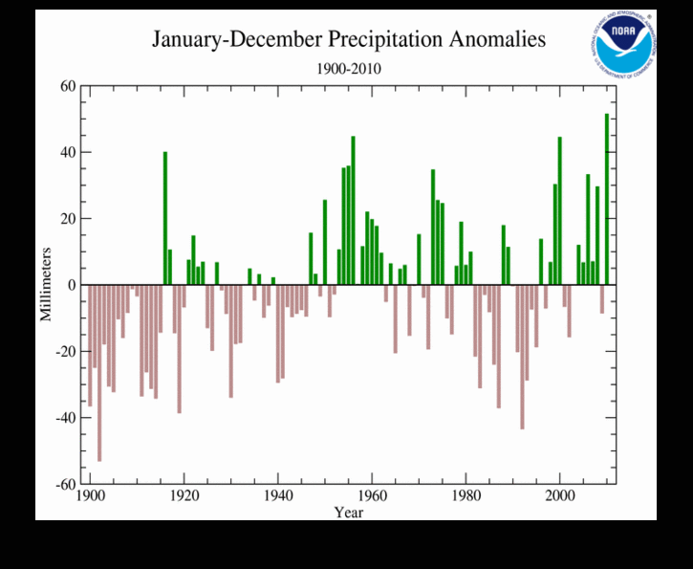
2010 had the highest global total precipitation in the 111 year record

Slide 32
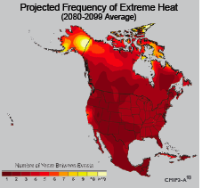
Extreme weather events become more common
Events now considered rare will become commonplace.
Heat waves will likely become longer and more severe
Droughts are likely to become more frequent and severe in some regions
Likely increase in severe thunderstorms (and perhaps in tornadoes).
Winter storm tracks are shifting
northward and the strongest storms are
likely to become stronger and more
frequent.
Don Wuebbles
Notes:
Shown here is the frequency at the end of the century of what we consider now to be a 20 year heat wave. Instead of once every 20 years, these temperatures would be experienced every other year or so over most of the continental US in this business as usual scenario.

Slide 33
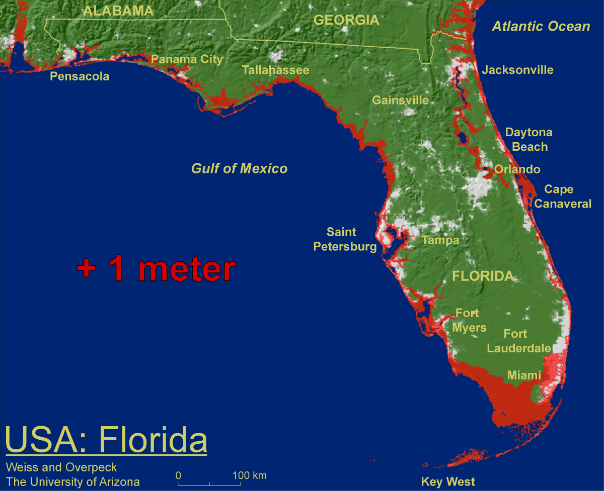
1 meter will be hard to avoid, possibly within this century, just from thermal expansion and small glacier melt.
Don Wuebbles

Slide 34

Widespread climate-related impacts are occurring now and are expected to increase
Water Resources
Energy Supply & Use
Transportation
Agriculture
Don Wuebbles
Ecosystems
Human Health
Society

Slide 35
But Abstract Concepts of Global Changes and Models Projecting Future Conditions Do Not Inspire Urgency and Action
It takes nearby events in my backyard that are recurring and outside the range of recent memory to raise questions about whether something fundamental is changing.
Let’s forget about models of the future for a few minutes and look at the data
The Iowa Example…

Slide 36
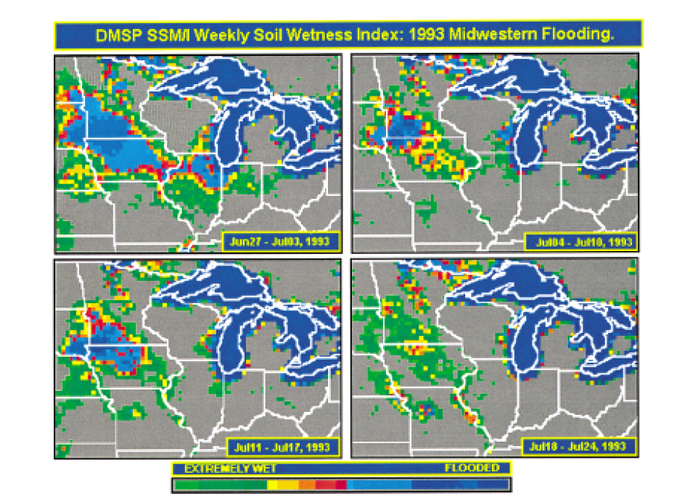
Great Flood of 1993 in the US Midwest:
A New “Great Lake”
1993
Historical Data indicate this should happen about once every 500 years
Lakshmi, V., and K. Schaaf, 2001: Analysis of the 1993 Midwestern flood using satellite and ground data. IEEE Trans. Geosci & Remote Sens., 39, 1736-1743.

Slide 37
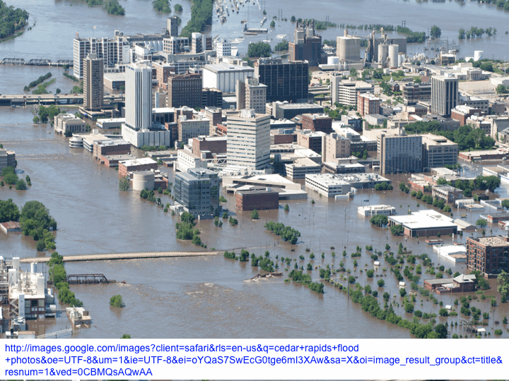
2008

Slide 38
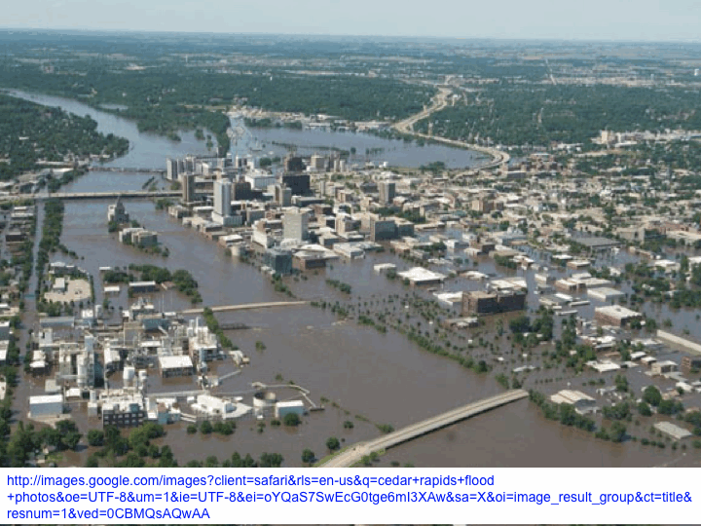

Slide 39
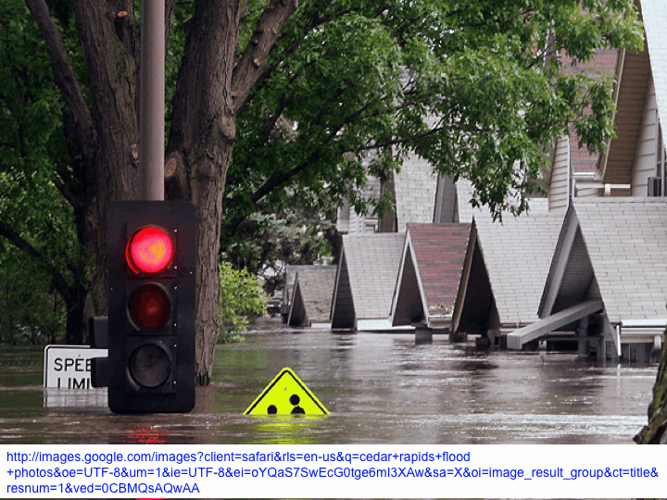

Slide 40
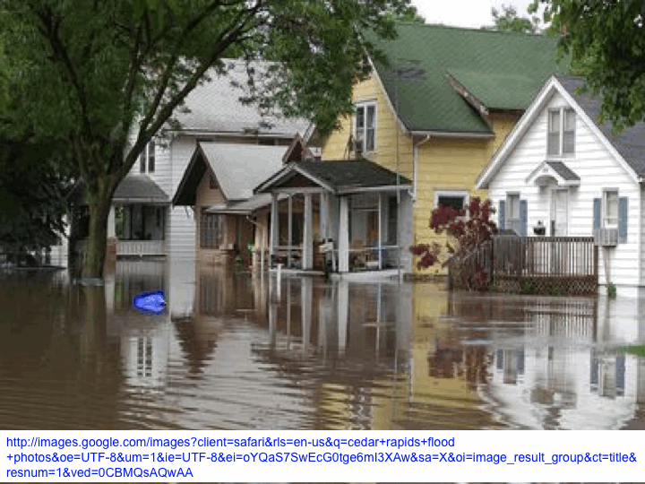

Slide 41
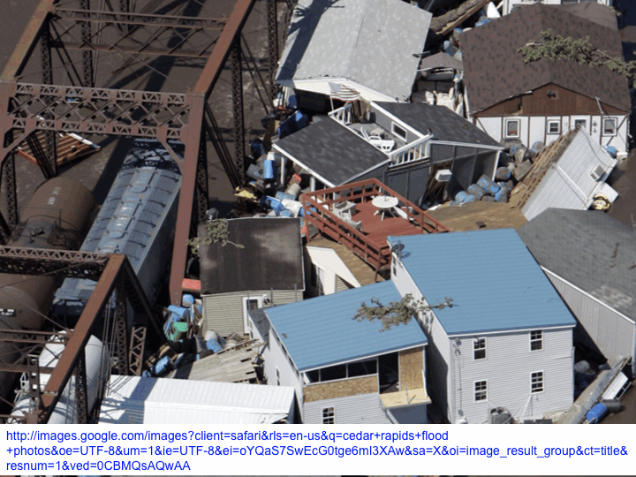

Slide 42
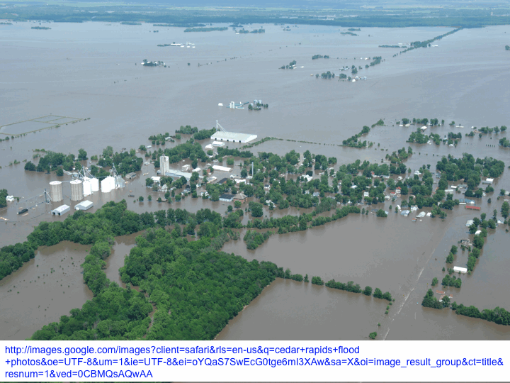

Slide 43
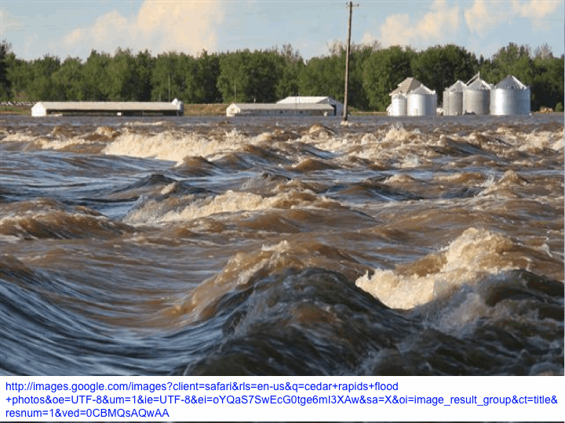

Slide 44
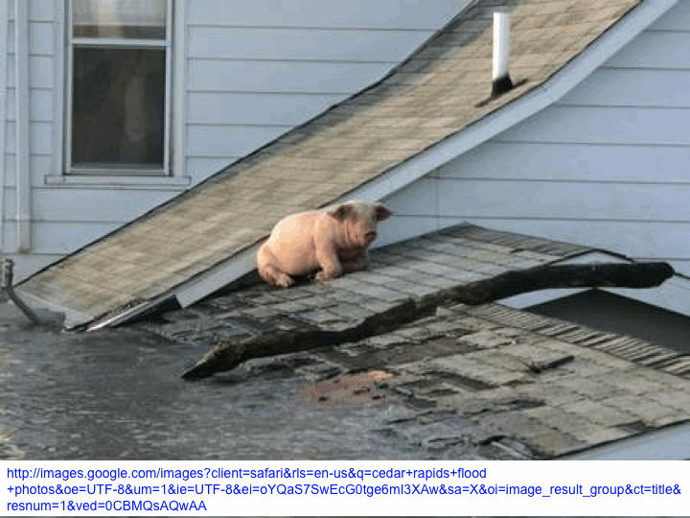
This is not normal weather

Slide 46
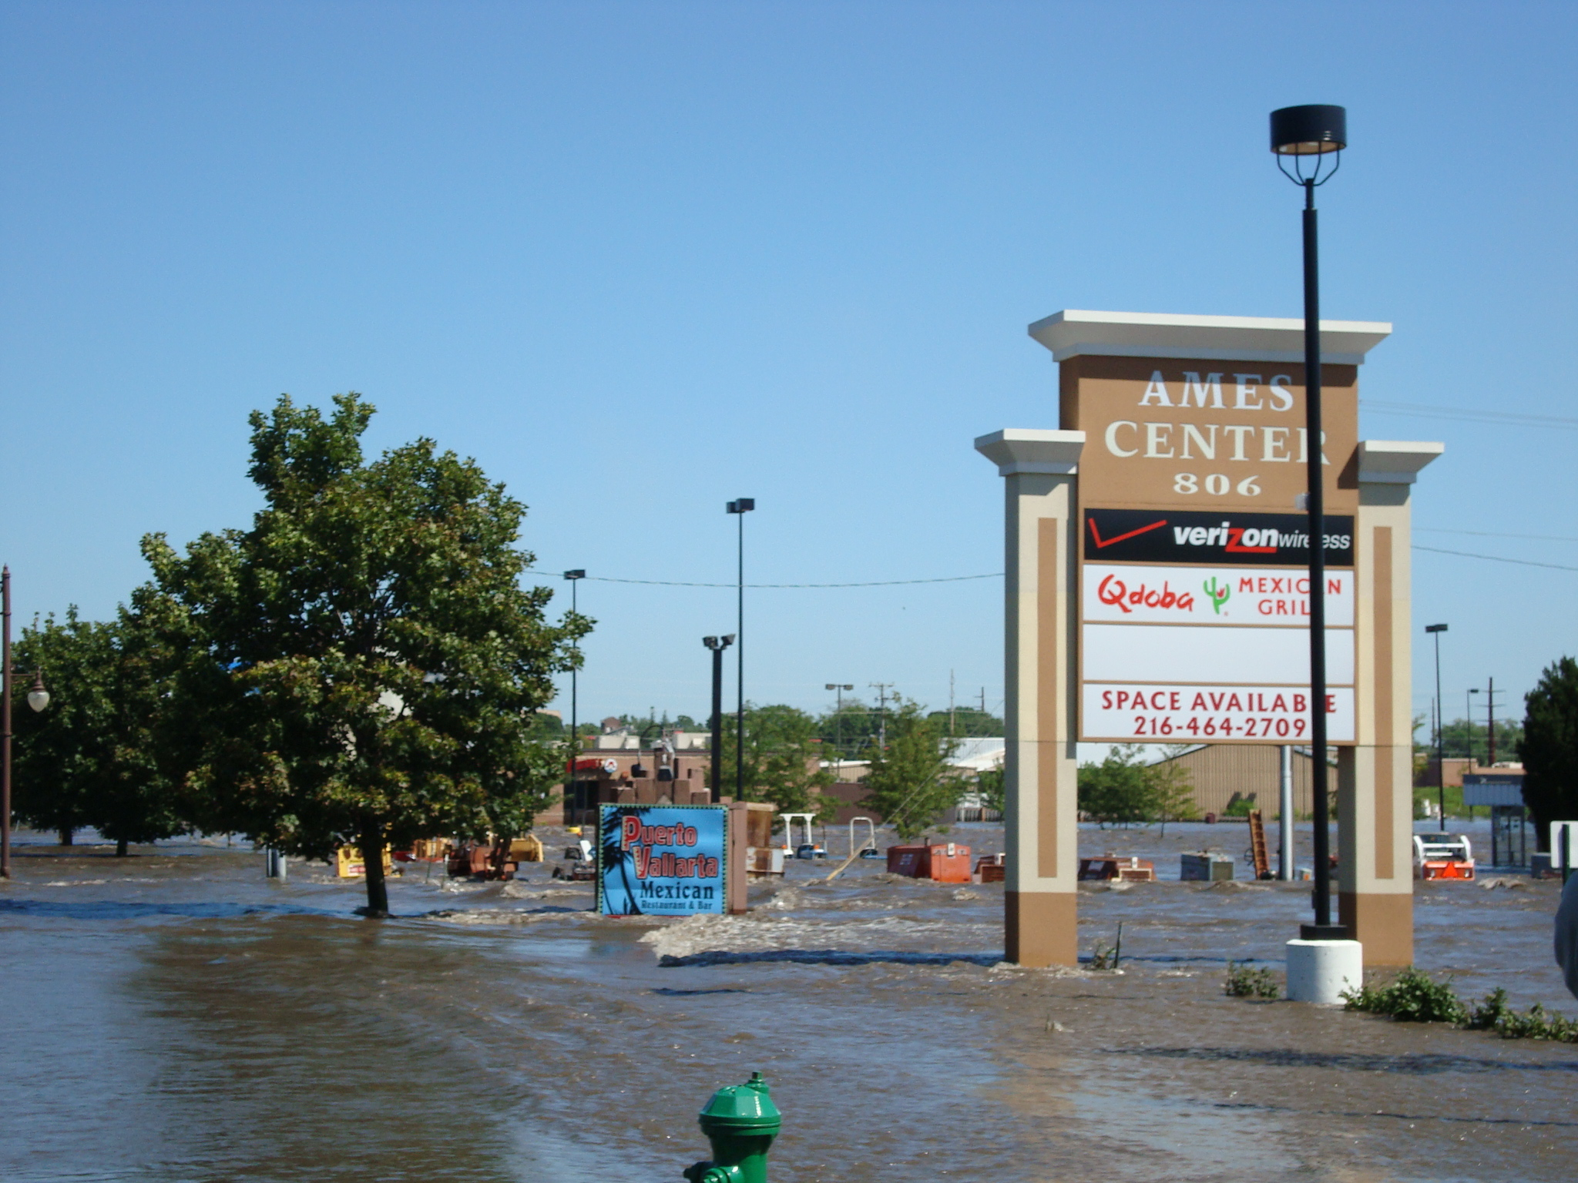
2010

Slide 47
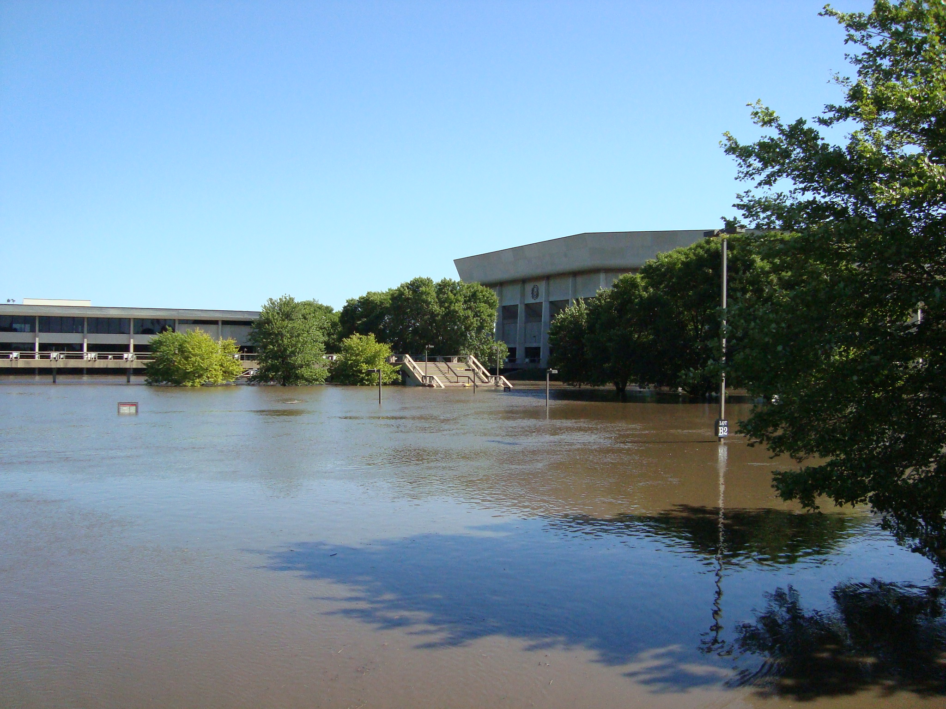

Slide 48
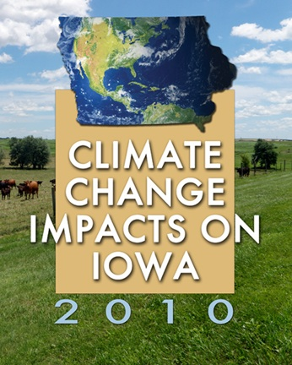
Iowa Climate Change Impacts Committee, 2011: Climate Change Impacts on Iowa.
Report to the Governor and the Iowa General Assembly. [Available online at
http://climate.engineering.iastate.edu/Document/Olson_Amend_Report.pdf]
Chapter 2. Climate Changes in Iowa
Eugene S. Takle
Chapter 3. Agriculture in Iowa
Natalia P. Rogovska and
Richard M. Cruse
Image courtesy of NASA/GSFC

Slide 49
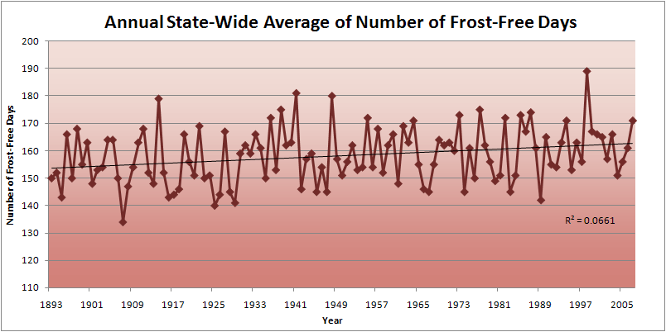
Iowa State-Wide Average Data

Slide 50
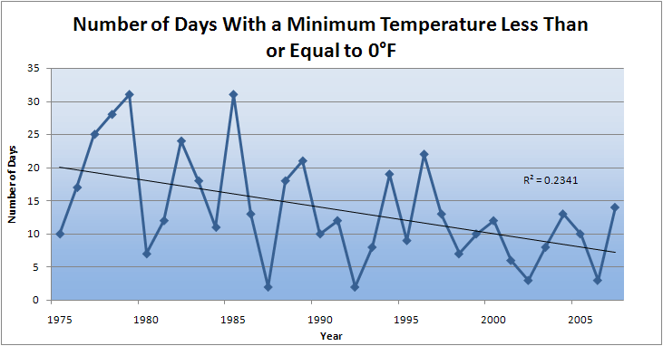
Des Moines Airport Data
Caution: Not corrected for urban heat island effects

Slide 51
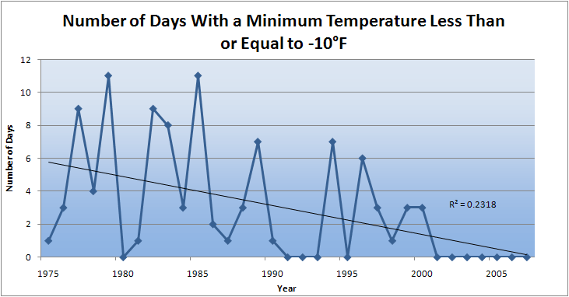
Des Moines Airport Data
Caution: Not corrected for urban heat island effects

Slide 52
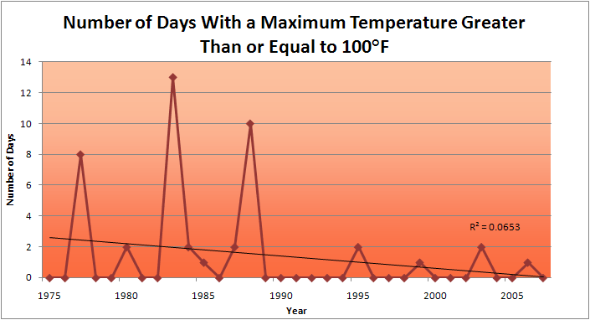
Des Moines Airport Data
1983: 13
1988: 10
1977: 8
2009: 0
2010: 0

Slide 53
Des Moines Airport Data
1983: 13
1988: 10
6 days ≥ 100ºF in the last 22 years
1977: 8
2009: 0
2010: 0

Slide 56
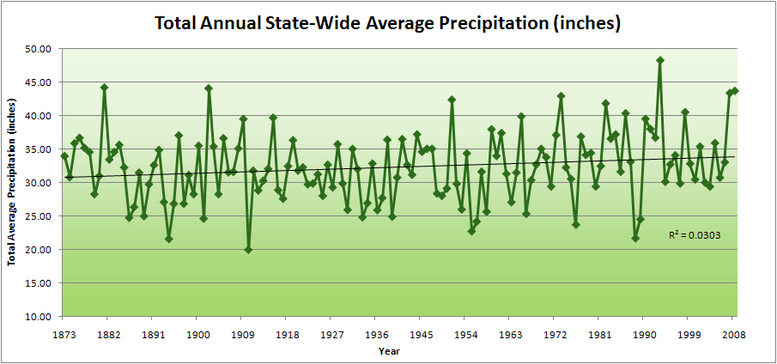
Iowa State-Wide Average Data

Slide 57
Iowa State-Wide Average Data
34.0”
10% increase
30.8”

Slide 58
Iowa State-Wide Average Data
Totals above 40”
2 years

Slide 59
Iowa State-Wide Average Data
Totals above 40”
8 years
2 years

Slide 60

Cedar Rapids Data

Slide 61
Cedar Rapids Data
28.0”
32% increase
37.0”

Slide 62
Cedar Rapids Data
Years with more than 40 inches
11
1
28.0”
32% increase
37.0”

Slide 63


Slide 64


“One of the clearest trends in the United States observational record is an increasing frequency and intensity of heavy precipitation events… Over the last century there was a 50% increase in the frequency of days with precipitation over 101.6 mm (four inches) in the upper midwestern U.S.; this trend is statistically significant “
Karl, T. R., J. M. Melillo, and T. C. Peterson, (eds.), 2009: Global Climate Change Impacts in the United States. Cambridge University Press, 2009, 196pp.

Slide 65

Cedar Rapids Data
1.25 inches
4.2 days
57% increase
6.6 days

Slide 66
Cedar Rapids Data
1.25 inches
Years having more than 8 days
13
2
4.2 days
57% increase
6.6 days

Slide 67
Years with more than 40 inches: 43% Increase
2010 so far

Slide 68
2010 through Sept 27
3.7
41% Increase
5.2

Slide 69
Years having more than 8 days
2010 through Sept 27
7
350% Increase
2
3.7
41% Increase
5.2

Slide 70




Amplification of the Seasonality of Precipitation
Spring
Fall
21.2 => 25.3 inches (19% increase)
12.1 => 10.5 inches (13% decrease)
Summer
Winter

Slide 71
Drainage basins
Storm tracks
Rivers
Mar-May
June
July
Aug-Sep

Slide 72
Why Small Increases in Rainfall Produce Much More Flooding
13% increase in atmospheric moisture in June-July-August
~8% increase in average precipitation in Iowa since 1970
~3 to 7-fold increase in high-precipitation events over the last century, mostly in June-July-August, that lead to runoff
Amplified seasonal cycle
Iowa rivers and watersheds are oriented NW-SE
Rainfall patterns turn from SW-NE in March-May to W-E or NW-SE in mid summer
More frequent floods are the result of one or more of the following
More rain
More intense rain events
More rain in spring and summer
Rainfall patterns more likely to align with streams and watersheds
Streams amplify changes in precipitation by a factor of 2-4
AND: more subsurface drainage tile has been installed

Slide 73

Photo courtesy of RM Cruse

Slide 74
Plot courtesy of RM Cruse

Slide 75
Iowa agricultural producers already are spending money to adapt to climate change:
Longer growing season: plant earlier, plant longer season hybrids, harvest later
Wetter springs: larger machinery enables planting in smaller weather windows
More summer precipitation: higher planting densities for higher yields
Wetter springs and summers: more subsurface drainage tile is being installed, closer spacing, sloped surfaces
Fewer extreme heat events: higher planting densities, fewer pollination failures
Higher humidity: more spraying for pathogens favored by moist conditions. more problems with fall crop dry-down, wider bean heads for faster harvest due to shorter harvest period during the daytime.
Drier autumns: delay harvest to take advantage of natural dry-down conditions
HIGHER YIELDS!!
Is it genetics or climate? Likely some of each.

Slide 76
Other Agricultural Impacts:
Carbon dioxide fertilization in field studies: corn - little or none, soybeans – up to 14%
Waterlogged soils in spring: shallow root system more prone to disease, nutrient deficiencies and drought later on; risk of compaction, delayed planting and pest control
More frequent rains: delayed fertilizer application
More intense rain events: more soil erosion
More humid conditions, dew: plant disease, sudden death syndrome
More weeds, invasive species
Water quality: loss of nitrate fertilizer, more sediment, runoff from manure application
Animal agriculture: reduced milk production, reduced weight gain, increased mortality

Slide 77
Policy Recommendations
Climate change is already affecting the way Iowans live and work. Without action to mitigate these effects, our future responses will become more complex and costly. The following policy recommendations are offered as initial steps to help safeguard our state’s economy, environment, and residents.
*
*
Take strong steps to protect Iowa’s soil, water quality, and long-term agricultural productivity in the face of climate change.
Image courtesy of NASA/GSFC

Slide 78
Legislature Response:
House File 99 This bill changes the date on which Code section 455B.851, establishing the Iowa climate change advisory council, is repealed from the current date of July 1, 2011, to the effective date of this bill. The bill also deletes a provision which requires the department of natural resources to submit by December 31 annually a report to the governor and the general assembly regarding greenhouse gas emissions in the state during the previous calendar year and forecasting trends in such emissions.
Image courtesy of NASA/GSFC

Slide 79
Do you believe that the climate of Iowa has changed in ways that affect agriculture? If so, then what is the next logical question?

Slide 80
You be the scientist: For which hypothesis can you find the most evidence?
Future will be more extreme than today
Current trend will continue
Future will be like today
Future will be like average of the past
Some Climate Variable (temp, precip, humid)
Future will return to something in the past
Measured past
Today
Past
Future

Slide 81
Sustaining agricultural production without depleting natural resources will become increasingly difficulty with increasing levels of climate change

Slide 82

Rise in global mean temperature (ºC)

Slide 83

Rise in global mean temperature (ºC)

Slide 84

Energy intensive
Balanced fuel sources
More environmentally friendly
Limit to avoid “dangerous anthropogenic
Interference” with the climate system
2ºC limit
IPCC Fourth Assessment Report Summary for Policy Makers

Slide 85

Share of Carbon-Free Energy
4.5ºC
4.0ºC
3.0ºC
2.0ºC*
* maximum temperature change over the 21st century assuming 3ºC climate sensitivity
Nebojša Nakićenović IIASA, Vienna
Notes:
Add temperature numbers here as well!!

Slide 86
Summary
Global temperature trends of the 20C cannot be explained on the basis of natural variation alone
Only when the influences of greenhouse gases and sulfate aerosols are included can the trends be explained
Models that explain these trends, when projected into the future, indicate a 1.5-6.5ºC warming over the 21C
Farmers are now engaged in adapting to climate change
Substantial adverse consequences to food production, fresh-water supplies, and sustainability will occur for temperature increases above 2ºC
The major challenge to our global society is to figure out how to reduce our global dependence on carbon-emitting fuels

Slide 87
For More Information
Contact me directly:
gstakle@iastate.edu
Climate Science Program website:
http://climate.engineering.iastate.edu/
Current research on regional climate and climate change at the ISU Regional Climate Modeling Laboratory:
http://rcmlab.agron.iastate.edu/
North American Regional Climate Change Assessment Program:
http://www.narccap.ucar.edu/
Iowa precipitation analysis and simulation is a collaborative project under funding from the Iowa Flood Center (http://www.iowafloodcenter.org/)
Or just Google Eugene Takle

