Slide 1
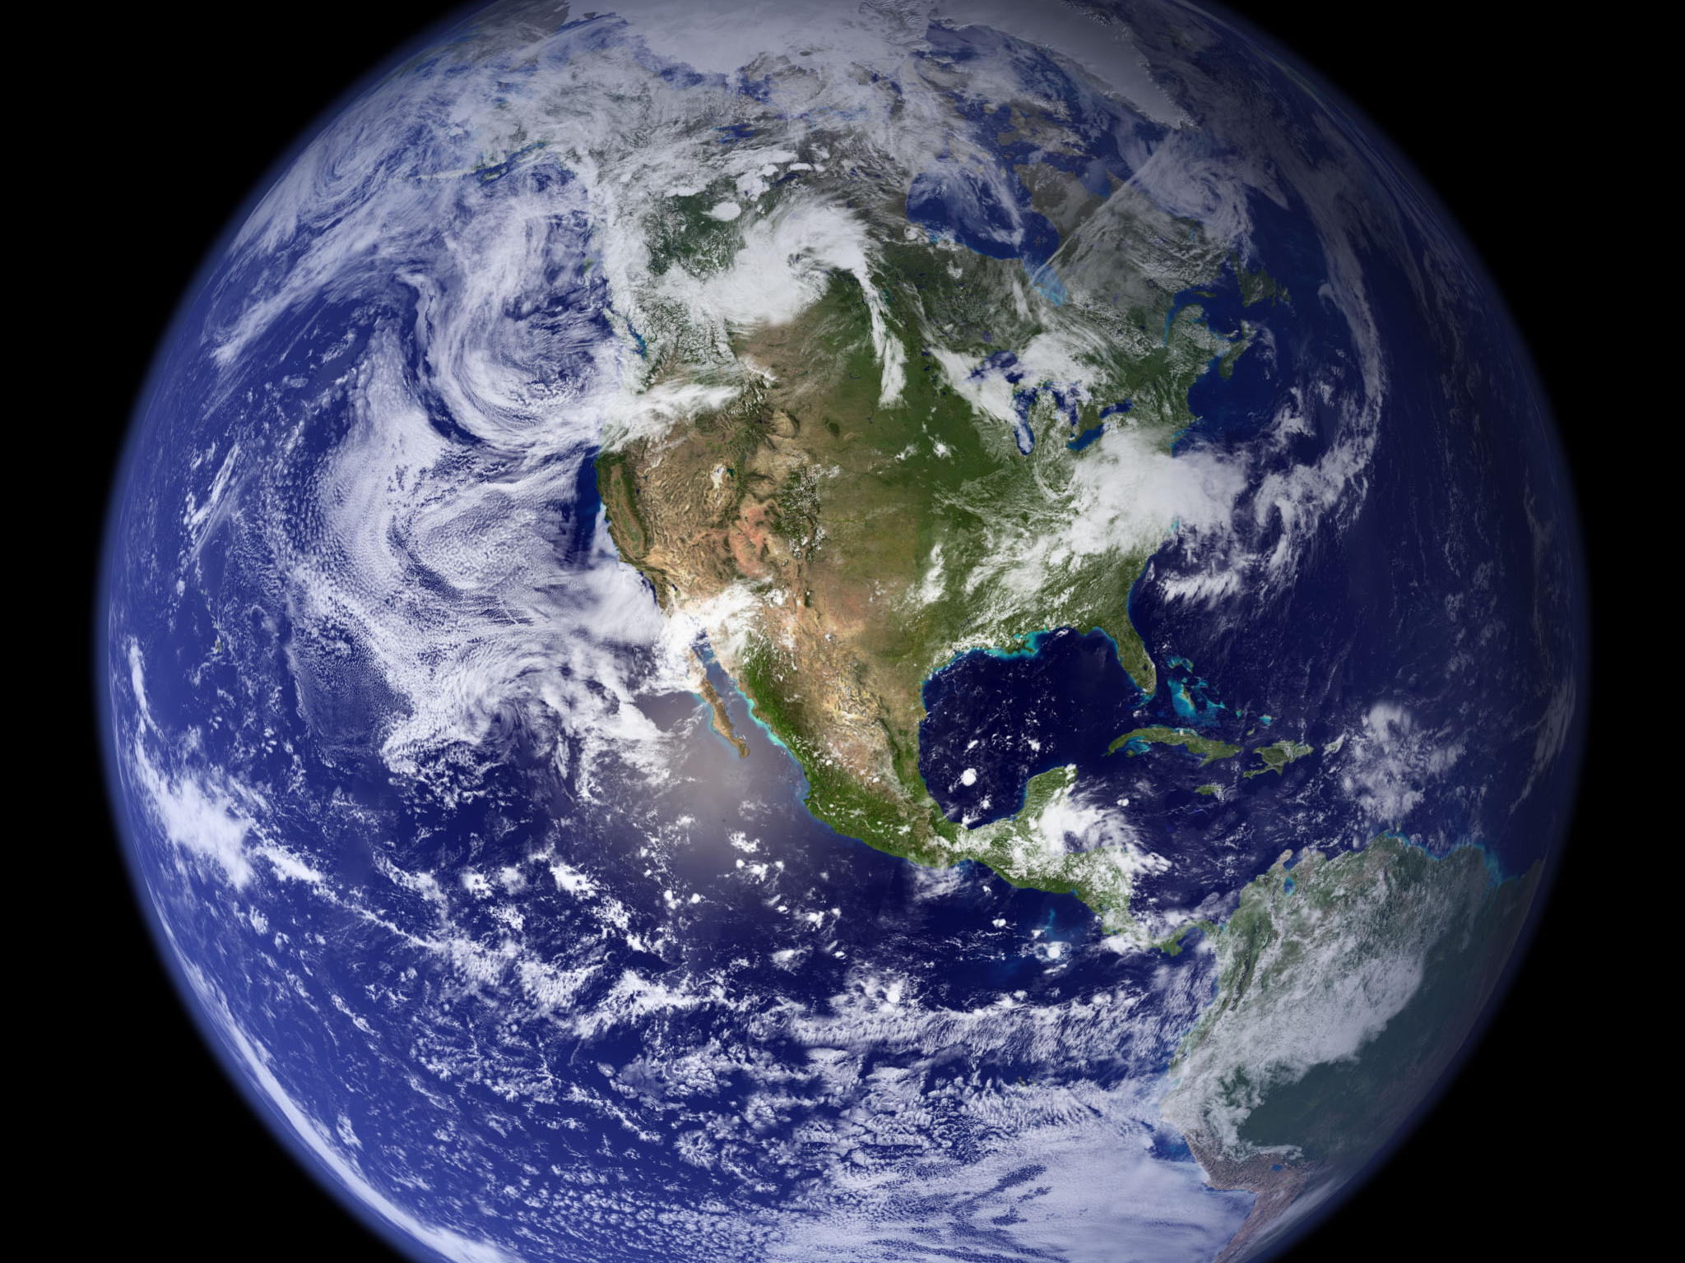
Image courtesy of NASA/GSFC

Slide 2
Climate Change and Crop Production in the US Midwest and Globally
Eugene S. Takle
Professor
Department of Agronomy
Director, Climate Science Program
Iowa State University
Ames, IA 50011
Pioneer Hybrid
Johnston, IA
8 September 2011

Slide 3
Outline
Observed changes in Midwest climate
Projected future changes in temperatures and precipitation
Ipwa farmer adaptation to climate change
AgMIP, CORDEX

Slide 4
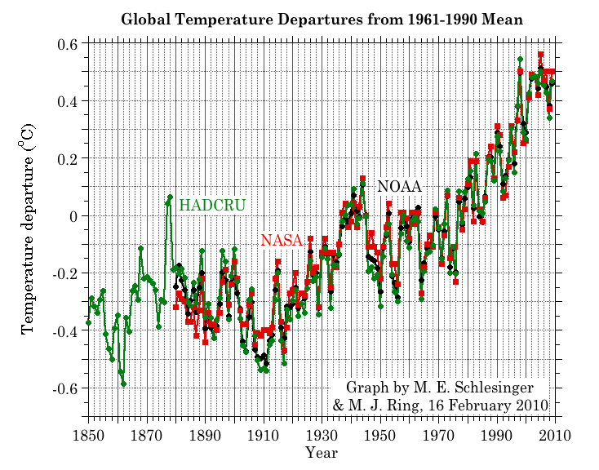
Three separate analyses of the temperature record – Trends are in close agreement
2010 has tied 2005 as the warmest year on record since 1880

Slide 5
First Date Iowa’s Average Fall 4-inch Soil Temperature Was Below 50ºF
Iowa Environmental Mesonet 2010

Slide 6
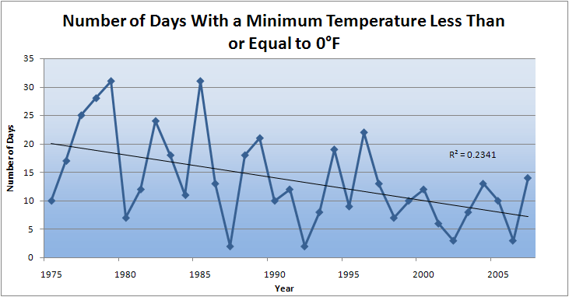
Des Moines Airport Data
Caution: Not corrected for urban heat island effects

Slide 7
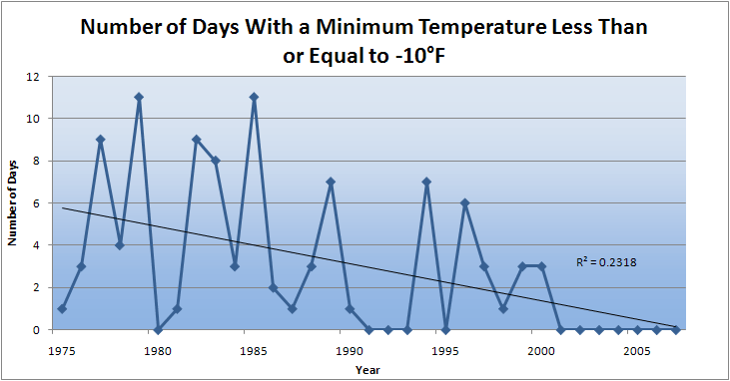
Des Moines Airport Data
Caution: Not corrected for urban heat island effects

Slide 8
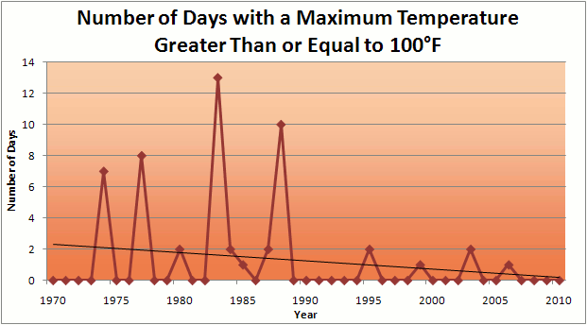
Des Moines Airport Data
1983: 13
1988: 10
1977: 8
6 days ≥ 100ºF in the last 22 years

Slide 9
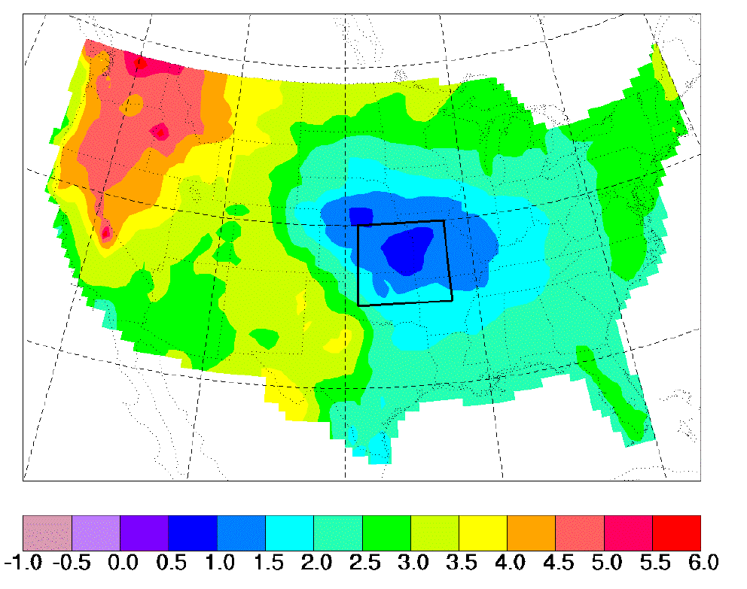
“Warming Hole”:
Regional climate model simulations of changes in daily maximum summertime temperatures between 1990s and 2040s
ΔT_{max} (JJA)
˚C
    Pan, Z., R. W. Arritt, E. S. Takle, W. J. Gutowski, Jr., C. J. Anderson, and M. Segal,2004: Altered hydrologic feedback in a warming climate introduces a “warming hole”. Geophys. Res. Lett.31, L17109, doi:10.1029/2004GL020528.
Notes:
A feature that corresponds to later 20th century trends. Not seen in GCMs. Linked to mesoscale circulation.

Slide 10
Observed Summer (JJA) Daily Maximum Temperature
Changes (K), 1976-2000
Adapted from Folland et al. [2001]

Slide 11
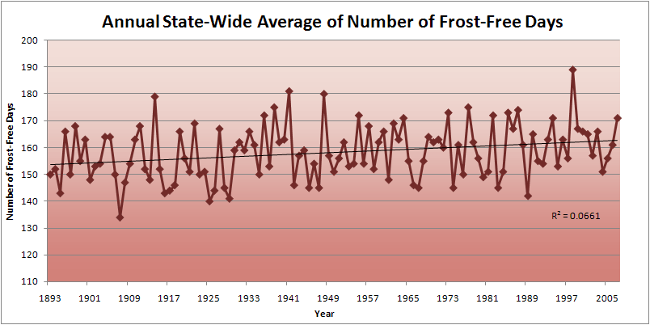
Iowa State-Wide Average Data

Slide 12
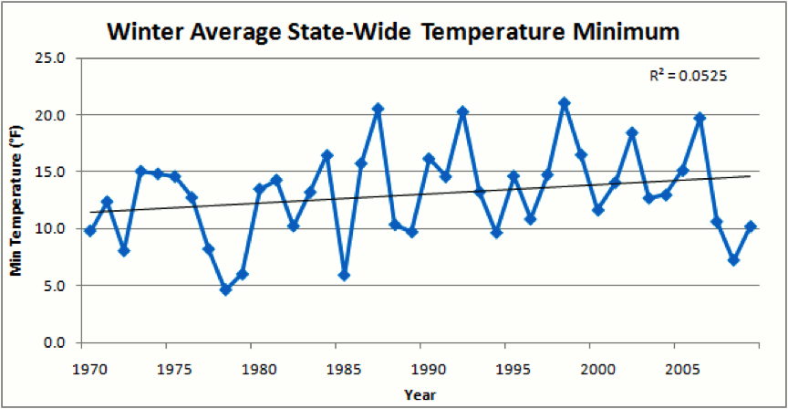
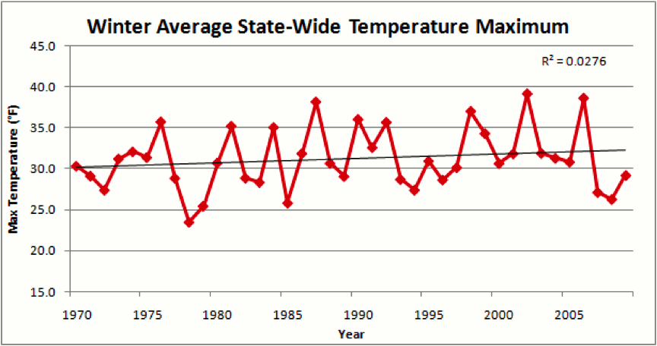
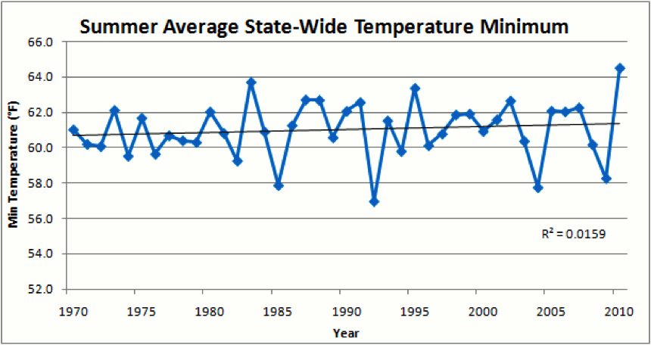
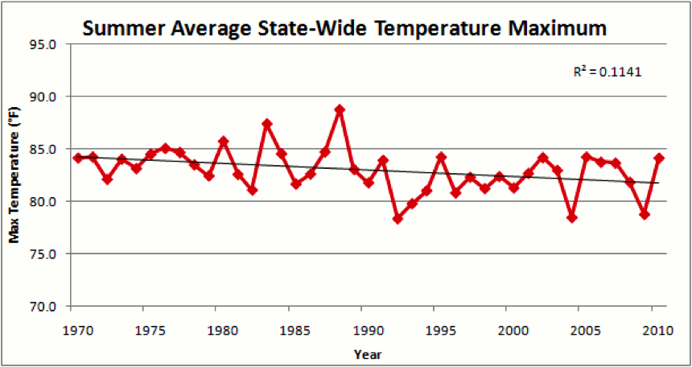

Slide 14
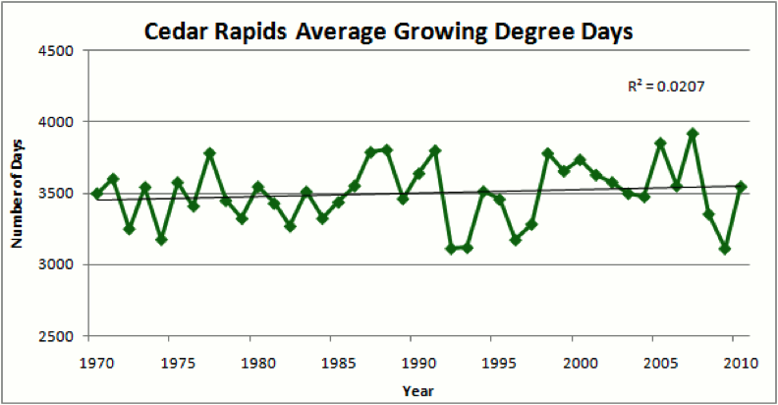
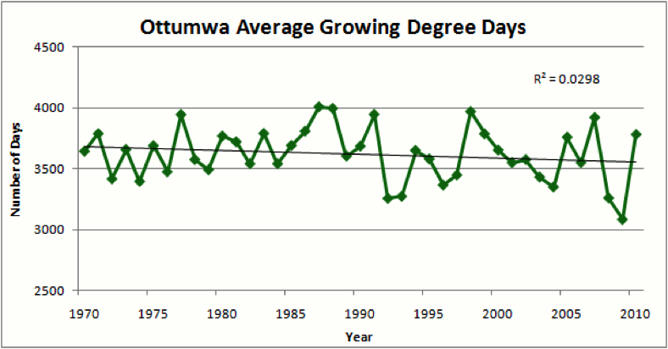
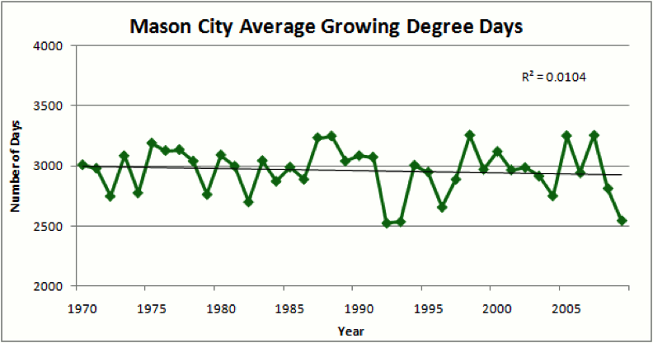
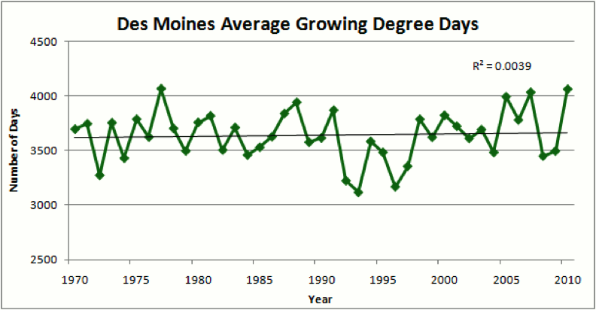

Slide 15
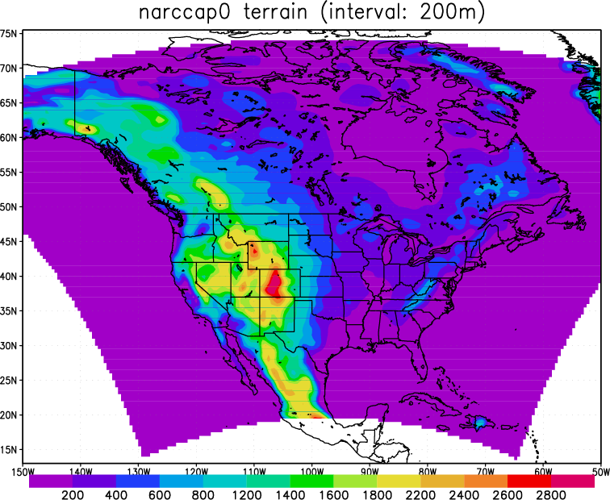
North American Regional
Climate Change
Assessment Program
Domain
Notes:
Subregions based on considerations of differing factors that determine local climate across North America.

Slide 16
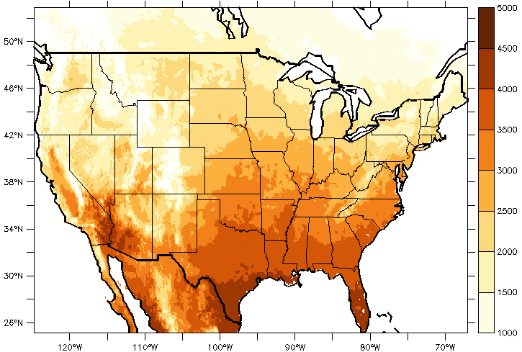
VIC average (1981-1999) number of GDD base 50F
during growing season (Apr-Aug)

Slide 17
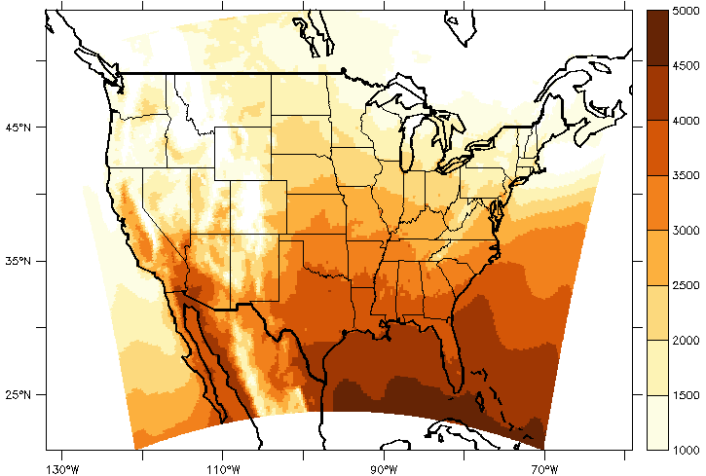
WRF24KF average (1981-1999) number of GDD base 50F
during growing season (Apr-Aug)

Slide 18
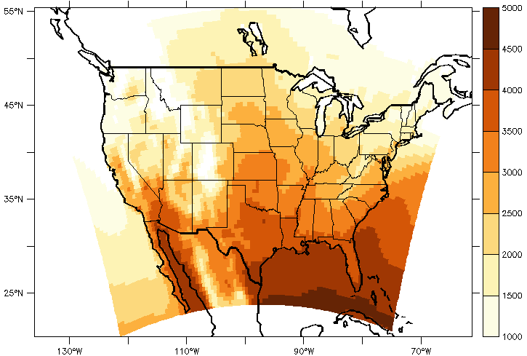
WRFG average (1981-1999) number of GDD base 50F
during growing season (Apr-Aug)

Slide 19
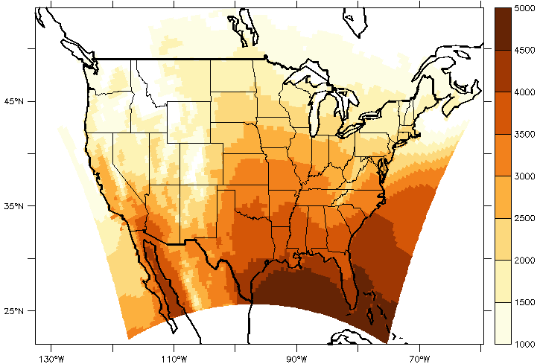
CRCM average (1981-1999) number of GDD base 50F
during growing season (Apr-Aug)

Slide 20
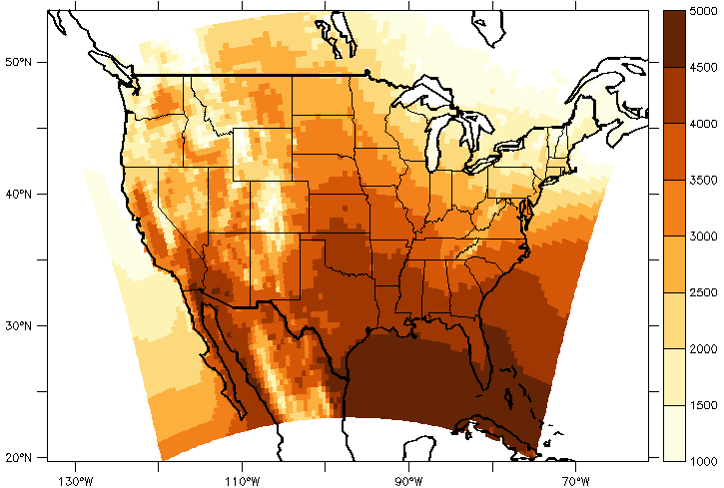
HRM3 average (1981-1999) number of GDD base 50F
during growing season (Apr-Aug)

Slide 21
WRF24KF
WRFG
2000
2500
VIC
2500
3000
2500
2500
3000
2500
3000
3000
CRCM
HRM3

Slide 22
Summer (JJA) Cloud Cover, Des Moines

Slide 23
Summer (JJA) Cloud Cover, Cedar Rapids
(Pre ASOS Installation)

Slide 24
Summer (JJA) Cloud Cover, Mason City
(Pre ASOS Installation)

Slide 25
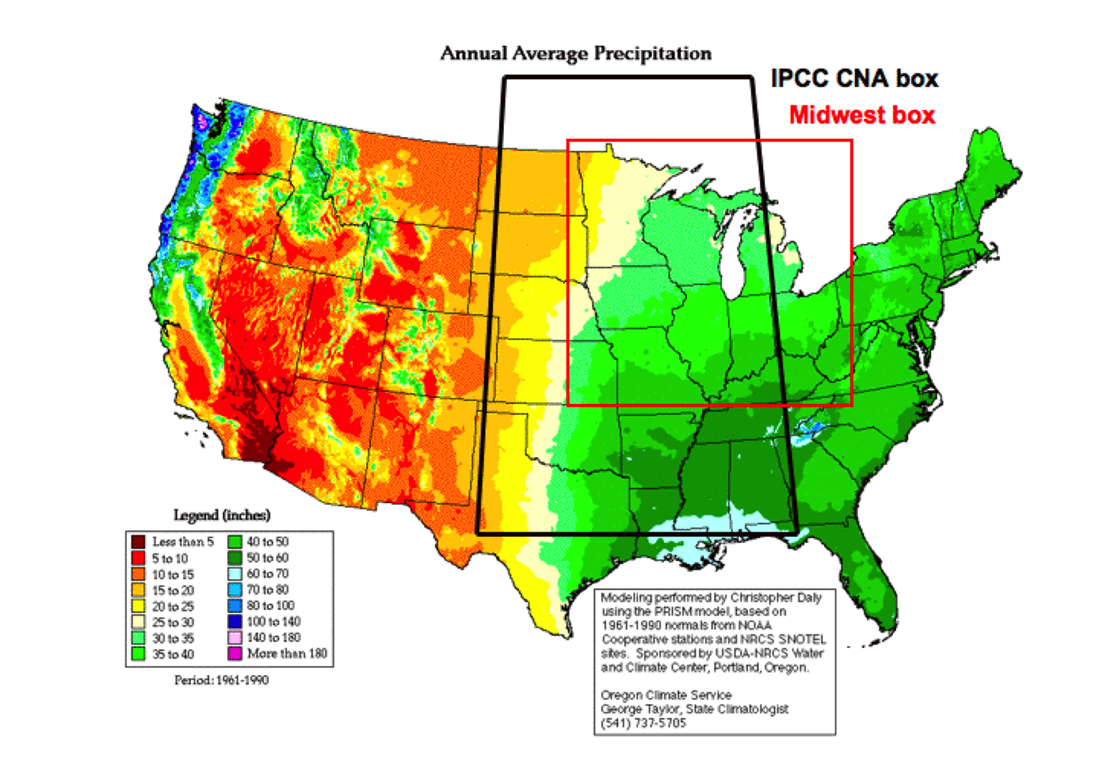

Slide 26
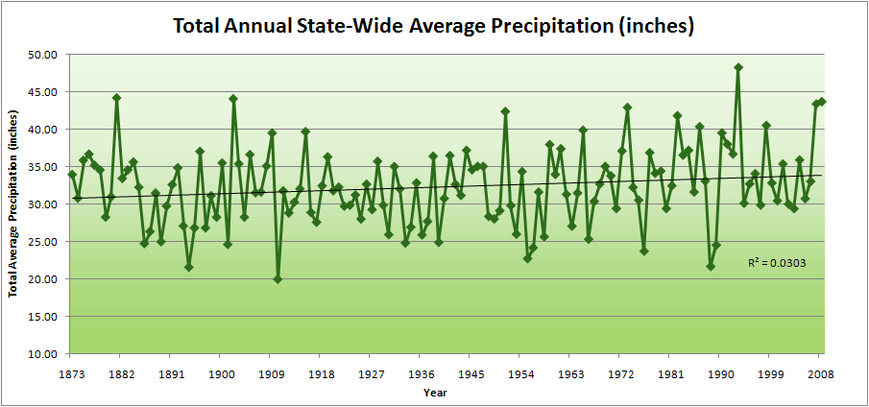
Iowa State-Wide Average Data

Slide 27
Iowa State-Wide Average Data
34.0”
10% increase
30.8”

Slide 28
Iowa State-Wide Average Data
Totals above 40”
2 years
34.0”
10% increase
30.8”

Slide 29
Iowa State-Wide Average Data
Totals above 40”
2 years
8 years
34.0”
10% increase
30.8”

Slide 30
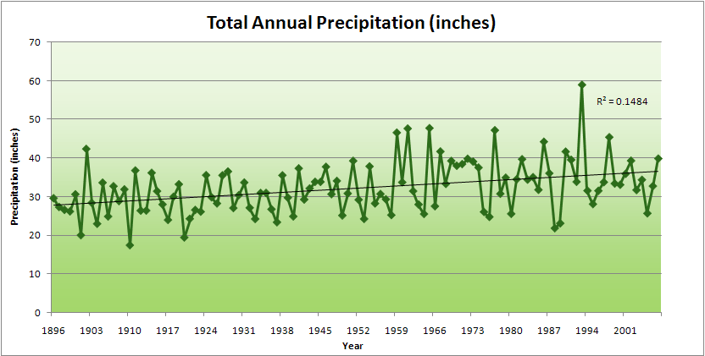
Cedar Rapids Data

Slide 31
Cedar Rapids Data
28.0”
32% increase
37.0”

Slide 32
Cedar Rapids Data
Years with more than 40 inches
1
28.0”
32% increase
37.0”

Slide 33
Cedar Rapids Data
Years with more than 40 inches
11
1
28.0”
32% increase
37.0”

Slide 34
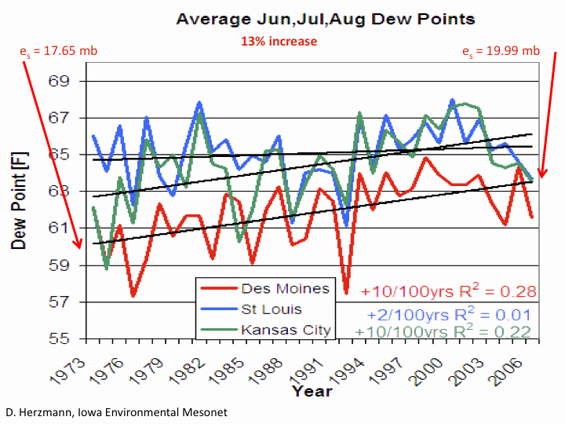

Slide 35
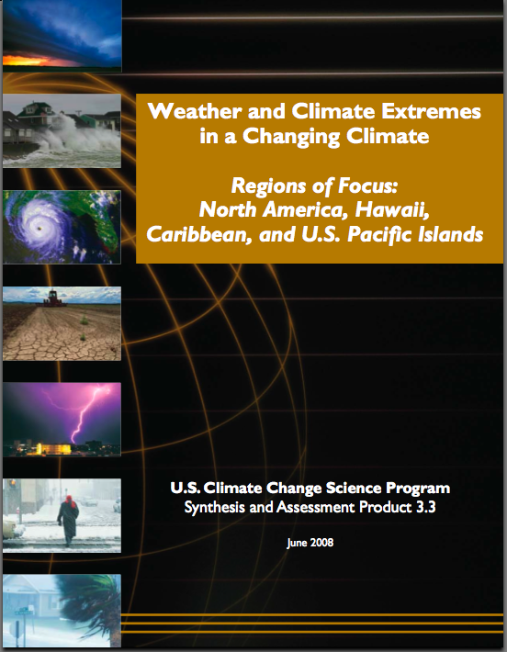
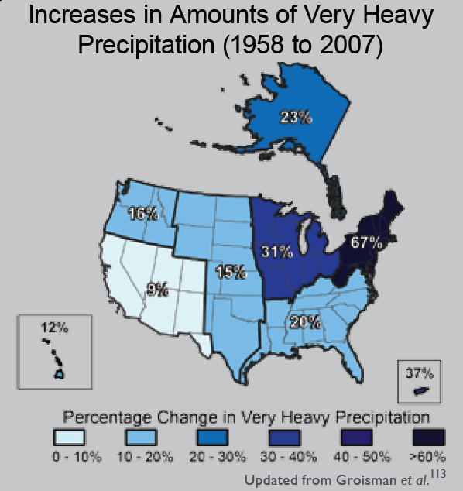
“One of the clearest trends in the United States observational record is an increasing frequency and intensity of heavy precipitation events… Over the last century there was a 50% increase in the frequency of days with precipitation over 101.6 mm (four inches) in the upper midwestern U.S.; this trend is statistically significant “
Karl, T. R., J. M. Melillo, and T. C. Peterson, (eds.), 2009: Global Climate Change Impacts in the United States. Cambridge University Press, 2009, 196pp.

Slide 36
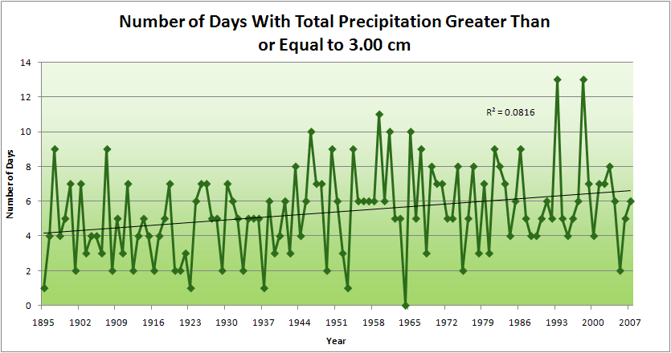
Cedar Rapids Data
1.25 inches
4.2 days
57% increase
6.6 days

Slide 37
Cedar Rapids Data
1.25 inches
Years having more than 8 days
13
2
4.2 days
57% increase
6.6 days

Slide 38
Years with more than 40 inches: 43% Increase

Slide 39
3.7
41% Increase
5.2

Slide 40
Years having more than 8 days
7
350% Increase
2
3.7
41% Increase
5.2

Slide 41
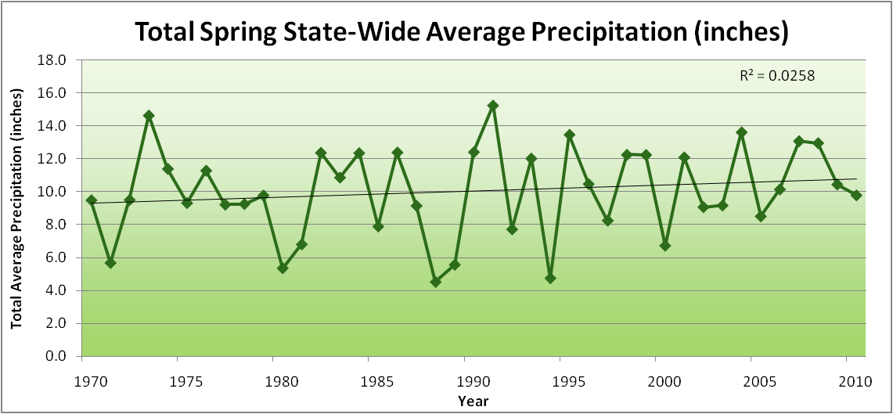
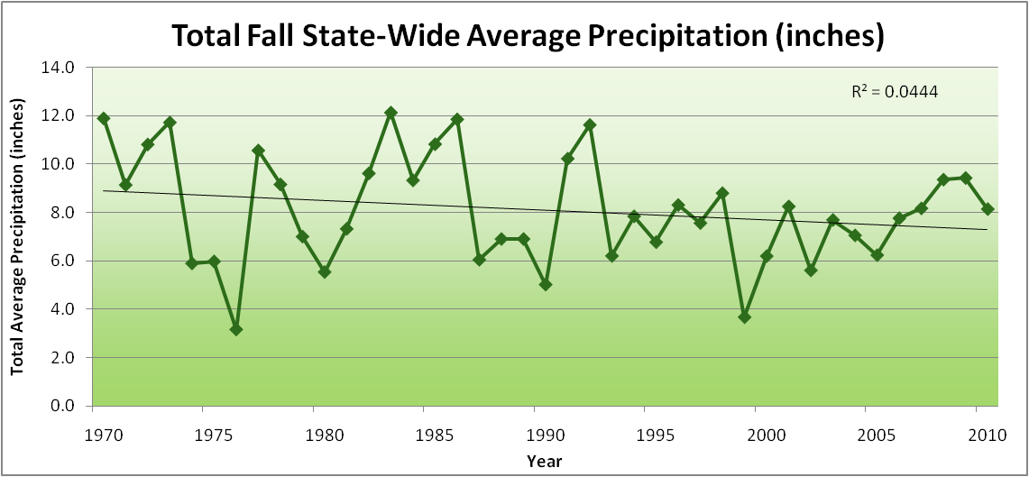
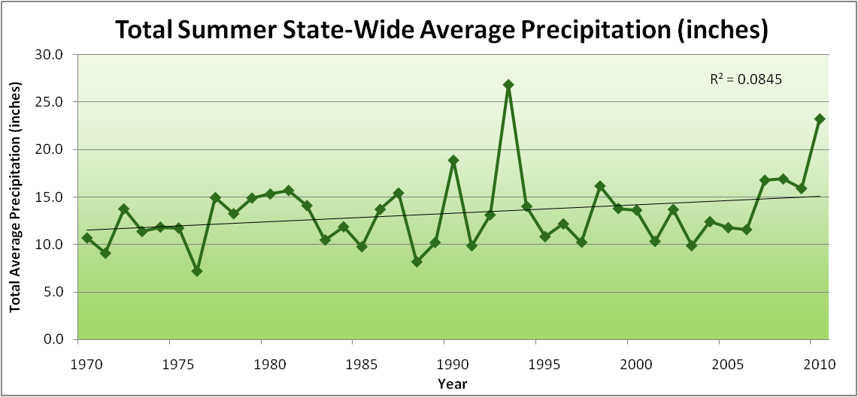
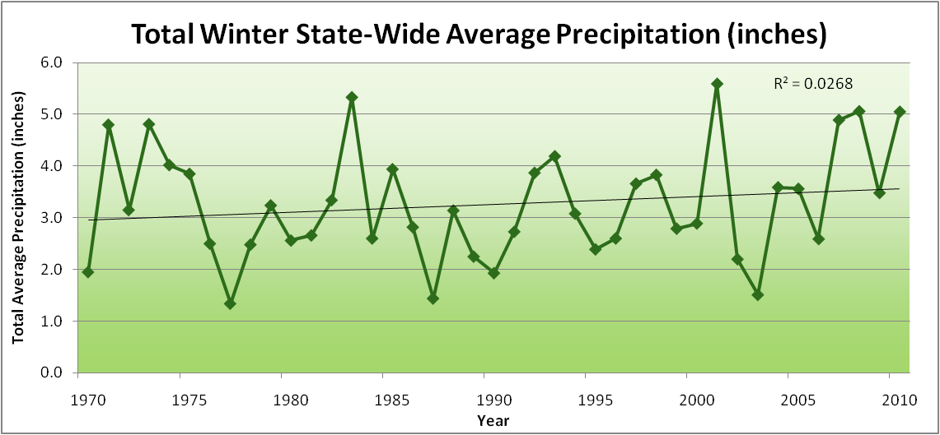
Amplification of the Seasonality of Precipitation
Spring
Fall
Summer
Winter

Slide 42
Amplification of the Seasonality of Precipitation
Spring
Fall
Summer
Winter

Slide 43
Amplification of the Seasonality of Precipitation
Spring
Fall
Summer
Winter

Slide 44
Amplification of the Seasonality of Precipitation
Spring
Fall
Summer
Winter

Slide 45
Amplification of the Seasonality of Precipitation
Spring
Fall
Summer
Winter

Slide 46
Amplification of the Seasonality of Precipitation
Spring
Fall
Summer
Winter

Slide 47
Amplification of the Seasonality of Precipitation
Spring
Fall
Summer
Winter

Slide 48
Amplification of the Seasonality of Precipitation
Spring
Fall
21.2 => 25.3 inches (22% increase)
12.1 => 10.5 inches (13% decrease)
Summer
Winter

Slide 49
Climate trends of the recent past have low statistical significance. Nevertheless, they have forced significant agricultural adaptation:

Slide 50
Climate trends of the recent past have low statistical significance. Nevertheless, they have forced significant agricultural adaptation:
Even climate trends of low statistical significance can have impacts of high agricultural significance

Slide 52
Iowa agricultural producers already are spending money to adapt to climate change:
Longer growing season: plant earlier, plant longer season hybrids, harvest later
Wetter springs: larger machinery enables planting in smaller weather windows
More summer precipitation: higher planting densities for higher yields
Wetter springs and summers: more subsurface drainage tile is being installed, closer spacing, sloped surfaces
Fewer extreme heat events: higher planting densities, fewer pollination failures
Higher humidity: more spraying for pathogens favored by moist conditions. more problems with fall crop dry-down, wider bean heads for faster harvest due to shorter harvest period during the daytime.
Drier autumns: delay harvest to take advantage of natural dry-down conditions
HIGHER YIELDS!!
Is it genetics or climate? Likely some of each.

Slide 53
Visioning Future Climate Change for Agriculture

Slide 54
Visioning Future Climate Change for Agriculture
You are here

Slide 55
Visioning Future Climate Change for Agriculture
You are here
Today

Slide 56
Visioning Future Climate Change for Agriculture
You are here
Today
Past

Slide 57
Visioning Future Climate Change for Agriculture
You are here
Today
Past
Future

Slide 58
Visioning Future Climate Change for Agriculture
You are here
?
Today
Past
Future

Slide 59
You be the scientist: For which hypothesis of the future can you find the most evidence?
?
Some Climate Variable (temp, precip, humid)
Today
Past
Future

Slide 60
You be the scientist: For which hypothesis of the future can you find the most evidence?
Some Climate Variable (temp, precip, humid)
Measured past
Today
Past
Future

Slide 61
You be the scientist: For which hypothesis of the future can you find the most evidence?
Some Climate Variable (temp, precip, humid)
Future will return to something in the past
Measured past
Today
Past
Future

Slide 62
You be the scientist: For which hypothesis of the future can you find the most evidence?
Future will be like average of the past
Some Climate Variable (temp, precip, humid)
Future will return to something in the past
Measured past
Today
Past
Future

Slide 63
You be the scientist: For which hypothesis of the future can you find the most evidence?
Future will be like today
Future will be like average of the past
Some Climate Variable (temp, precip, humid)
Future will return to something in the past
Measured past
Today
Past
Future

Slide 64
You be the scientist: For which hypothesis of the future can you find the most evidence?
Current trend will continue
Future will be like today
Future will be like average of the past
Some Climate Variable (temp, precip, humid)
Future will return to something in the past
Measured past
Today
Past
Future

Slide 65
You be the scientist: For which hypothesis of the future can you find the most evidence?
Future will be more extreme than today
Current trend will continue
Future will be like today
Future will be like average of the past
Some Climate Variable (temp, precip, humid)
Future will return to something in the past
Measured past
Today
Past
Future

Slide 66
You be the scientist: For which hypothesis of the future can you find the most evidence?
Future will be more extreme than today
Current trend will continue
Future will be like today
Future will be like average of the past
Some Climate Variable (temp, precip, humid)
Future will return to something in the past
Measured past
Today
Past
Future

Slide 67
You be the scientist: For which hypothesis of the future can you find the most evidence?
Some Climate Variable (temp, precip, humid)
Measured past
Today
Past
Future

Slide 68
My View
Natural year-to-year variability
will dominate changes in climate
over the next 10-15 years
A Prudent View of the Future
Some Climate Variable (temp, precip, humid)
Measured past
Today
Past
Future

Slide 69
Future Challenges to Adaptation in the US Midwest (near term):
Wetter spring and early summer:
    Delayed planting
    Shallow rooting
More frequent and higher-intensity extreme rain events:
    Water-logged soils
    Lack of oxygen to roots
    More ponding (rural roads are becoming levees)
    Additional installation of subsurface tile drainage is inundating downstream urban areas
    Loss of nitrogen
Higher daily average temperatures (due to higher night-time temperatures):
    Differential acceleration of reproductive processes: pollination failure
    During grain-filling periods leads to higher nighttime respiration and reduced grain weight
    Loss of soil carbon
Increased humidity:
    More pressure from pests and pathogens
    Multiple stressors

Slide 70
Future Challenges to Adaptation in the US Midwest (long-term, occasional short-term):
Drought pattern from the west or south spills into Midwest:
    Underlying warming of the last 40 years caused by rise in CO₂ that has been buffered by high evaporative and transpiration cooling is unmasked
    High plant populations not sustainable on reduced moisture
    Prairie fires
    Wind erosion of soils
Overwintering of pests and pathogens formerly not able to survive extreme cold temperatures

Slide 71
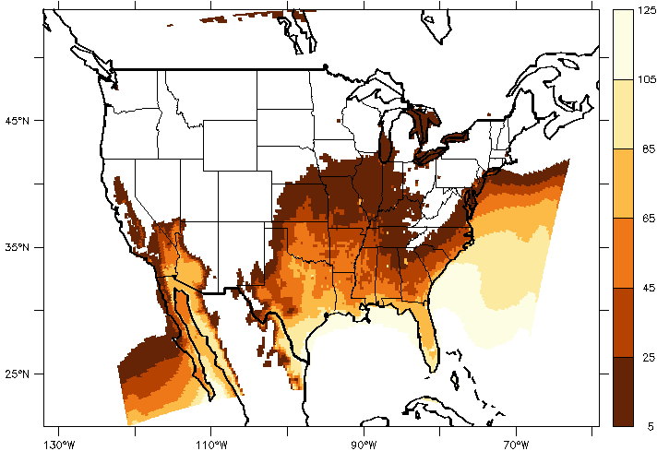
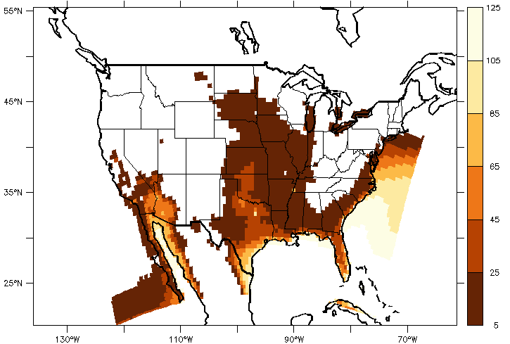
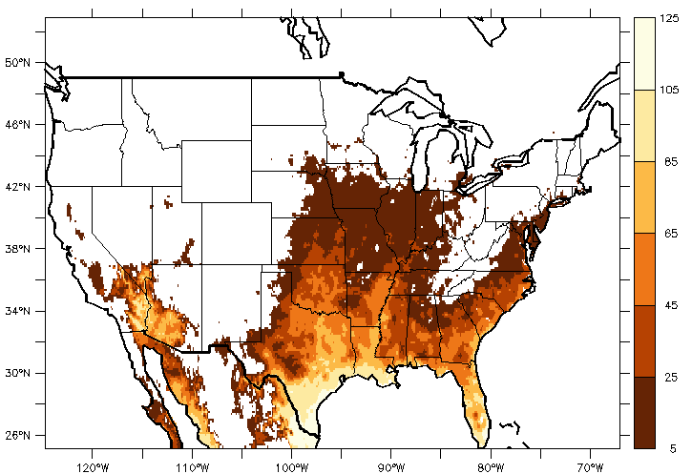
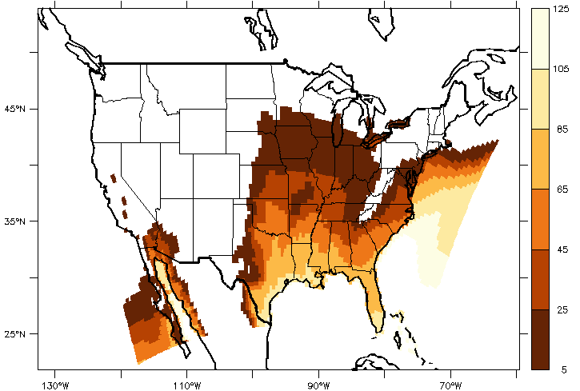
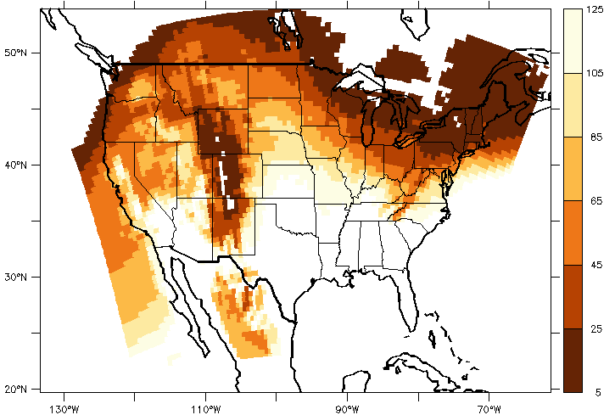
WRF24KF
WRFG
Apr-Aug days with
Tmin> 70F
1981-1999
VIC
CRCM
HRM3

Slide 72
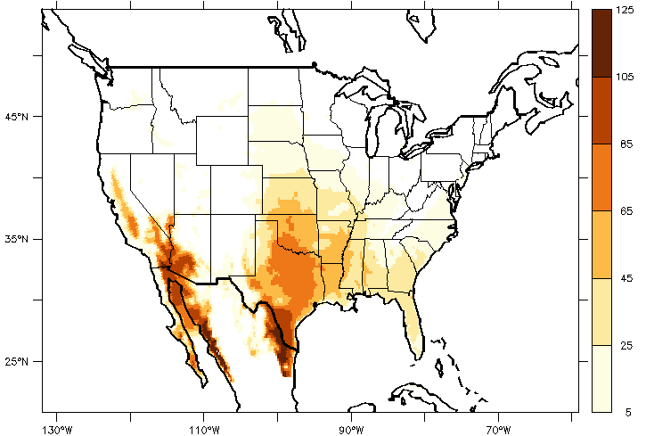
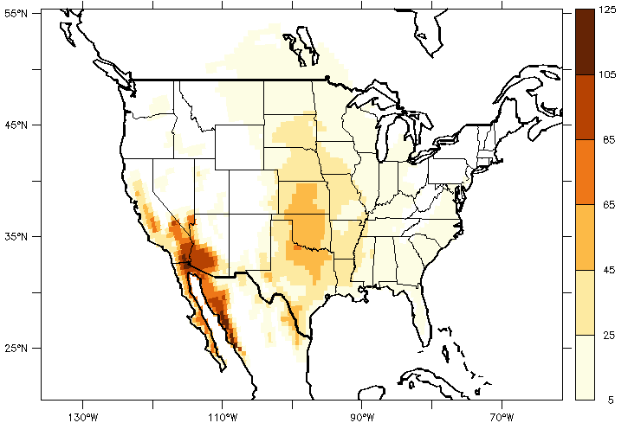
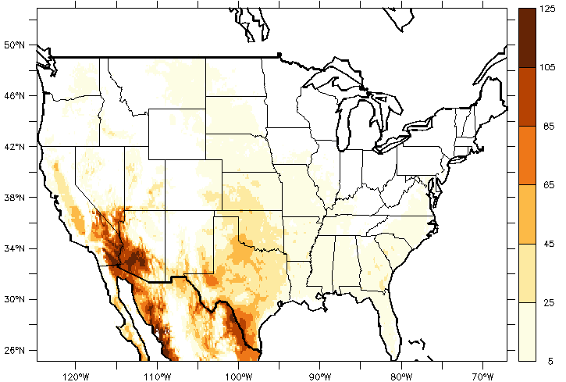
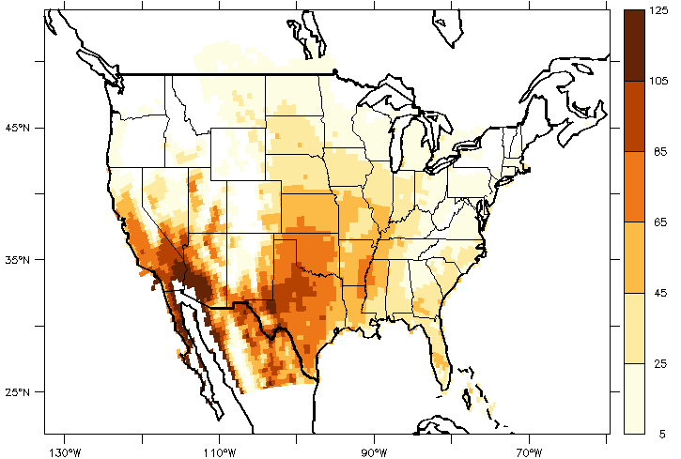
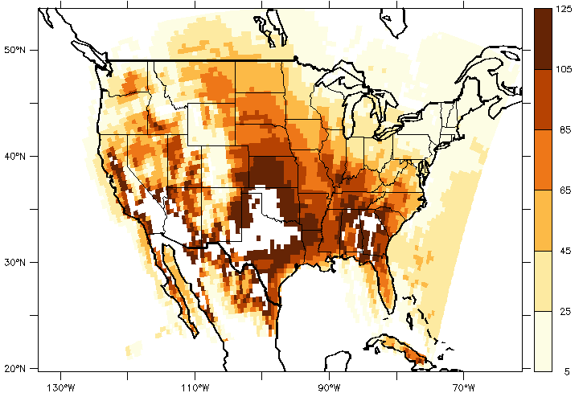
WRF24KF
WRFG
Number days with
Tmax>95F
1981-1999
VIC
CRCM
HRN3

Slide 73
Comparison of NARCCAP and BCSD
Annual T and P Change
Notes:
Quick Notes:
The NARCCAP results lie within the high density cluster of GCM A2 results. The only noticeable difference is the lack of overlap between NARCCAP and BCSD above a diagonal that runs roughly from 20%, 2.5C change to -5%, 4C change.
The NARCCAP models span a smaller range of uncertainty than the GCMs, and they do not contain any results that lie outside the range of GCMs.

Slide 74
Comparison of NARCCAP and BCSD
Annual T and P Change
Notes:
Quick Notes:
The NARCCAP results lie within the high density cluster of GCM A2 results. The only noticeable difference is the lack of overlap between NARCCAP and BCSD above a diagonal that runs roughly from 20%, 2.5C change to -5%, 4C change.
The NARCCAP models span a smaller range of uncertainty than the GCMs, and they do not contain any results that lie outside the range of GCMs.

Slide 75
Comparison of NARCCAP and BCSD
March-April-May T and P Change
Notes:
Quick Notes:
The NARCCAP results lie within the high density cluster of GCM A2 results.
The NARCCAP models span a smaller range of uncertainty than the GCMs, and they do not contain any results that lie outside the range of GCMs.

Slide 76
Comparison of NARCCAP and BCSD
January-February T and P Change
Notes:
Quick Notes:
The NARCCAP results lie within the high density cluster of GCM A2 results, and the GCM range of precipitation change is much larger than in other seasons. This might be due in part to using a 2-month rather than a three-month average.
The NARCCAP models span a smaller range of uncertainty than the GCMs, and they do not contain any results that lie outside the range of GCMs.

Slide 77
Comparison of NARCCAP and BCSD
October-November-December T and P Change
Notes:
Technical meeting of Iowa Cedar Interagency Team (18 federal agencies/NGOs). Want to ask us about addressing risk and uncertainty. For the entire watershed.
Corallville worked at sediment and streamflow/precipitation.
10 areas of assessment – different crop types, land use types, recreation, power (biofuels, hydropower), floodplain management
Reformat data
Do they need a more intensive model if they have a smaller region? And, would the climate make any difference?
5/19
A single event, relationship for 15-day pcp and streamflow is messy. Need seasonal factors. April-May is very different from August, not just an
tecedent rain, looks like uptake is critical.
If the main concern is biggest floods, that isn't happening in fall.
Very rare events have a more linear relationship but you don't have many big events.
Any event with more than 15-day cfs, giving 200 events; 15-day precipitation with travel time and some measure of antecendent wetness (15-days prior to travel time).
Next steps:
Break it into seasonal pieces; non-linear regression – Kevin
Do whatever I can with Greg to figure out the SWAT input issues. Greg will let me know what they hear ARS.
Chris will intercompare historical data going into SWAT with selected RCM datapoints.
Jason Smith – larger planning effort for Iowa-Cedar basin, more comprehensive plan (mainly flood risk management for Corps; but DNR has a different perspective).
They have to prove that putting a climate change analysis into their planning
What contribution to this project will having climate change analysis have? What can be done on a marginal cost? The benefit of the climate change must be demonstrated. Their thinking about shared vision planning – what do you want this to look like in the future? Look at measures and how they can achieve this goal, getting down to HUC-12 level. And, if they put in NRCS-type measures, can they do detailed investigations of modeling at that scale to look at Gulf Hypoxia. March up from HUC-12 to HUC-8. Watershed for learning.

Slide 78
Simulating Future Climates
with Models Trained on Current Climates
FCA
Climates
CCB
FCA=Future, region A
CCA=Current, region A
Variable or Process 2
CCB=Current, region B
Model Simulations
CCA, model 1
CCA, model 2
CCB, model 2
CCB, model 1
CCA
Fully spanning FCA requires:
More models
More domains
Variable or Process 1

Slide 80
CORDEX Regional Domains

Slide 81
For More Information
Contact me directly:
gstakle@iastate.edu
Current research on regional climate and climate change is being conducted at Iowa State University under the Regional Climate Modeling Laboratory
http://rcmlab.agron.iastate.edu/
North American Regional Climate Change Assessment Program
http://www.narccap.ucar.edu/
Climate Science Program website:
http://climate.engineering.iastate.edu/
Or just Google Eugene Takle

