Slide 1
Climate Change in the Heartland
Eugene S. Takle
Professor
Department of Agronomy
Department of Geological and Atmospheric Science
Director, Climate Science Program
Iowa State University
Ames, IA 50011
Heartland Regional Water Coordination Initiative
Climate Change and its Effect on Nutrient Management
Webcast
November 16, 2010

Slide 2
Outline
Observed global changes in carbon dioxide and temperature
Projected future changes in global and US temperatures and precipitation
Adaptation already is happening
Mitigation must be a priority
Confronting Climate Change: Avoiding the Unmanageable, Managing the Unavoidable,
Rosina Bierbaum, John P. Holdren, Michael MacCracken, Richard Moss, and Peter H. Raven.
http://www.globalproblems-globalsolutions-files.org/unf_website/PDF/climate%20_change_avoid_unmanagable_manage_unavoidable.pdf

Slide 3
Climate change is one of the most important issues facing humanity
The scientific evidence clearly indicates that our climate is changing, and that human activities have been identified as a dominant contributing cause.
Don Wuebbles
Notes:
No disagreement in peer reviewed literature
Powerful statements from every major professional science society and organization in the world
Powerful statements from the National Academies of Sciences (the leadership in science) for every major country
G8 + 5 other countries, May 2009: “The need for urgent action to address climate change is now indisputable.”

Slide 4
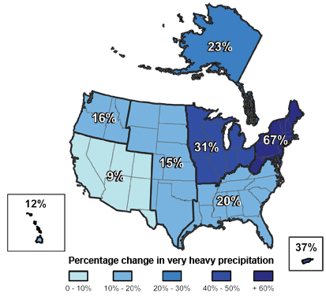
Climate changes are underway in the U.S. and are projected to grow
Temperature rise
Sea-level rise
Increase in heavy downpours
Rapidly retreating glaciers
Thawing permafrost
Lengthening growing
season
Lengthening ice-free season
in the ocean and on lakes
and rivers
Earlier snowmelt
Changes in river flows
Plants blooming earlier; animals, birds and fish moving northward
Don Wuebbles

Slide 5
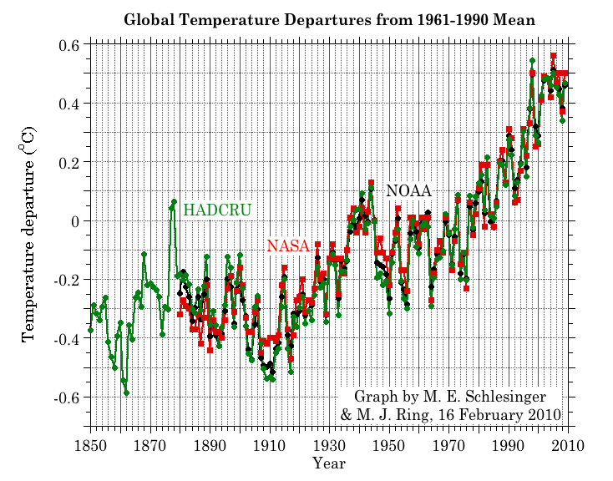
Three separate analyses of the temperature record – Trends are in close agreement
Don Wuebbles

Slide 6
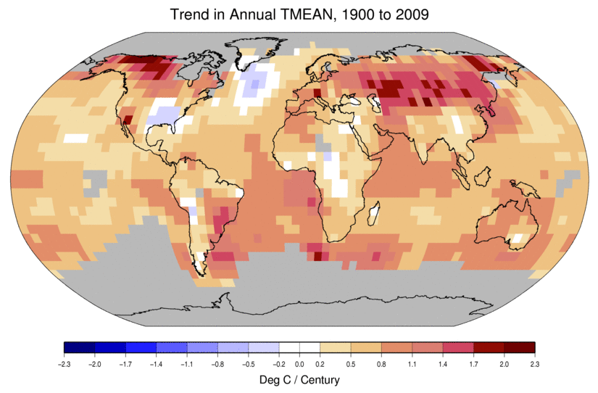
Temperature Changes are Not
Uniform Around the Globe
From Tom Karl, NOAA NCDC

Slide 7
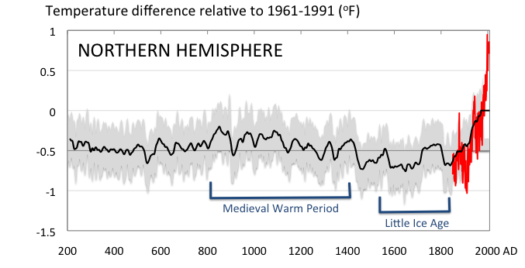
Conditions today are unusual in the context of the last 2,000 years …
Don Wuebbles

Slide 8
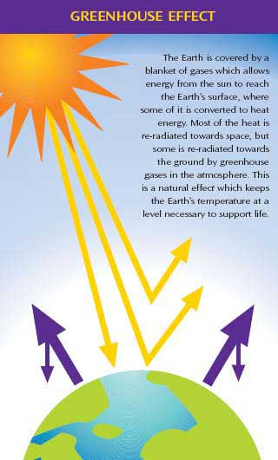
Why does the Earth warm?
1. Natural causes
THE GREENHOUSE EFFECT…
…is 100% natural.
  Heat is trapped in the atmosphere.
…sustains life on Earth.
  Keeps average temperatures at 12.8ºC (55ºF), instead of –29ºC (-20ºF).
Don Wuebbles

Slide 9
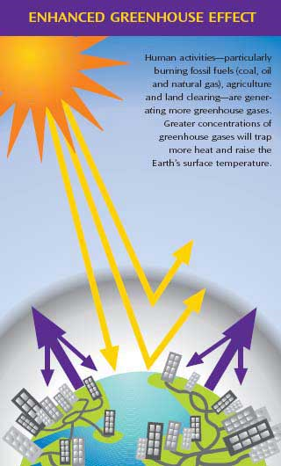
Why does the Earth warm?
2. Human causes
THE ENHANCED GREENHOUSE EFFECT
(or GLOBAL WARMING)
… is primarily human-induced: We’re increasing heat-trapping gases in the atmosphere.
… is like wrapping an extra blanket around the Earth.
Don Wuebbles

Slide 10
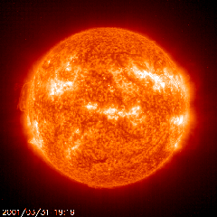
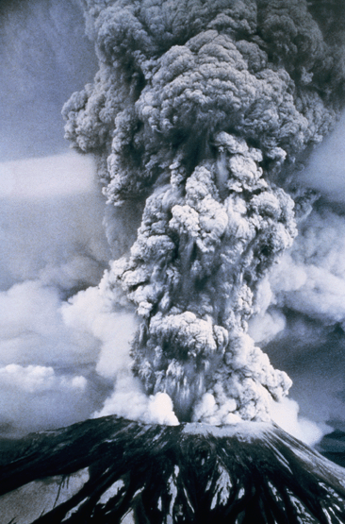
Natural factors affect climate
Variations in the energy
received from the sun
Variations in the Earth's orbit
(Milankovic effect)
Stratospheric
aerosols from
energetic
volcanic eruptions
Chaotic interactions in
the Earth's climate
(for example, El Nino, NAO)
Don Wuebbles

Slide 11
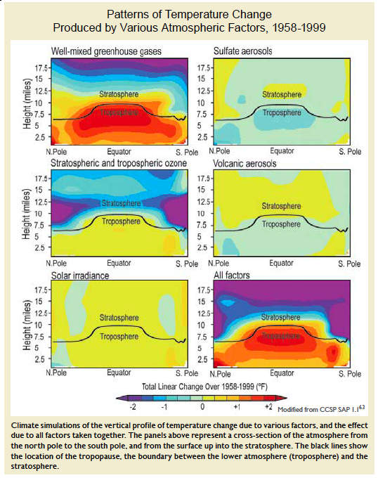
Warming of the Lower and Upper Atmosphere Produced by Natural and Human Causes
Karl, T. R., J. M. Melillo, and T. C. Peterson, (eds.), 2009: Global Climate Change Impacts in the United States. Cambridge University Press, 2009, 196pp.

Slide 12
Warming of the Lower and Upper Atmosphere Produced by Natural and Human Causes
Note that greenhouse gases have a unique temperature signature, with strong warming in the upper troposphere, cooling in the lower stratosphere and strong warming at the surface over the North Pole. No other warming factors have this signature.
Karl, T. R., J. M. Melillo, and T. C. Peterson, (eds.), 2009: Global Climate Change Impacts in the United States. Cambridge University Press, 2009, 196pp.

Slide 13
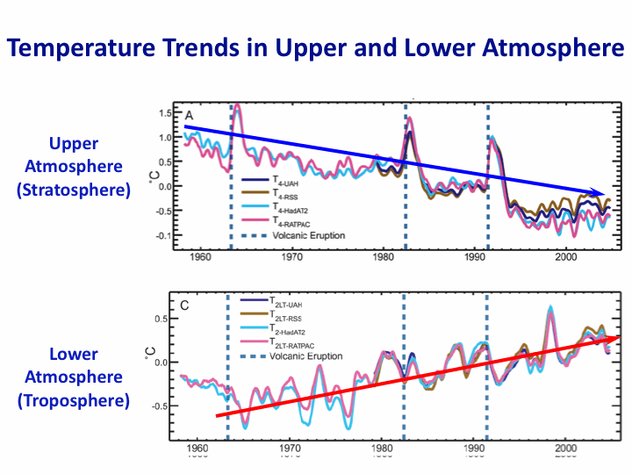
Warming of the Lower and Upper Atmosphere Produced by Natural and Human Causes
Note that greenhouse gases have a unique temperature signature, with strong warming in the upper troposphere, cooling in the lower stratosphere and strong warming at the surface over the North Pole. No other warming factors have this signature.
Karl, T. R., J. M. Melillo, and T. C. Peterson, (eds.), 2009: Global Climate Change Impacts in the United States. Cambridge University Press, 2009, 196pp.

Slide 14
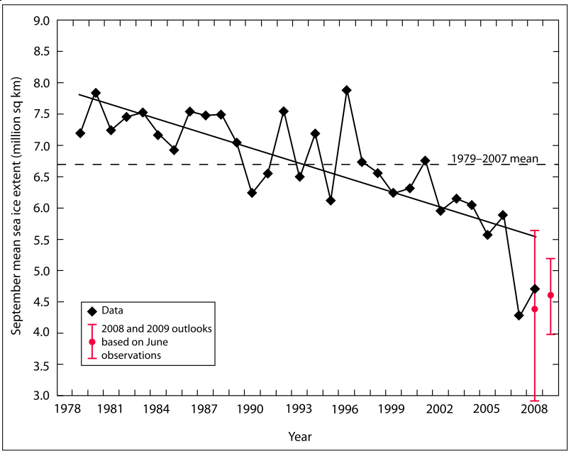
Warming of the Lower and Upper Atmosphere Produced by Natural and Human Causes
Note that greenhouse gases have a unique temperature signature, with strong warming in the upper troposphere, cooling in the lower stratosphere and strong warming at the surface over the North Pole. No other warming factors have this signature.

Slide 15
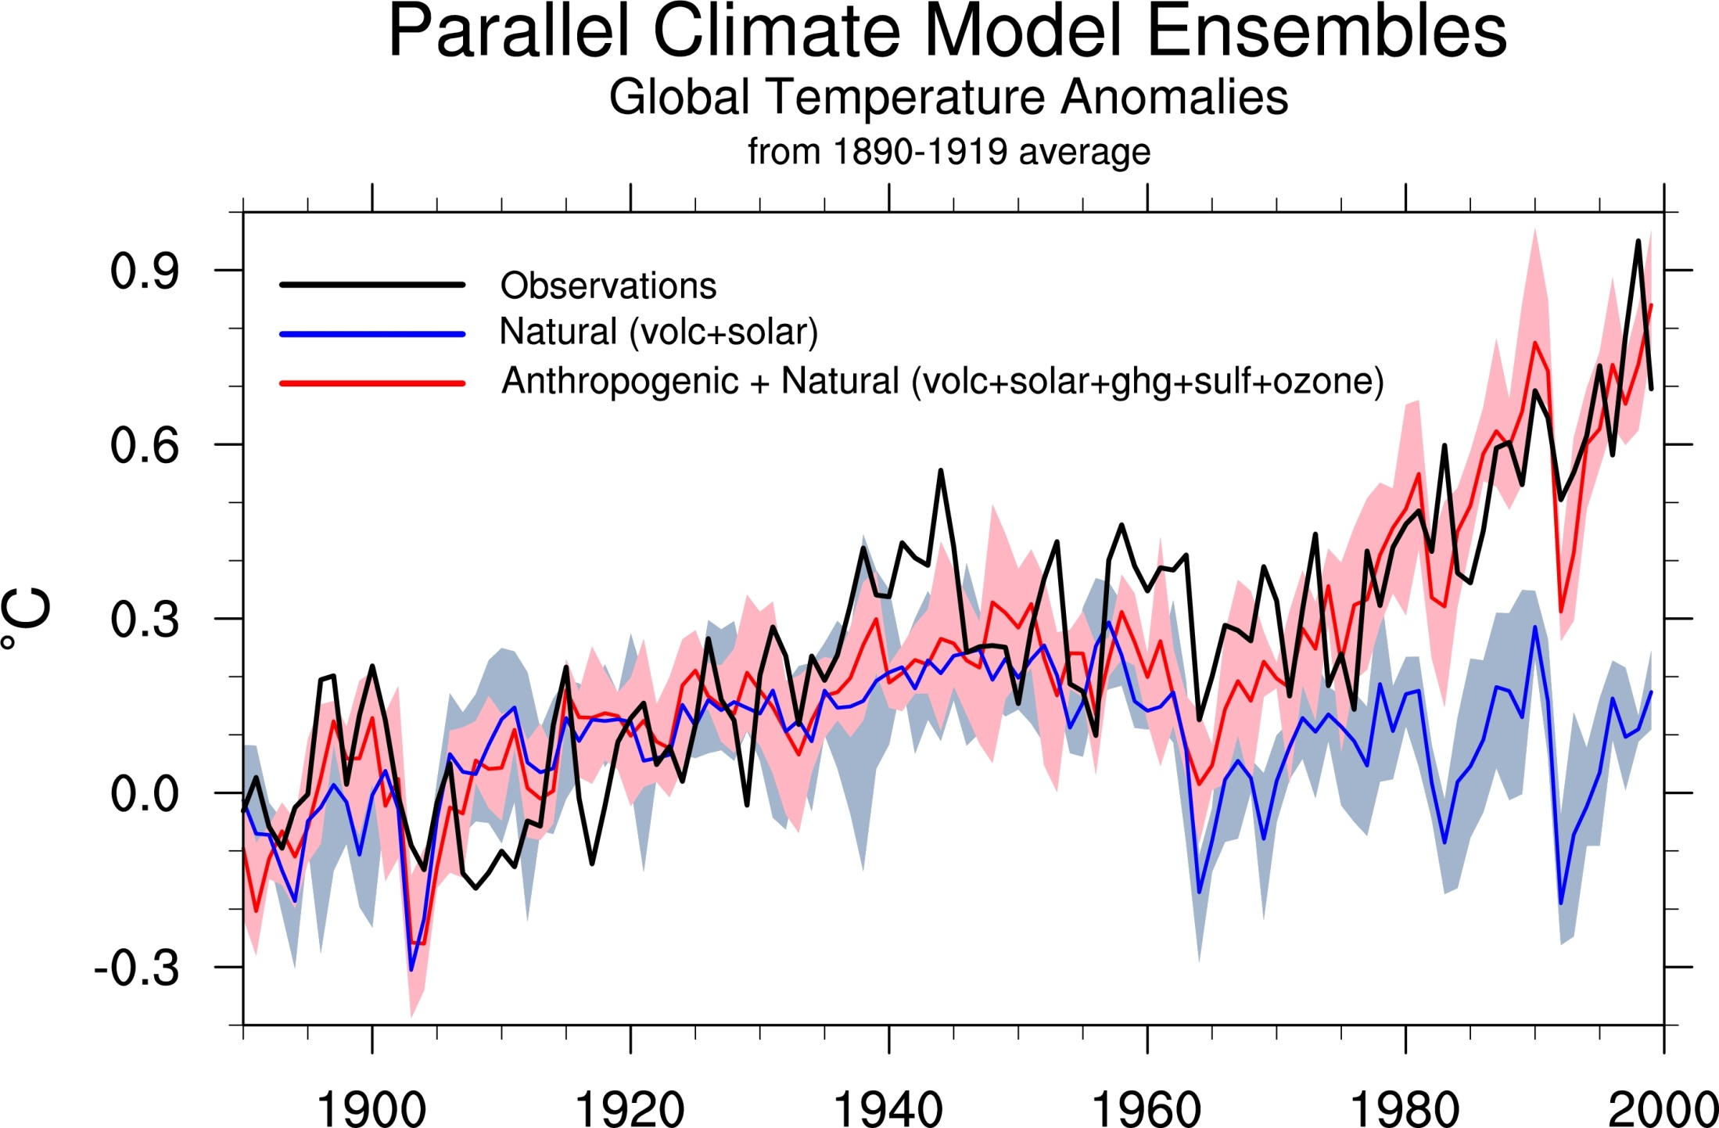
Climate models: Natural processes do not account for
observed 20th century warming after 1965

Slide 16
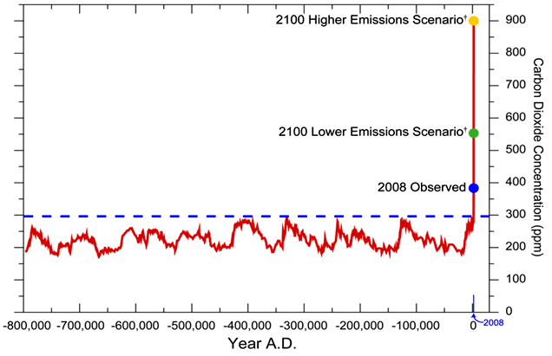
We have Moved Outside the Range of Historical Variation
800,000 Year Record of Carbon Dioxide Concentration
Don Wuebbles

Slide 17
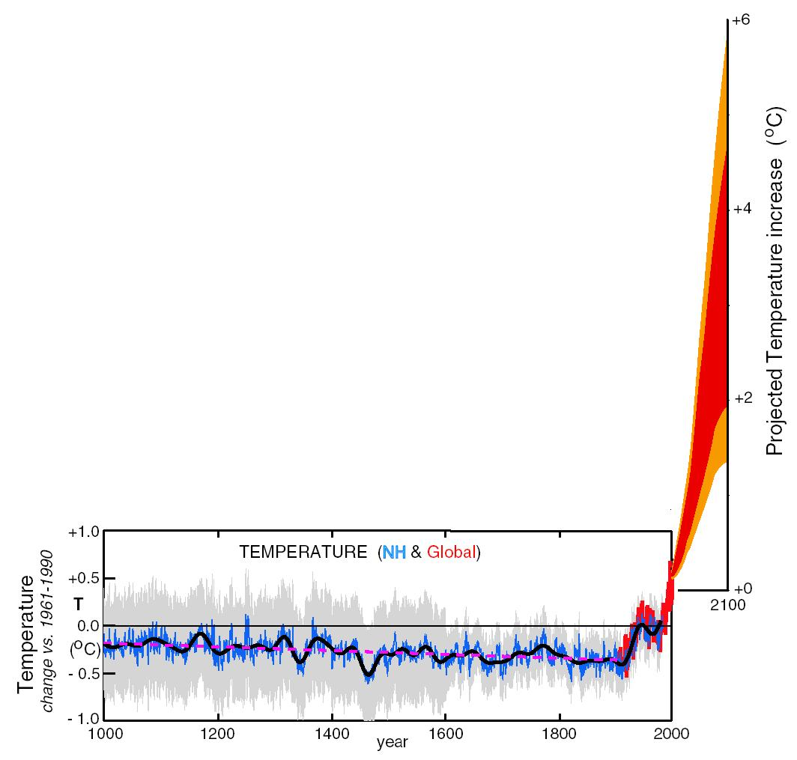
What can we expect in the future?
Don Wuebbles

Slide 18
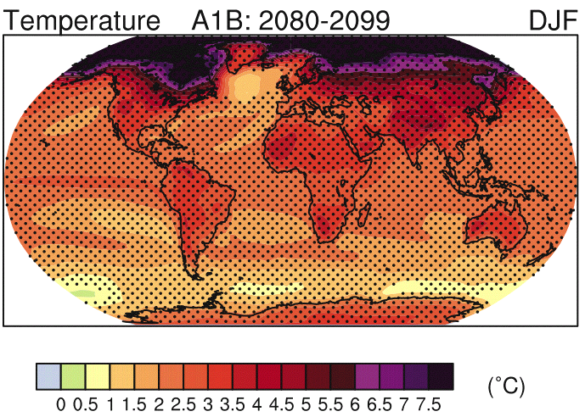
IPCC 2007

Slide 19
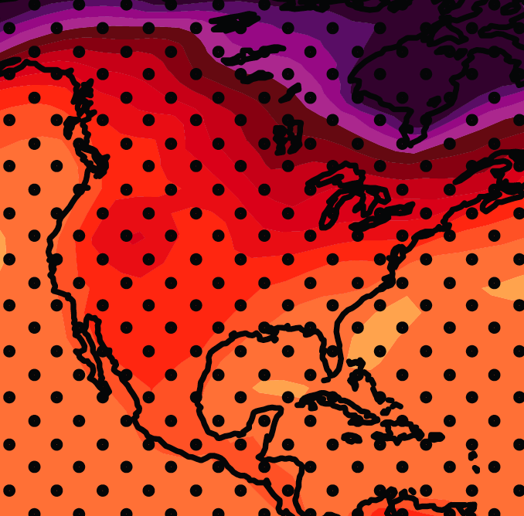
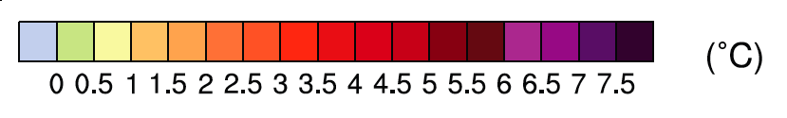
December-January-February Temperature Change
7.2ºF
6.3ºF
A1B Emission Scenario
2080-2099 minus1980-1999

Slide 20
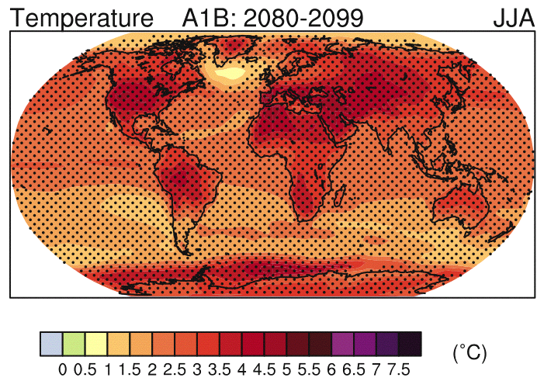
IPCC 2007

Slide 21
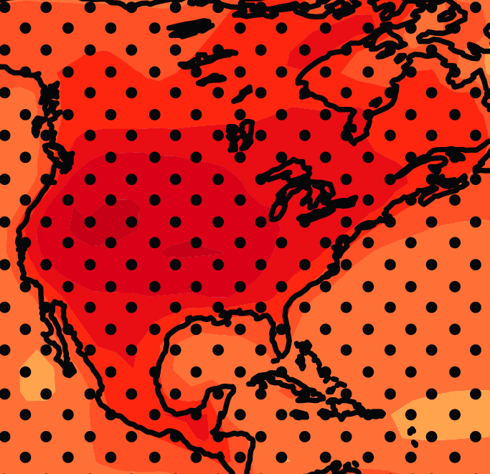
June-July-August Temperature Change
4.5ºF
5.4ºF
A1B Emission Scenario
2080-2099 minus1980-1999

Slide 22
June-July-August Temperature Change
4.5ºF
5.4ºF
A1B Emission Scenario
2080-2099 minus1980-1999
Not the direction of current trends

Slide 23
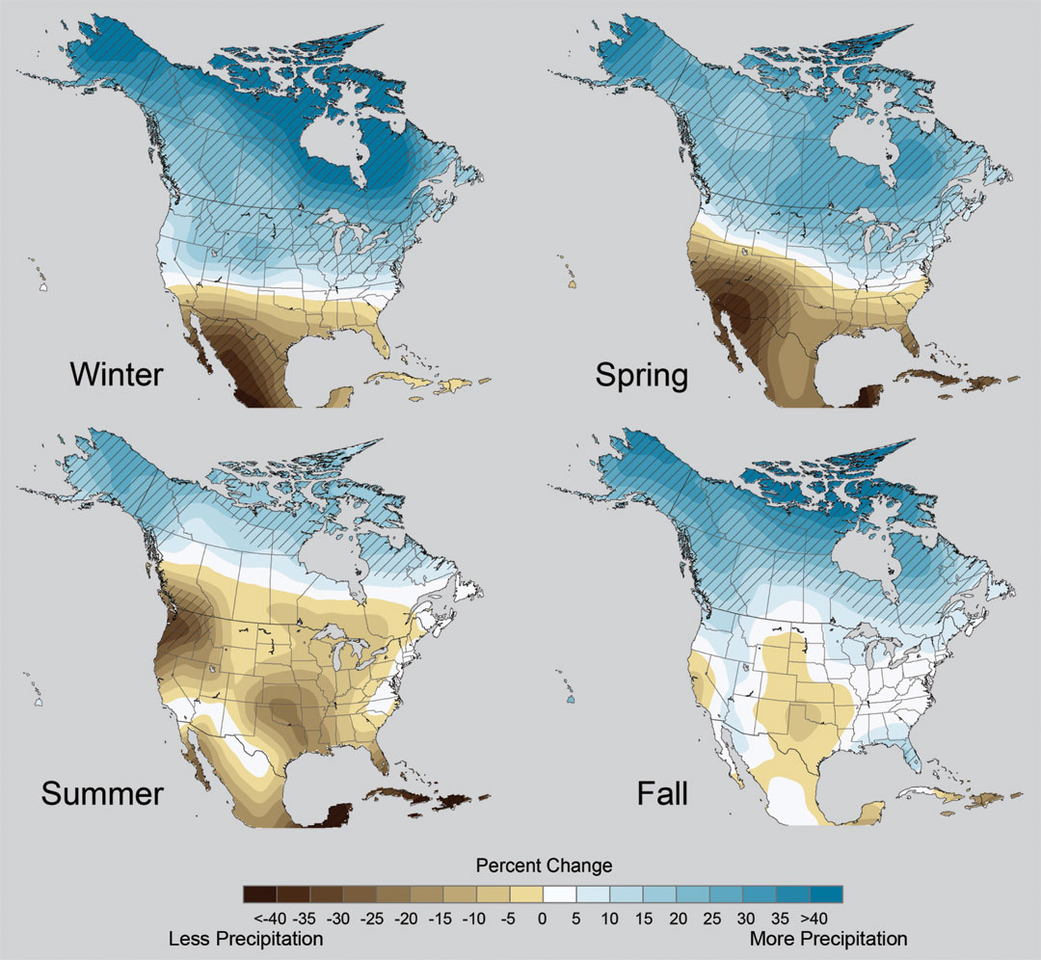
Projected Change in Precipitation: 2081-2099
Midwest: Increasing winter and spring precipitation, with drier summers
More frequent and intense periods of heavy rainfall
Unstippled regions indicate reduced confidence
Relative to 1960-1990
NOTE: Scale Reversed
Don Wuebbles

Slide 24
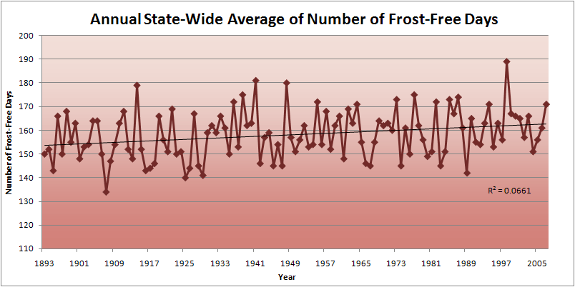
Iowa State-Wide Average Data

Slide 25
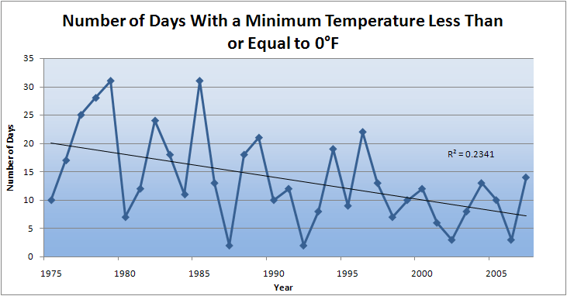
Des Moines Airport Data
Caution: Not corrected for urban heat island effects

Slide 26
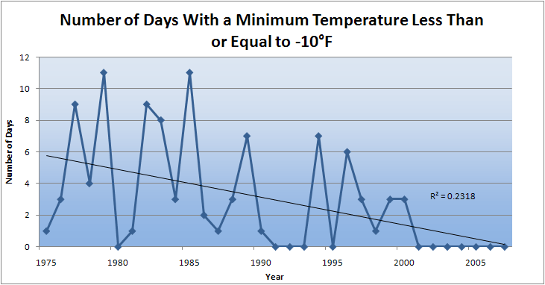
Des Moines Airport Data
Caution: Not corrected for urban heat island effects

Slide 27
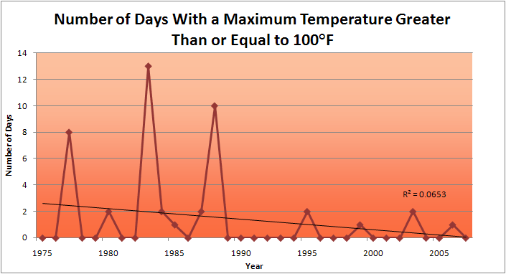
Des Moines Airport Data
1983: 13
1988: 10
1977: 8
2009: 0
2010: 0

Slide 28
Des Moines Airport Data
1983: 13
1988: 10
6 days ≥ 100ºF in the last 22 years
1977: 8
2009: 0
2010: 0

Slide 29
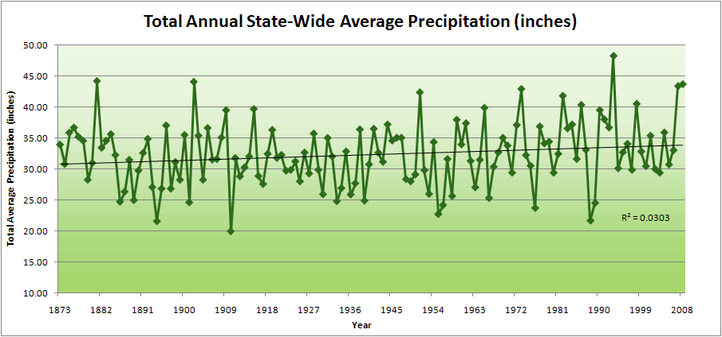
Iowa State-Wide Average Data

Slide 30
Iowa State-Wide Average Data
34.0”
10% increase
30.8”

Slide 31
Iowa State-Wide Average Data
Totals above 40”
2 years

Slide 32
Iowa State-Wide Average Data
Totals above 40”
8 years
2 years

Slide 33
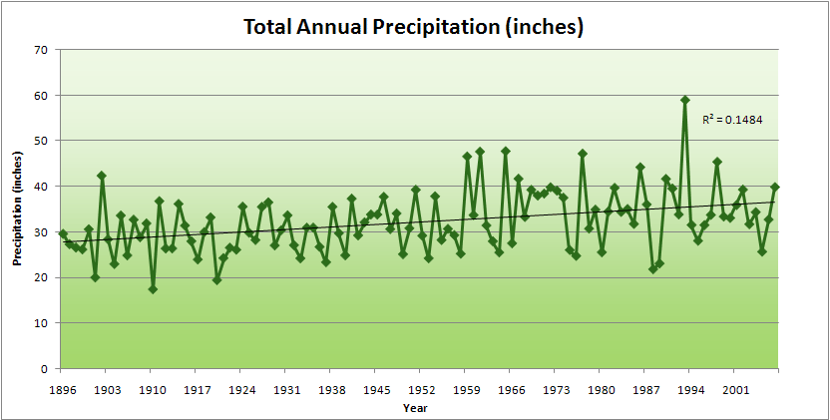
Cedar Rapids Data

Slide 34
Cedar Rapids Data
28.0”
32% increase
37.0”

Slide 35
Cedar Rapids Data
Years with more than 40 inches
11
1
28.0”
32% increase
37.0”

Slide 36
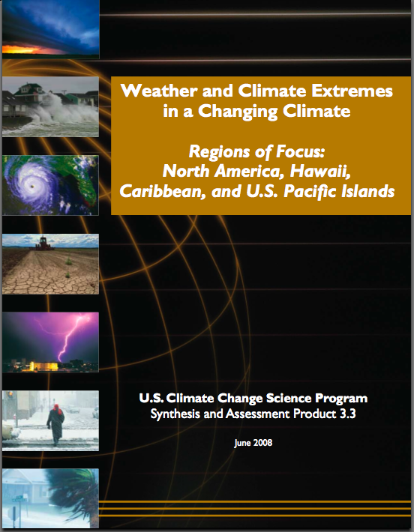
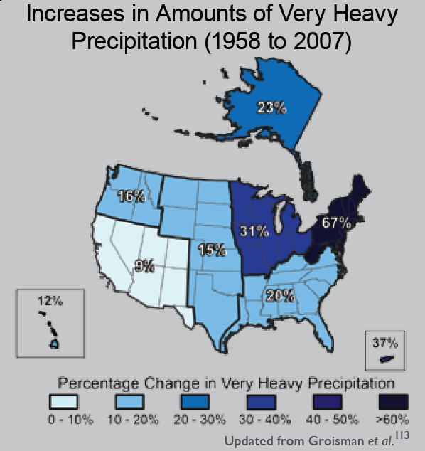
“One of the clearest trends in the United States observational record is an increasing frequency and intensity of heavy precipitation events… Over the last century there was a 50% increase in the frequency of days with precipitation over 101.6 mm (four inches) in the upper midwestern U.S.; this trend is statistically significant “
Karl, T. R., J. M. Melillo, and T. C. Peterson, (eds.), 2009: Global Climate Change Impacts in the United States. Cambridge University Press, 2009, 196pp.

Slide 37
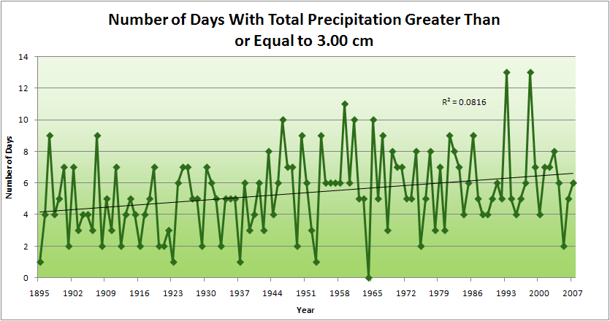
Cedar Rapids Data
4.2 days
57% increase
6.6 days

Slide 38
Cedar Rapids Data
Years having more than 8 days
13
2
4.2 days
57% increase
6.6 days

Slide 39
Years with more than 40 inches: 43% Increase
2010 so far

Slide 40
2010 through Sept 27
3.7
41% Increase
5.2

Slide 41
Years having more than 8 days
2010 through Sept 27
7
350% Increase
2
3.7
41% Increase
5.2

Slide 42
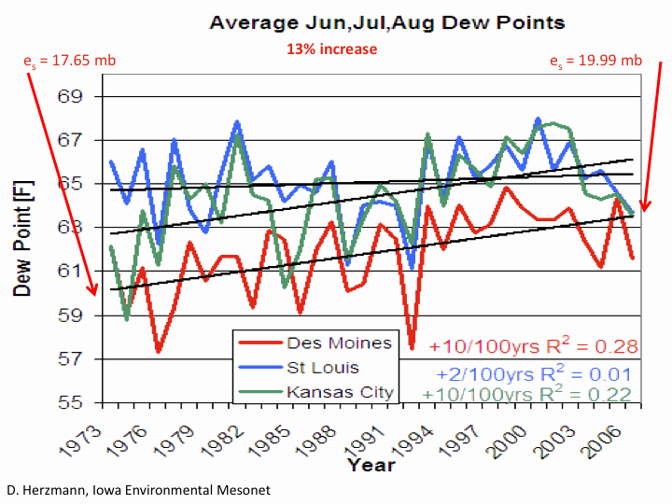

Slide 43
Iowa Agricultural Producers are Adapting to Climate Change:
Longer growing season: plant earlier, plant longer season hybrids, harvest later
Wetter springs: larger machinery enables planting in smaller weather windows
More summer precipitation: higher planting densities for higher yields
Wetter springs and summers: more subsurface drainage tile is being installed, closer spacing, sloped surfaces
Fewer extreme heat events: higher planting densities, fewer pollination failures
Higher humidity: more spraying for pathogens favored by moist conditions. more problems with fall crop dry-down, wider bean heads for faster harvest due to shorter harvest period during the daytime.
Drier autumns: delay harvest to take advantage of natural dry-down conditions
HIGHER YIELDS!!
Is it genetics or climate? Likely some of each.

Slide 44
Summary
Global temperature trends of the 20C cannot be explained on the basis of natural variation alone
Only when the influences of greenhouse gases and sulfate aerosols are included can the trends be explained
Models that explain these trends, when projected into the future, indicate a 1.5-6.5ºC warming over the 21C
Changes in farm expenditures confirm that farmers are adapting to climate change
Substantial adverse consequences to sea-level rise, food production, fresh-water supplies, severe weather events, environmental degradation and human health will occur for temperature increases above 2ºC
The major challenge to our global society is to figure out how to manage the unavoidable while avoiding the unmanageable

Slide 45
For More Information
Contact me directly:
gstakle@iastate.edu
Current research on regional climate and climate change is being conducted at Iowa State University under the Regional Climate Modeling Laboratory
http://rcmlab.agron.iastate.edu/
North American Regional Climate Change Assessment Program
http://www.narccap.ucar.edu/
For current activities on the ISU campus, regionally and nationally relating to climate change see the Climate Science Initiative website:
http://climate.engineering.iastate.edu/
Or just Google Eugene Takle

