Slide 1
Use of Climate Science for Decision-Making
Eugene S. Takle
Professor
Department of Agronomy
Department of Geological and Atmospheric Science
Director, Climate Science Program
Iowa State University
Ames, IA 50011
14th Annual Atmospheric Science Librarians International (ASLI) Conference Seattle, WA
26 January 2011

Slide 2
Outline
Climate change at the global scale
Weird happenings in my backyard (the Iowa example)
Using climate science to connect the dots
A public call for action

Slide 3
Climate change is one of the most important issues facing humanity
The scientific evidence clearly indicates that our climate is changing, and that human activities have been identified as a dominant contributing cause.
Notes:
No disagreement in peer reviewed literature
Powerful statements from every major professional science society and organization in the world
Powerful statements from the National Academies of Sciences (the leadership in science) for every major country
G8 + 5 other countries, May 2009: “The need for urgent action to address climate change is now indisputable.”

Slide 4
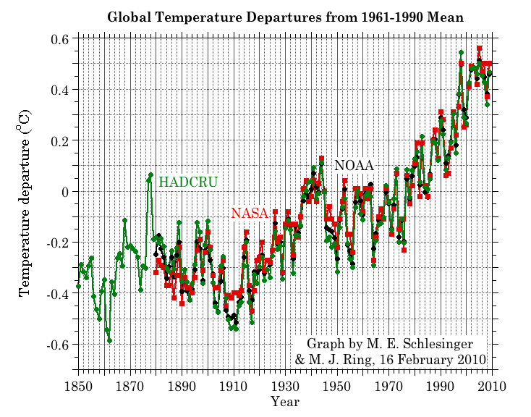
Three separate analyses of the temperature record – Trends are in close agreement
2010 has tied 2005 as the warmest year on record since 1880

Slide 5
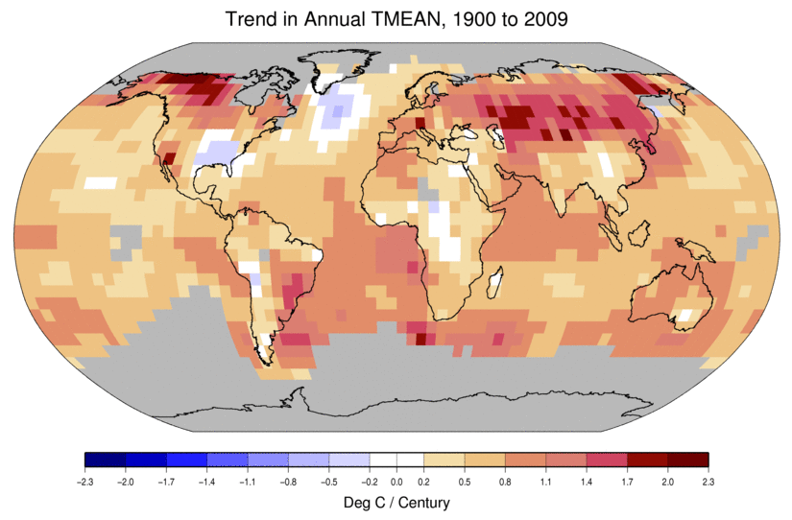
Temperature Changes are Not Uniform Around the Globe
From Tom Karl, NOAA NCDC

Slide 6
Many lines of evidence for conclusion of a “discernible human influence”
“Basic physics” evidence
Physical understanding of the climate system and the heat-trapping properties of greenhouse gases
Qualitative analysis evidence
Qualitative agreement between observed climate changes and model predictions of human-caused climate changes (warming of oceans, land surface and troposphere, water vapor increases, etc.)
Paleoclimate evidence
Reconstructions of past climates enable us to place the warming of the 20th century in a longer-term context
Fingerprint evidence
Rigorous statistical comparisons between modeled and observed patterns of climate change
Don Wuebbles

Slide 7
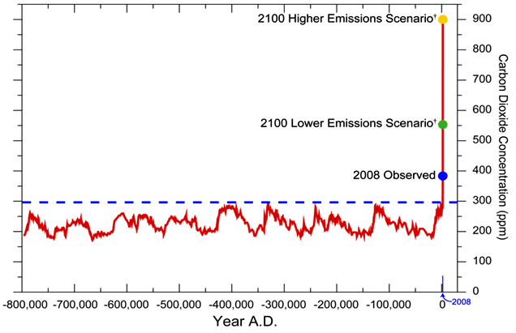
We have Moved Outside the Range of Historical Variation
800,000 Year Record of Carbon Dioxide Concentration
Don Wuebbles

Slide 8
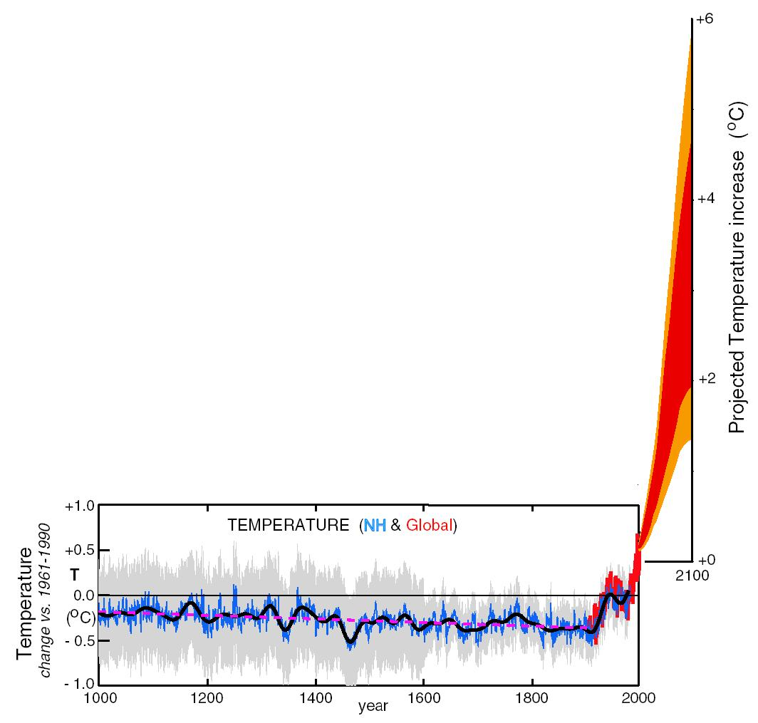
What can we expect in the future?
Don Wuebbles

Slide 9
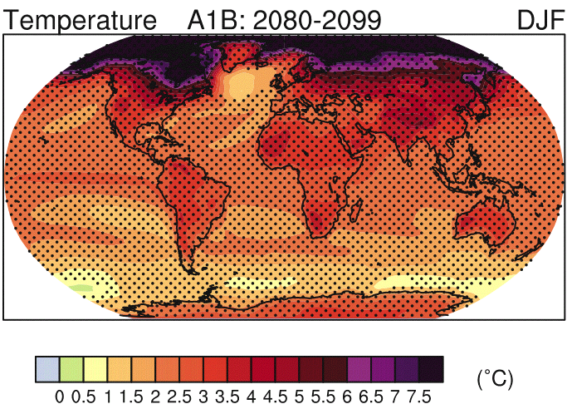
IPCC 2007

Slide 10
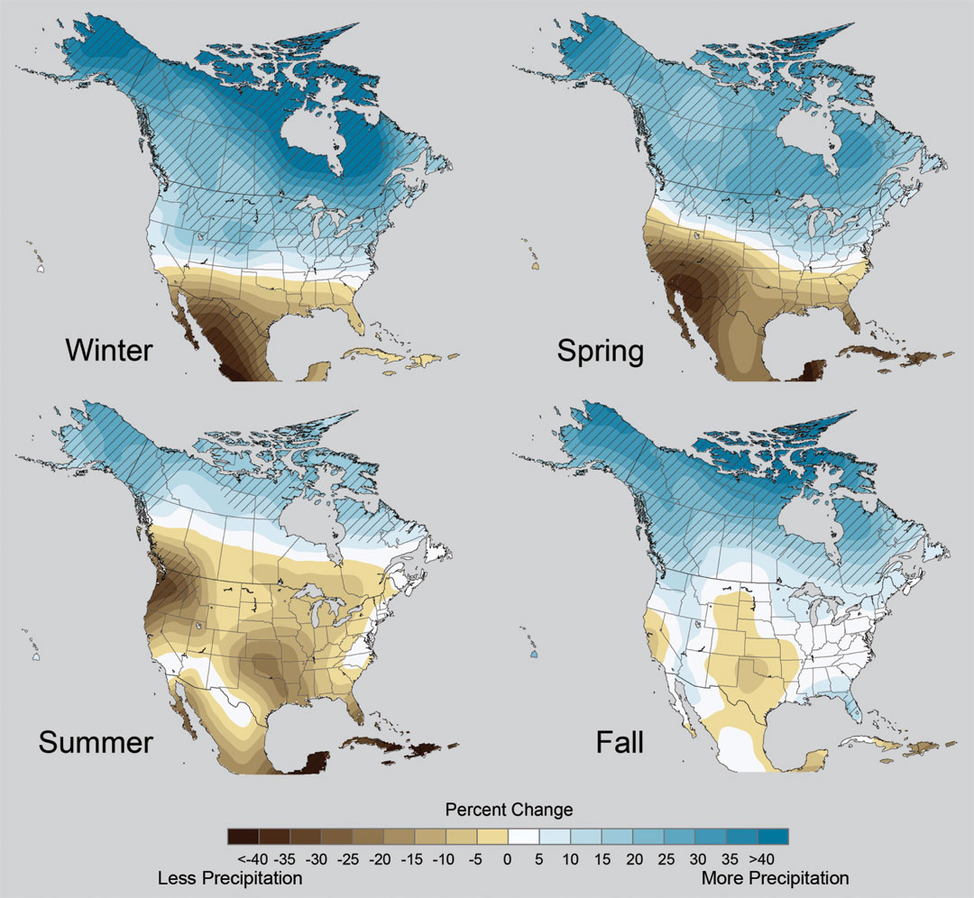
Projected Change in Precipitation: 2081-2099
Midwest: Increasing winter and spring precipitation, with drier summers
More frequent and intense periods of heavy rainfall
Unstippled regions indicate reduced confidence
Relative to 1960-1990
NOTE: Scale Reversed
Don Wuebbles

Slide 11
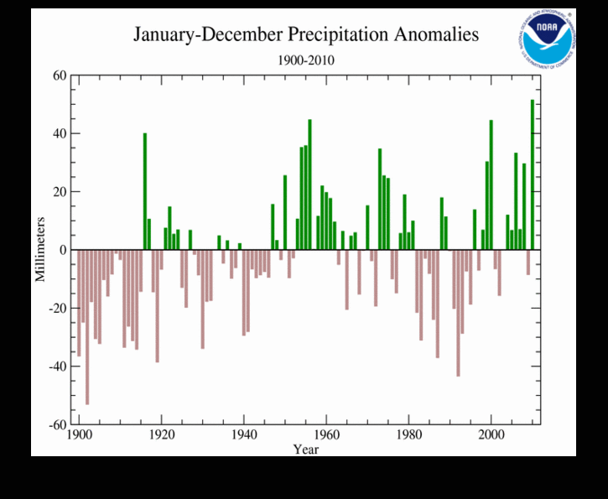
2010 had the highest global total precipitation in the 111 year record

Slide 12
But Abstract Concepts of Global Changes and Models Projecting Future Conditions Do Not Inspire Urgency and Action
It takes nearby events in my backyard that are recurring and outside the range of recent memory to raise questions about whether something fundamental is changing.
The Iowa Example…

Slide 13
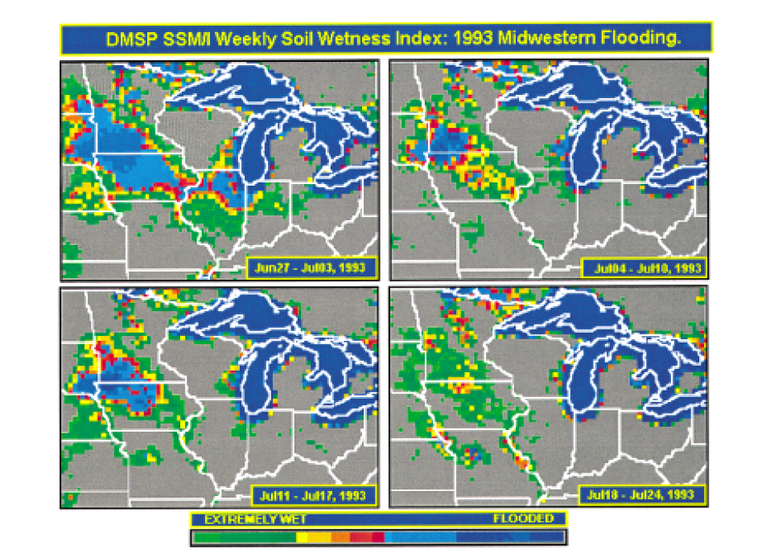
Great Flood of 1993 in the US Midwest:
A New “Great Lake”
1993
Historical Data indicate this should happen about once every 500 years
Lakshmi, V., and K. Schaaf, 2001: Analysis of the 1993 Midwestern flood using satellite and ground data. IEEE Trans. Geosci & Remote Sens., 39, 1736-1743.

Slide 14
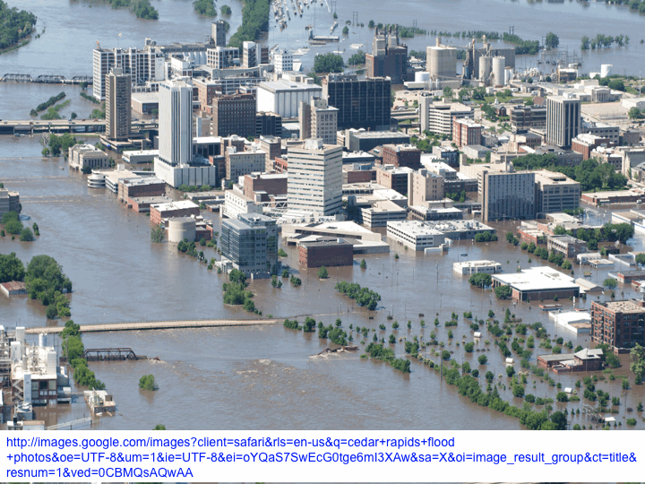
2008

Slide 15
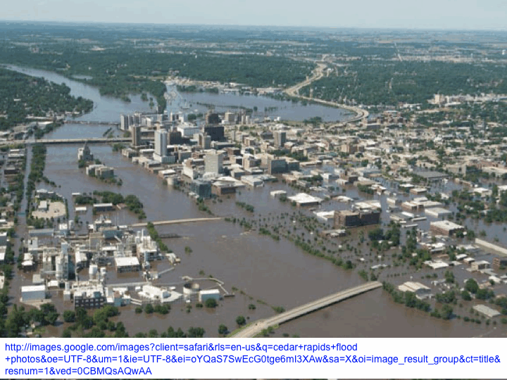

Slide 16
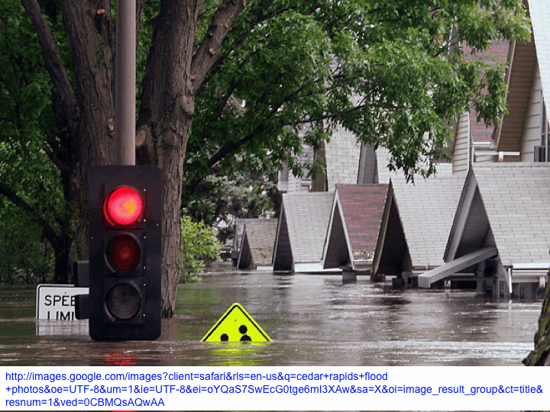

Slide 17
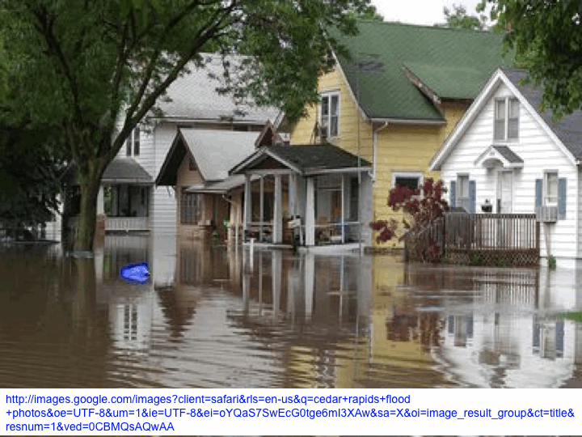

Slide 18
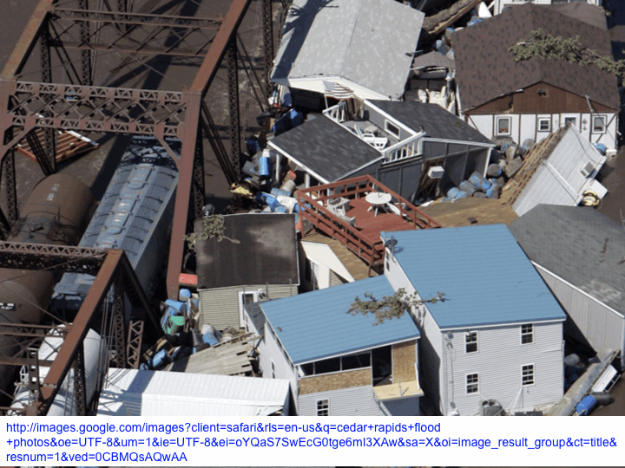

Slide 19
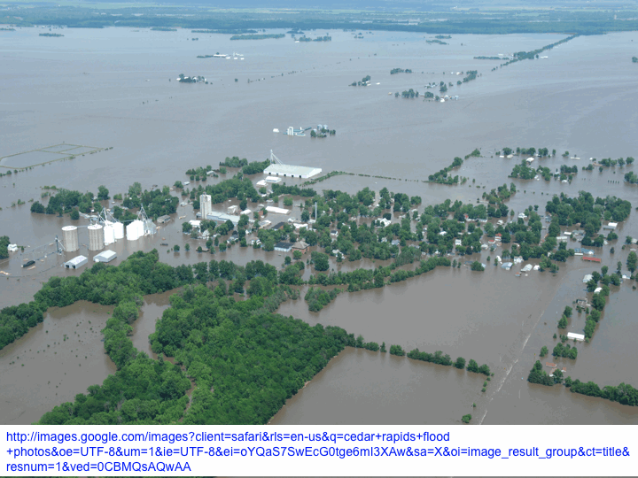

Slide 20
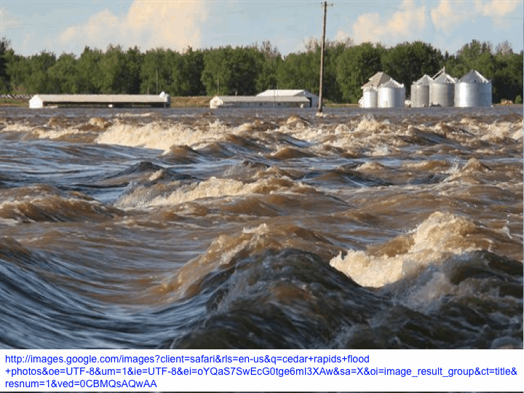

Slide 21
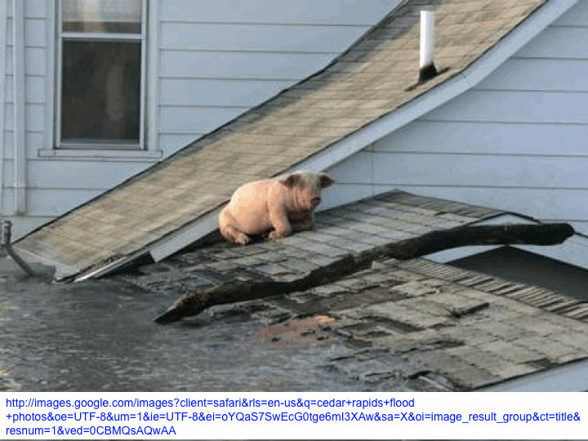
We need to adapt to climate change

Slide 23
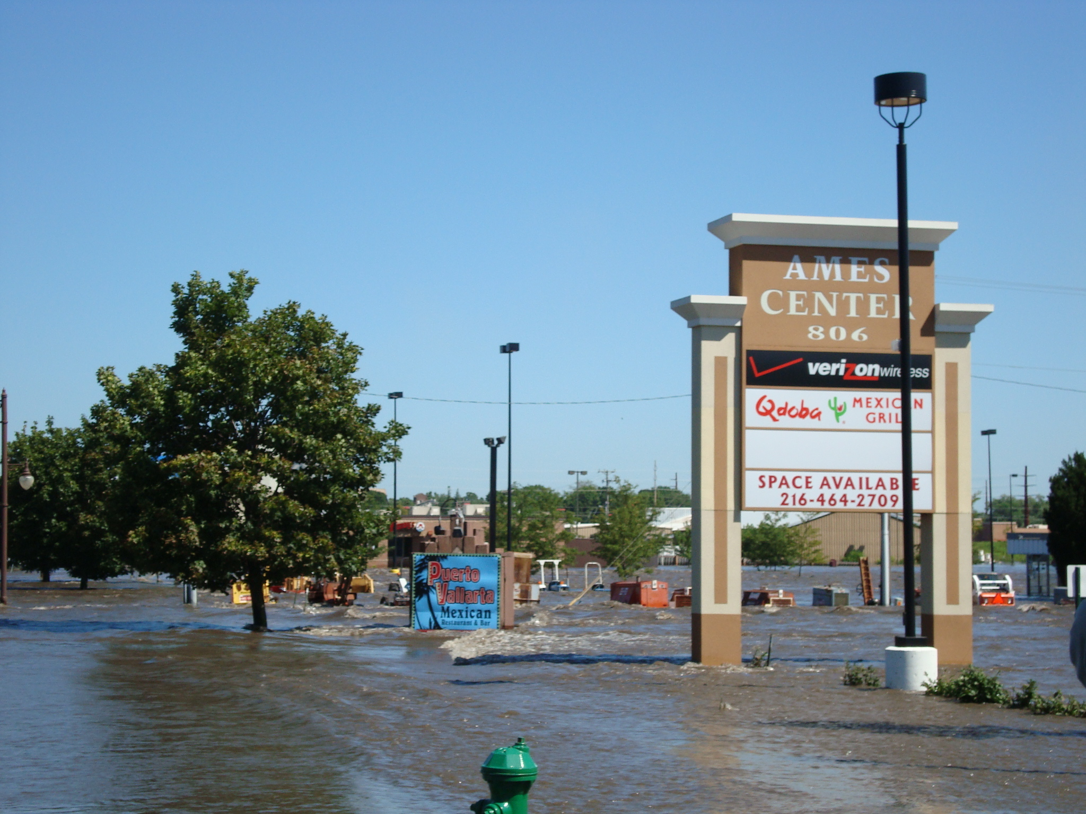
2010

Slide 24
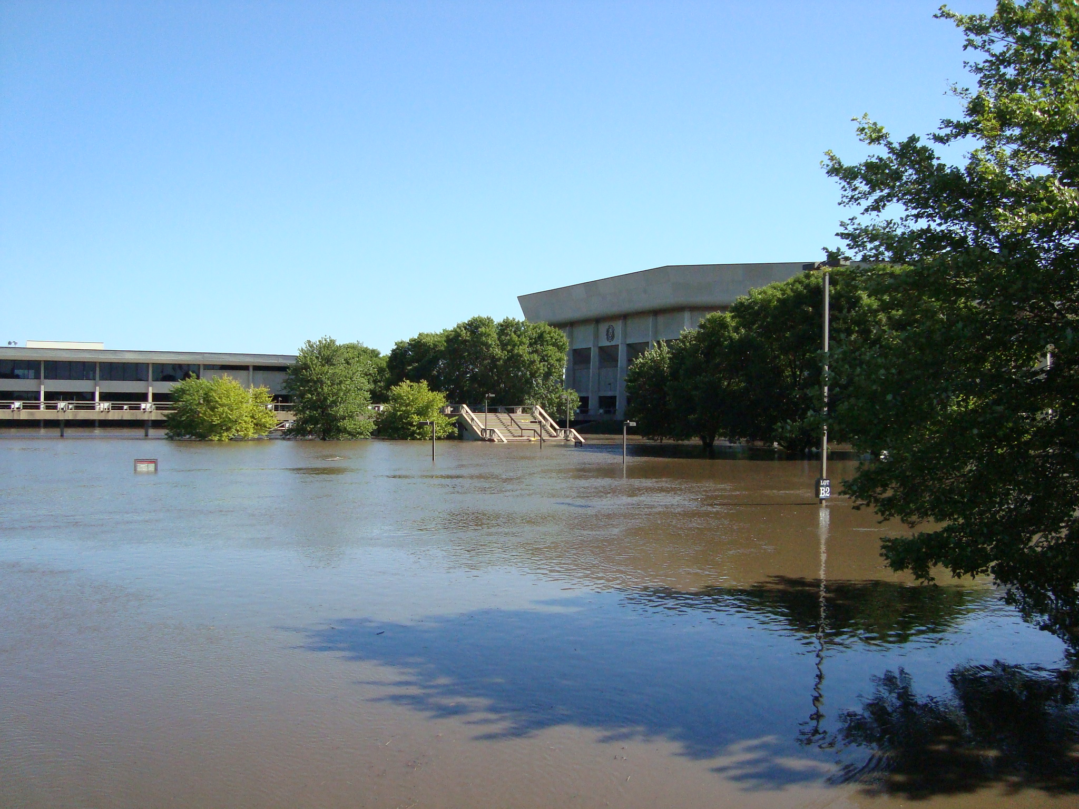

Slide 25
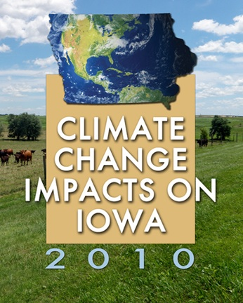
http://climate.engineering.iastate.edu/CSPPublications.html
Image courtesy of NASA/GSFC

Slide 26
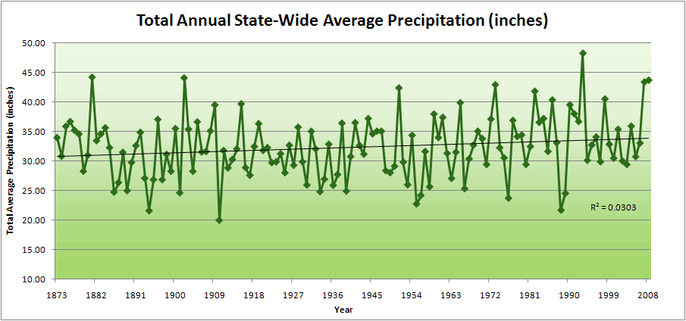
Iowa State-Wide Average Data

Slide 27
Iowa State-Wide Average Data
34.0”
10% increase
30.8”

Slide 28
Iowa State-Wide Average Data
Totals above 40”
2 years

Slide 29
Iowa State-Wide Average Data
Totals above 40”
8 years
2 years

Slide 30
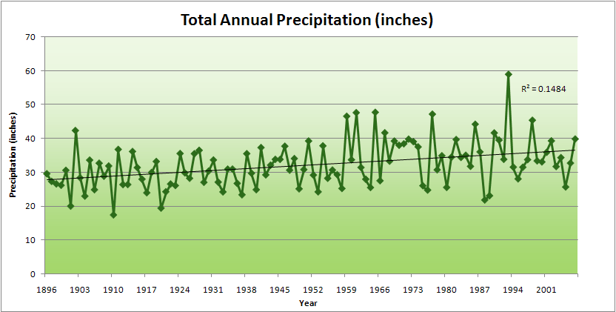
Cedar Rapids Data

Slide 31
Cedar Rapids Data
28.0”
32% increase
37.0”

Slide 32
Cedar Rapids Data
Years with more than 40 inches
11
1
28.0”
32% increase
37.0”

Slide 33
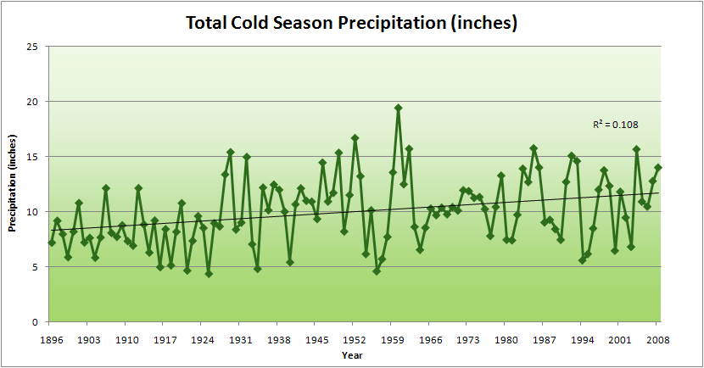
Cedar Rapids Data
51% increase
11.8”
7.8”

Slide 34
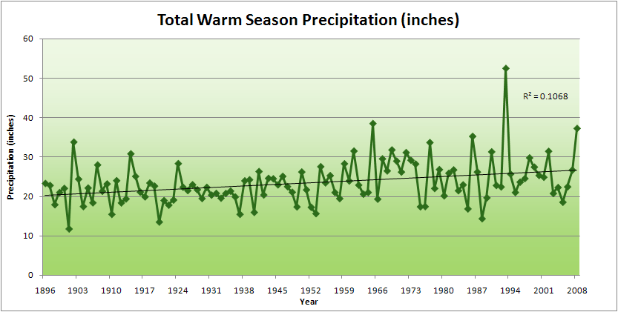
Cedar Rapids Data
34% increase
26.8”
20.2”

Slide 35
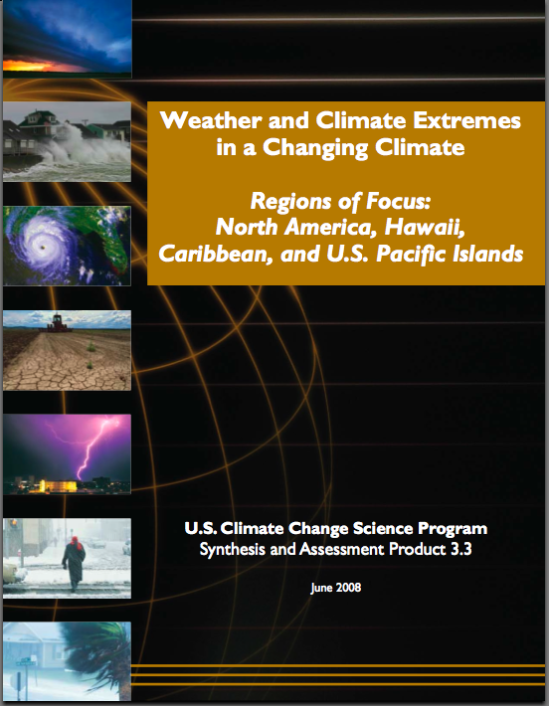
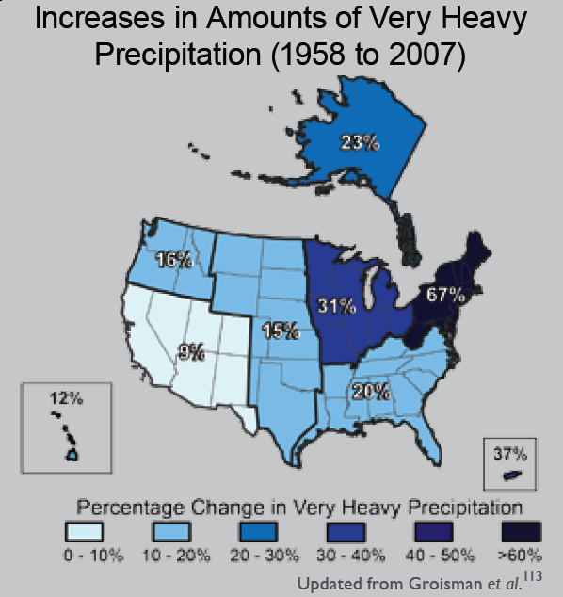
“One of the clearest trends in the United States observational record is an increasing frequency and intensity of heavy precipitation events… Over the last century there was a 50% increase in the frequency of days with precipitation over 101.6 mm (four inches) in the upper midwestern U.S.; this trend is statistically significant “
Karl, T. R., J. M. Melillo, and T. C. Peterson, (eds.), 2009: Global Climate Change Impacts in the United States. Cambridge University Press, 2009, 196pp.

Slide 36
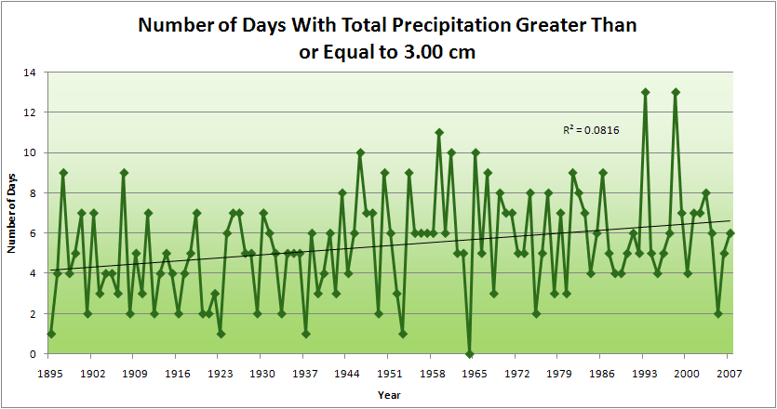
Cedar Rapids Data
4.2 days
57% increase
6.6 days

Slide 38
Years with more than 40 inches: 43% Increase
2010 so far

Slide 39
2010 through Sept 27
3.7
41% Increase
5.2

Slide 40
Years having more than 8 days
2010 through Sept 27
7
350% Increase
2
3.7
41% Increase
5.2

Slide 41
Drainage basins
Storm tracks
Rivers
Mar-May
June
July
Aug-Sep

Slide 42
Why Small Changes in Rainfall Produce Much More Flooding
13% increase in atmospheric moisture in June-July-August
~10% increase in average precipitation in Iowa
~3 to 7-fold increase in high-precipitation events, mostly in June-July-August, that lead to runoff
Iowa rivers and watersheds are oriented NW-SE
Rainfall patterns turn from SW-NE in March-May to W-E or NW-SE in mid summer
More frequent floods are the result of one or more of the following
More rain
More intense rain events
More rain in the summer
Rainfall patterns more likely to align with streams and watersheds
Streams amplify changes in precipitation by a factor of 2-4
AND: more subsurface drainage tile has been installed

Slide 43
Iowa must change with the climate Des Moines Register, Jan. 22, 2011
“Climate change has already happened in Iowa. “It's not a matter of computer models predicting climate change in the future. It's a matter of real measurements showing real change already. “So the question isn't whether climate change is happening. The question is, what are Iowans going to do about it?
“The facile answer is: nothing. Iowa can't put its climate back the way it was. “But while Iowans can't change the climate, they can try to adapt intelligently to the new climate. “That's where the Legislature comes in…”

Slide 44
Summary
The science is clear that climate is changing on the global scale
The Iowa Example
Recent local weather events are far beyond natural variation
Analysis of climate data clarify underlying reasons
Models that explain these trends, when projected into the future, indicate even more severe changes may be forthcoming
Iowans already are paying the price of climate change
It is time for public and private decision-makers to develop practices that will make Iowa and its landscapes more resilient to climate change

Slide 45
For More Information
Contact me directly:
gstakle@iastate.edu
Current research on regional climate and climate change is being conducted at Iowa State University under the Regional Climate Modeling Laboratory
http://rcmlab.agron.iastate.edu/
North American Regional Climate Change Assessment Program
http://www.narccap.ucar.edu/
For current activities on the ISU campus, regionally and nationally relating to climate change see the Climate Science Initiative website:
http://climate.engineering.iastate.edu/
Or just Google Eugene Takle

