Slide 1
Impacts of
Changing Climate and Weather on the
Agriculture and Forestry Sectors
Eugene S. Takle
Professor
Department of Agronomy
Department of Geological and Atmospheric Science
Director, Climate Science Program
Iowa State University
Ames, IA 50011
25 x ‘25 Adaptation Meeting
Baltimore, MD
3-4 April 2012

Slide 2
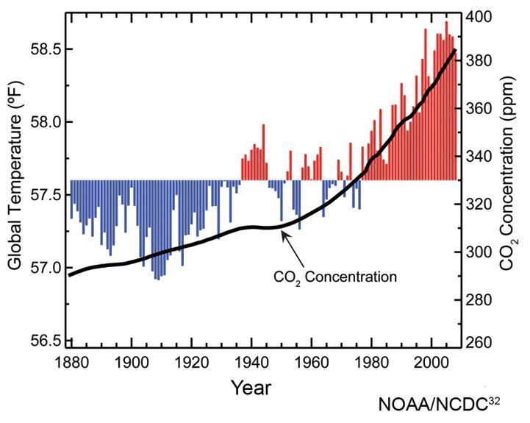
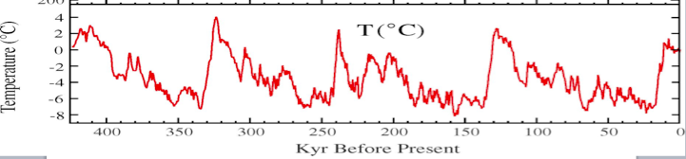
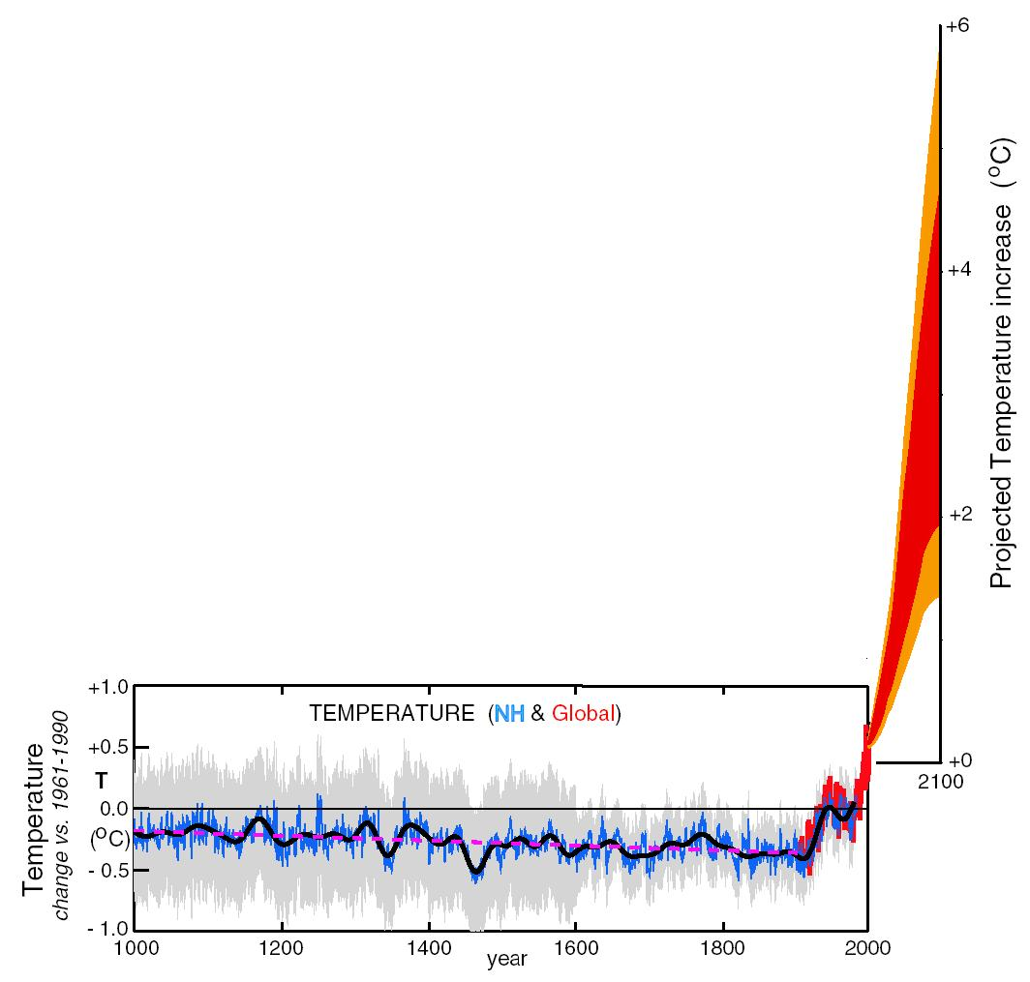
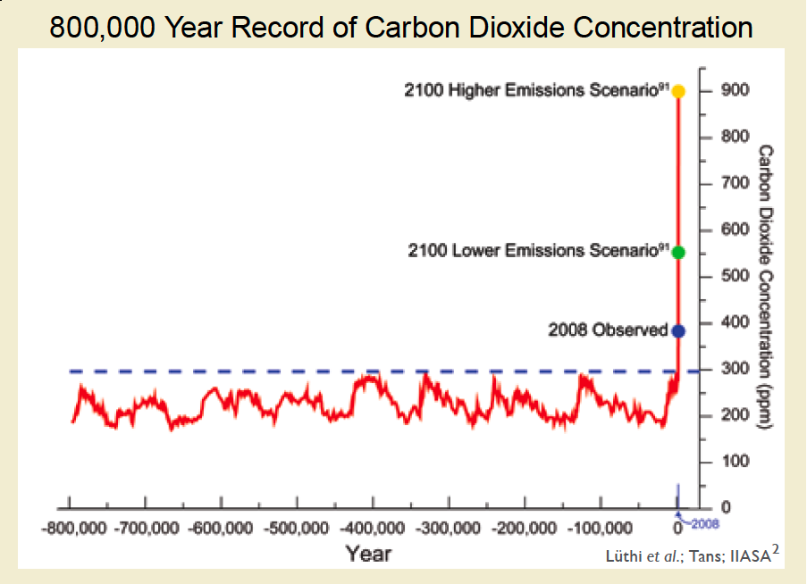
Natural Causes Cannot Explain Global Temperature Rises of the Last 40 Years
Changes in temperature over
the last 40 years cannot
be explained by orbital
changes of Earth around the
Sun, changes in volcanic
activity, changes in output of
the Sun, or natural variability
(El Nino, MJO, etc.). The only
explanation is increase in
greenhouse gas concentrations,
mostly CO₂.

Slide 3
We Know with Confidence that…
Recent global temperature changes are outside the range of natural variability
Agricultural producers are accustomed to adapting to a wide range of challenges, including weather
Agriculture is highly vulnerable to changes in weather and climate
Not all changes in climate are detrimental to agriculture

Slide 4
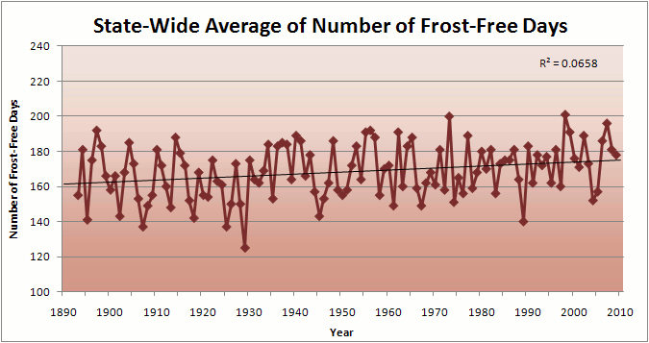
Longer Growing Season Allows Planting
of Longer Season Hybrid Corn
Iowa Data

Slide 5
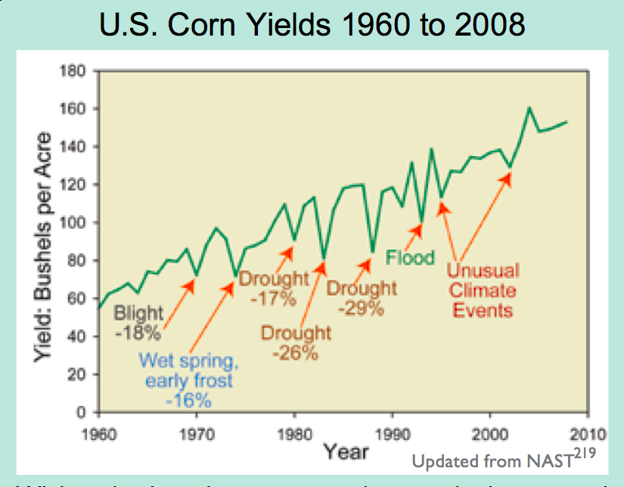
Extreme Events are Usually Detrimental

Slide 6
US agriculture has adapted in the past…
But what about the future?

Slide 7
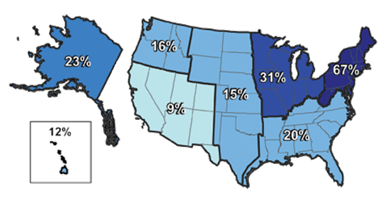
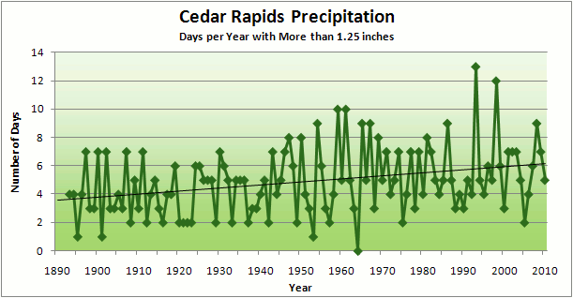
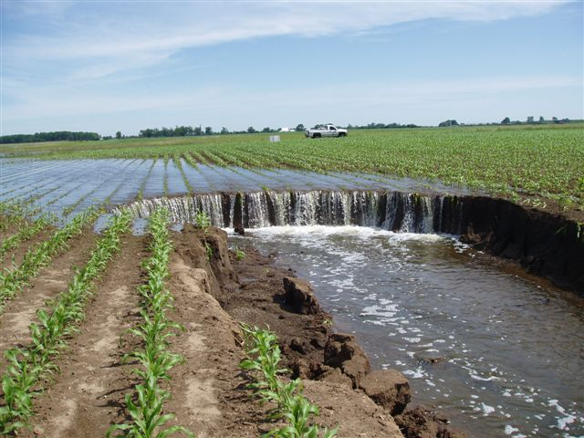
Increase in Frequency and Intensity of Extreme Precipitation Events is Statistically Significant
Over the last century there was a 50% increase in the frequency of days with precipitation over four inches in the upper midwestern U.S.

Slide 8
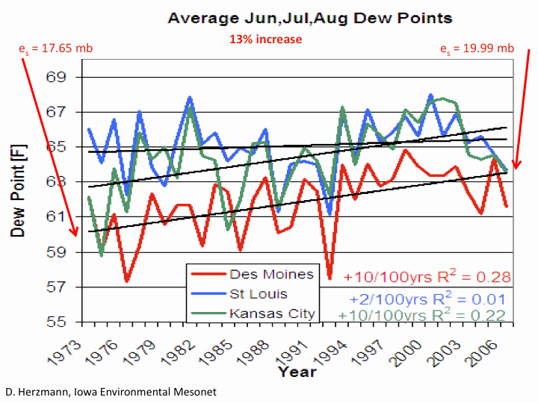
Increase in Occurrence and Intensity of Extreme Precipitation Events Leads to Higher Humidity

Slide 9
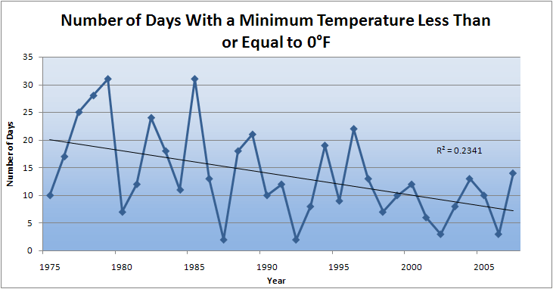
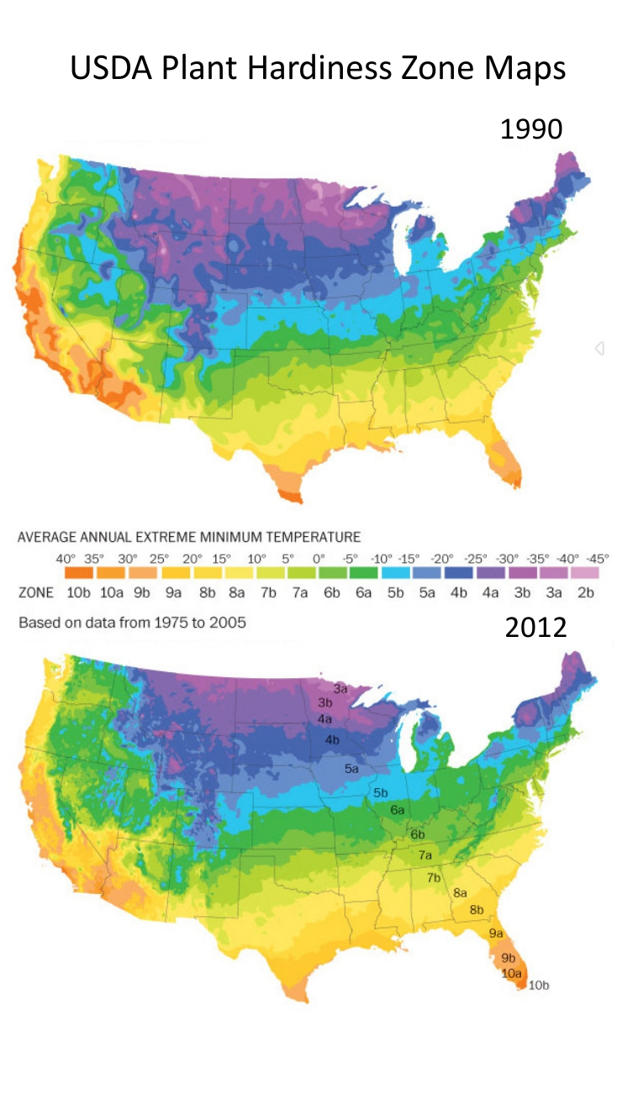
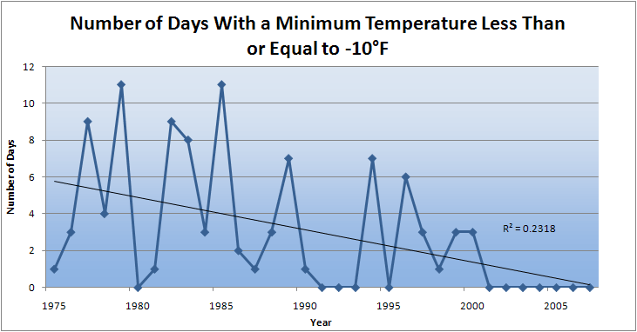
Winter Temperatures are Rising, Fewer Extreme Cold Events
Des Moines, IA
Des Moines, IA

Slide 10
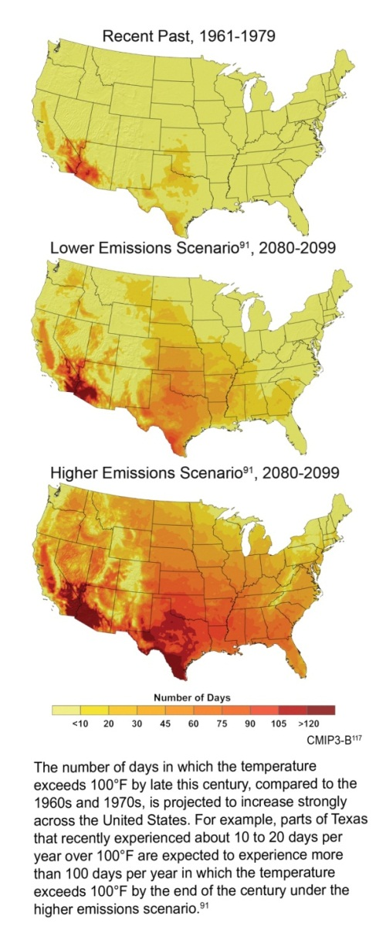
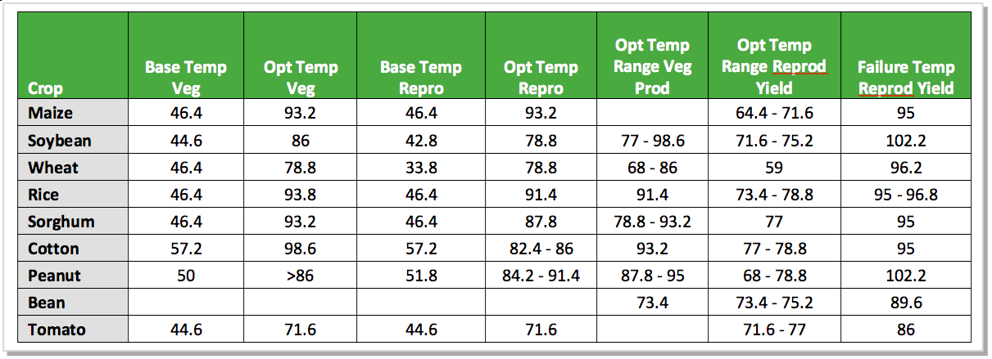
Crop Yield and Grain Quality are Compromised by Temperature Increase
Days/Yr with T>100ºF
Rising daily maximum temperatures increase the likelihood of extended periods with temperatures above the failure point for reproduction (grain production)
Rising nighttime temperatures decrease the quality of grain (corn)

Slide 11
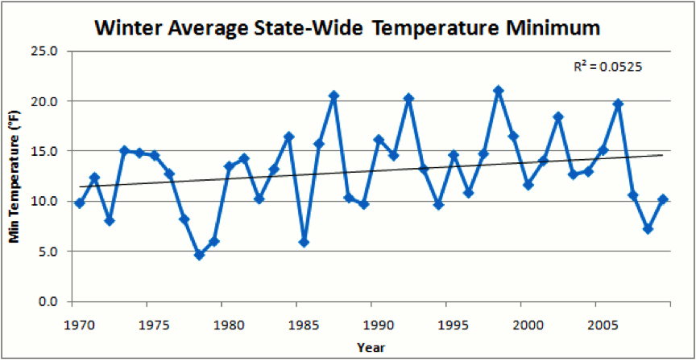
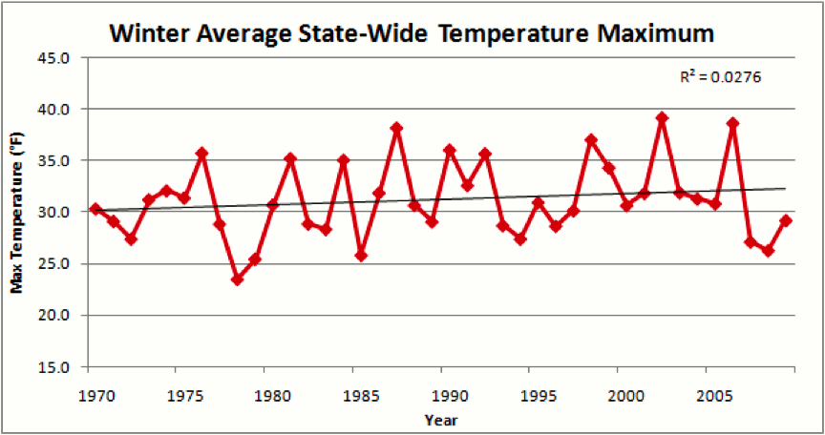
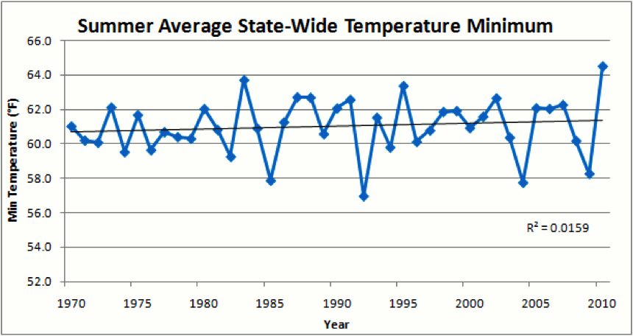
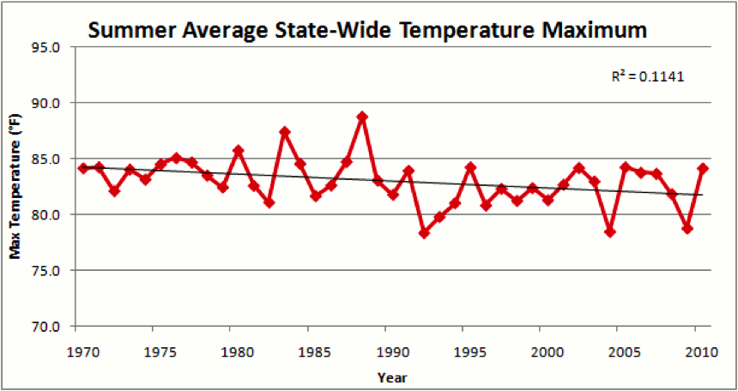
Daytime and Nighttime Temperatures are Rising in Iowa in All Seasons Except Summer Maximum Temperatures

Slide 12
Iowa Agricultural Producers are Adapting to Climate Change:
Longer growing season: plant earlier, plant longer season hybrids, harvest later
Wetter springs: larger machinery enables planting in smaller weather windows
More summer precipitation: higher planting densities for higher yields
Wetter springs and summers: more subsurface drainage tile is being installed, closer spacing, sloped surfaces
Fewer extreme heat events: higher planting densities, fewer pollination failures
Higher humidity: more spraying for pathogens favored by moist conditions. more problems with fall crop dry-down, wider bean heads for faster harvest due to shorter harvest period during the daytime.
Drier autumns: delay harvest to take advantage of natural dry-down conditions, thereby reducing fuel costs

Slide 13
Impacts of Climate Change on Animal Agriculture
Decreased weight gain in meat animals
Decreased summer egg production in poultry operations
Decreased summer milk production in dairy operations
Decreased breeding success in animal agriculture
Increase in sickness and disease

Slide 14
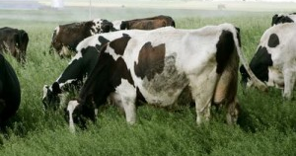
You go girl! Iowa milk production hits February record
The USDA said Iowa’s production total
was a record for February, which it
attributed to warmer temperatures.
In Iowa, the number of milk cows declined by 3,000 head to 205,000,
but because each cow produced 120 pounds more of milk this year than
in 2011 total production in the state rose by 5.9 percent to 359 million pounds.

Slide 15
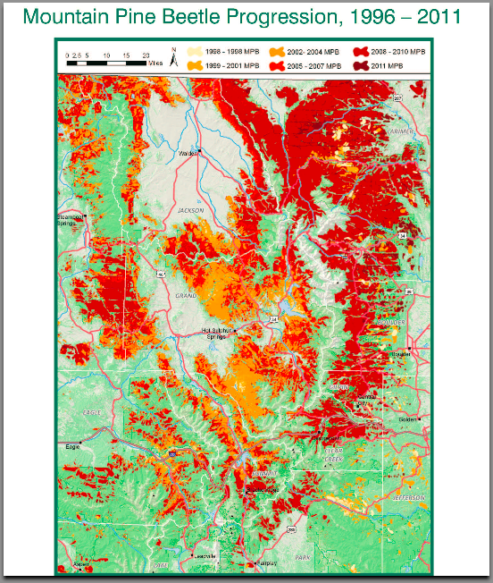
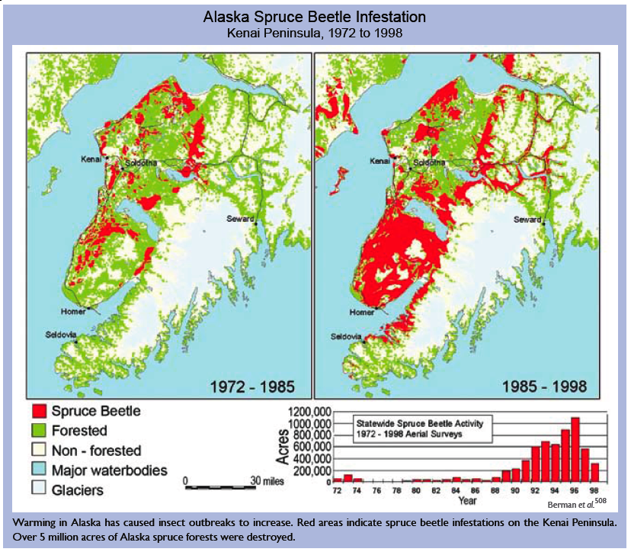
Forestry Management and Production Considers a Longer Future Horizon: Mitigation is Critical
Temperatures below -30ºF must be sustained for at least five days to suppress mountain pine beetles in Colorado
Warmer temperatures have allowed for Spruce Beetle infestations in Alaska

Slide 16
Best available science says that the future climate will not resemble the past
Some Climate Variable (temp, precip, humid)
A Prudent View of the Future
Measured past
Today
Past
Future

Slide 17
Recent Updates
March heat wave in central US, 12-23 March
Chicago had nine consecutive days with record high temperatures, eight being over 80ºF
NOAA attribution study (Marty Hoerling): http://www.esrl.noaa.gov/psd/csi/events/2012/marchheatwave/
Four possible contributing factors:
    La Nina
    Warm water in Gulf of Mexico
    Minimal snow cover in upper Midwest
    Climate change

Slide 18
Summary
Increases in greenhouse gases (primarily carbon dioxide) currently are the largest contributing cause to increases in global temperature
Agricultural producers are facing increased costs for adapting to climate change
Adaptation strategies for forestry are longer term
Mitigating the causes of climate change is important for both crop production and forestry

Slide 19
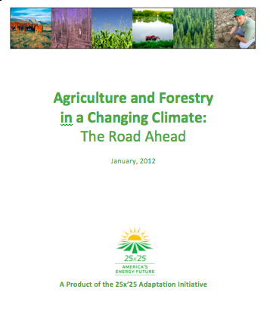
For More Information:
Climate Science Program
Iowa State University
http://climate.engineering.iastate.edu/
Google me:
http://www.meteor.iastate.edu/faculty/takle/
Email me:
gstakle@iastate.edu

