Slide 1
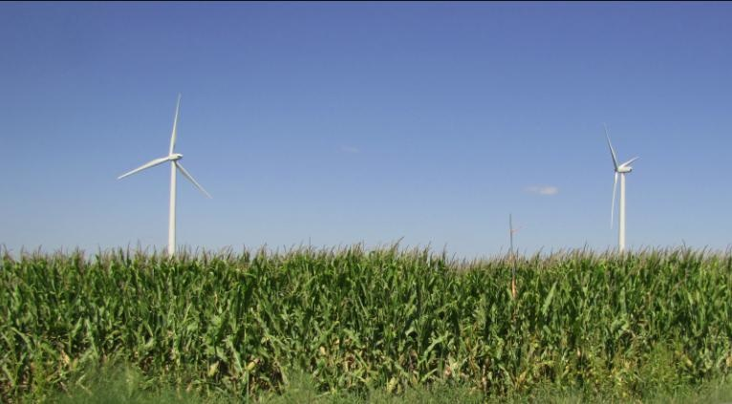
Crop/Wind-energy EXperiment (CWEX):
Results from CWEX10/11 and Vision for the Future
Eugene S. Takle
Department of Agronomy
Department of Geological and Atmospheric Science
Director, Climate Science Program
Iowa State University
Wind Energy Research Group
St Anthony Falls Laboratory
University of Minnesota
16 November 2012

Slide 2
CWEX Participants
Ames Laboratory
National Center for Atmospheric Research
Anemometry Specialists, Inc
Iowa State University
University of Colorado/
National Renewable Energy Laboratory
National Laboratory for Agriculture
and the Environment
Rajewski, D. A., E. S. Takle, J. K. Lundquist, S. Oncley, J. H. Prueger, T. W. Horst, M. E. Rhodes, R. Pfeiffer, J. L. Hatfield, K. K. Spoth, and R. K. Doorenbos, 2012: CWEX: Crop/Wind-energy Experiment: Observations of surface-layer, boundary-layer and mesoscale interactions with a wind farm. Bull. Amer. Meteor. Soc. (in press)

Slide 3
Conceptual Model of Turbine-crop Interaction via Mean Wind and Turbulence Fields
Speed recovery
day
H₂O
CO₂
Heat
__ ___________________________________
night

Slide 4
CWEX10 Field Experiment
Iowa wind farm ( 200 1.5-MW turbines)
Southern edge of a wind farm
Corn-soybean cropping pattern (measurements made in corn)
26 June – 7 September 2010; turbines off 0700 LST 26 July – 2300 LST 5 Aug 2300
4 Eddy Covariance flux towers
NREL/CU Lidar (J. Lundquist) (28 June-9 July)

Slide 6
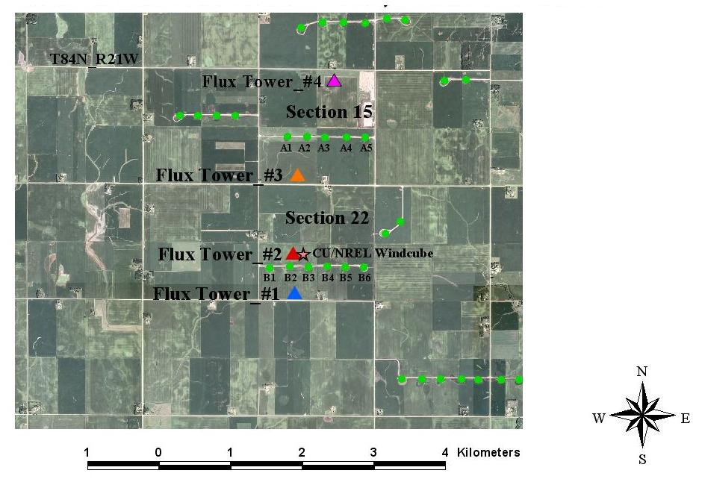
4 flux towers
  maize canopy
  26 June – 7 Sept, 2010
CU/NREL Lidar
  28 June - 9 July 2010

Slide 8
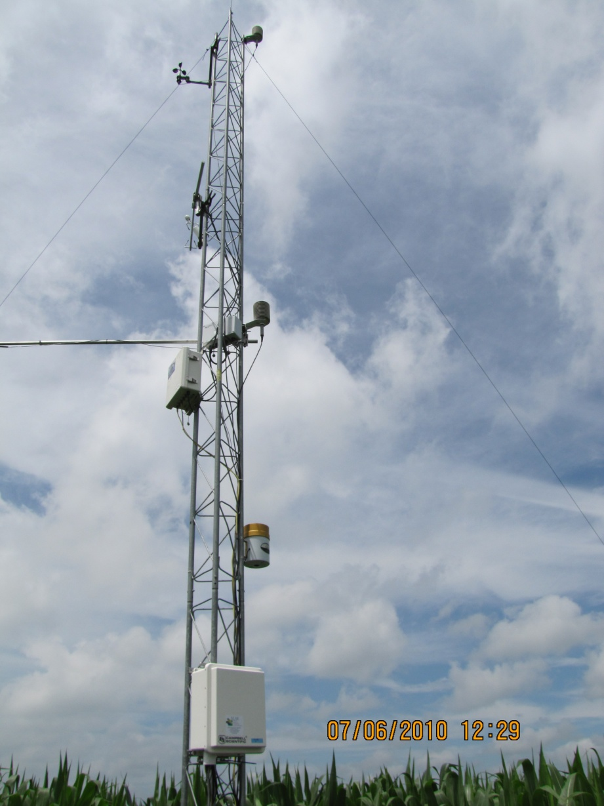
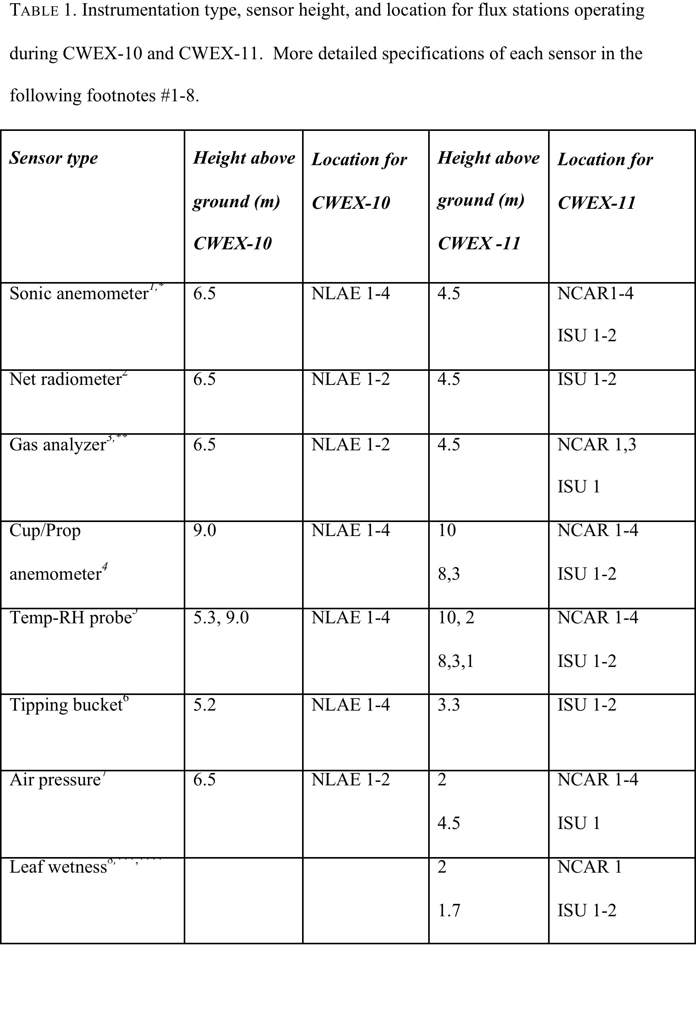

Slide 9
Case study: 50-min period of wind farm shutdown in nighttime
Dan Rajewski

Slide 10
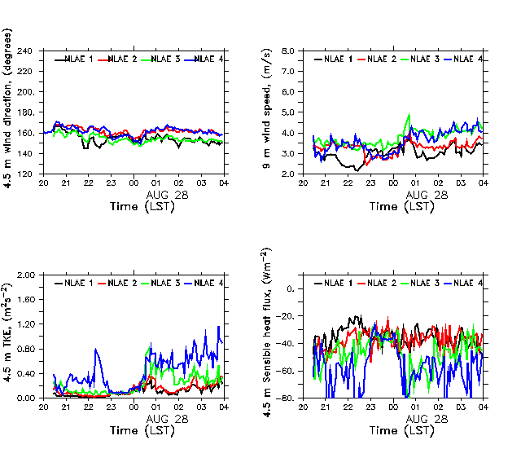
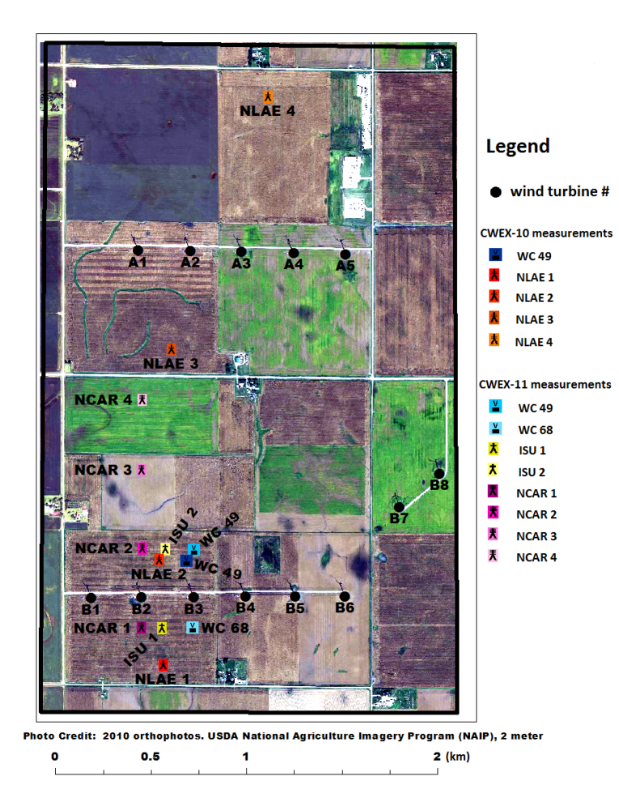
Turbines offline:
August 27, 2010 2300-0000 LST
Station north of two turbine lines has 2-3X ambient TKE and Heat flux before/after OFF period
80-m wind direction
vector
Return to reference flow
conditions during the shut
down

Slide 11
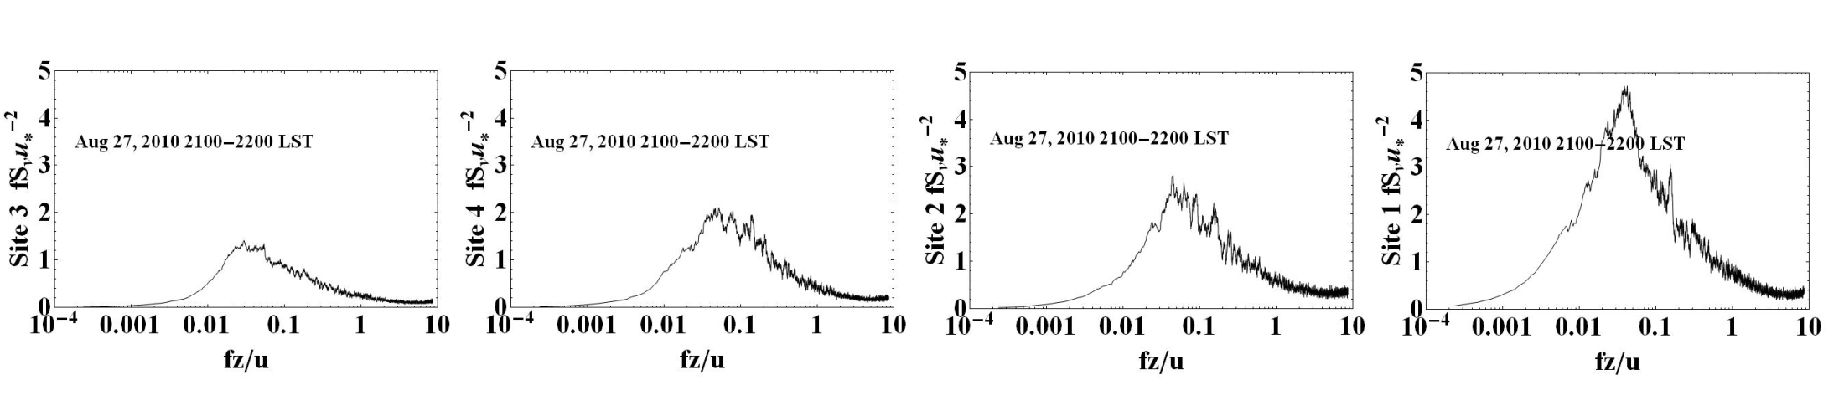
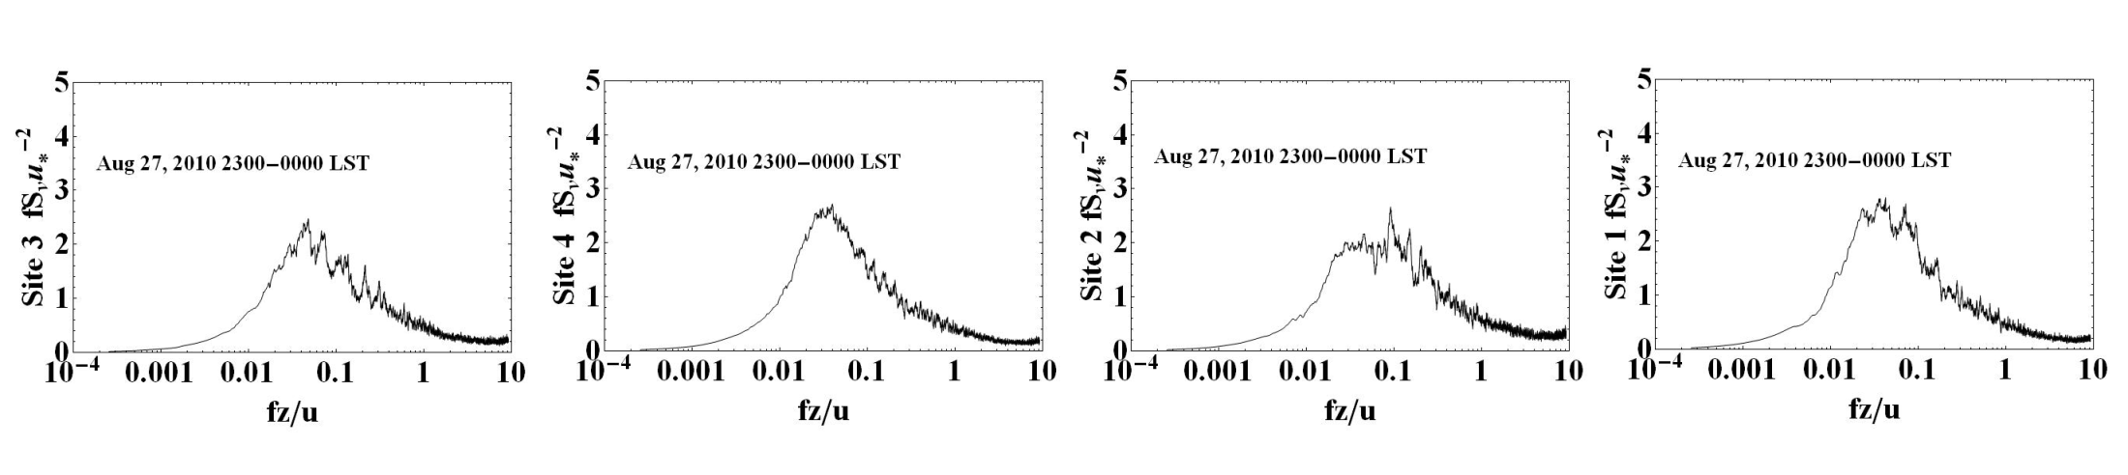
Spectral evidence before and during the shutdown period
V-power spectra
South → North
Turbines ON
NLAE 1
NLAE 2
NLAE 3
NLAE 4
South → North
Turbines OFF
NLAE 1
NLAE 2
NLAE 3
NLAE 4
ON: Increase in stream-wise momentum variance of: 1.5X downwind of first line of turbines
3.0X downwind of two lines of turbines
OFF: Similar intensity of variance for all flux stations south and north of two turbine lines

Slide 12
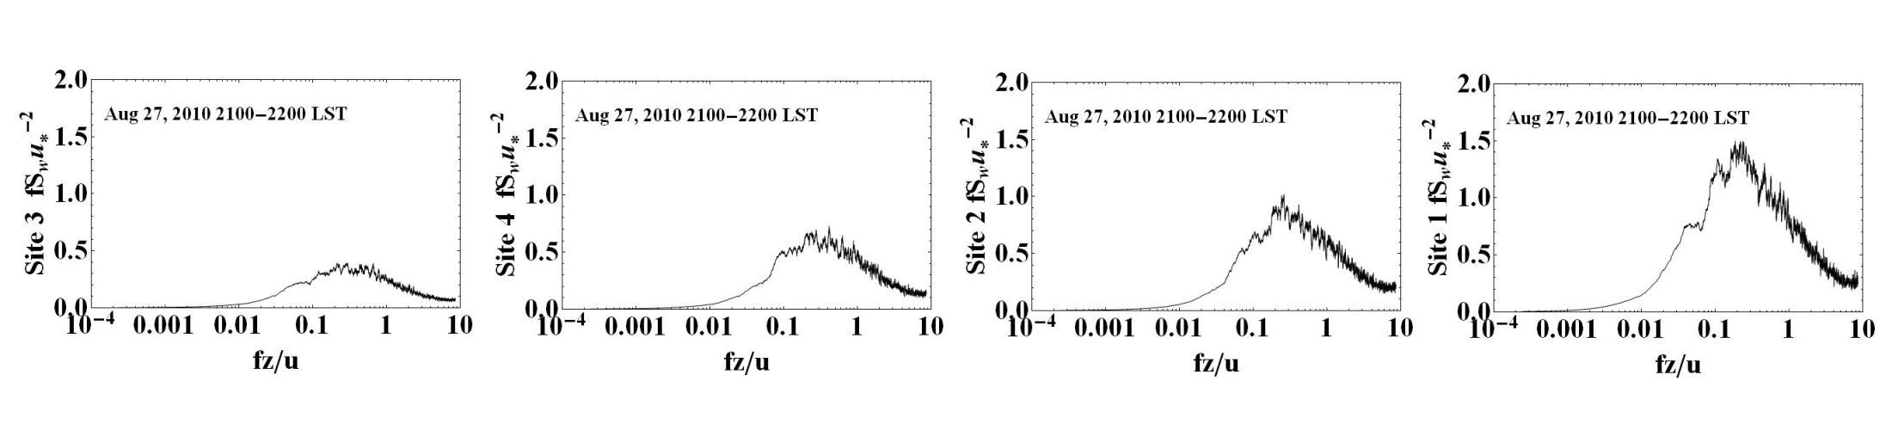
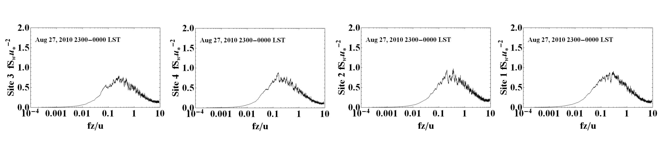
Spectral evidence before and during the shutdown period
W-power spectra
South → North
Turbines ON
NLAE 1
NLAE 2
NLAE 3
NLAE 4
South → North
Turbines OFF
NLAE 1
NLAE 2
NLAE 3
NLAE 4
ON: Increase in vertical velocity variance of: 2.0X downwind of first line of turbines
5.0X downwind of two lines of turbines
OFF: Similar intensity of variance for all flux stations south and north of two turbine lines

Slide 13
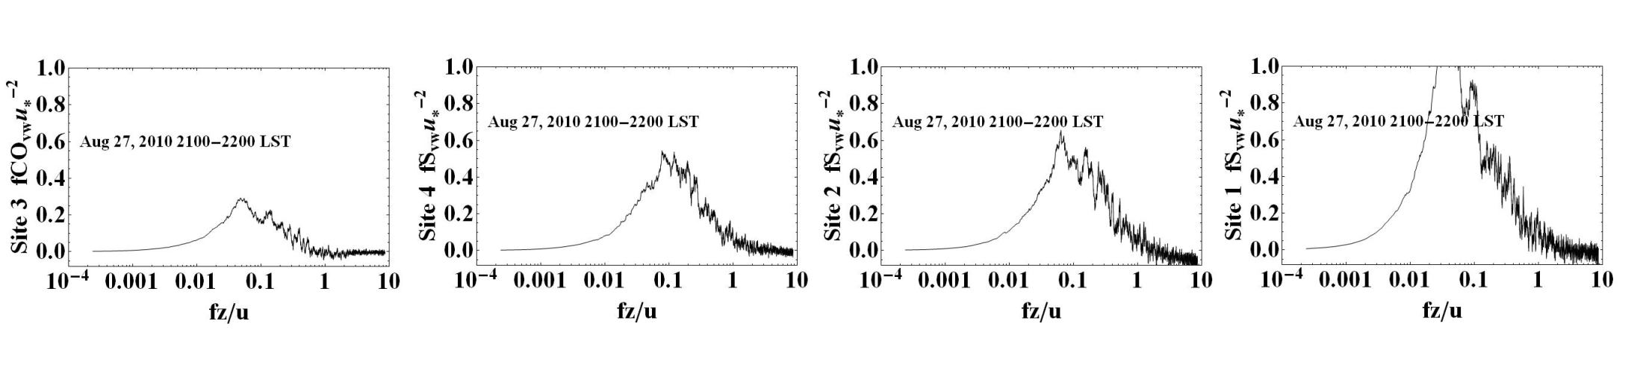
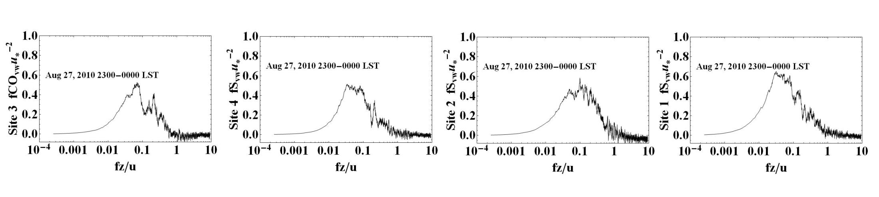
Spectral evidence before and during the shutdown period
VW-power spectra
South → North
Turbines ON
NLAE 1
NLAE 2
NLAE 3
NLAE 4
South → North
Turbines OFF
NLAE 1
NLAE 2
NLAE 3
NLAE 4
ON: Increase in stream-wise co-variance of 2.0X downwind of first line of turbines
4.0X downwind of two lines of turbines
OFF: Similar intensity of covariance for all flux stations south and north of two turbine lines

Slide 14
Summary
Turbine wake response is nearly instantaneous to changes in operational characteristics
Significant differences in both flow and microclimate are measurable for surface stations under the influence of two lines of turbines
Spectra of momentum and co-spectra of momentum co-variances demonstrate the asymmetric 3-D wake structure and the translation of this flow pattern to the surface

Slide 15
CWEX11 Field Campaign
Same location
Measure from June-August
Six measurement stations (instead of 4); four provided by National Center for Atmospheric Research
Two lidars (one upwind, one downwind of turbine line) provided by J. Lundquist, CU
Wind Energy Science, Engineering and Policy Research Experience for Undergraduates (REU) students involved

Slide 16
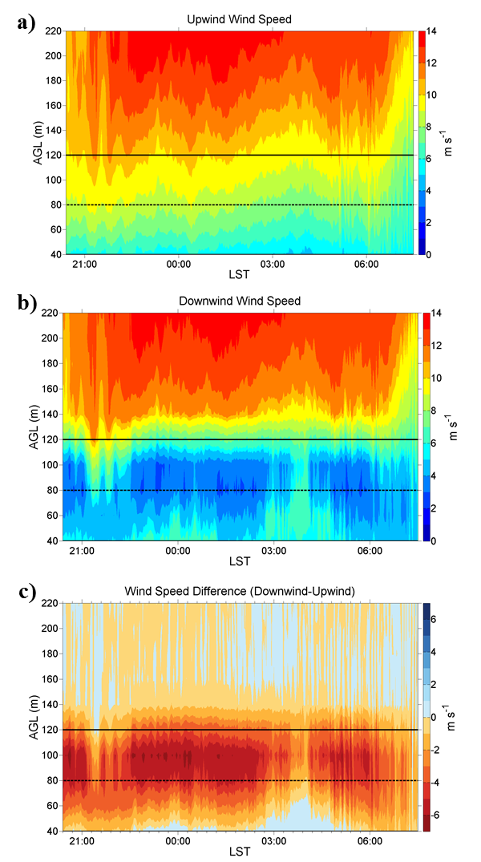
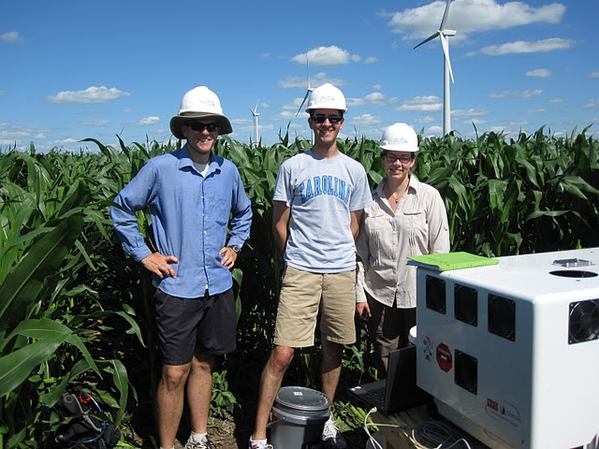
Vertically Pointing Lidar
Wind Speed Contours upwind and downwind of B-line of turbines (D = Rotor diameter, ~80 m)
16-17 July 2011
4.5 D South of B-turbines
Rotor Layer
2.0 D North of B-turbines
CU/NREL Lidar research team
Speed difference

Slide 17
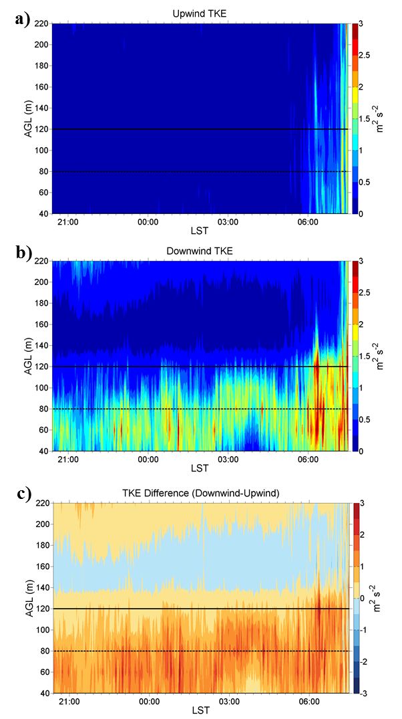
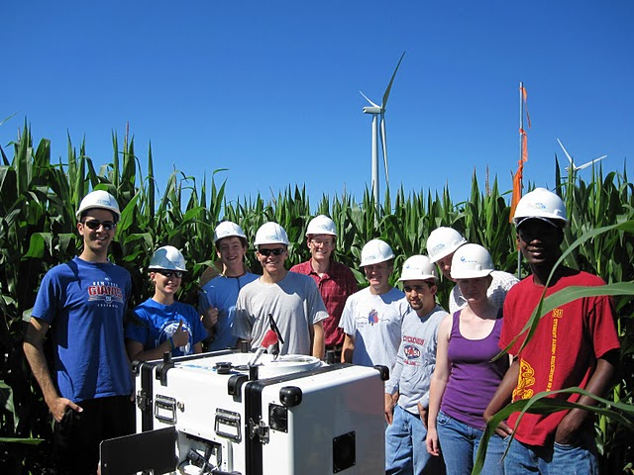
Vertically Pointing Lidar
Vertical profiles of turbulence kinetic energy (TKE)
16-17 July 2011
4.5 D South of B-turbines
Rotor Layer
2.0 D North of B-turbines
CU/NREL/ISU Lidar deployment team
TKE difference

Slide 18
Analysis by Dan Rajewski
Lidar Data Provided by J.K. Lundquist, M.E. Rhodes, M. Aitken
See also:
M Rhodes: The Effect of Wind Turbine Wakes on Summertime Midwest Wind Profiles
as Observed with Ground Based Doppler LIDAR (NREL seminar available online at
http://wind.nrel.gov/seminars/ )

Slide 19
Factors influencing turbine wakes
Wind direction
  (centerline vs. periphery effects important to distinguish with downwind distance)
Upwind 80-m wind speed
  (wind speed determines the amount of power generation and wake-turbulence production
Stratification/shear
  (ambient vertical directional shear larger than 30° disorganizes the wake)

Slide 20
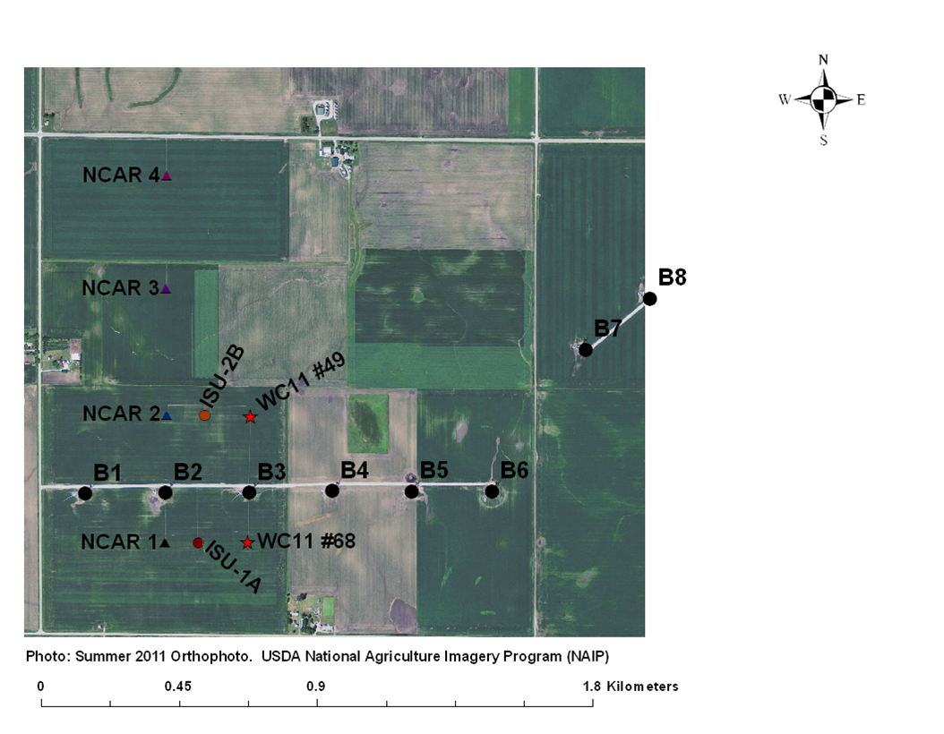
Wake sectors for composites of wind cube and flux station differences (downwind-upwind)
Use the 80 m wind direction
from south wind cube (WC68)
to develop wake windows:
WEST
B12 (WSW)
B23G (between turbines B2 and B3) (SW)
B3 (S)
B34G between turbines B3 and B4 (SSE)
B456h1 (SE)
B456h2 (ESE)
B567h1 (E)
80 m wind direction
from north wind cube (WC49)
to develop wake windows for:
B78 (ENE)
NORTH (NW-NE) (multiple lines of
turbine wakes upstream from this sector)

Slide 21
Coupled wind cube and surface station differences: vertical velocity (downwind-upwind)
Upward velocity
only important in
near-wake centerline
position?
(Δw)
Neutral
No significant vertical
motion at the surface
Temperature stratification suppresses vertical motion for isolated wakes?
Is uplift an artifact
of the static
pressure field
near the line of
turbines?
Static pressure
effects are weaker
for oblique flow
conditions?
(Δw)
Stable

Slide 22
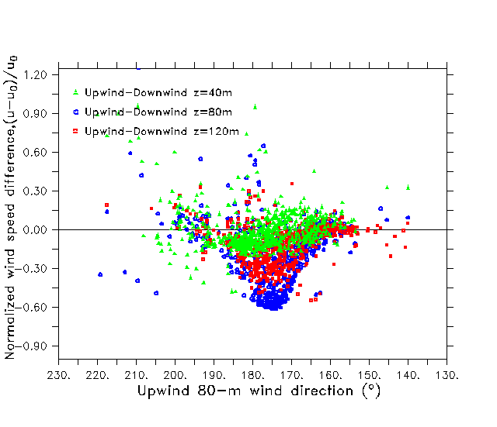
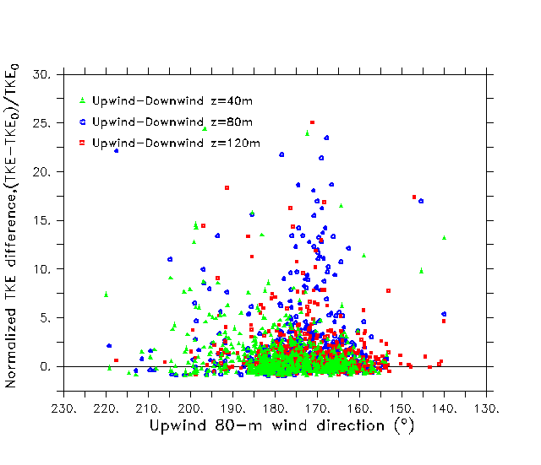
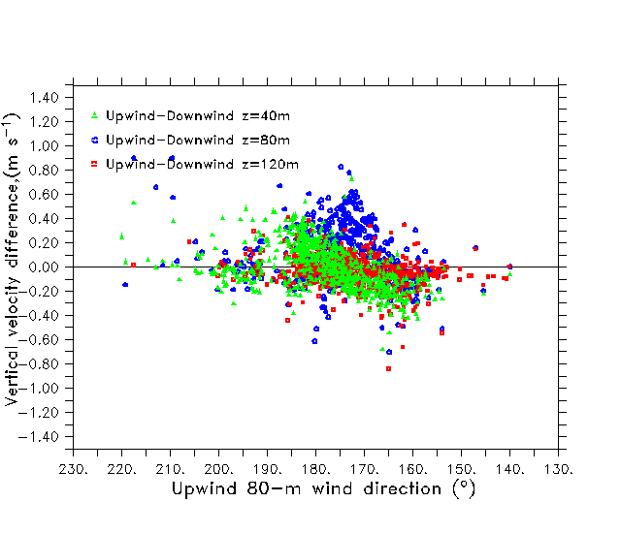
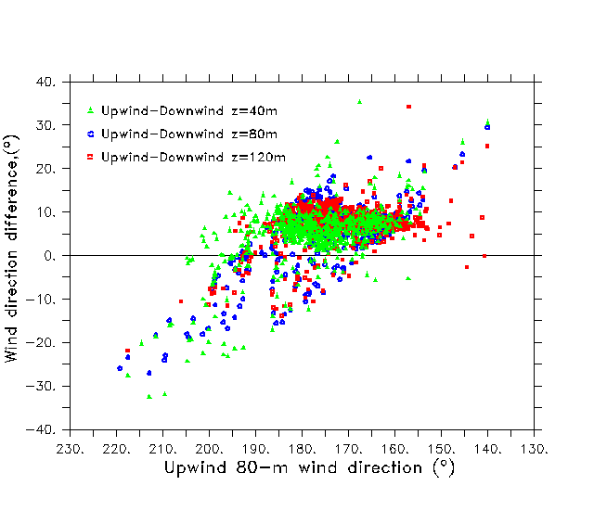
Centerline impacts important for speed, 10-15 degree expansion of other variables
Normalized speed (ΔU/U₀)
Normalized TKE(ΔTKE/TKE₀)
Vertical velocity (w)
Wind direction (°)
Uplift only in center-line of wake?
Backing wind direction
in wake?

Slide 23
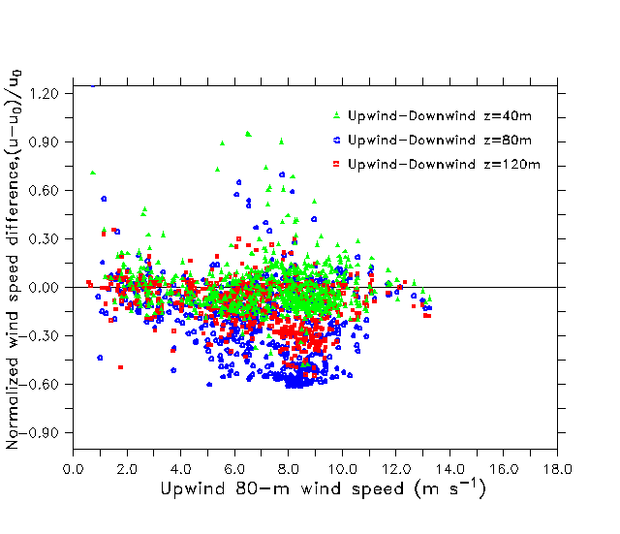
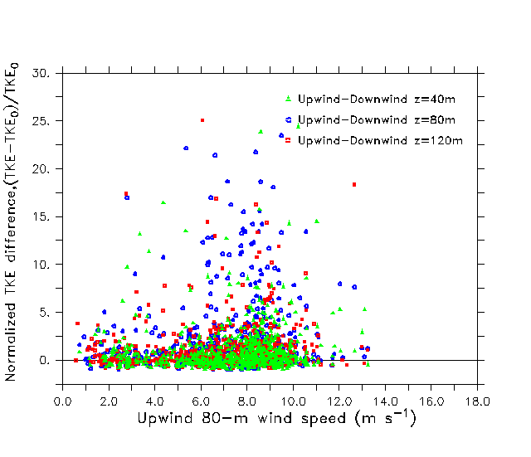
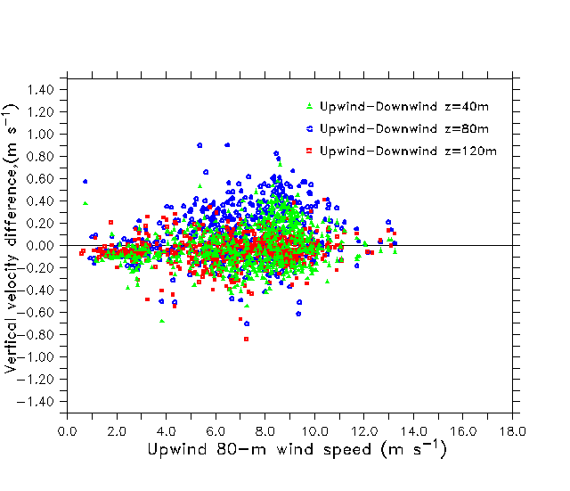
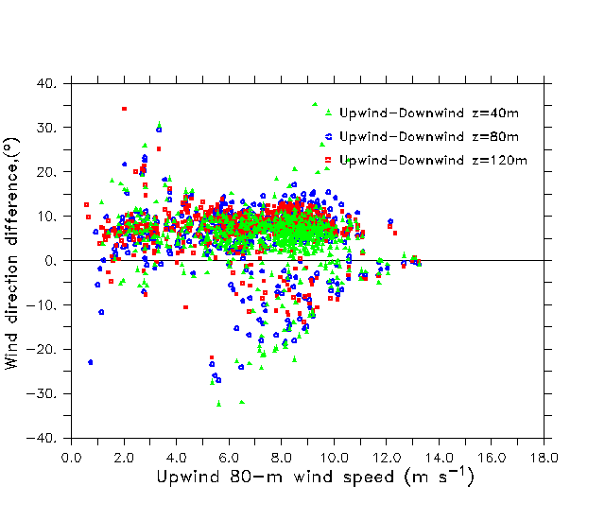
Largest difference seems to peak at an upwind speed near 9 m/s for all variables
Normalized speed (ΔU/U₀)
Normalized TKE(ΔTKE/TKE₀)
Vertical velocity (w)
Wind direction (°)

Slide 24
Key Messages
Temperature increases at night in lee of turbines
Temperature decreases during day in lee of the turbines
Wind speed increases in the near lee of the turbines, more for stable flow
Significant wind shear from surface to nacelle particularly under stable flow
Downward CO₂ flux is enhanced during day in lee of the turbines
Some evidence for surface layer convergence across a line of turbines

Slide 25
Surface Pressure Perturbation Produced by a Line of Turbines

Slide 26
ISU 1
Wind Vector
L
B1
B5
H
Grad P
F
ISU 2

Slide 27
Wake from B1
B1
B5

Slide 28
Wake from B1
B1
B5
Wang, H., and E. S. Takle, 1996: On three-dimensionality of shelterbelt structure
and its influences on shelter effects. Bound.-Layer Meteor. 79, 83-105.

Slide 29
Sfc
Wake from B1
B1
B5
Sfc

Slide 30
Wake from B1
B1
B5

Slide 31
Southerly Winds, SW at Surface
Backing wind at ISU 2
under stable conditions

Slide 32
Wake from B4
B1
B5

Slide 33
Southerly winds, SE at Surface
Veering wind at ISU 2
under stable conditions

Slide 34
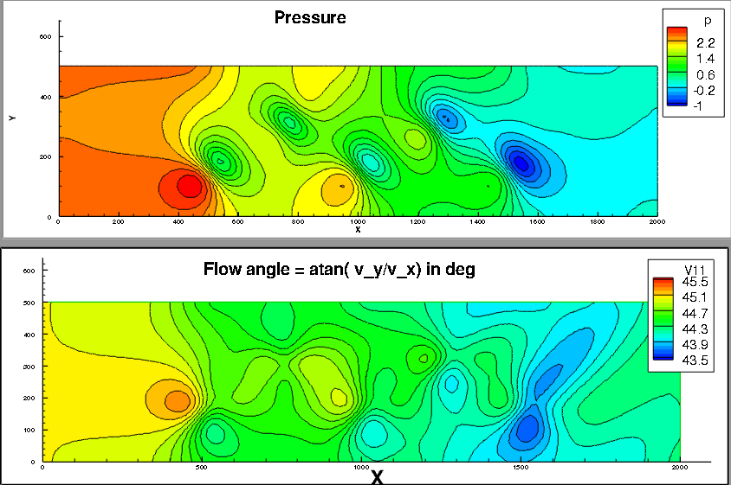
OpenFOAM simulation
Anupam Sharma
Aerospace Engineering Department, Iowa State University
slip surface condition
x
x
Turbines
x
x
x

Slide 35
OpenFOAM simulation
Anupam Sharma
Aerospace Engineering Department, Iowa State University
slip surface condition
p
Veering produced
by pressure gradient

Slide 36
Surface Pressure Perturbation Produced by a Line of Turbines
Important factor in driving near-turbine surface flow, especially speed-up in the lee
Some evidence that this pressure field leads to surface convergence within the wind farm
Need to deploy a network of high-accuracy barometers (nanobarometers) to map out the perturbation pressure field both near turbines and across the wind farm

Slide 37
Measurements Needed
Additional surface flux measurements (middle of wind farm)
Surface pressure field across turbine line
Vertical profiles of horizontal velocity through the turbine layer (H)
Horizontal velocities across the wind farm (convergence?)
Turbulence in and above the turbine layer with the layer above (H-2H); also vertical velocity above the turbine layer
Diurnal changes of u, T, RH, turbulence in H-10H
Low-level jet characteristics

Slide 38
Analysis Needed
Surface flux anomalies
Wake structure – dependence on stability, speed and direction shear
Coupling of the turbine layer with the layer above (H-2H)
Horizontal convergence in the H layer
Diurnal changes in H-10H
Low-level jet characteristics

Slide 39
Modeling Needed
Diurnal changes of surface fluxes
Coupling of the turbine layer with the layer above (H-2H)
Horizontal convergence in the H layer
Diurnal changes in H-10H
Low-level jet characteristics
Turbine-turbine interactions (wake characteristics)
Shear and turbulence coupling to blade stresses

Slide 40
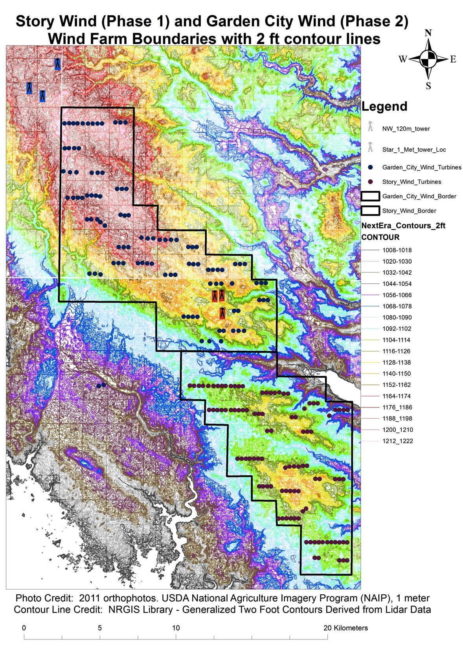
Potential Future Contributions from CWEX
200-turbine utility scale test bed
Flat terrain allows clarity for exploring fundamental interactions of the wind farm with the PBL
Strong diurnal changes in surface layer stratification and resulting shear in speed and direction
Strong Low-Level Jet (similarities to coastal jets as well, horizontal uniformity)
Seasonal land surface change characteristics
Cooperative land owners, multiple field sites
NDA with wind farm operator, access to SCADA data

Slide 41
Potential Future Contributions from CWEX
Utility scale test bed
Flat terrain allows clarity for exploring fundamental interactions of the wind farm with the PBL
Strong diurnal changes in surface layer stratification and resulting shear in speed and direction
Strong Low-Level Jet (similarities to coastal jets as well, horizontal uniformity)
Seasonal land surface change characteristics
Cooperative land owners, multiple field sites
NDA with wind farm operator, access to SCADA data

Slide 42
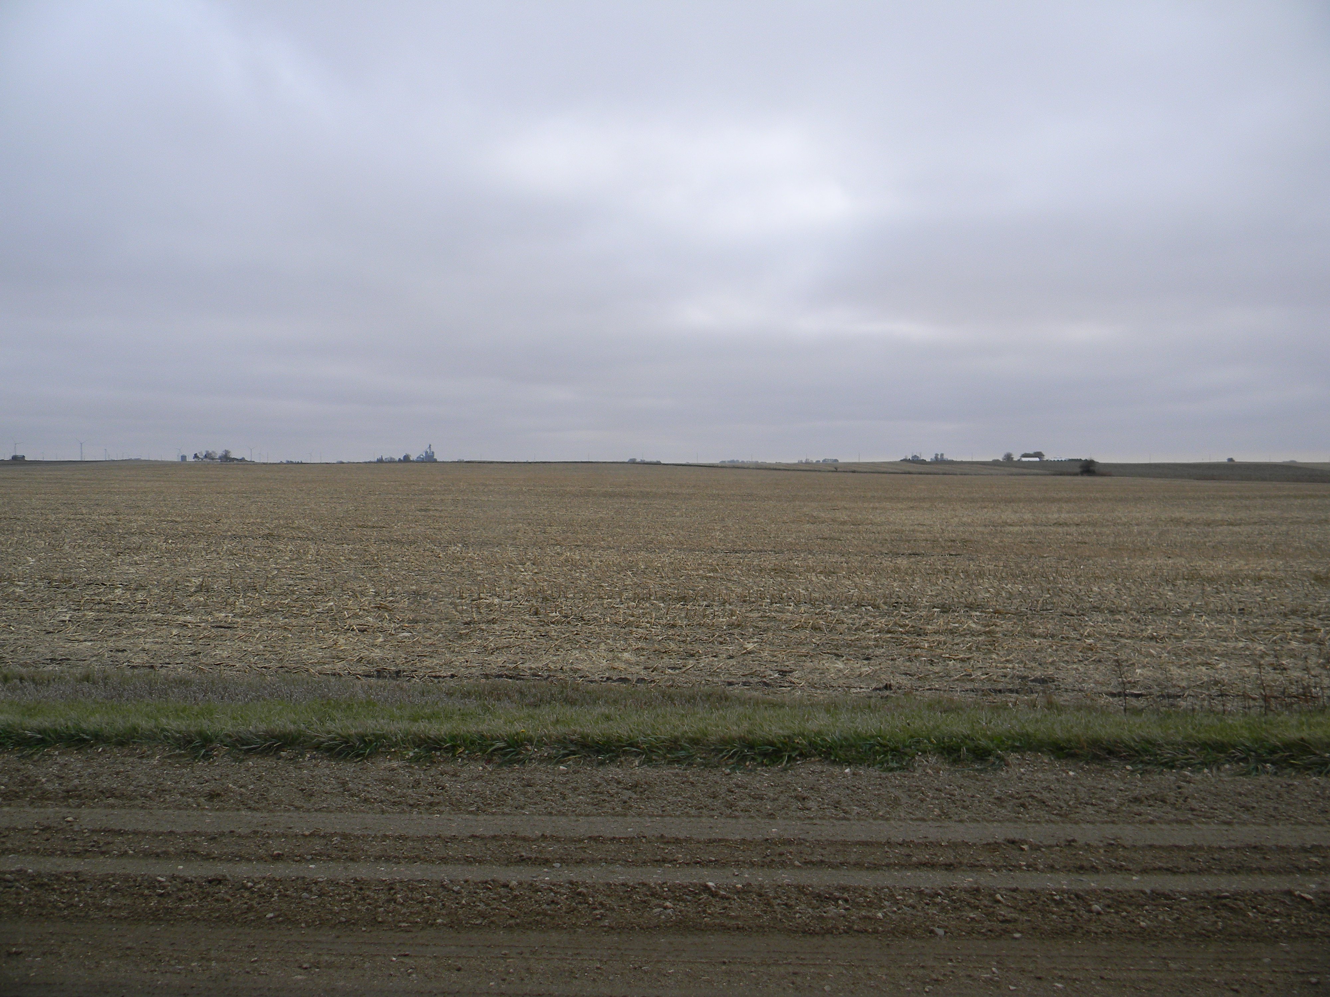
Figure 3. View to the south from Site A.

Slide 43
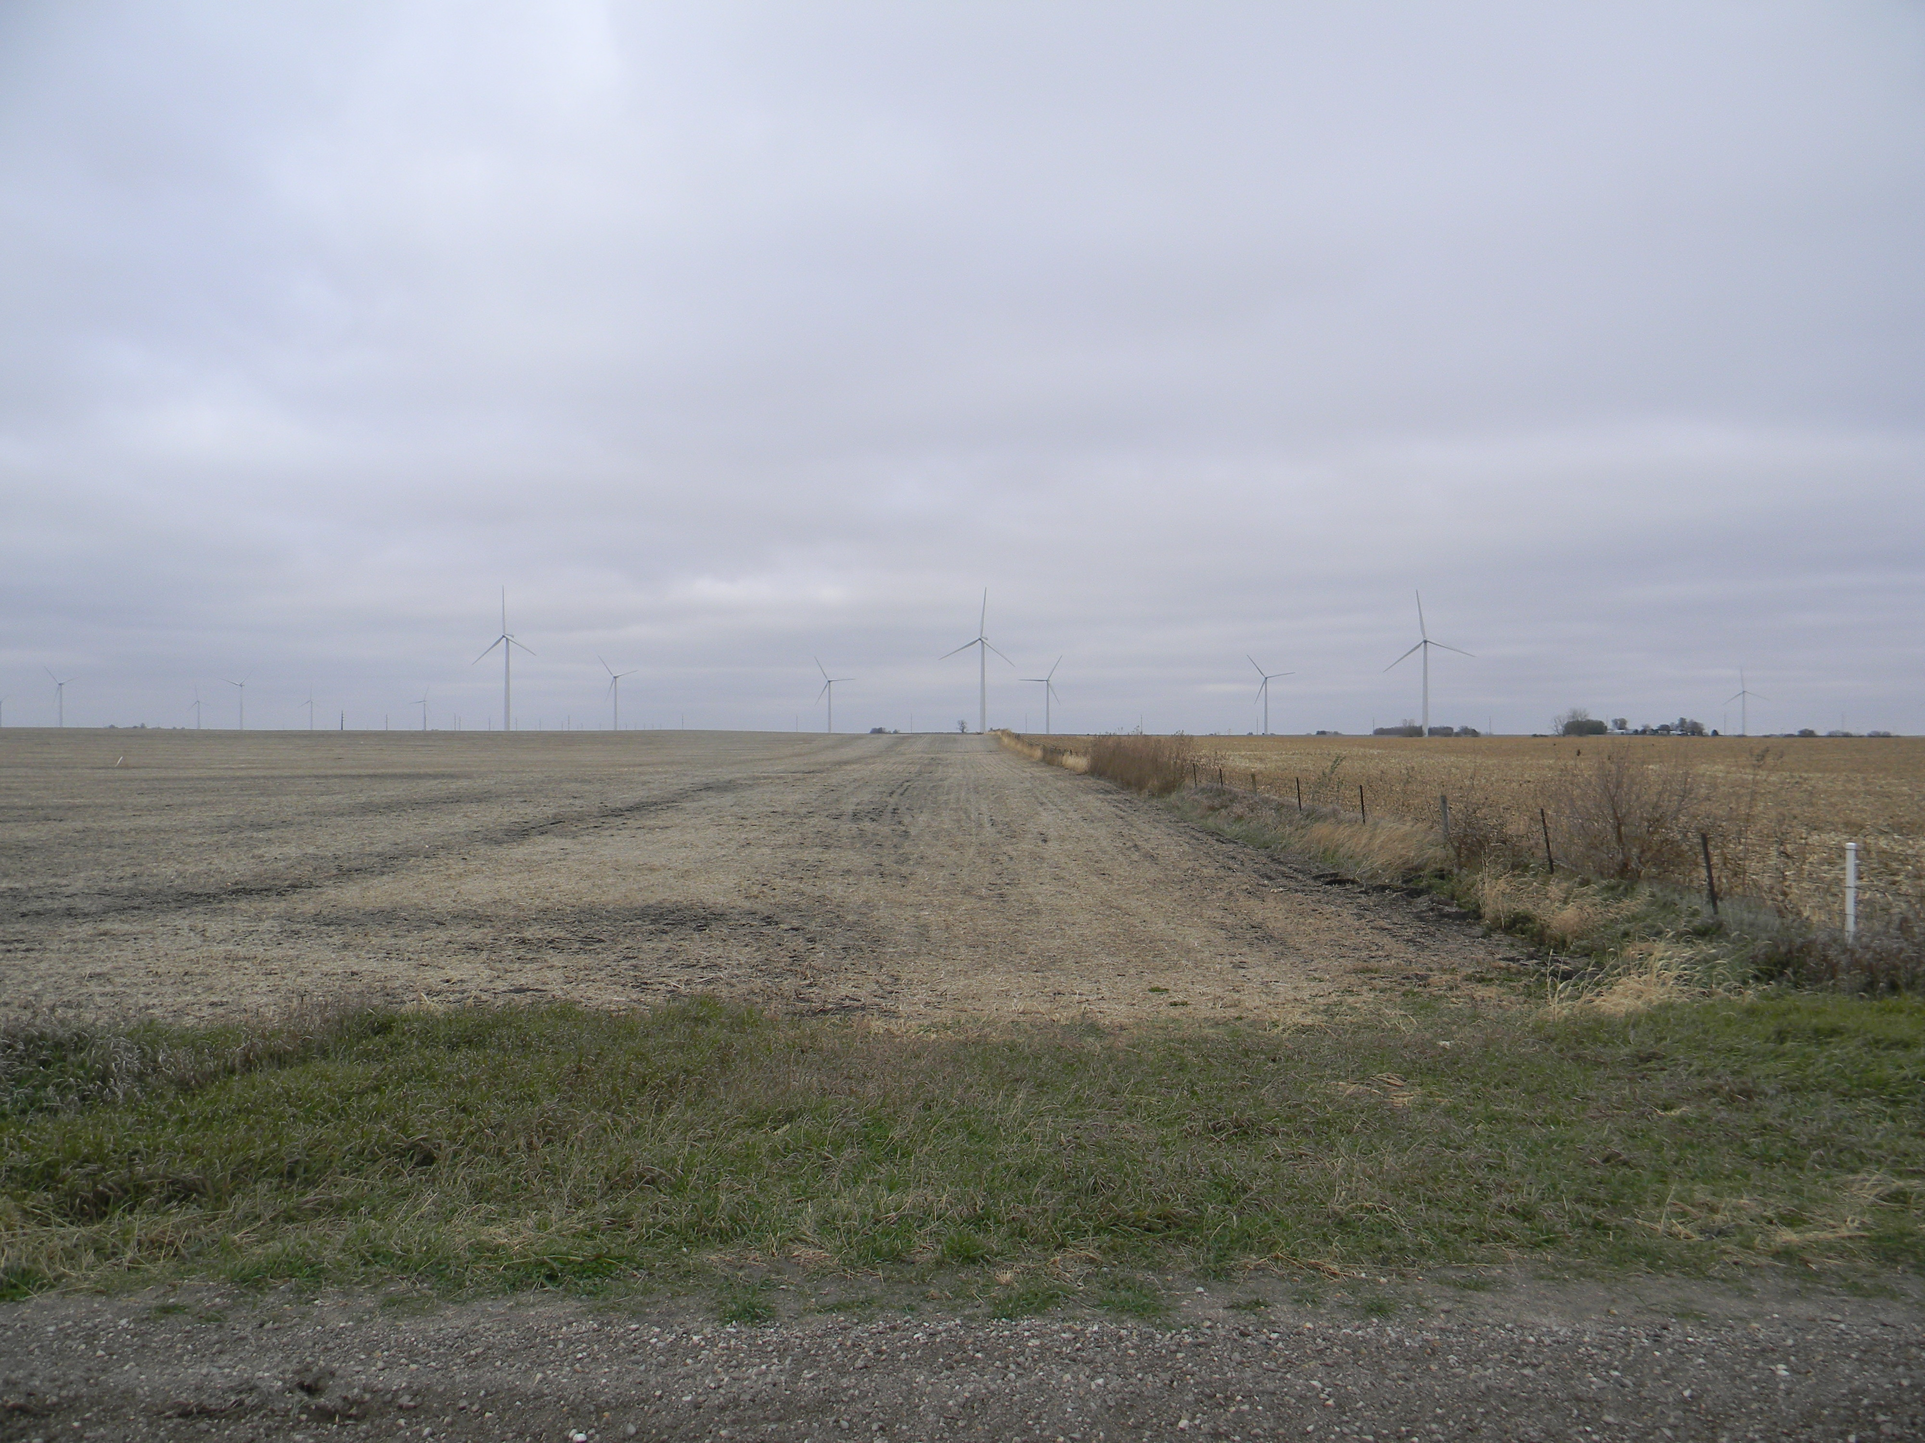
Figure 4. View to the north from Site B

Slide 44
Current Status:
Instrumentation
EPSCoR funding for two 120-m instrumented towers
EPSCoR funding for network of surface stations
IGERT funding for nanobarometer network
State of Iowa funding for partnership with a private company for developing a tethered balloon measurement platform (loan of 4 50-m towers, 2 lidars)
Wind farm owner is redeploying 4 sodars to the CWEX site

Slide 45
Collaborations being Planned
National Laboratory for Agriculture and the Environment will be deploying instruments nearby-but-outside this wind farm in 2013-2015
US Agriculture Research Service plans major field campaign (air-craft, surface, satellite special obs) in 2015
NASA plans major field campaign for satellite soil moisture obs in nearby watershed in 2015

Slide 46
Summary
CWEX10/11 have demonstrated the feasibility of a major wind farm observing capability in a high-wind resource region of the US.
Educational component in place
Strong interest from
  private sector
  State of Iowa
  Iowa State University
  Federal agencies (NLAE, ARS, NASA, NCAR, NREL)
  University collaborators (CU. UofIowa, UNI)

Slide 47
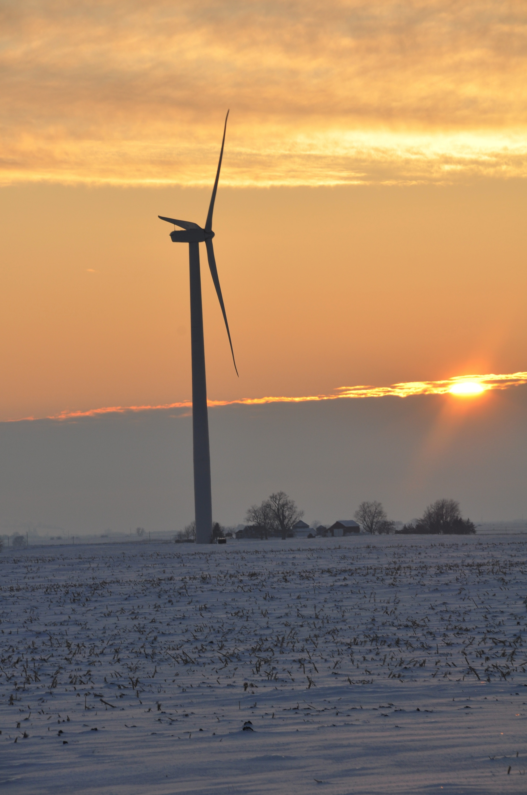
For More Information
Eugene S. Takle
gstakle@iastate.edu
http://www.meteor.iastate.edu/faculty/takle/
515-294-9871
Julie K. Lundquist
Julie.Lundquist@colorado.edu
Julie.Lundquist@nrel.gov
http://atoc.colorado.edu/~jlundqui
303/492-8932 (@CU)
303/384-7046 (@NWTC)
Photo courtesy of Lisa H Brasche

Slide 48
Coupled wind cube and surface station differences: wind direction (upwind-downwind)
(Δ°)
Neutral
Surface
and upper level
differences
indicate
a strengthening
of CW vertical shear
within the rotor
and an increase
of CCW shear
below the rotor
(Δ°)
Stable
Wind direction with
the rotor depth
quasi-uniform
for north winds
(far downwind within
leading edge of the wind farm)

Slide 49
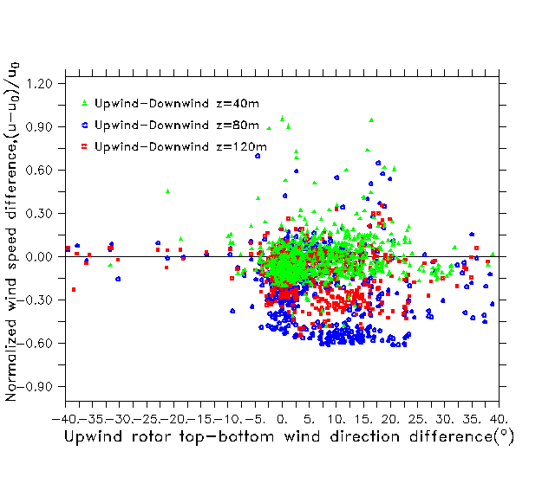
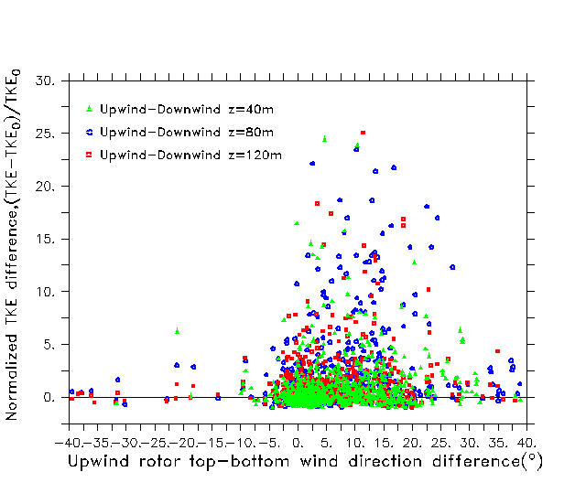
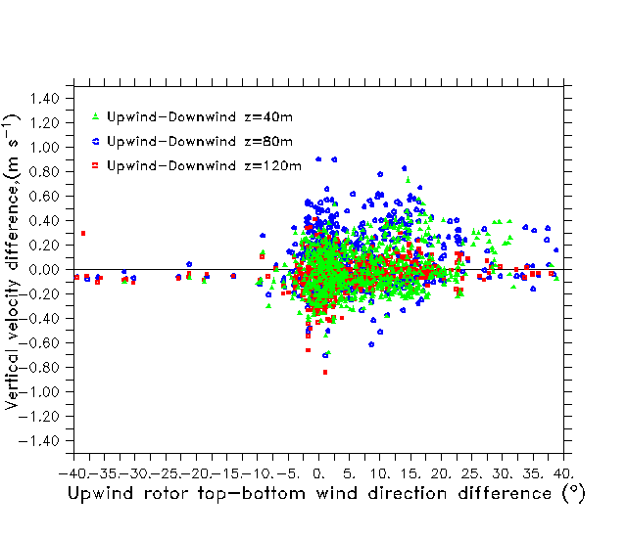
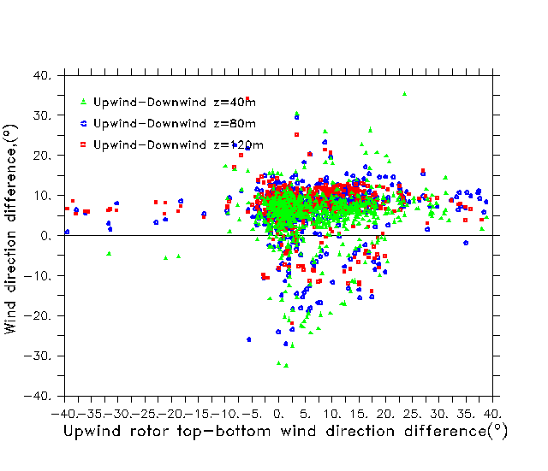
Vertical directional shear > 20-25 ° reduces wake influence of all variables
Normalized speed (ΔU/U₀)
Normalized TKE(ΔTKE/TKE₀)
These are for
unstable periods
Vertical velocity (w)
Wind direction (°)

