Slide 1
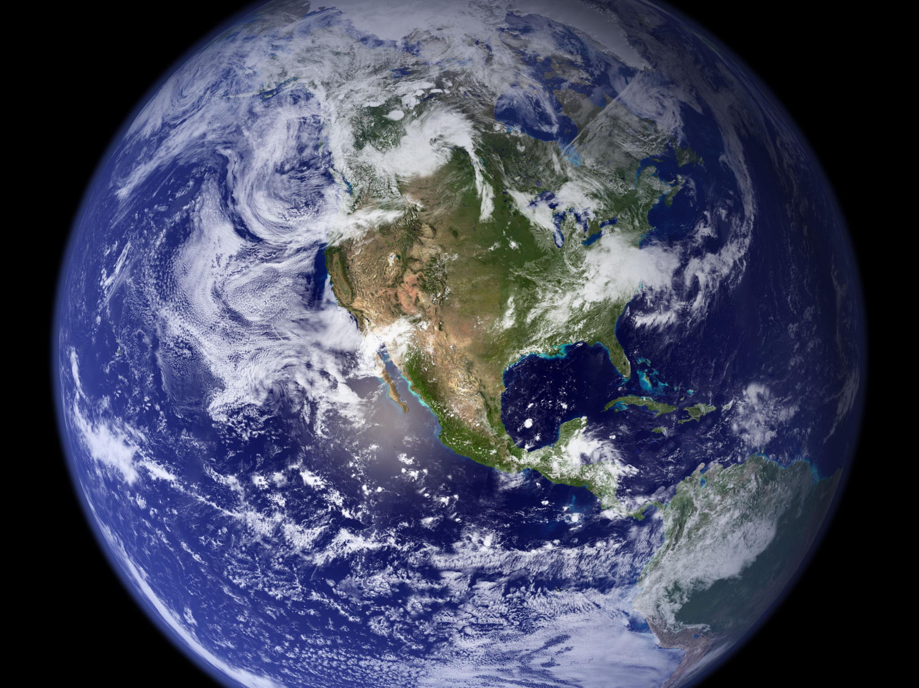
Image courtesy of NASA/GSFC

Slide 2
Climate Change: Educating for Informed Decision-Making
Eugene S. Takle
Professor of Atmospheric Science
Professor of Agricultural Meteorology
Director, Climate Science Program
Iowa State University
Ames, IA 50011
gstakle@iastate.edu
Iowa Association of Community College Trustees
Annual Conference
Iowa Valley Community College District
Marshalltown, IA
29 July 2010

Slide 3
Outline
The science of global climate change
Climate change in Iowa
Using local/regional climate change as a springboard to understanding global climate change and the nature of science

Slide 4
Global climate change is one of the most important issues facing humanity
The scientific evidence clearly indicates that our climate is changing, and that human activities have been identified as a dominant contributing cause.
Don Wuebbles
Notes:
No disagreement in peer reviewed literature
Powerful statements from every major professional science society and organization in the world
Powerful statements from the National Academies of Sciences (the leadership in science) for every major country
G8 + 5 other countries, May 2009: “The need for urgent action to address climate change is now indisputable.”

Slide 5
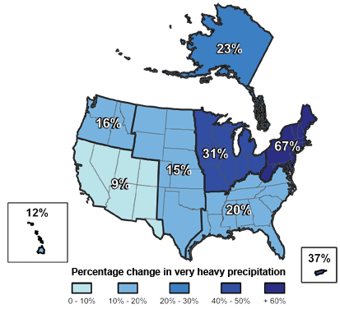
Climate changes are underway in the U.S. and are projected to grow
Temperature rise
Sea-level rise
Increase in heavy downpours
Rapidly retreating glaciers
Thawing permafrost
Lengthening growing
season
Lengthening ice-free season
in the ocean and on lakes
and rivers
Earlier snowmelt
Changes in river flows
Plants blooming earlier; animals, birds and fish moving northward
Don Wuebbles

Slide 6
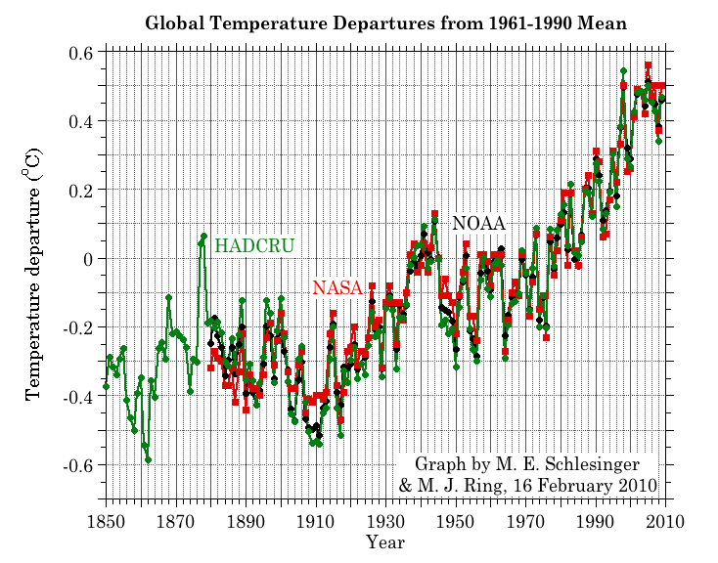
Three separate analyses of the temperature record – Trends are in close agreement
Don Wuebbles

Slide 7
Three separate analyses of the temperature record – Trends are in close agreement
January-June 2010 is the warmest such Jan-June in the 160 year record
Don Wuebbles

Slide 8
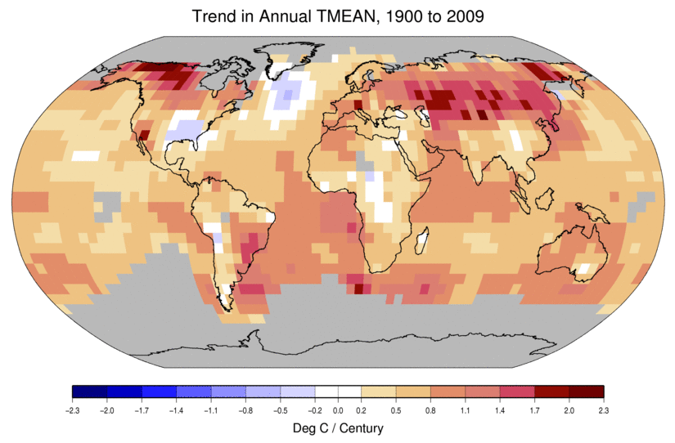
Temperature Changes are Not
Uniform Around the Globe
From Tom Karl, NOAA NCDC

Slide 9
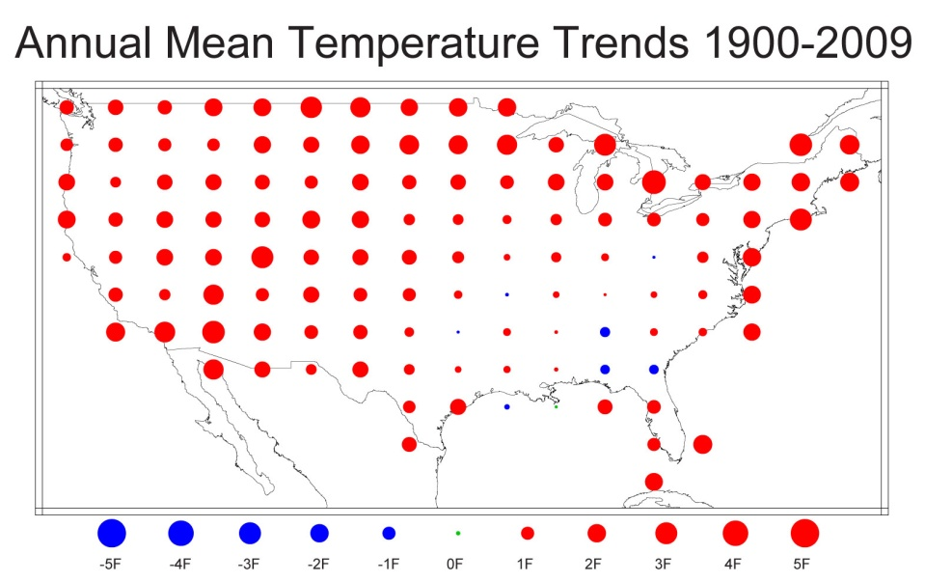
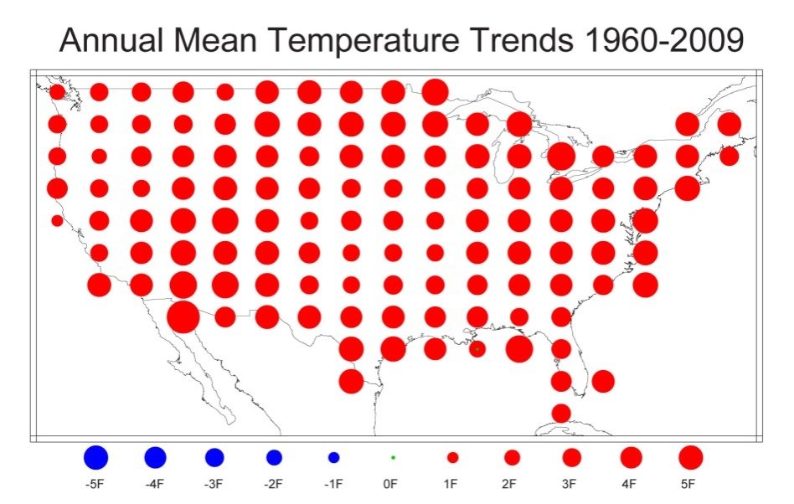
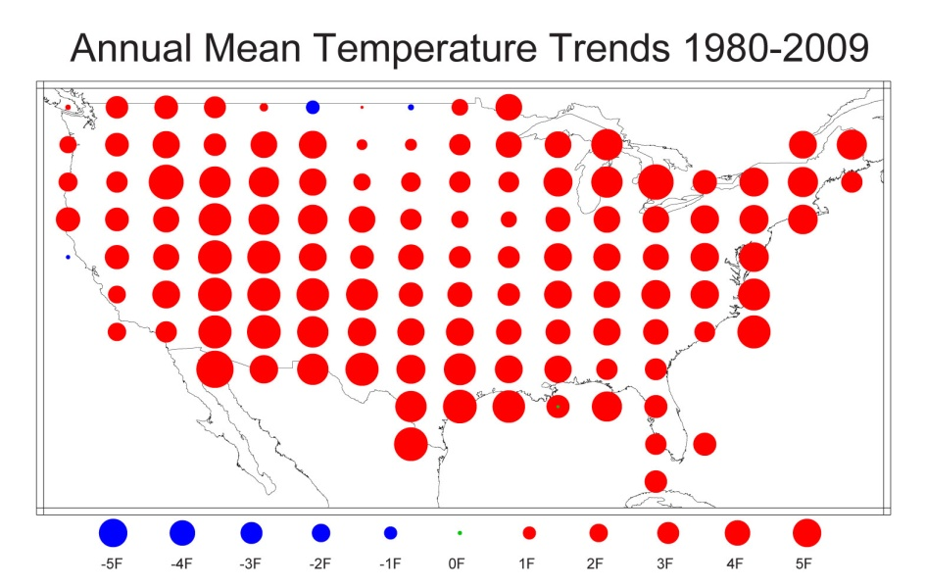
U.S. Temperature Trends
U.S. average temperature has risen more than 2ºF over the past 50 years
From Tom Karl, NOAA NCDC

Slide 10
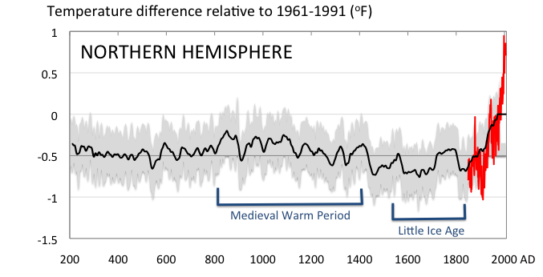
Conditions today are unusual in the context of the last 2,000 years …
Don Wuebbles

Slide 11
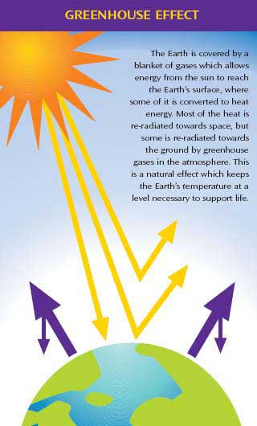
Why does the Earth warm?
1. Natural causes
THE GREENHOUSE EFFECT…
…is 100% natural.
  Heat is trapped in the atmosphere.
…sustains life on Earth.
  Keeps average temperatures at 12.8ºC (55ºF), instead of –29ºC (-20ºF).
Don Wuebbles

Slide 12
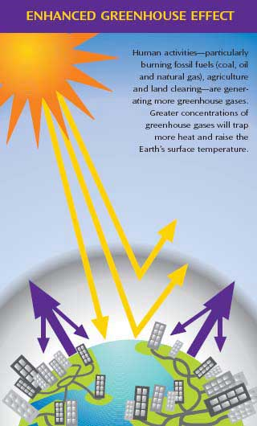
Why does the Earth warm?
2. Human causes
THE ENHANCED GREENHOUSE EFFECT
(or GLOBAL WARMING)
… is primarily human-induced: We’re increasing heat-trapping gases in the atmosphere.
… is like wrapping an extra blanket around the Earth.
Don Wuebbles

Slide 13
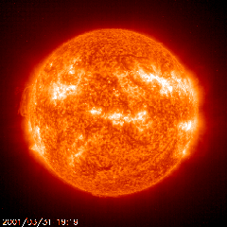
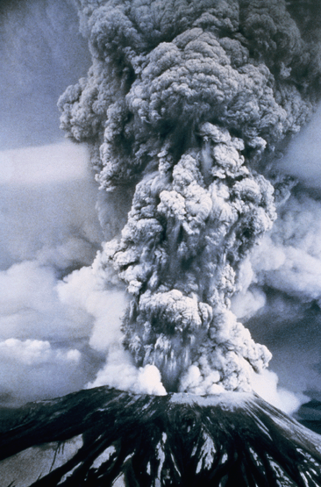
Natural factors affect climate
Variations in the energy
received from the sun
Variations in the Earth's orbit
(Milankovic effect)
Stratospheric
aerosols from
energetic
volcanic eruptions
Chaotic interactions in
the Earth's climate
(for example, El Nino, NAO)
Don Wuebbles

Slide 14
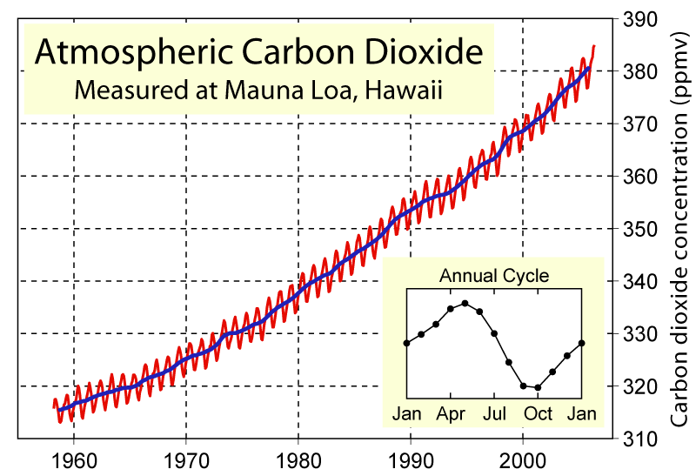
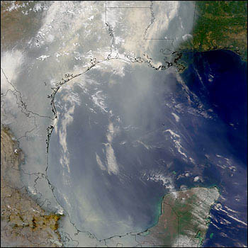
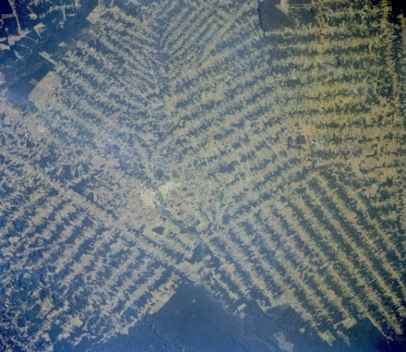
Non-natural mechanisms
Changes in atmospheric concentrations of radiatively important gases
Changes in aerosol particles from burning fossil fuels and biomass
Changes in the reflectivity (albedo) of the Earth’s surface
Don Wuebbles

Slide 15
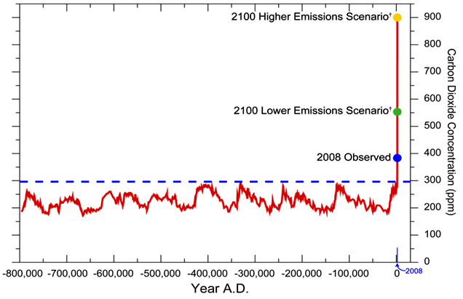
We have Moved Outside the Range of Historical Variation
800,000 Year Record of Carbon Dioxide Concentration
Don Wuebbles

Slide 16
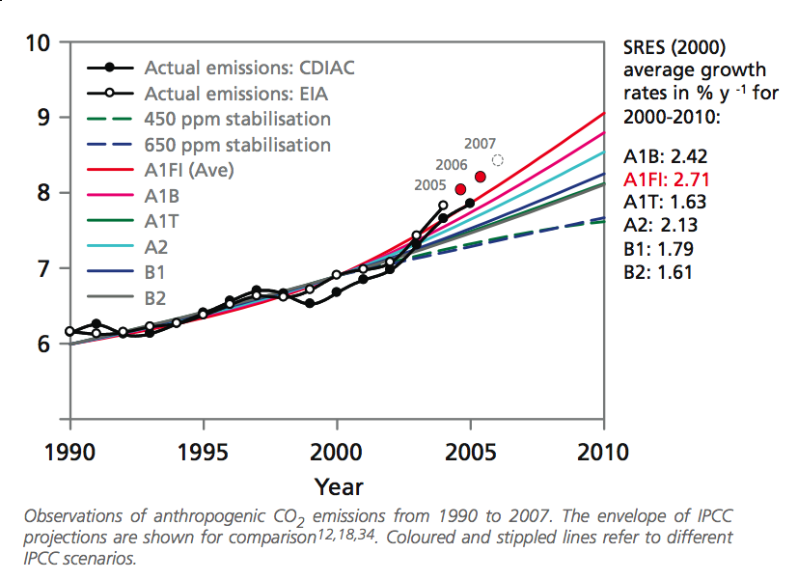
Annual Global Carbon Emissions (Gt)

Slide 17
Annual Global Carbon Emissions (Gt)
Actual emissions are exceeding worst case scenarios projected in 1990

Slide 18
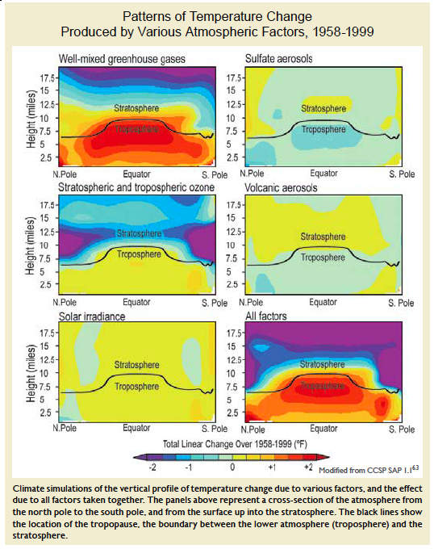
Warming of the Lower and Upper Atmosphere Produced by Natural and Human Causes
Karl, T. R., J. M. Melillo, and T. C. Peterson, (eds.), 2009: Global Climate Change Impacts in the United States. Cambridge University Press, 2009, 196pp.

Slide 19
Warming of the Lower and Upper Atmosphere Produced by Natural and Human Causes
Note that greenhouse gases have a unique temperature signature, with strong warming in the upper troposphere, cooling in the lower stratosphere and strong warming over the North Pole. No other warming factors have this signature.
Karl, T. R., J. M. Melillo, and T. C. Peterson, (eds.), 2009: Global Climate Change Impacts in the United States. Cambridge University Press, 2009, 196pp.

Slide 20
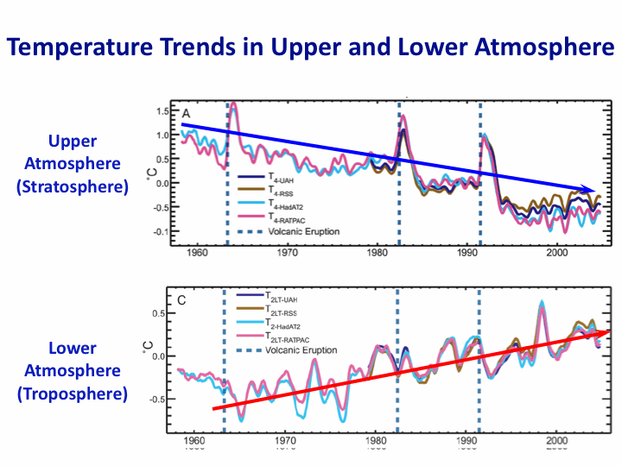
Warming of the Lower and Upper Atmosphere Produced by Natural and Human Causes
Note that greenhouse gases have a unique temperature signature, with strong warming in the upper troposphere, cooling in the lower stratosphere and strong warming over the North Pole. No other warming factors have this signature.
Karl, T. R., J. M. Melillo, and T. C. Peterson, (eds.), 2009: Global Climate Change Impacts in the United States. Cambridge University Press, 2009, 196pp.

Slide 21
Many lines of evidence for conclusion of a “discernible human influence”
“Basic physics” evidence
  Physical understanding of the climate system and the heat-trapping properties of greenhouse gases
Qualitative analysis evidence
  Qualitative agreement between observed climate changes and model predictions of human-caused climate changes (warming of oceans, land surface and troposphere, water vapor increases, etc.)
Paleoclimate evidence
  Reconstructions of past climates enable us to place the warming of the 20th century in a longer-term context
Fingerprint evidence
  Rigorous statistical comparisons between modeled and observed patterns of climate change
Don Wuebbles

Slide 22
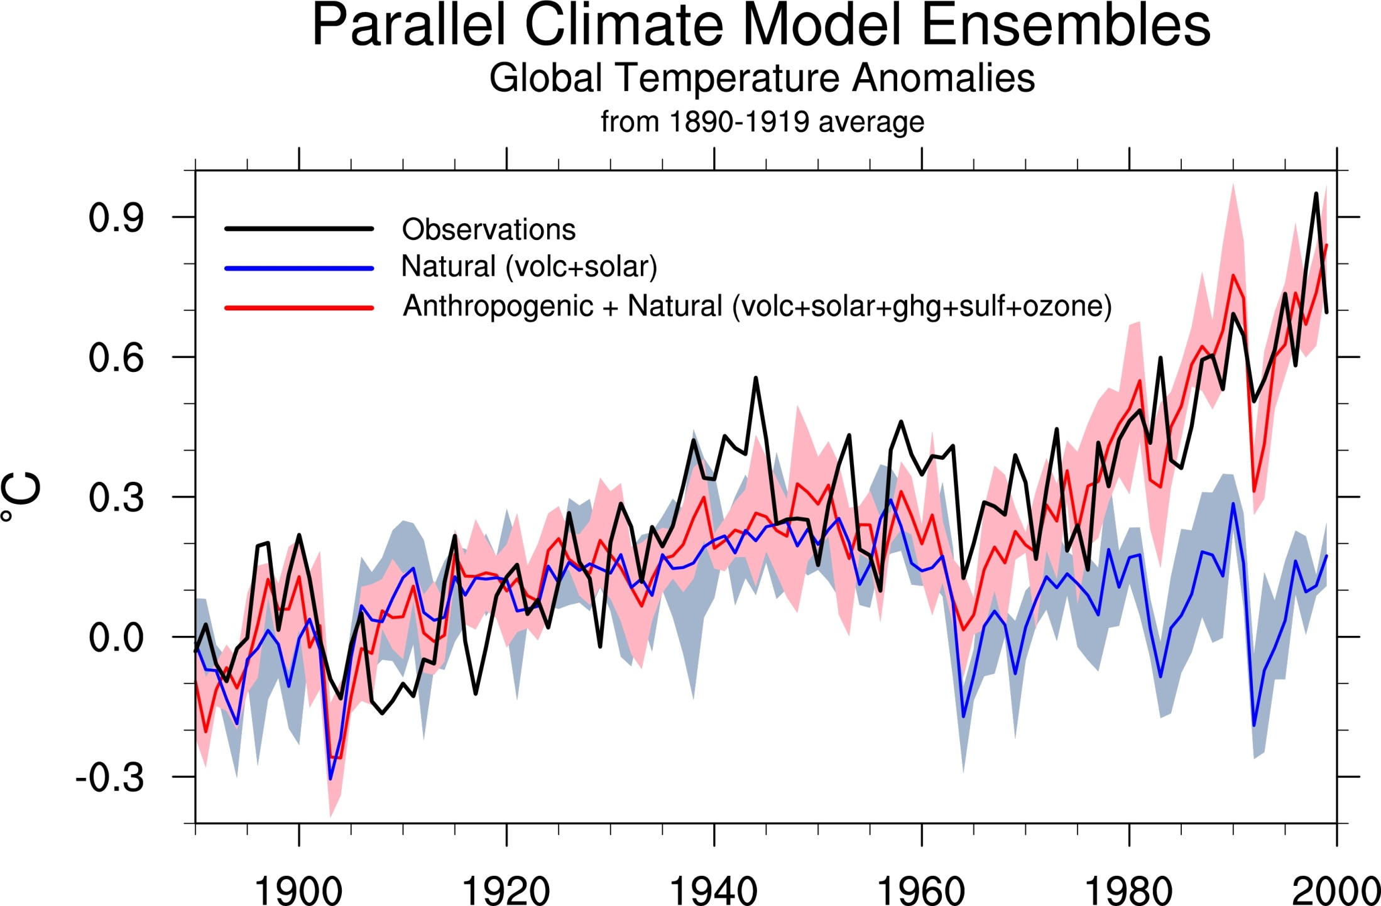
Climate models: Natural processes do not account for
observed 20th century warming after 1965
Don Wuebbles

Slide 23
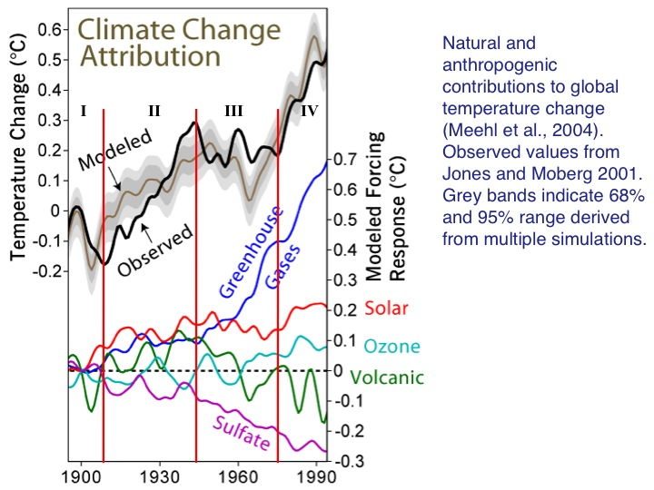

Slide 24
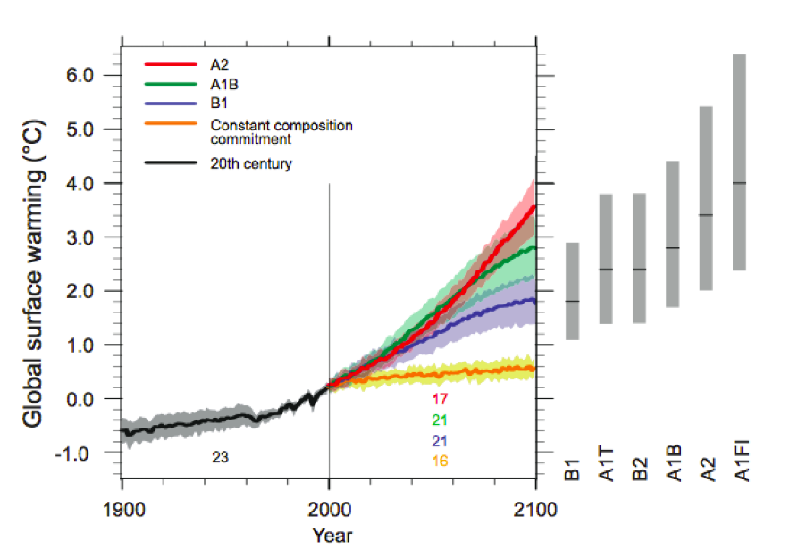
Energy intensive
Balanced fuel sources
More environmentally friendly
If current emission trends continue, global temperature rise will exceed worst case scenarios projected in 2007
FI =fossil intensive
IPCC Fourth Assessment Report Summary for Policy Makers

Slide 25
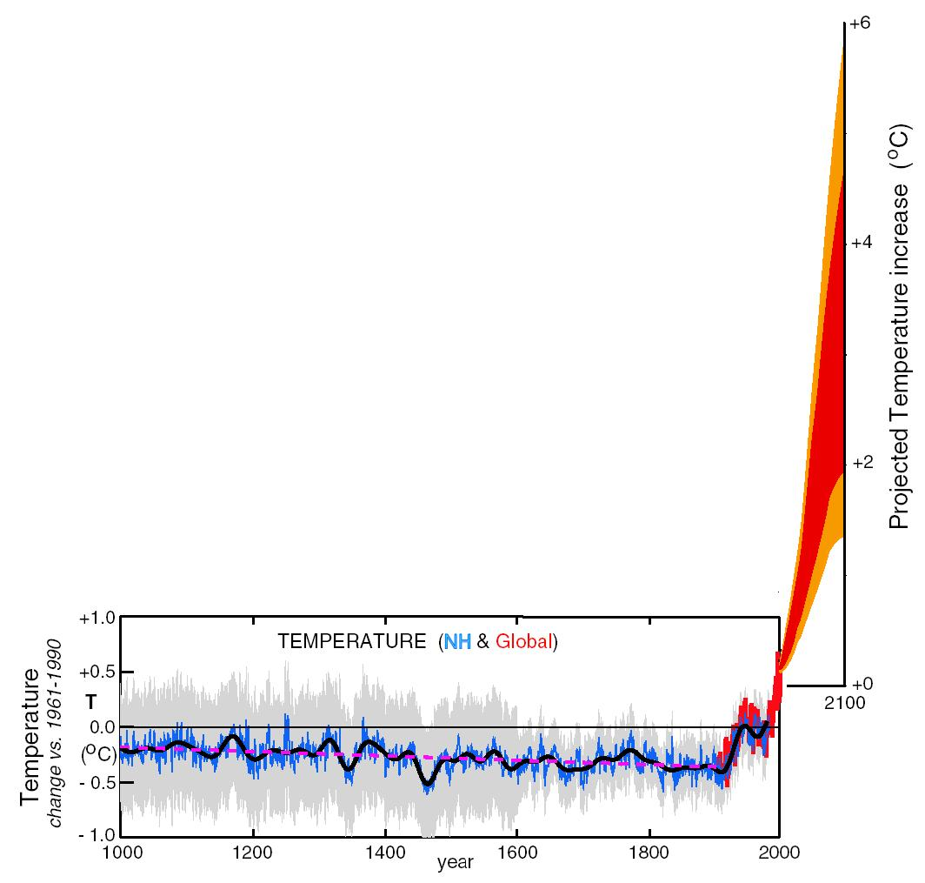
What can we expect in the future?
Don Wuebbles

Slide 26
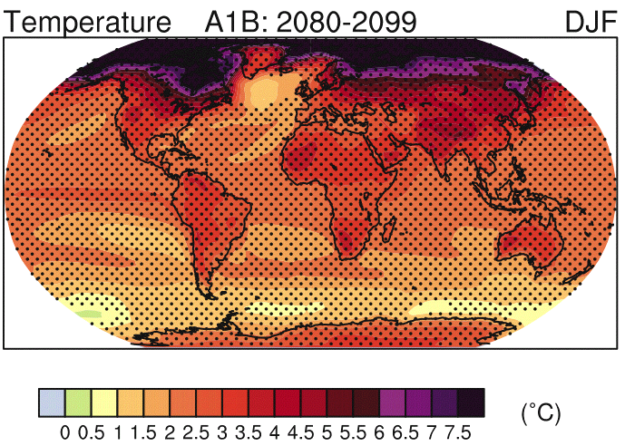
IPCC 2007

Slide 27
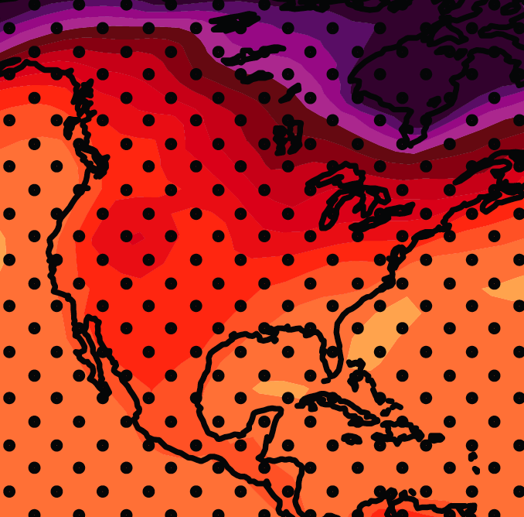
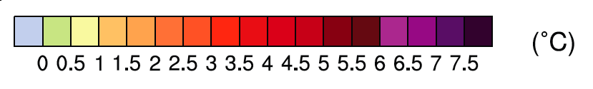
December-January-February Temperature Change
7.2ºF
6.3ºF
A1B Emission Scenario
2080-2099 minus1980-1999

Slide 28
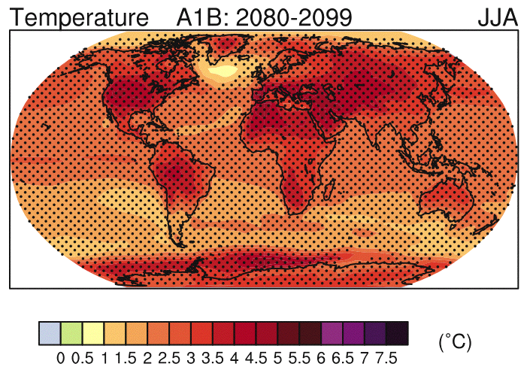
IPCC 2007

Slide 29
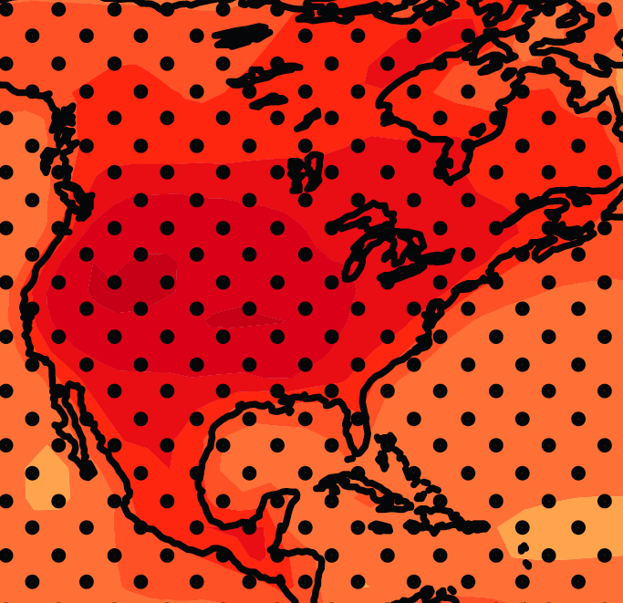
June-July-August Temperature Change
4.5ºF
5.4ºF
A1B Emission Scenario
2080-2099 minus1980-1999

Slide 30
June-July-August Temperature Change
4.5ºF
5.4ºF
Not the direction of current trends
A1B Emission Scenario
2080-2099 minus1980-1999

Slide 31
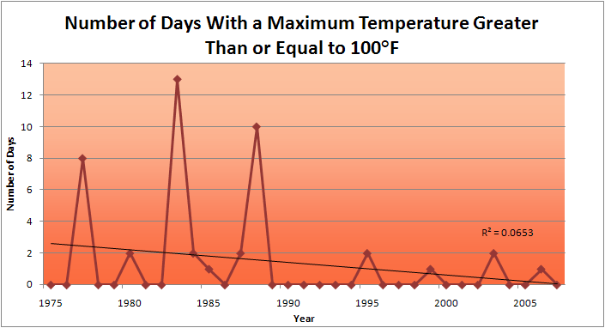
Des Moines Airport Data
1983: 13
1988: 10
1977: 8
2009: 0

Slide 32
Des Moines Airport Data
1983: 13
1988: 10
6 days ≥ 100ºF in the last 20 years
1977: 8
2009: 0

Slide 33
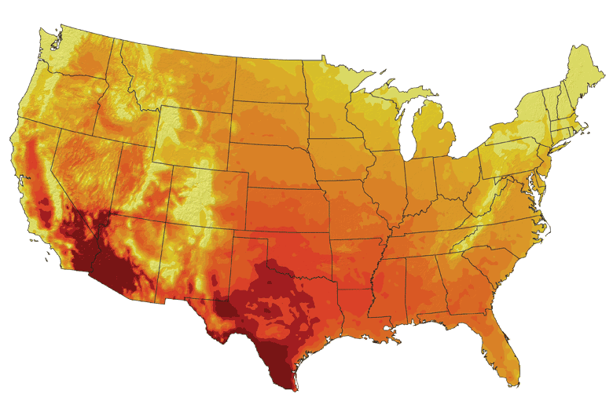
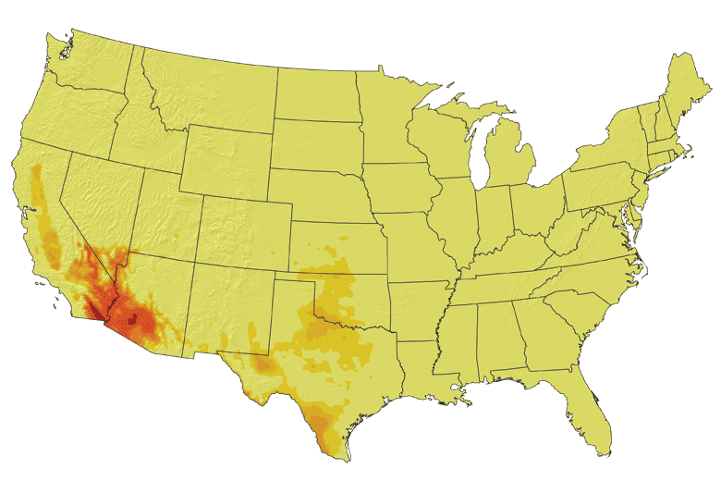
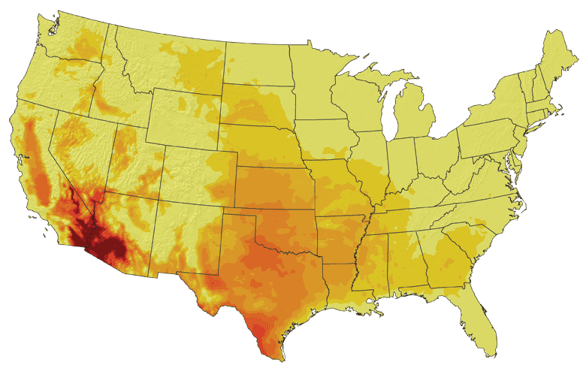
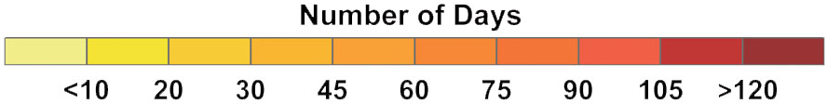
Increases in very high temperatures will have
wide-ranging effects
Higher Emissions Scenario, 2080-2099
Number of Days Over 100ºF
Recent Past, 1961-1979
Average:
30-40 days
Lower Emissions Scenario, 2080-2099
Average:
10-20 days
Don Wuebbles

Slide 34
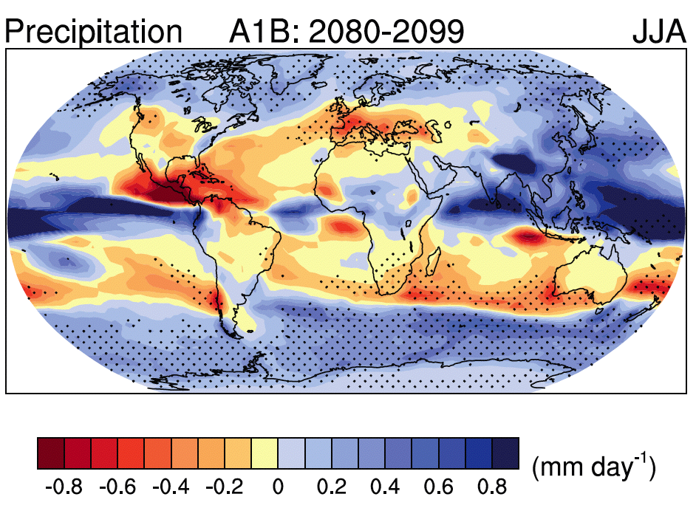
IPCC 2007

Slide 35
Low confidence in model projection of summer precipitation
IPCC 2007

Slide 36
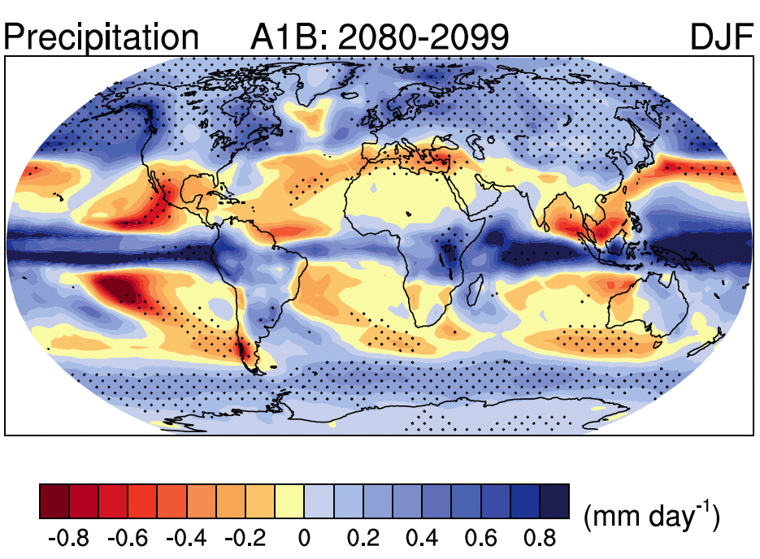
IPCC 2007

Slide 37
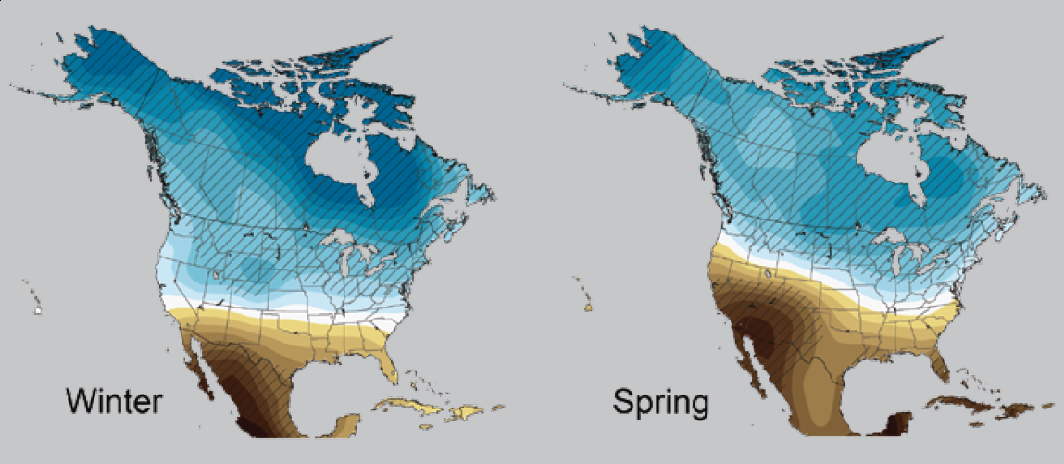
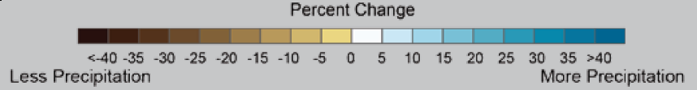
2080-2099
Karl, T. R., J. M. Melillo, and T. C. Peterson, (eds.), 2009: Global Climate Change Impacts in the United States. Cambridge University Press, 2009, 196pp.

Slide 38
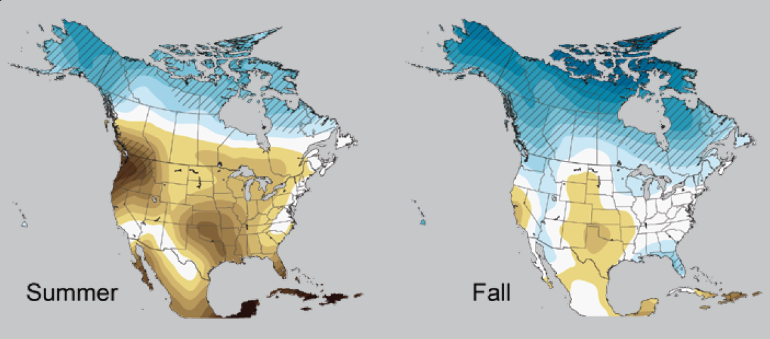
2080-2099
Low confidence
Karl, T. R., J. M. Melillo, and T. C. Peterson, (eds.), 2009: Global Climate Change Impacts in the United States. Cambridge University Press, 2009, 196pp.

Slide 39
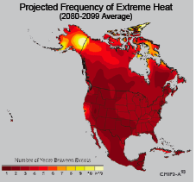
Extreme weather events become more common
Events now considered rare will become commonplace.
Heat waves will likely become longer and more severe
Droughts are likely to become more frequent and severe in some regions
Likely increase in severe thunderstorms (and perhaps in tornadoes).
Winter storm tracks are shifting
northward and the strongest storms are
likely to become stronger and more
frequent.
Don Wuebbles
Notes:
Shown here is the frequency at the end of the century of what we consider now to be a 20 year heat wave. Instead of once every 20 years, these temperatures would be experienced every other year or so over most of the continental US in this business as usual scenario.

Slide 40
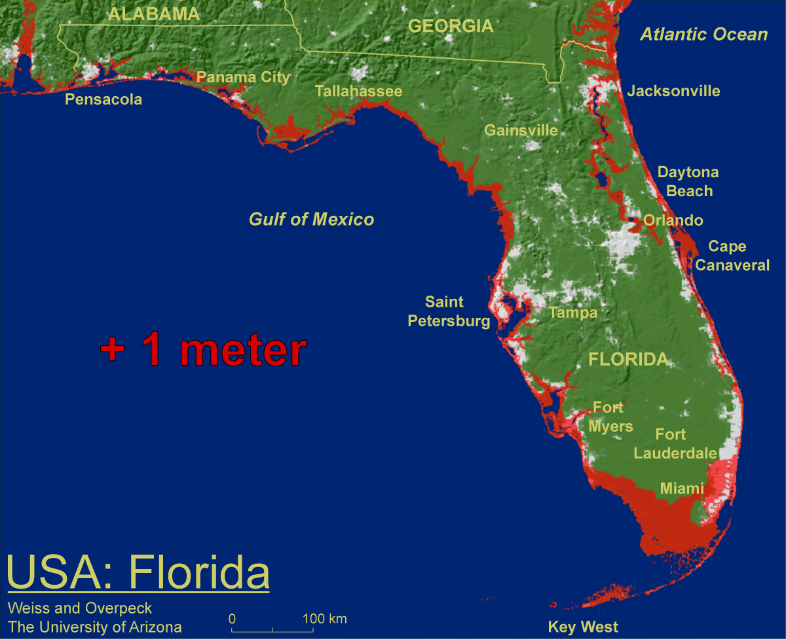
1 meter will be hard to avoid, possibly within this century, just from thermal expansion and small glacier melt.
Don Wuebbles

Slide 41

Widespread climate-related impacts are occurring now and are expected to increase
Water Resources
Energy Supply & Use
Transportation
Agriculture
Don Wuebbles
Ecosystems
Human Health
Society

Slide 42
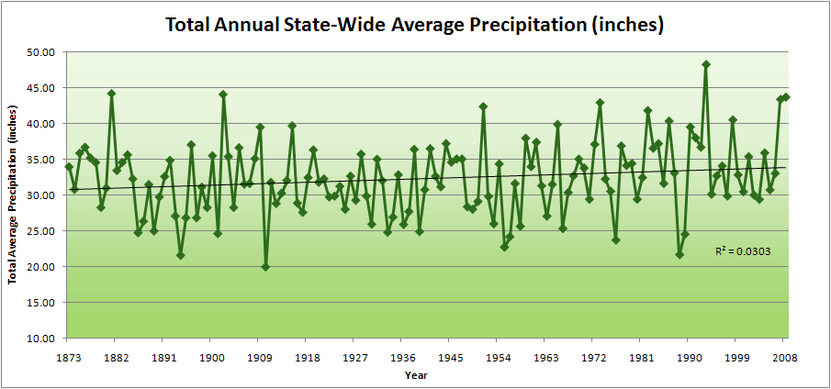
Iowa State-Wide Average Data

Slide 43
Iowa State-Wide Average Data
34.0”
8% increase
31.5”

Slide 44
Iowa State-Wide Average Data
Totals above 40”
2 years

Slide 45
Iowa State-Wide Average Data
Totals above 40”
8 years
2 years

Slide 46
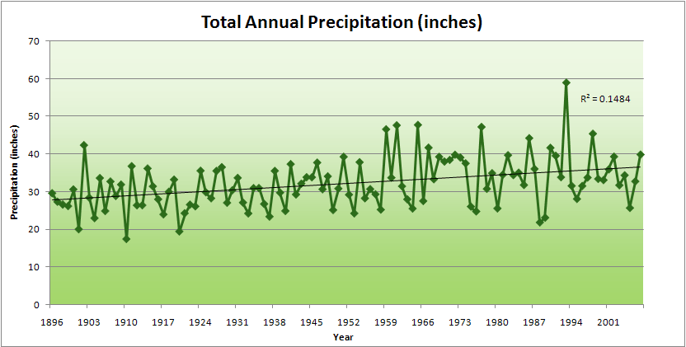
Cedar Rapids Data

Slide 47
Cedar Rapids Data
28.0”
32% increase
37.0”

Slide 48
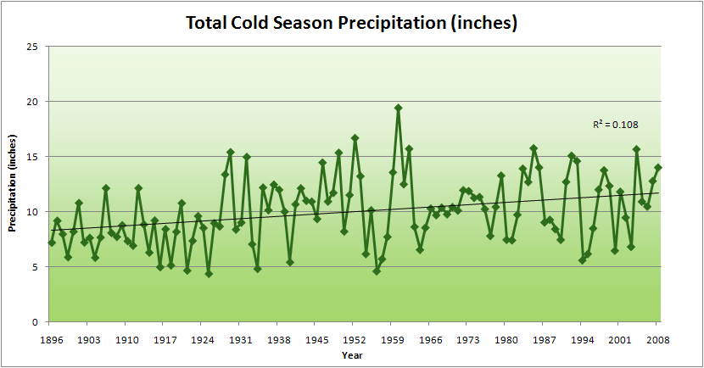
Cedar Rapids Data
51% increase
11.8”
7.8”

Slide 49
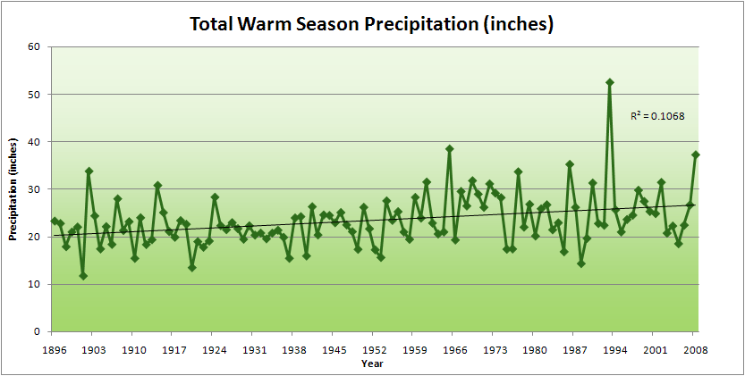
Cedar Rapids Data
34% increase
26.8”
20.2”

Slide 50
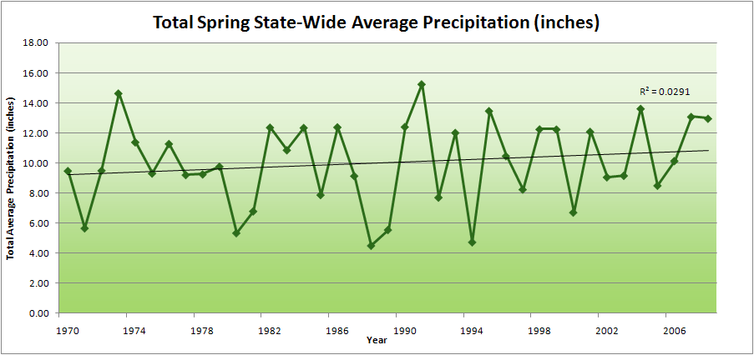
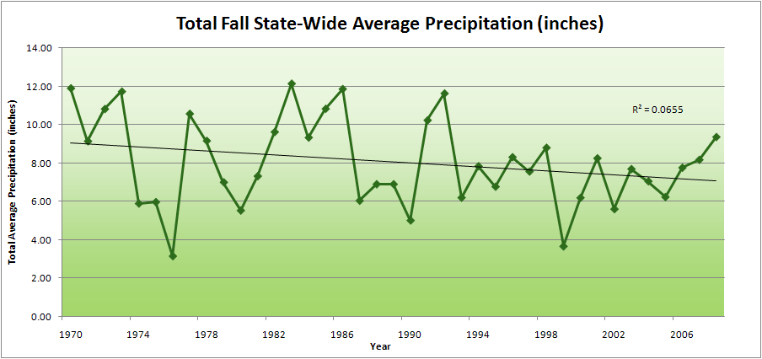

Slide 51
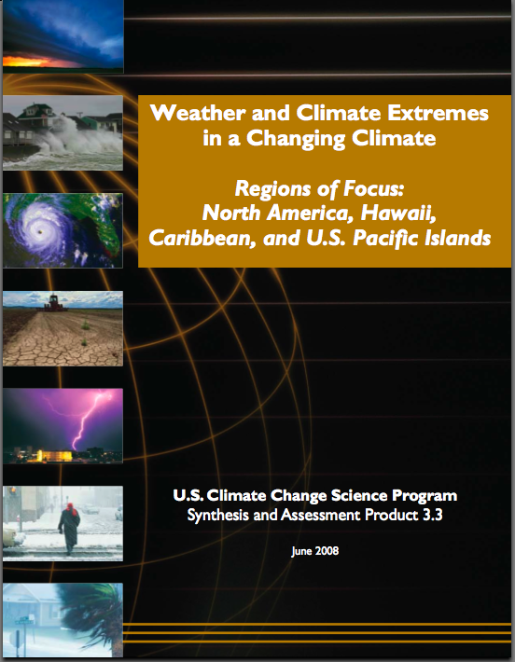
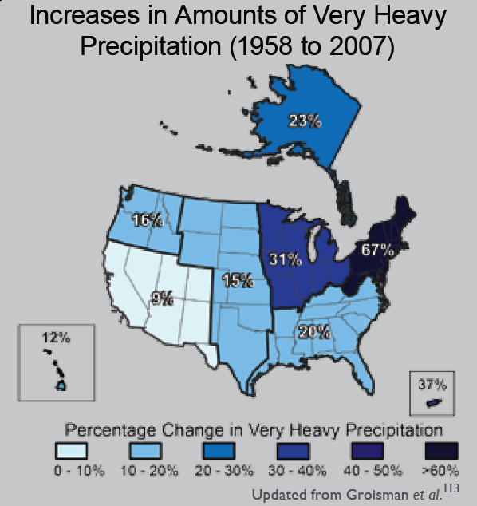
“One of the clearest trends in the United States observational record is an increasing frequency and intensity of heavy precipitation events… Over the last century there was a 50% increase in the frequency of days with precipitation over 101.6 mm (four inches) in the upper midwestern U.S.; this trend is statistically significant “
Karl, T. R., J. M. Melillo, and T. C. Peterson, (eds.), 2009: Global Climate Change Impacts in the United States. Cambridge University Press, 2009, 196pp.

Slide 52
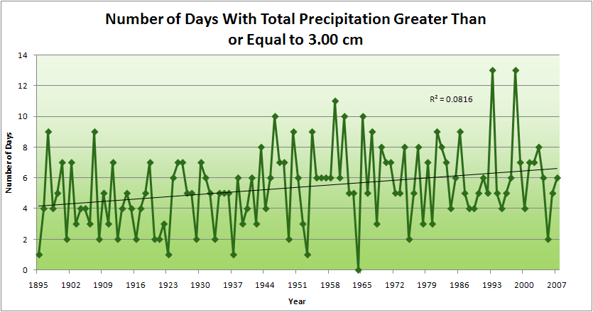
Cedar Rapids Data
4.2 days
57% increase
6.6 days

Slide 53
Cedar Rapids Data
Years having more than 8 days
11
2
4.2 days
57% increase
6.6 days

Slide 54
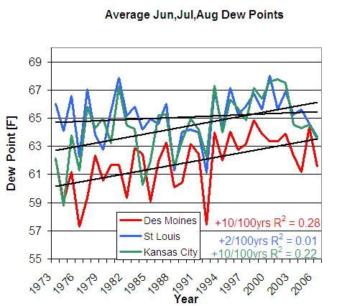
D. Herzmann, Iowa Environmental Mesonet

Slide 55

Iowa State-Wide Average Data
162
153

Slide 56
Projected Changes* for the Climate of the Midwest
Temperature
Longer frost-free period (high)
Higher average winter temperatures (high)
Fewer extreme cold temperatures in winter (high)
Fewer extreme high temperatures in summer in short term but more in long term (medium)
Higher nighttime temperatures both summer and winter (high)
More freeze-thaw cycles (high)
Increased temperature variability (high)
Follows trend of last 25 years and projected by models
No current trend but model suggestion or current trend but model inconclusive
*Estimated from IPCC reports

Slide 57
Projected Changes* for the Climate of the Midwest
Precipitation
More (~10%) precipitation annually (medium)
Change in “seasonality”: Most of the increase will come in the first half of the year (wetter springs, drier summers) (high)
More water-logging of soils (medium)
More variability of summer precipitation (high)
More intense rain events and hence more runoff (high)
Higher episodic streamflow (medium)
Longer periods without rain (medium)
Higher absolute humidity (high)
Stronger storm systems (medium)
More winter soil moisture recharge (medium)
Snowfall increases (late winter) in short term but decreases in the long run (medium)
Follows trend of last 25 years and projected by models
No current trend but model suggestion or current trend but model inconclusive
*Estimated from IPCC reports

Slide 58
Iowa Agricultural Producers’ Adaptations to Climate Change
Longer growing season: plant earlier, plant longer season hybrids, harvest later
Wetter springs: larger machinery enables planting in smaller weather windows
More summer precipitation: higher planting densities for higher yields
Wetter springs and summers: more subsurface drainage tile is being installed, closer spacing, sloped surfaces
Fewer extreme heat events: higher planting densities, fewer pollination failures
Higher humidity: more spraying for pathogens favored by moist conditions. more problems with fall crop dry-down, wider bean heads for faster harvest due to shorter harvest period during the daytime.
Drier autumns: delay harvest to take advantage of natural dry-down conditions
HIGHER YIELDS!!
Is it genetics or climate? Likely some of each.

Slide 59
Using Local/Regional Climate Change as a Springboard to Understanding Global Climate Change and the Nature of Science
National Science Foundation Proposal:
“Building resiliency to climate change in the US Midwest: Using past changes in precipitation extremes to inform future adaptation”

Slide 60
Build Learning Partnerships
Universities in the Midwest
Community Colleges
High Schools and Middle Schools
Minority Serving Institutions
4-H

Slide 61
Focus on Precipitation
Iowa Flood Center
National Drought Mitigation Center
American Meteorological Society

Slide 62
Connection to Iowa Community Colleges
One Source Training Division of the Iowa Association of Community Colleges
Sheri Reynolds
Director

Slide 63
Strategy
Develop Professional Learning Communities for sharing ideas of what works and how to implement learning experiences into formal and informal learning

Slide 64
Community College Outcome
Students have a better understanding of the nature of science
Students are better prepared to use best available science of climate change in the workforce and civic responsibility
Students continuing their education are better prepared to transition to four-year institutions

Slide 65
Our Team
Gene Takle, Director Climate Science Program
Barb Licklider, Department of Curriculum and Instruction
Bill Gutowski, Climate Scientist
U. Sunday Tim, link to Minority Serving Institutions and Community Colleges
Shana Carpenter, Cognitive Psychologist
Cathy Kling, Environmental Economist

Slide 66
For More Information
Contact me directly:
gstakle@iastate.edu
Current research on regional climate and climate change is being conducted at Iowa State University under the Regional Climate Modeling Laboratory
http://rcmlab.agron.iastate.edu/
North American Regional Climate Change Assessment Program
http://www.narccap.ucar.edu/
For current activities on the ISU campus, regionally and nationally relating to climate change see the Climate Science Initiative website:
http://climate.engineering.iastate.edu/
Or just Google Eugene Takle

Slide 67
Three separate analyses of the temperature record – Trends are in close agreement
Don Wuebbles

