Slide 1
Sudden Stratospheric Warming
(From Holton & Hakim)

Slide 2
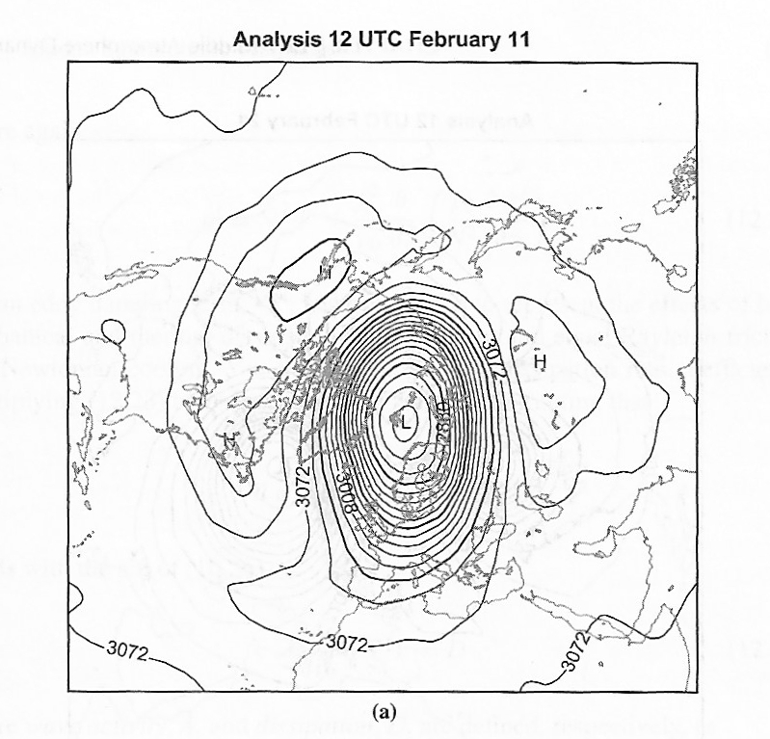

Slide 3
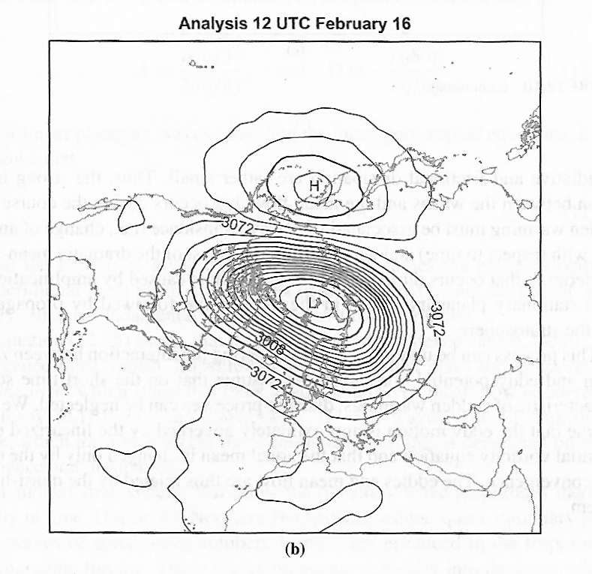

Slide 4
