Slide 1
Zonal Average Structure of the Atmosphere
Climatology from the ERA-40 Reanalysis
(https://software.ecmwf.int/static/ERA40_Atlas/docs/section_D25/index.html)

Slide 2
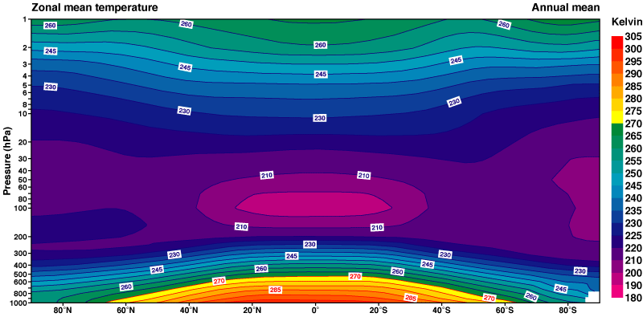
Annual Temperature

Slide 3
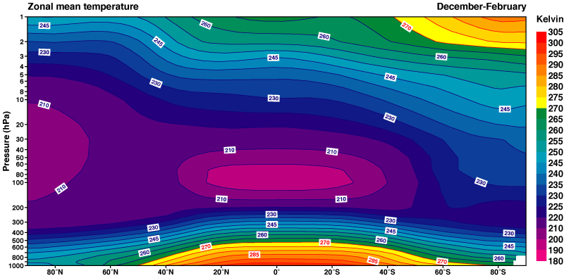
DJF Temperature

Slide 4
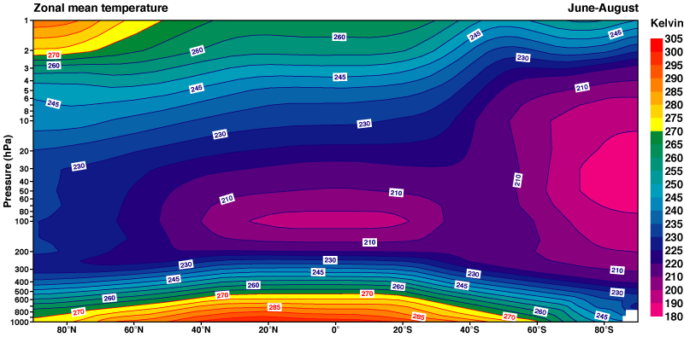
JJA Temperature

Slide 5
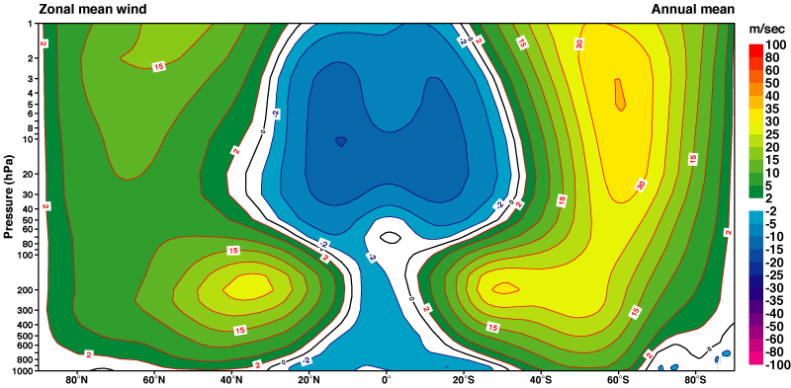
Annual Zonal Wind

Slide 6
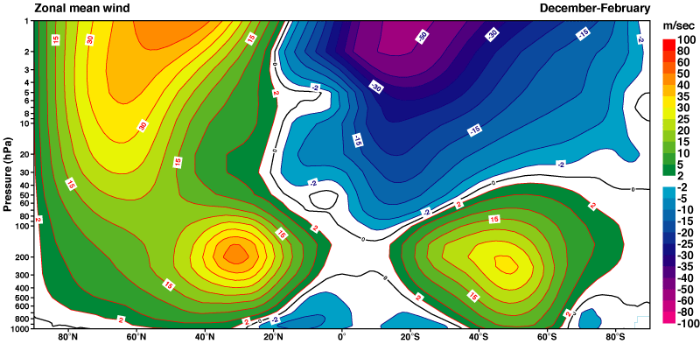
DJF Zonal Wind

Slide 7
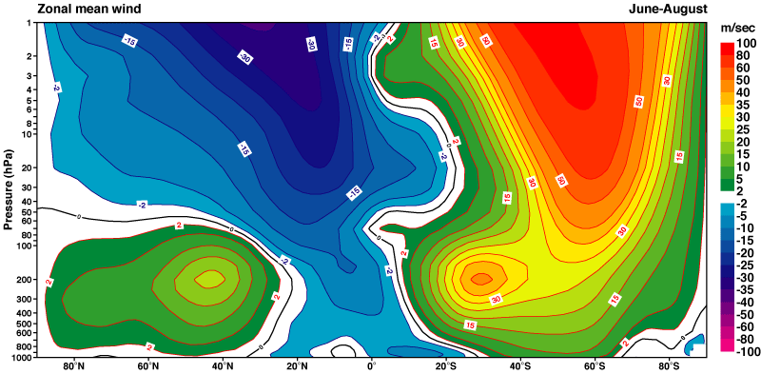
JJA Zonal Wind

