Slide 1
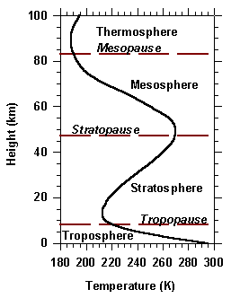
Representative temperature profile
(https://crisp.nus.edu.sg/~research/tutorial/atmos.htm)

