Slide 1
Mesoscale Dynamics
Introduction

Slide 2
Mesoscale
Between synoptic scale (e.g., large-scale weather) and microscale (e.g., fair-weather cumulus cloud)
Scales of ~ 10 – 1000 km
Wide variety of motions: thunderstorms, internal gravity waves, fronts, mesoscale convective systems, tropical storms.
Sources:
Thermal/orographic forcing,
Nonlinear scale transfers of energy
Cloud processes
Some instability

Slide 3
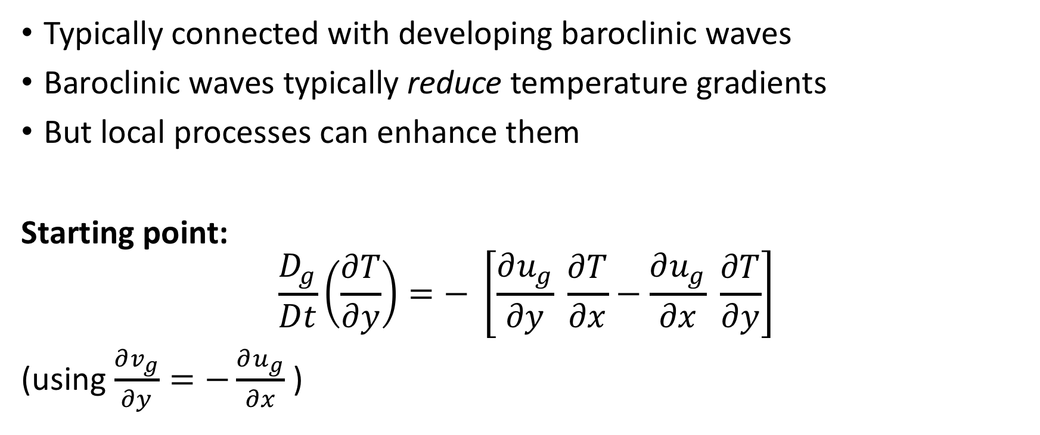
Fronts & Frontogenesis
Typically connected with developing baroclinic waves
Baroclinic waves typically reduce temperature gradients
But local processes can enhance them
Starting point:
$$\frac{D_{g}}{Dt}\left(\frac{∂T}{∂y}\right)=− \left[\frac{∂u_{g}}{∂y} \frac{∂T}{∂x}−\frac{∂u_{g}}{∂x} \frac{∂T}{∂y}\right]$$
(using $\frac{∂v_{g}}{∂y}=−\frac{∂u_{g}}{∂x}$ )

Slide 4
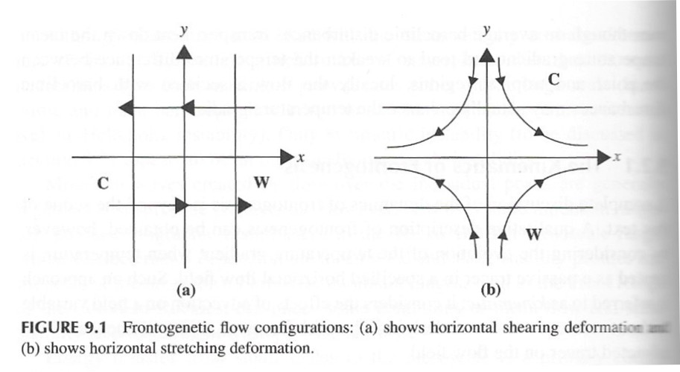

Fronts & Frontogenesis
$$\frac{D_{g}}{Dt}\left(\frac{∂T}{∂y}\right)=− \left[\frac{∂u_{g}}{∂y} \frac{∂T}{∂x}−\frac{∂u_{g}}{∂x} \frac{∂T}{∂y}\right]$$

Slide 5
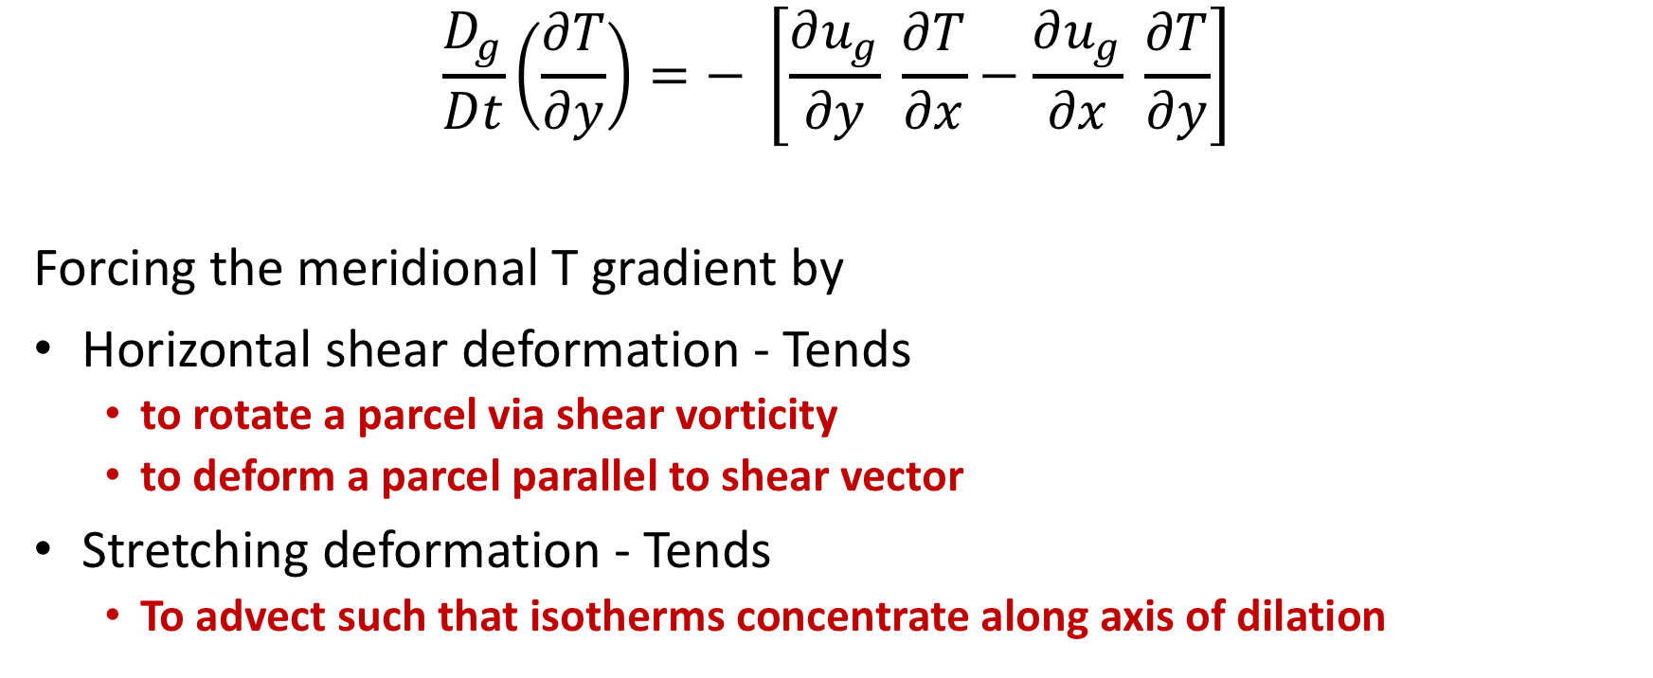
Fronts & Frontogenesis
$$\frac{D_{g}}{Dt}\left(\frac{∂T}{∂y}\right)=− \left[\frac{∂u_{g}}{∂y} \frac{∂T}{∂x}−\frac{∂u_{g}}{∂x} \frac{∂T}{∂y}\right]$$
Forcing the meridional T gradient by
Horizontal shear deformation - Tends
to rotate a parcel via shear vorticity
to deform a parcel parallel to shear vector
Stretching deformation - Tends
To advect such that isotherms concentrate along axis of dilation

Slide 6
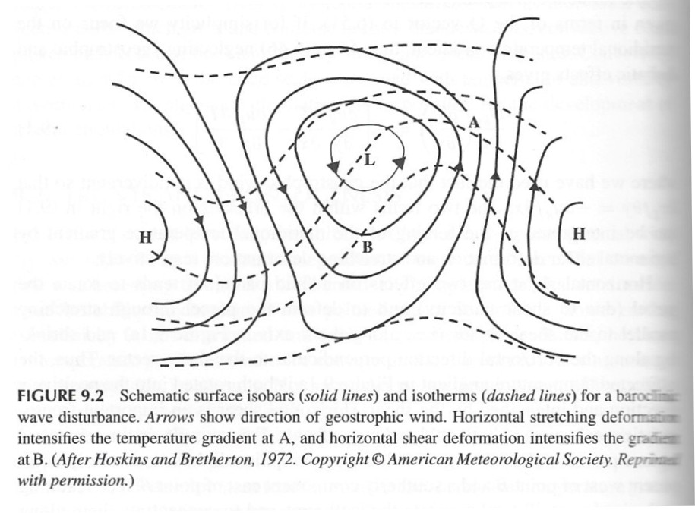

Fronts & Frontogenesis
$$\frac{D_{g}}{Dt}\left(\frac{∂T}{∂y}\right)=− \left[\frac{∂u_{g}}{∂y} \frac{∂T}{∂x}−\frac{∂u_{g}}{∂x} \frac{∂T}{∂y}\right]$$

Slide 7
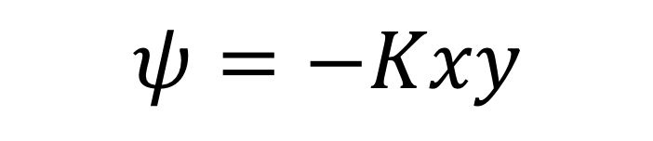
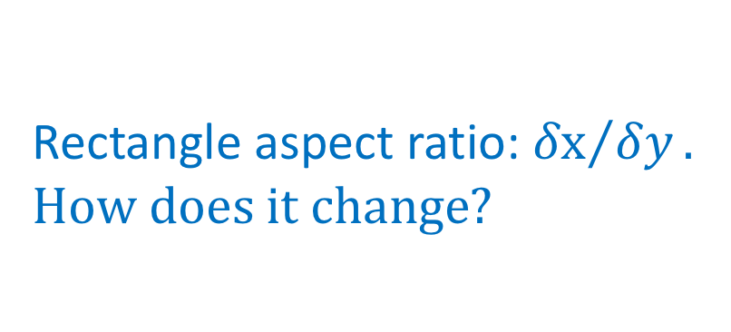
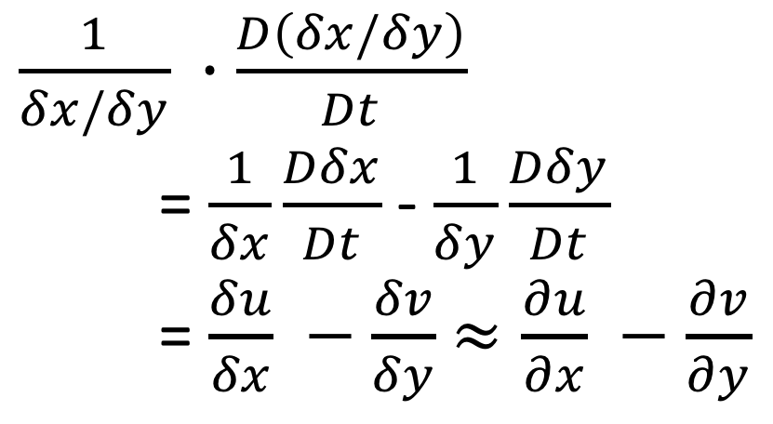
Pure deformation (irrotational & nondivergent)
$$ψ=−Kxy$$
Rectangle aspect ratio: ${δx}/{δy}.$
$$How does it change?$$
$\frac{1}{δx/δy} ∙\frac{D\left(δx/δy\right)}{Dt}$
= $\frac{1}{δx}\frac{Dδx}{Dt}$ - $\frac{1}{δy}\frac{Dδy}{Dt}$
= $\frac{δu}{δx} −\frac{δv}{δy}$ $≈\frac{∂u}{∂x} −\frac{∂v}{∂y}$

Slide 8
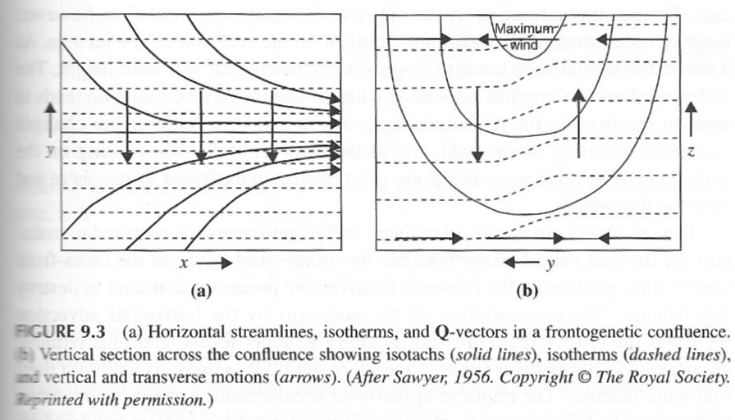
Confluent Flow (Warm front + upper level westerlies)

