Slide 1
Geostrophic Adjustment
Development

Slide 2







































Slide 3


























































Slide 4



















Slide 5
































































Slide 6




























Slide 7





























Slide 8








































Slide 9



















































Slide 10












































Slide 11




























Slide 12







































Slide 13



































































Slide 14


















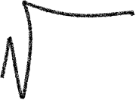
















Slide 15







































