Slide 1
Shallow-water model
Applies to both ocean and atmosphere

Slide 2


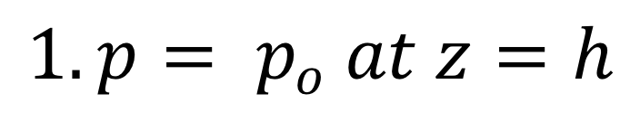
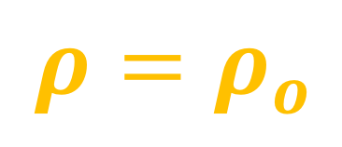

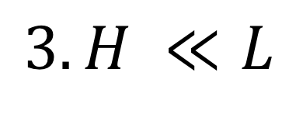

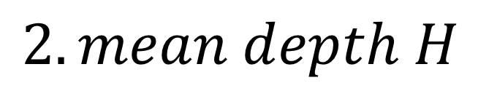
$$1.p= p_{o} at z=h$$
$2Ω$ = f
$$2.mean depth H$$
$$3. H ≪L$$
L
$$h(x,y,t)$$
or
g
$$η(x,y,t)$$
$$ρ=ρ_{o}$$
$$z=0$$
Notes:
See slides from 180906 (horizontal momentum) and 180911 (continuity)

Slide 3































Slide 4



































Slide 5




























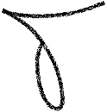




Slide 6






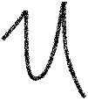

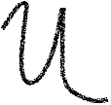
















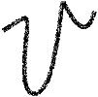




















Slide 7










