Slide 1
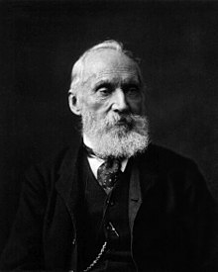
William Thompson, Lord Kelvin (26 June 1824, Belfast, Ireland – 17 December 1907, Ayrshire, Scotland)
He did important work in the mathematical analysis of electricity and formulation of the first and second laws of thermodynamics, and did much to unify the emerging discipline of physics in its modern form. Absolute temperatures are stated in units of kelvin in his honour.
For his work on the transatlantic telegraph project he was knighted in 1866 by Queen Victoria.
He was ennobled in 1892 in recognition of his achievements in thermodynamics, and of his opposition to Irish Home Rule.

