Slide 1
Transients in the Adjustment Problem
Propagation of Gravity Waves

Slide 2
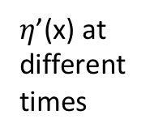
$η$’(x) at different times

Slide 3
u’(x) at different times

Slide 4
v’(x) at different times

Slide 5
U’(t) at two points

