Slide 2
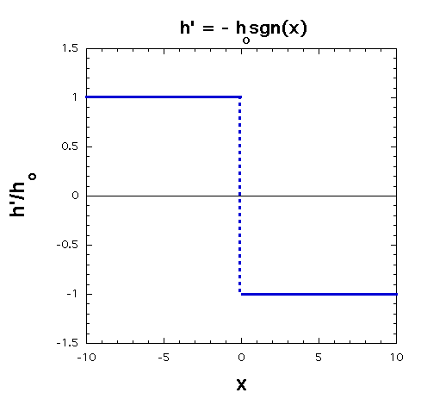
Example: Initial State
u’, v’ = 0
h’ = -h_{o} sgn(x)
Step function for initial h'. This is not balanced!
(What is PGF at x=0?)
7.6 Geostrophic Adjustment

Slide 3
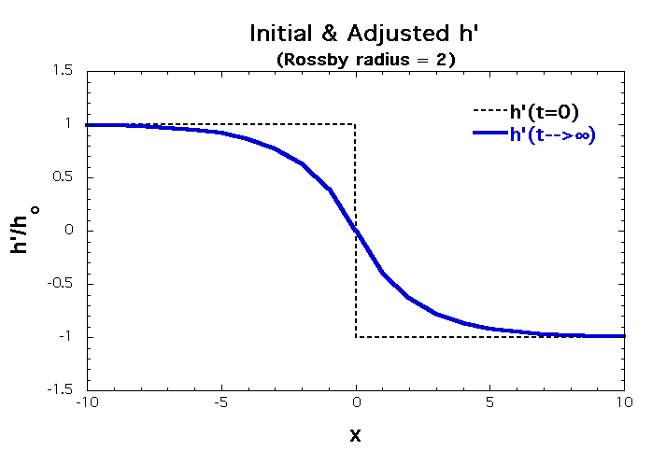
Adjusted State
For |x| >> λ_{R}, h' unchanged
u' = - (g/f)∂h′/∂y = 0
v' = + (g/f)∂h′/∂x = -(gh_{o}/λ_{R}) exp{-|x|/λ_{R}}
7.6 Geostrophic Adjustment

Slide 4
Adjusted State
For |x| >> λ_{R}, η’ unchanged
u' = - (g/f)∂η’/∂y = 0
v' = + (g/f)∂η’/∂x
= - (gh_{o}/λ_{R}) exp{-|x|/λ_{R}}
η’
v’

