Slide 1
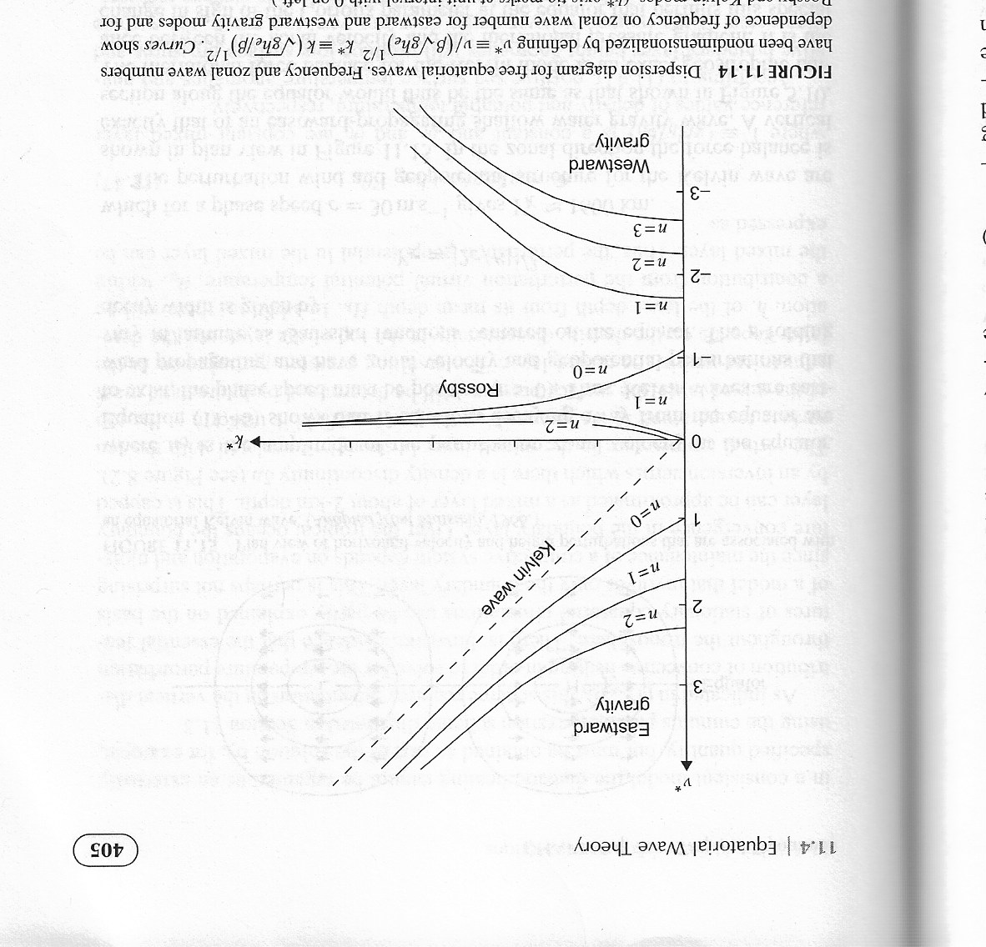
Frequency vs. wavenumber

Slide 2
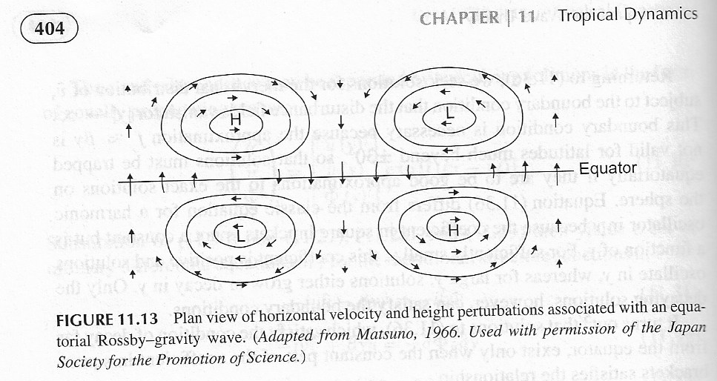


Equatorial Rossby-Gravity Wave
$ξ={\left(β/\sqrt{gh_{e}}\right)}^{1/2}$y
$$\hat{v}\left(ξ\right){=v}_{o}H_{n}exp\left\{−ξ^{2}/2\right\}$$
$$H_{o}=1 ;H_{1}=2ξ ;H_{2}=4ξ^{2}−2 ;H_{3}=48−12ξ$$

Slide 3
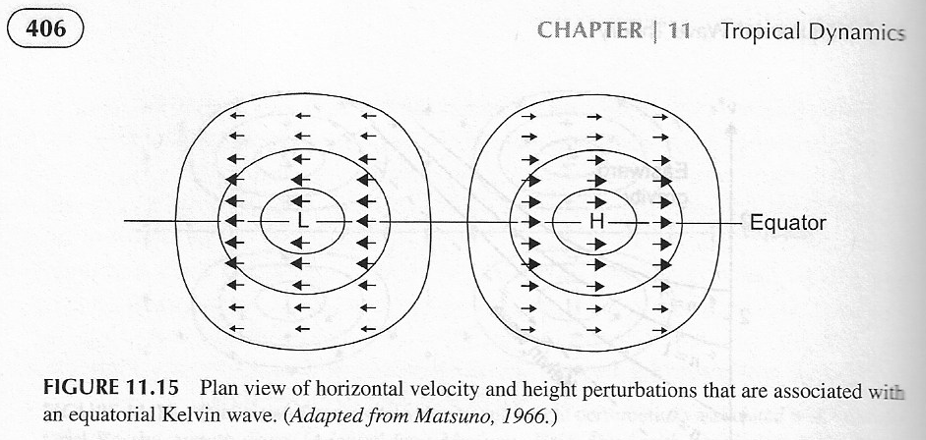
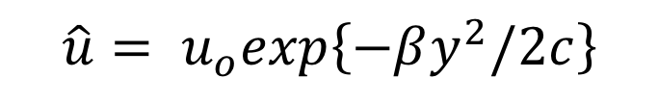
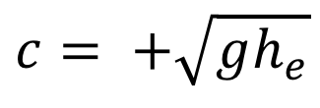
Kelvin Wave
$$\hat{u}= u_{o}exp\left\{−βy^{2}/2c\right\}$$
$$c= +\sqrt{gh_{e}}$$

