Slide 1
Linear System of Equations
Consider three equations, linear in the unknowns F, G, H:
a11 F + a12 G + a13 H = 0
a21 F + a22 G + a23 H = 0
a31 F + a32 G + a33 H = 0
Can we have a non-trivial solution?
(A trivial solution is F=G=H=0 – not usually of interest.)

Slide 2
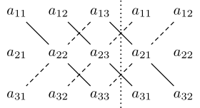
Determinant
A non-trivial solution requires determinant = 0, or
(a11)(a22)(a33) + (a12)(a23)(a31) + (a13)(a21)(a32)
- (a13)(a22)(a31) - (a11)(a23)(a32) - (a12)(a21)(a33)
= 0

Slide 3
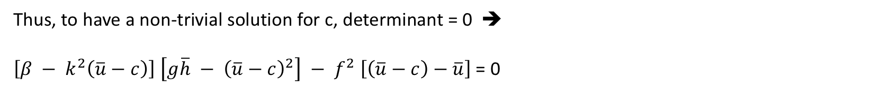
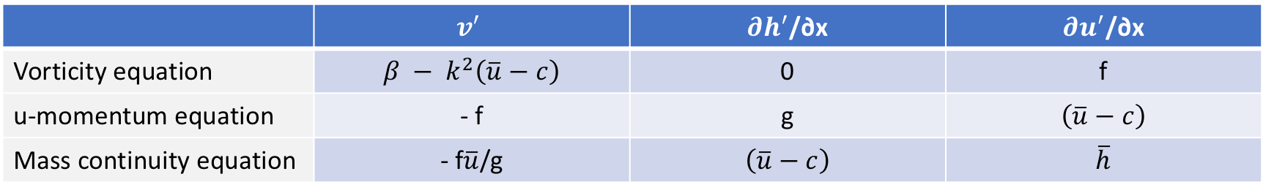
From Thompson (1961)
 | $$v^{′}$$ | $∂h^{′}$/∂x | $∂u^{′}$/∂x
Vorticity equation | $$β − k^{2}\left(\overline{u}−c\right)$$ | 0 | f
u-momentum equation | - f | g | $$\left(\overline{u}−c\right)$$
Mass continuity equation | - f$\overline{u}$/g | $$\left(\overline{u}−c\right)$$ | $$\overline{h}$$
Thus, to have a non-trivial solution for c, determinant = 0 ➔
$\left[β − k^{2}\left(\overline{u}−c\right)\right]$ $\left[g\overline{h} − {\left(\overline{u}−c\right)}^{2}\right] − f^{2}$ $\left[\left(\overline{u}−c\right)−\overline{u}\right]$ = 0

