Slide 1

Conservation of Momentum (horizontal)
$$\frac{d\vec{V}}{dt }=− \frac{1}{ρ}\vec{∇}p −f\hat{k}×\vec{V}+ m$$
Conservation of Momentum (vertical)
$\frac{∂p}{∂z}= −ρg$
Conservation of Mass
$\frac{∂ρ}{∂t}= −∇∙\left(ρ\vec{V}\right)−\frac{∂}{∂z}(ρw)$
First Law of Thermodynamics (Cons. of Energy)
$\frac{∂}{∂t}\ln{θ}= −\vec{V}∙∇\ln{θ}−w\frac{∂}{∂z}\ln{θ}− \frac{Q}{C_{p}T}$

Slide 2
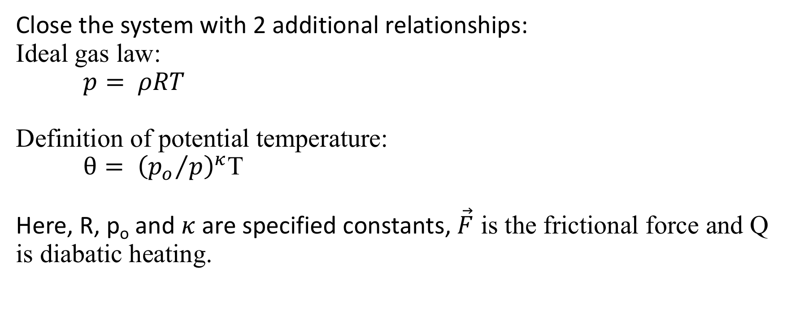
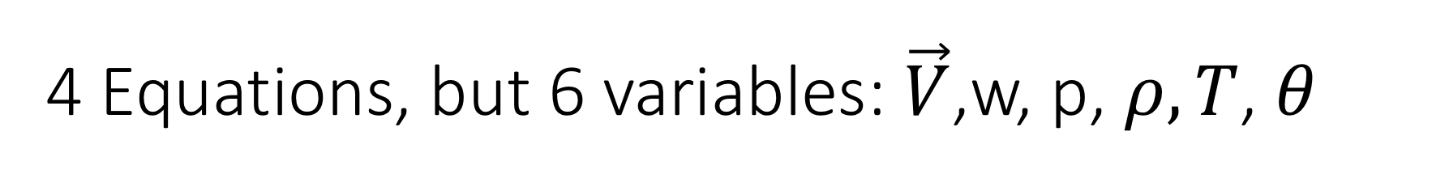
4 Equations, but 6 variables: $\vec{V}$,w, p, $ρ, T$, $θ$
Close the system with 2 additional relationships:
Ideal gas law:
$p= ρRT$
Definition of potential temperature:
$θ= {\left({p_{o}}/p\right)}^{κ}$T
Here, R, p_{o} and $κ$ are specified constants, $\vec{F}$ is the frictional force and Q is diabatic heating.

