Slide 1
Waves Presentation
W. Gutowski
10 September 2018

Slide 2
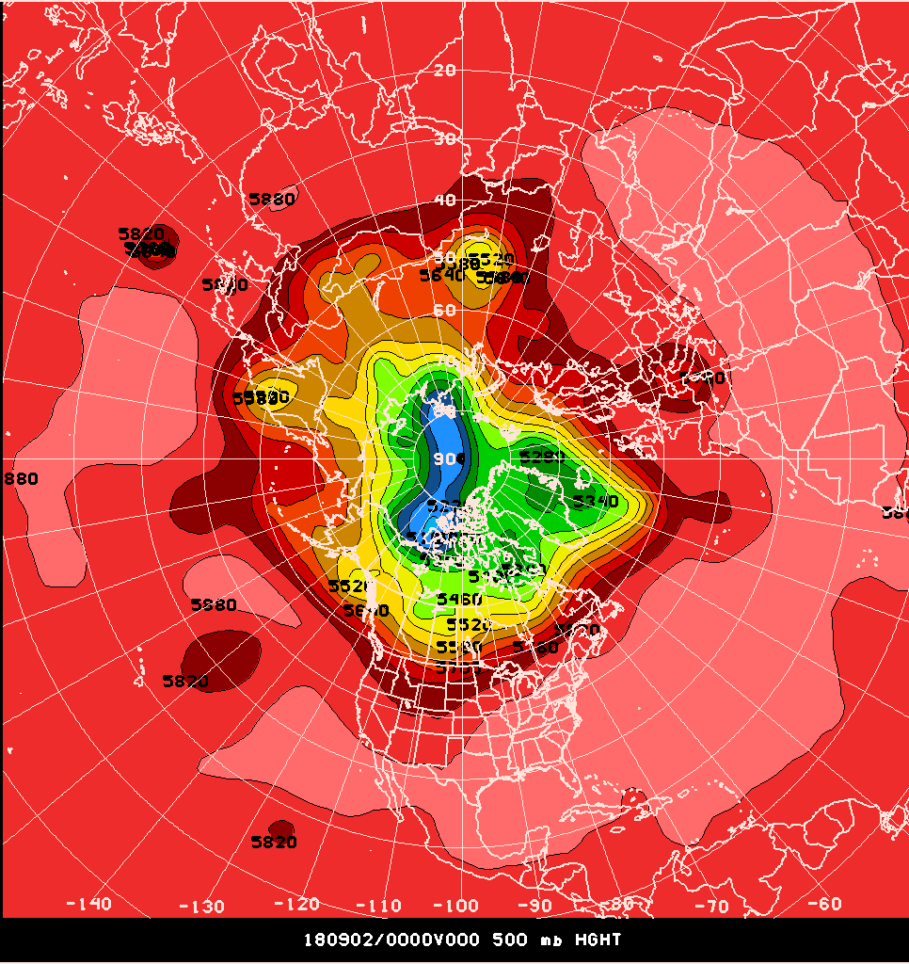
Northern Hemisphere
4 crossings => N = 2

Slide 3
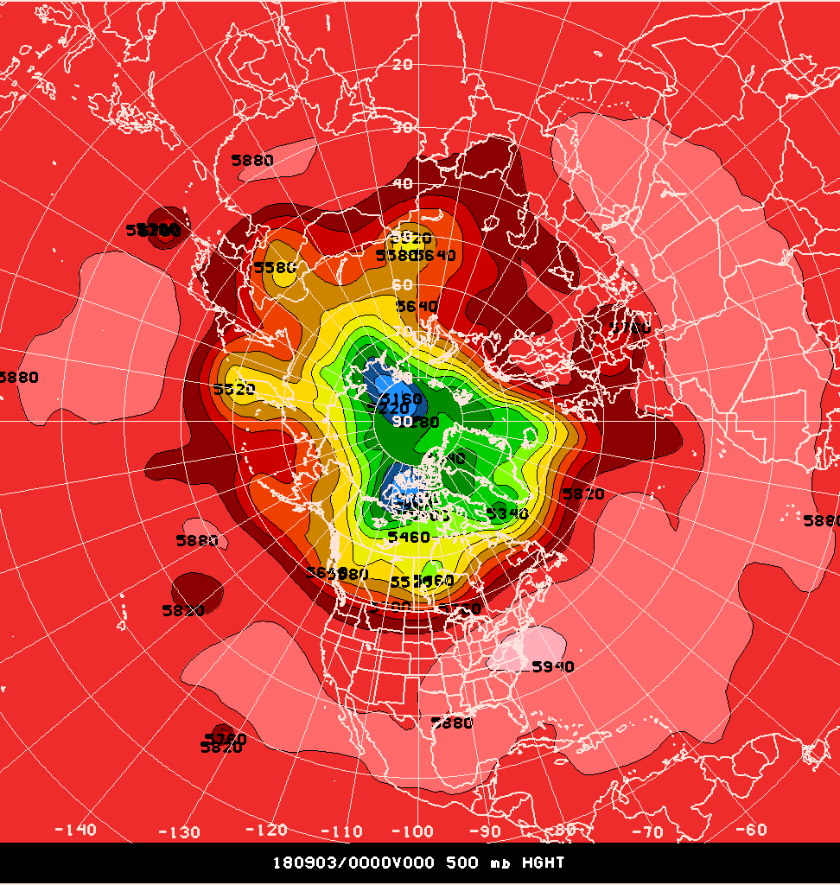
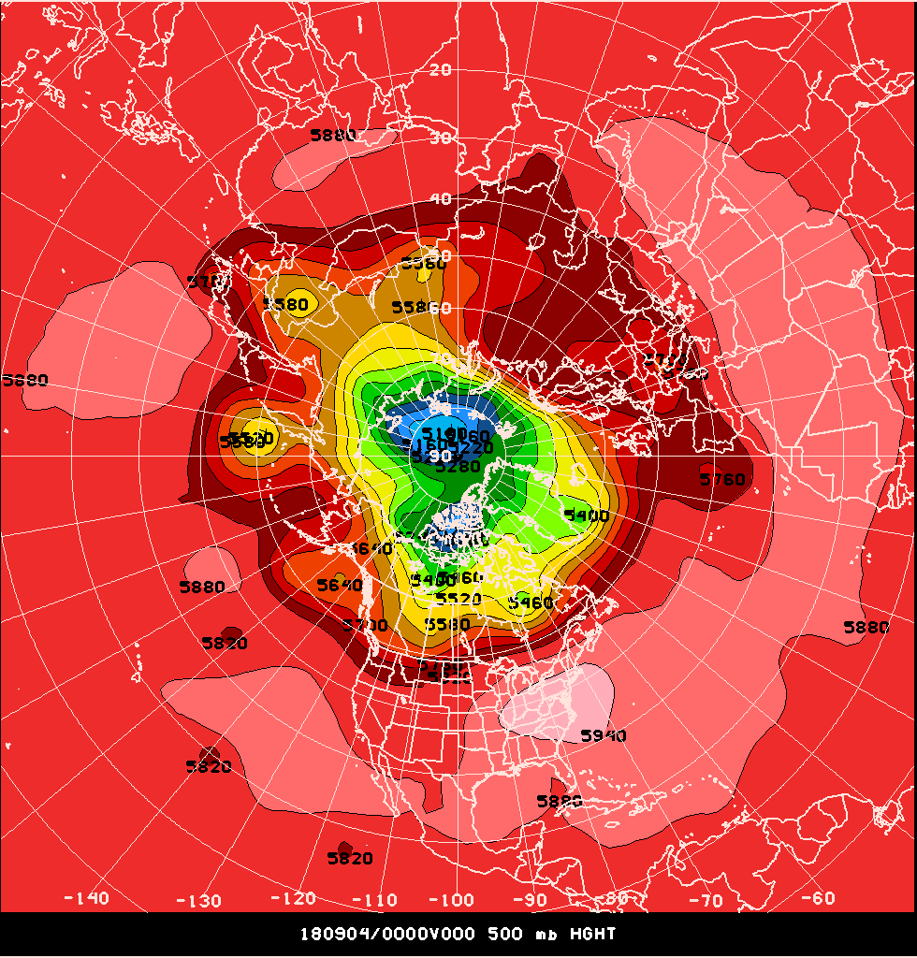
Northern Hemisphere
4 crossings => N = 2
2 crossings => N = 1

Slide 4
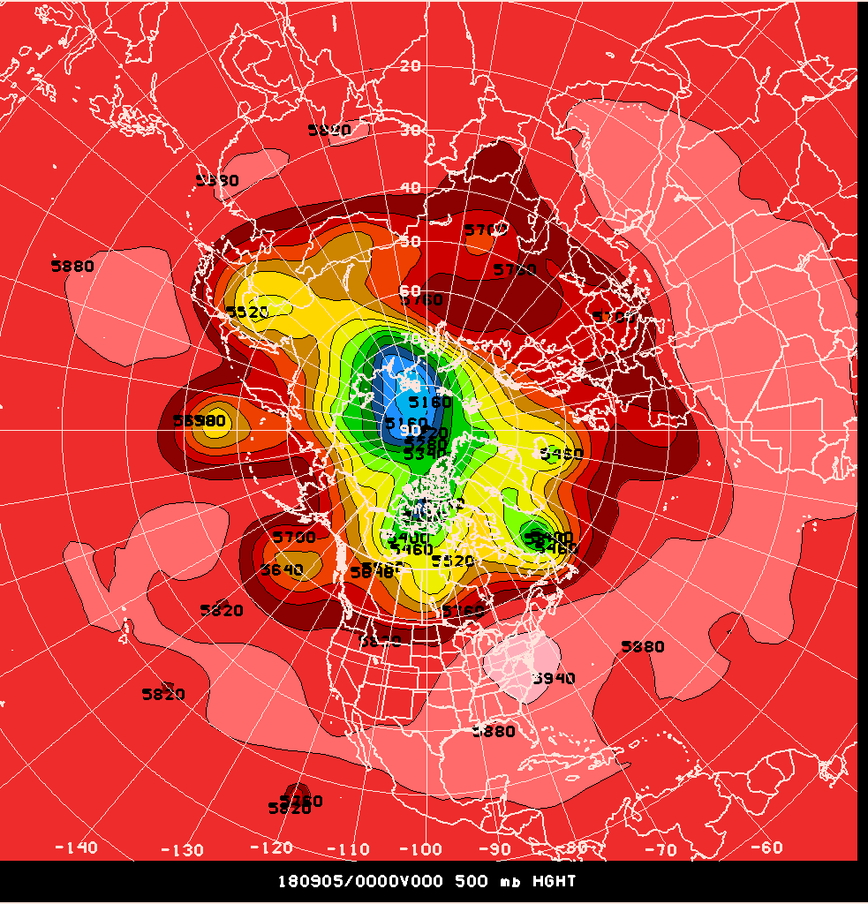
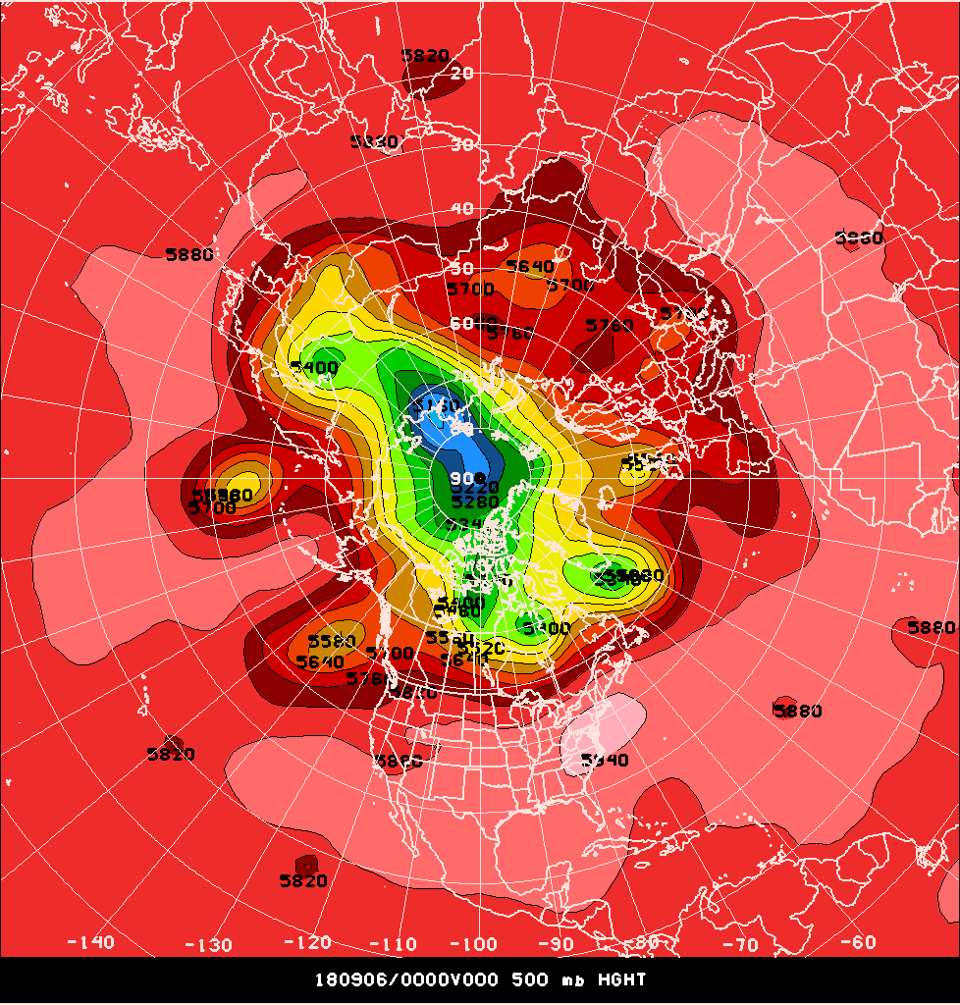
Northern Hemisphere
2 crossings => N = 1
2 crossings => N = 1

Slide 5
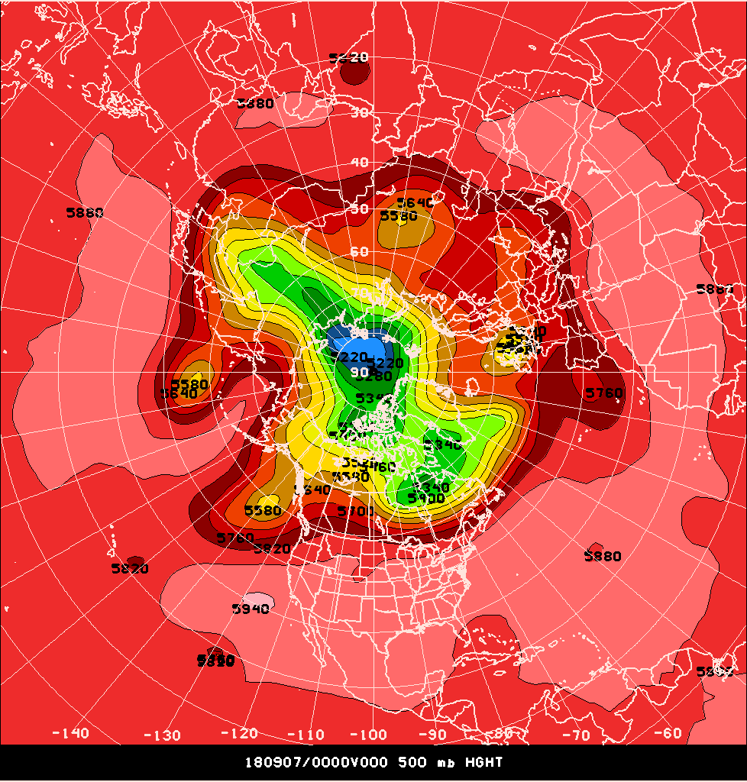
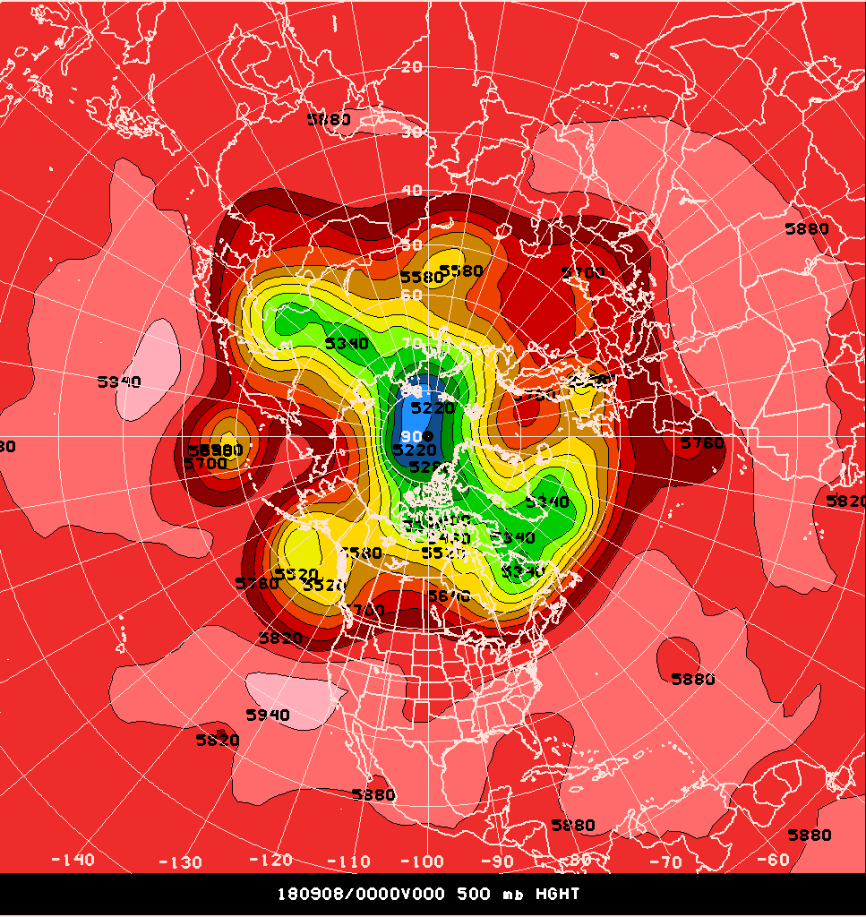
Northern Hemisphere
4 crossings => N = 2
8 crossings => N = 4
A = 140 m
Notes:
For 8 Sept 18: Maxima: +150, +270, +240, +180 => Average = +210
Minima: -180, -10, -60, -30 => Average = - 70
Amplitude = (210 – (-70))/2 = 280/2 = 140 meters

Slide 6
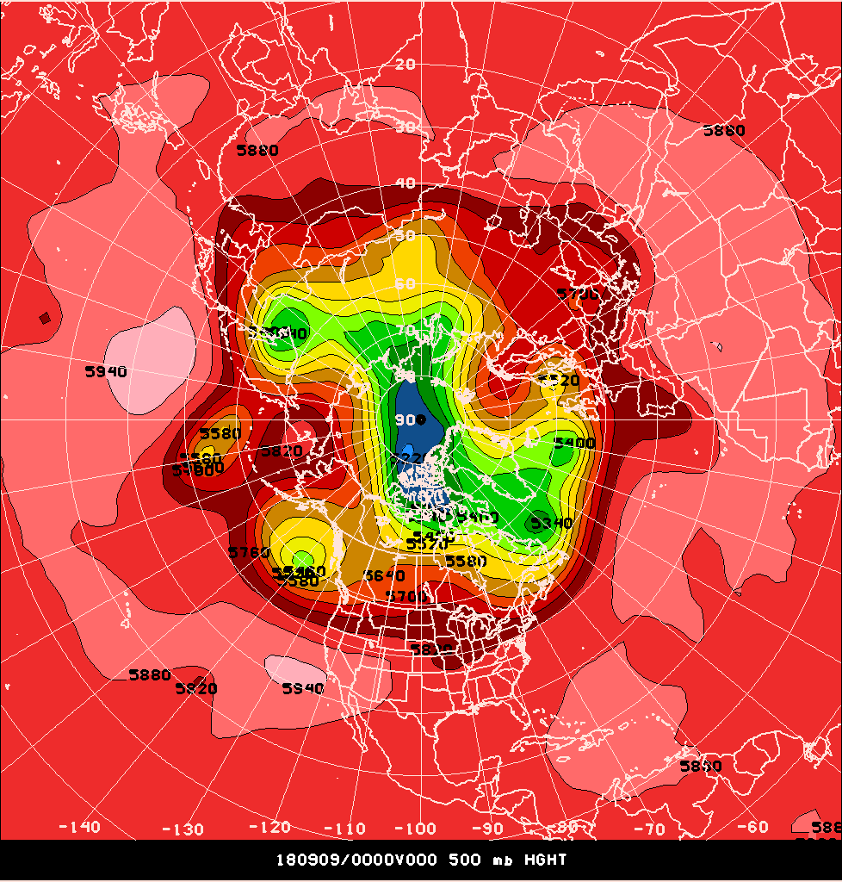
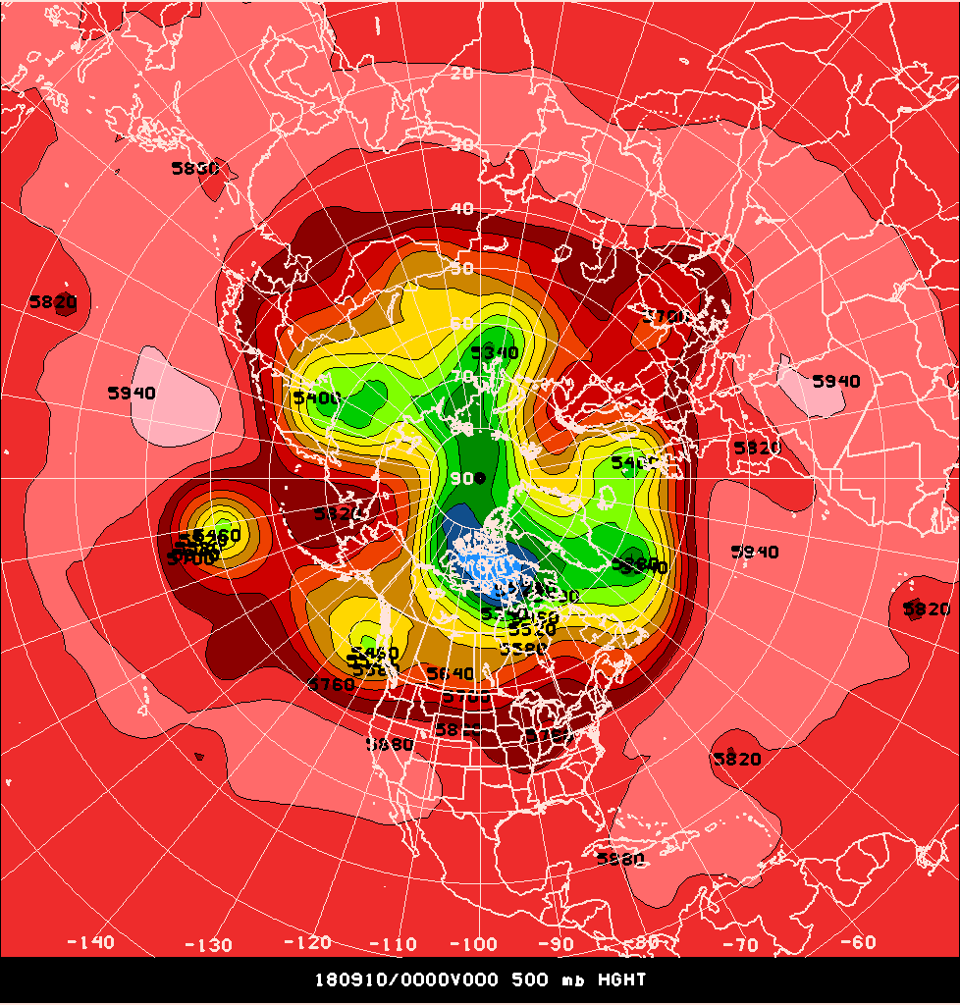
Northern Hemisphere
6 crossings => N = 3
6 crossings => N = 3

Slide 7
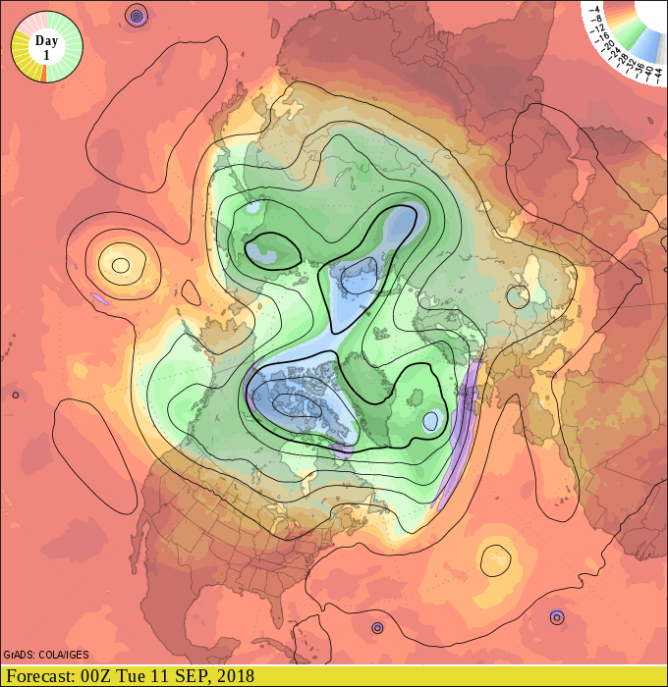
GFS Forecast
Trough moving into northern Europe
Stockholm, Sweden:
BBC: partly cloudy
AccuWx: “ “
WxChannel: “ “
http://www.ogimet.com

Slide 8
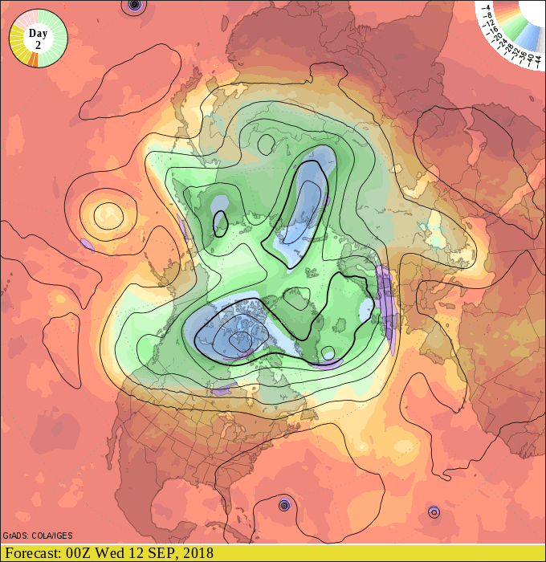
GFS Forecast
Trough moving into northern Europe
Stockholm, Sweden:
BBC: light showers (85%)
AccuWx: ”touch of rain” (73%)
WxChannel: light rain (90%)
http://www.ogimet.com

Slide 9
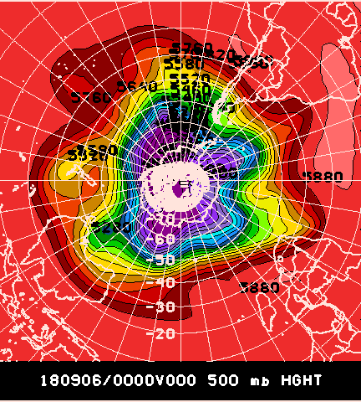
Southern Hemisphere
8 crossings => N = 4

Slide 10
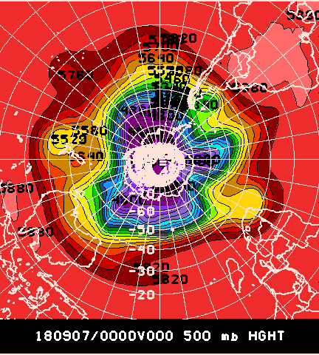
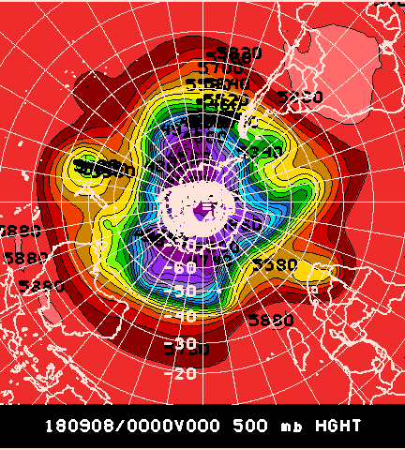
Southern Hemisphere
6 crossings => N = 3
6 crossings => N = 3

Slide 11
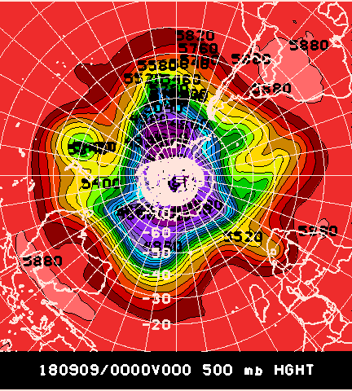
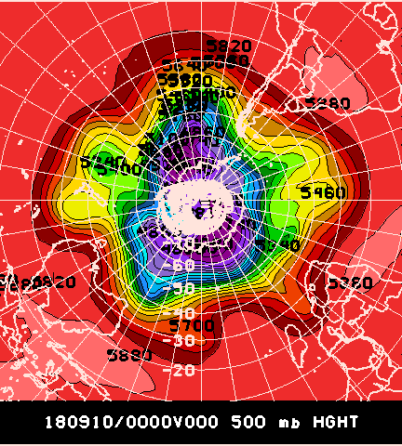
Southern Hemisphere
4 crossings => N = 2
4 crossings => N = 2

Slide 12
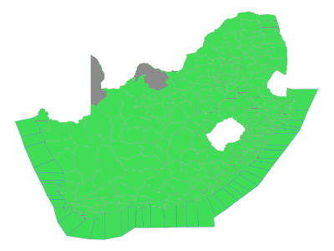
Cape Town, South Africa, Forecast
Trough approaching the Western Cape province.
http://www.weathersa.co.za/

Slide 13



Cape Town, South Africa, Forecast
Today – Sunny
21/10 C
Tues – Cloudy
19/12 C
Wed – Rain
16/13 C
http://www.weathersa.co.za/

Slide 14
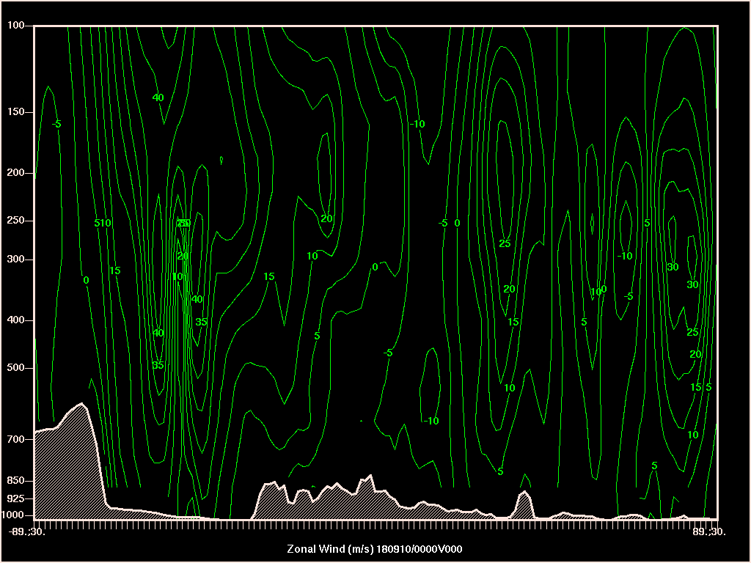
Zonal Wind

Slide 15
Questions?

