Slide 1
Wave Presentation
Group #3

Slide 2
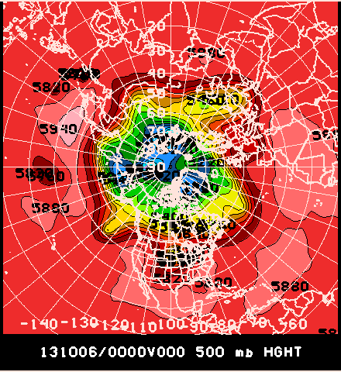
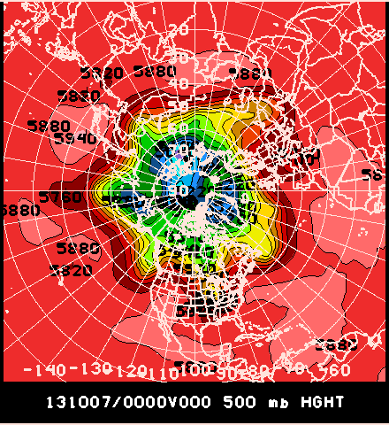
Northern Hemisphere

Slide 3
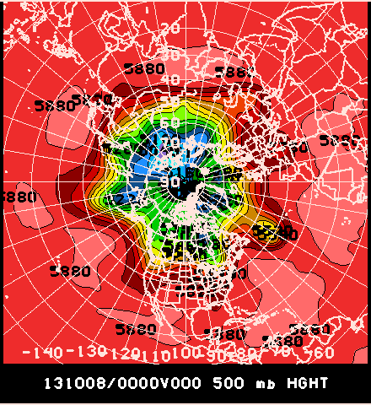
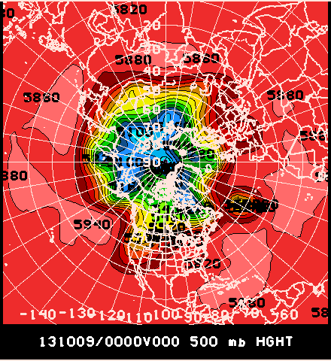
Northern Hemisphere

Slide 4
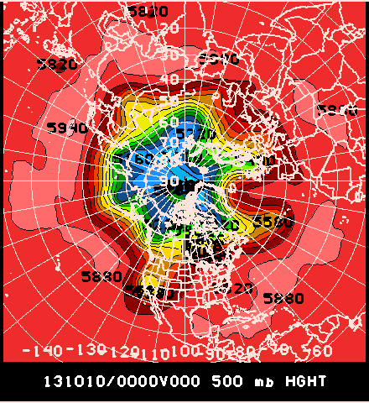
Northern Hemisphere
Big wave off Eastern US coast
Cutoff low in western in California.
Wave over Siberia.
Wave over Scandinavia

Slide 5
Northern Hemisphere Recent Behavior
Date | N (Wave #) | A (m) | C (deg)
10/6/2013 | 5 | 162 | 12.5
10/7/2013 | 6 | 180 | 10
10/8/2013 | 4 | 195 | 15
10/9/2013 | 5 | 144 | 15
10/10/2013 | 3 | 150

Slide 6
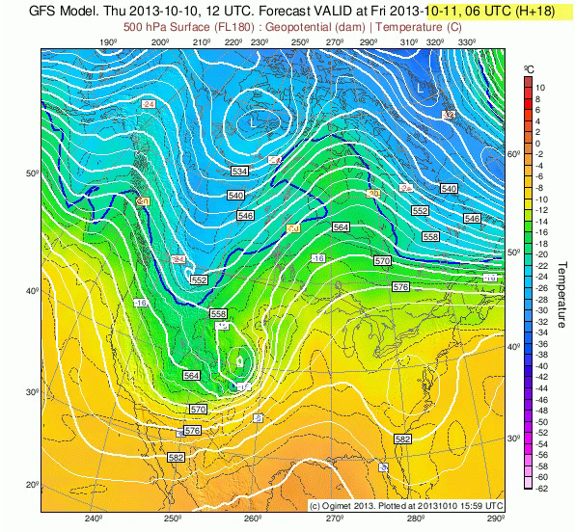
United States GFS Forecast
The low is going to track north east and move over the Dakotas early Saturday morning.
Bringing chance of showers.
http://www.ogimet.com

Slide 7
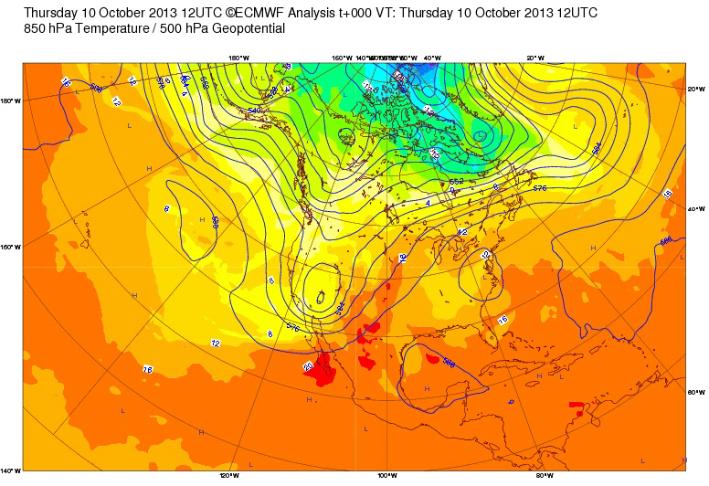
United States ECMWF Forecast
The ECMWF has a much weaker wave moving north east.
http://www.ecmwf.int/

Slide 8
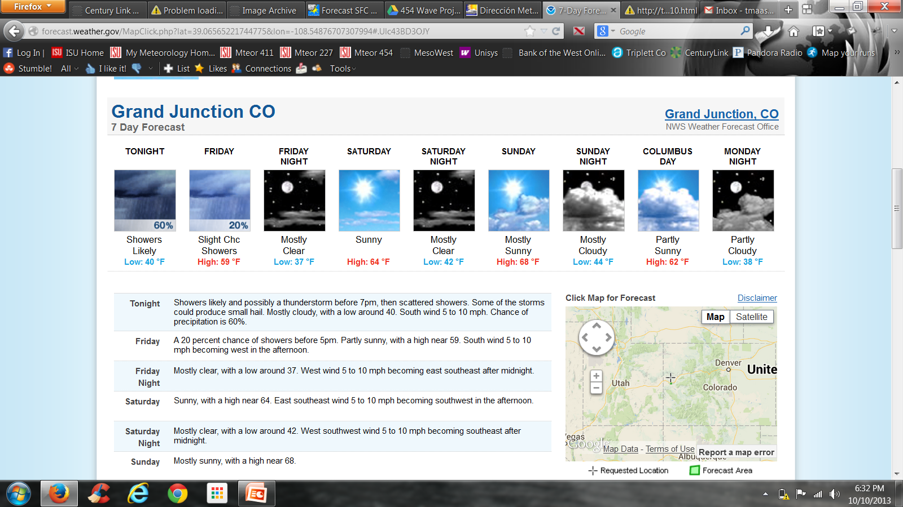
Grand Junction, CO U.S.
The current forecast shows the wave moving through and bringing clouds to the area today.

Slide 9
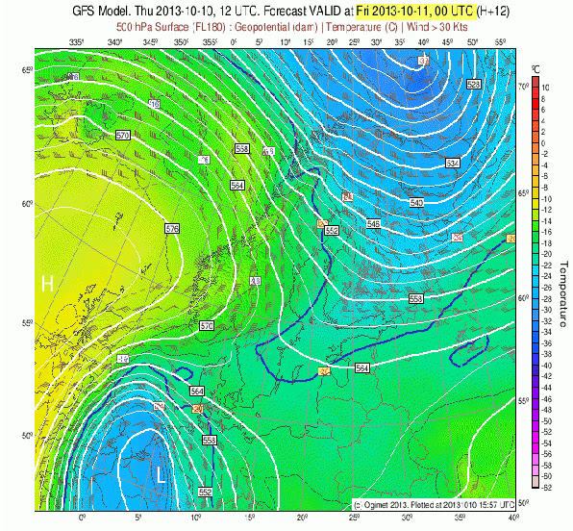
Scandinavian Forecast GFS
The wave will be moving out of the region and a high pressure system will be moving into the area the next couple days.
http://www.ogimet.com

Slide 10
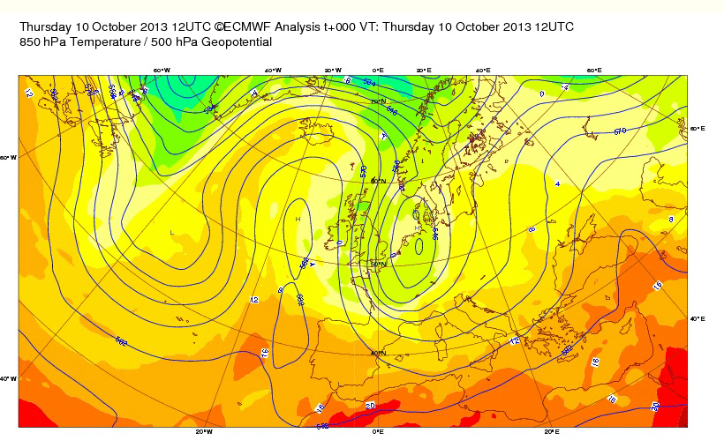
Scandinavian Forecast ECMWF
The ECMWF has the wave moved out already, so a much faster progression.
http://www.ecmwf.int/

Slide 11
Stockholm, Sweden
http://www.scandinavia.meteox.com
Current forecast shows us that the clouds today is the wave moving its way out of Stockholm, Sweden.

Slide 12
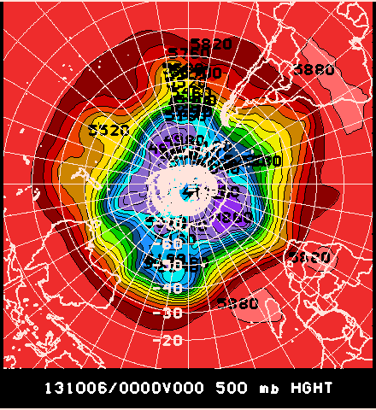
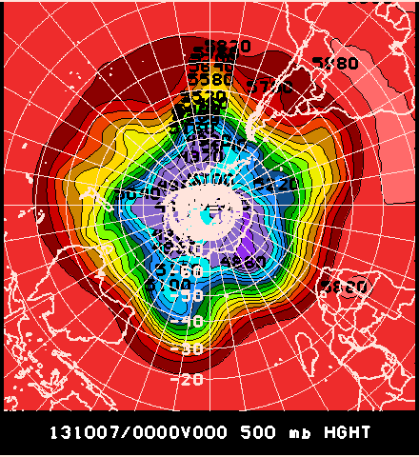
Southern Hemisphere

Slide 13
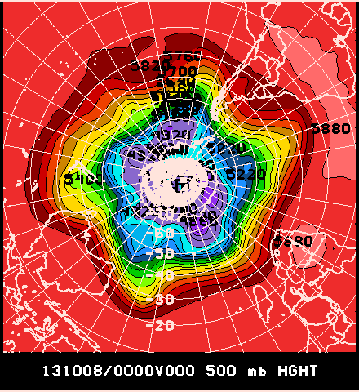
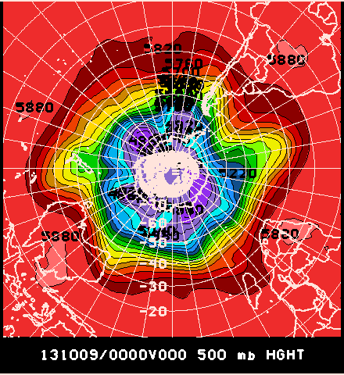
Southern Hemisphere

Slide 14
Southern Hemisphere
A wave moving into the southern tip of South America.
A major wave leaving South America.
Another large wave moving into Western Australia.
While a minor wave moving off the east coast of Australia.

Slide 15
Southern Hemisphere Recent Behavior
Date | N (Wave #) | A (m) | C (de)
10/6/2013 | 3 | 195 | 11
10/7/2013 | 4 | 187.5 | 10
10/8/2013 | 4 | 180 | 7.5
10/9/2013 | 3 | 180 | 10
10/10/2013 | 3 | 200

Slide 16
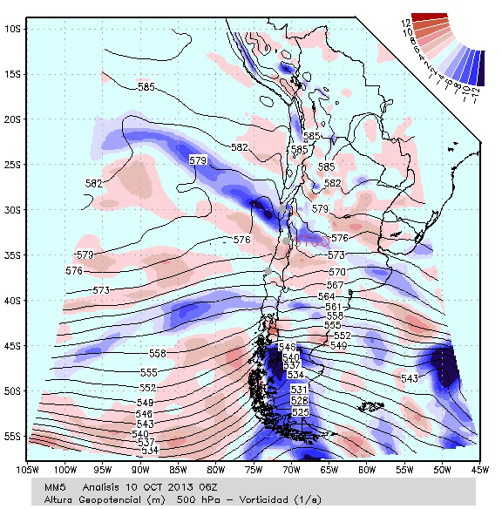
Southern Hemisphere Forecast GFS
Wave currently has PVA in in Argentina and Chile.
Will be moving out of the area soon so NVA will move be advected in.
http://www.meteochile.gob.cl

Slide 17
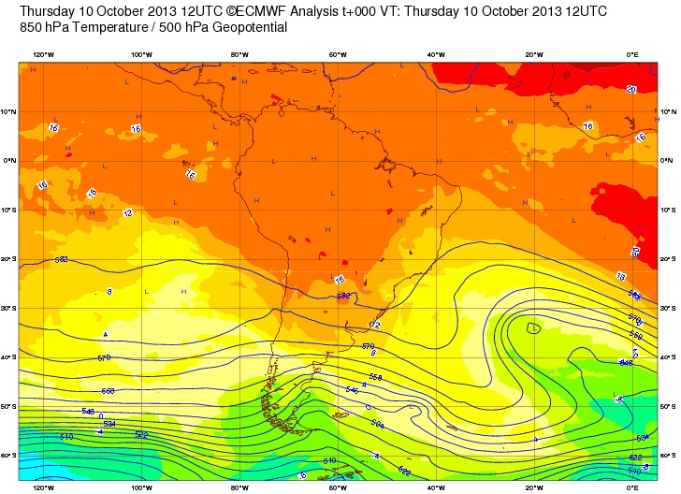
Southern Hemisphere Forecast ECMWF
Two waves off east coast merge together.
http://www.ecmwf.int/

Slide 18
Southern Hemisphere Forecast
http://www.meteochile.gob.cl

Slide 19
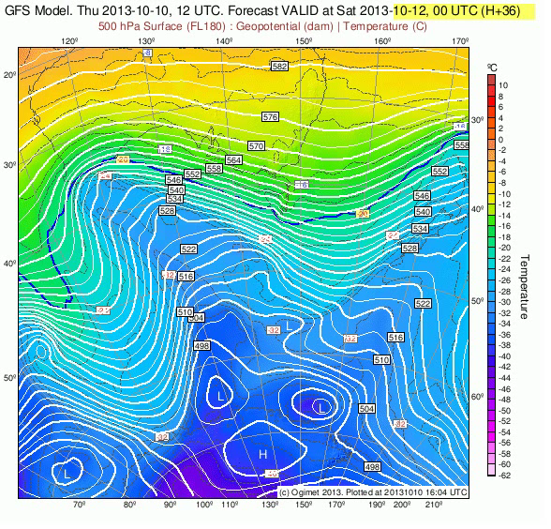
Southern Hemisphere Forecast GFS
A wave moving through southern Australia.
http://www.ogimet.com

Slide 20
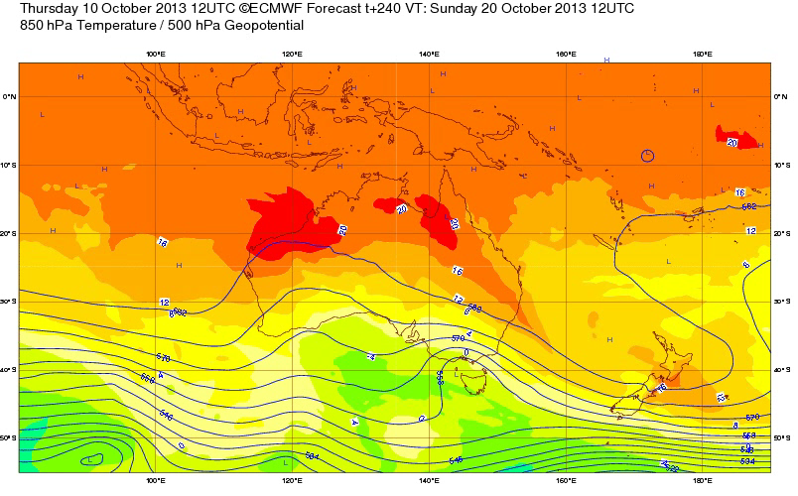
Southern Hemisphere Forecast ECMWF
Southern Au.
Fairly active
http://www.ecmwf.int/

Slide 21
Perth, Australia Forecast
The large wave is bringing our precipitation chances for today and clouds into tomorrow
http://www.bom.gov.au

Slide 22
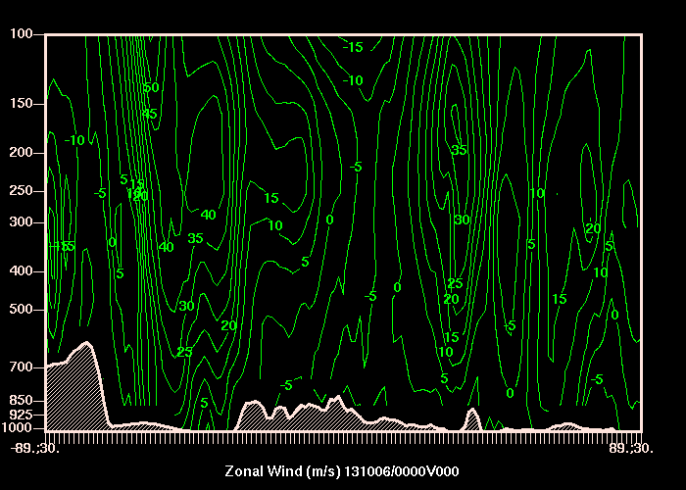
Zonal Wind

Slide 23
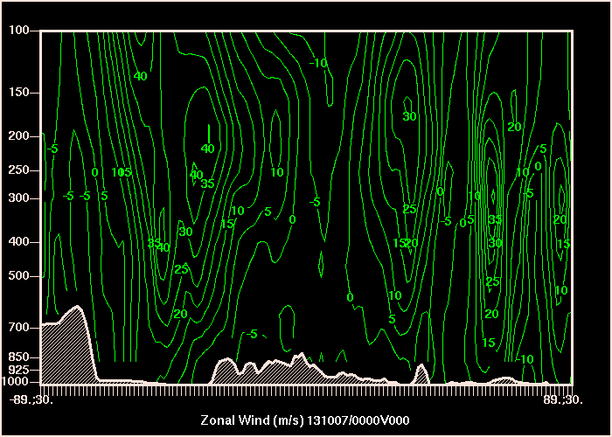
Zonal Wind

Slide 24
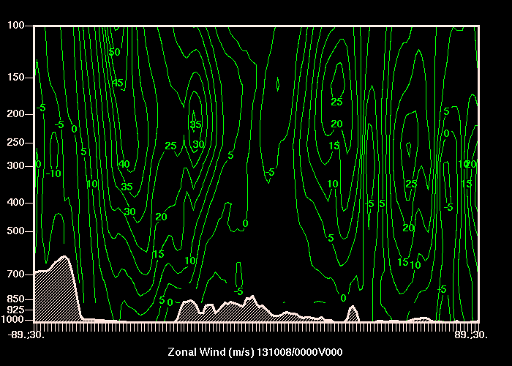
Zonal Wind

Slide 25
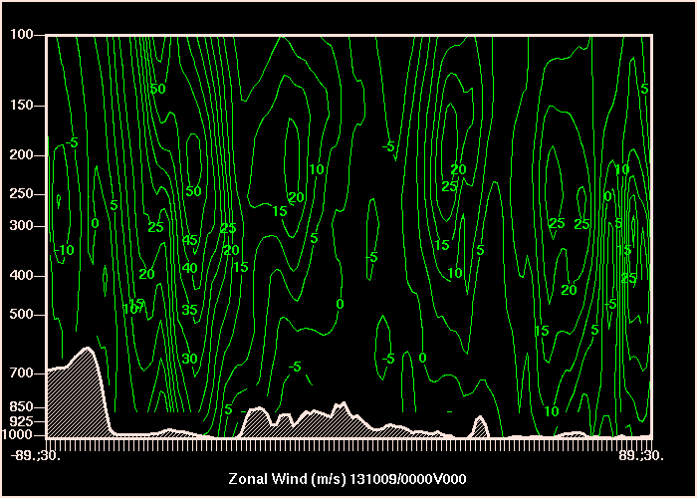
Zonal Wind

Slide 26
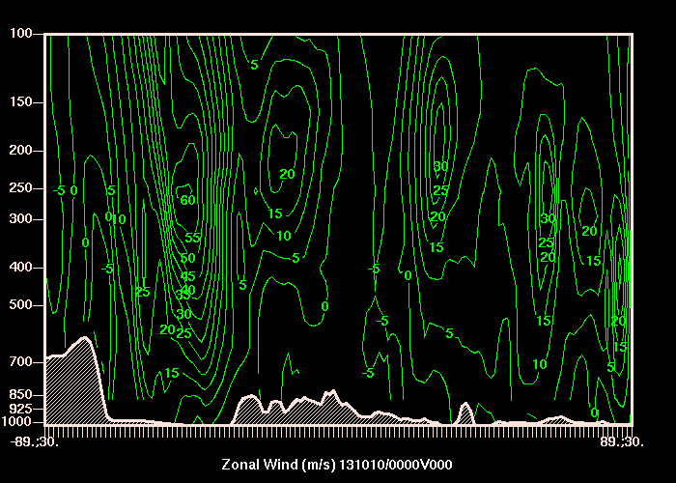
Zonal Wind Northern Hemisphere
Date | U500 | U upper
10/6/2013 | -5 | 3
10/7/2013 | 0 | 4
10/8/2013 | 2 | 5
10/9/2013 | 5 | 7
10/10/2013 | 7 | 12
Northern Hemisphere has been much quieter.

Slide 27
Zonal Wind Southern Hemisphere
Date | U500 | U upper
10/6/2013 | 15 | 30
10/7/2013 | 5 | 25
10/8/2013 | 10 | 30
10/9/2013 | 5 | 25
10/10/2013 | 20 | 30
The Sothern Hemisphere has been much stronger.

Slide 28
References
http://www.meteochile.gob.cl
http://www.ogimet.com
http://www.ecmwf.int/

Slide 29
Questions?

