Slide 1
Mesoscale Dynamics
Introduction

Slide 2
Mesoscale
Between synoptic scale (e.g., large-scale weather) and microscale (e.g., fair-weather cumulus cloud)
Scales of ~ 10 – 1000 km
Wide variety of motions: thunderstorms, internal gravity waves, fronts, mesoscale convective systems, tropical storms.
Sources:
Thermal/orographic forcing,
Nonlinear scale transfers of energy
Cloud processes
Some instability

Slide 3
Downslope Wind Events
(Based on Holton & Hakim, Chapter 9, Section 9.4.4)

Slide 4



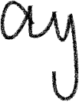






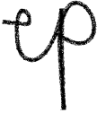











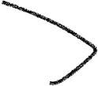















Slide 5
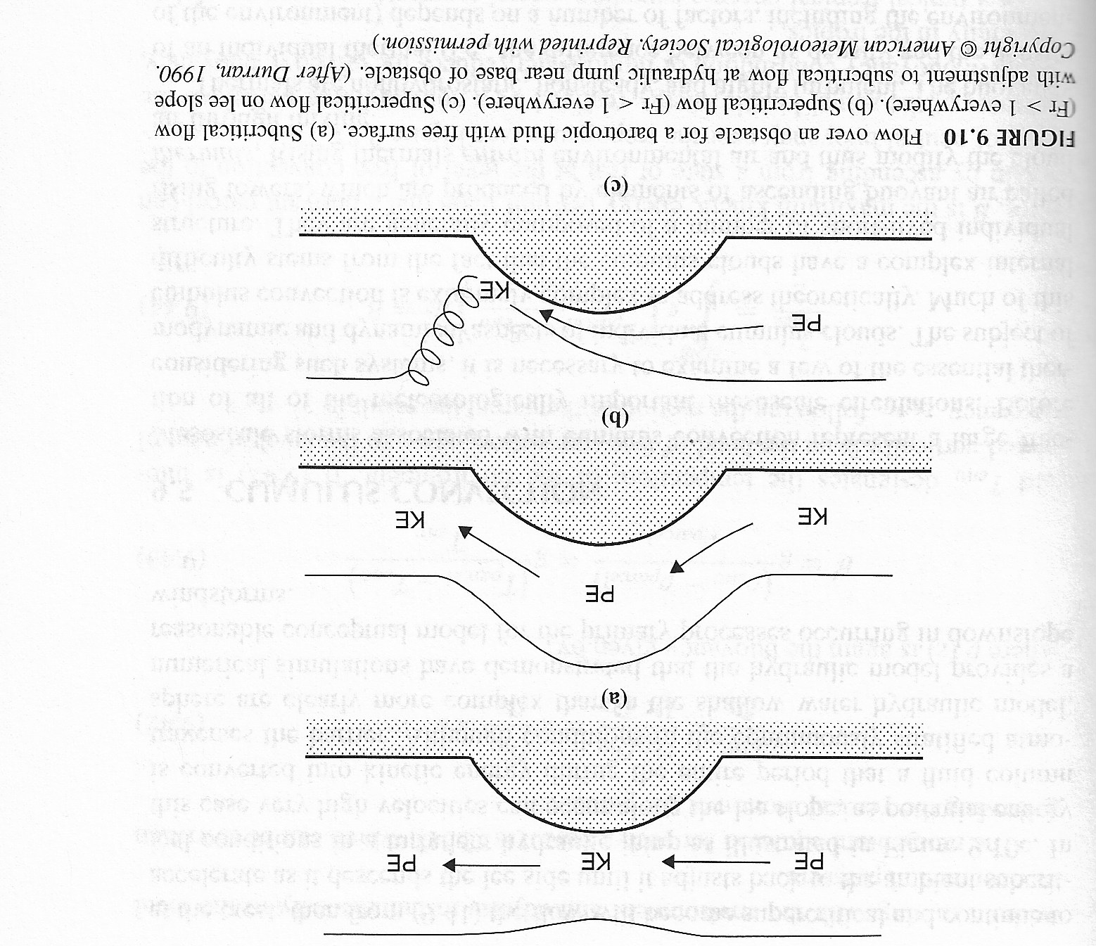
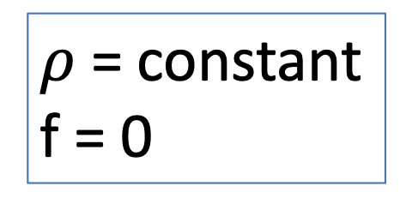
Shallow-Water Environment
H
h’
U
U
U
$ρ$ = constant
f = 0
h_{M}
What happens as wind blows over mountain?

Slide 6
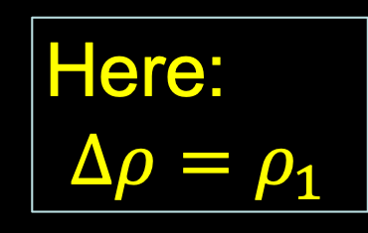
Conservation Laws
Conservation of u momentum:
Here:
$$Δρ=ρ_{1}$$
Need only lower layer and only u momentum on basis of assumptions.
Conservation of mass:
Incompressible
(which also => no need for a thermodynamic equation)
7.3 Wave Types

Slide 7






























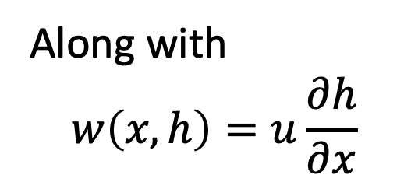
Along with
$$w\left(x,h\right)=u\frac{∂h}{∂x}$$

Slide 8












































Slide 9






















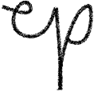














Slide 10



























Slide 11



































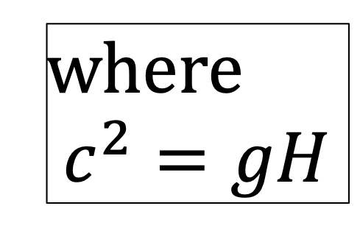
where
$$c^{2}=gH$$

Slide 12











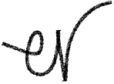




























Slide 13

























Slide 14




















Slide 15











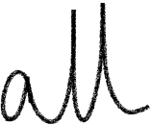



Slide 16





































Slide 17






























Slide 18

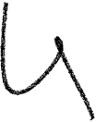
























Slide 19











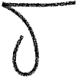




































Slide 20
Moving up the mountainside, for subcritical flow, ∂u/∂x > 0, so wind speed increases and h decreases. This is consistent with conservation of energy. This opens the potential for Fr approaching 1.
If Fr > 1 after the mountain top, then by the equation on the previous slide, ∂u/∂x > 0,
and the flow can go faster and faster down the mountain side, which can make Fr yet more positive. Consistent with energy conservation, h continues to decrease, which makes c decrease further, also making Fr more positive.
Eventually, a hydraulic jump occurs and turbulence is generated, which leads to lee mountain waves.

