Slide 1
MT454 - Energy Cycle
Two-layer, Q-G Model

Slide 2































Slide 3




























Slide 4


























Slide 5























Slide 6


































Slide 7











































Slide 8
























































Slide 9













































Slide 10








































Slide 11


























Slide 12




























Slide 13




















































Slide 14





















2

Slide 15












































Slide 16





























Slide 17











































Slide 18





































Slide 19

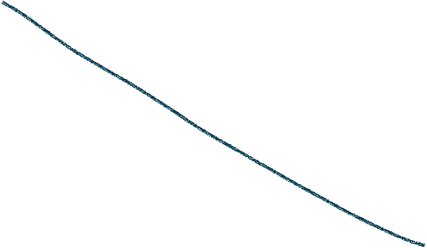
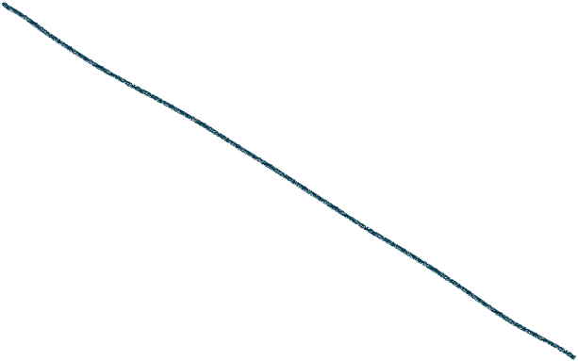




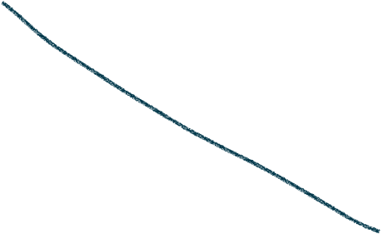








Slide 20





















Slide 21
































Slide 22























































Slide 23






















































Slide 24
















































Slide 25


























