Slide 1
Atmospheric Energetics
Ties to Baroclinic Instability

Slide 2
Two buckets with equal amounts of water.
A)
B)
In which one will spontaneous motion occur?

Slide 3
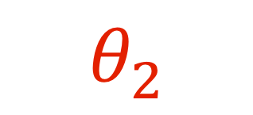
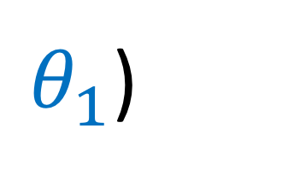
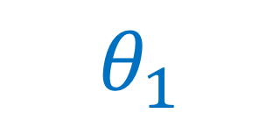
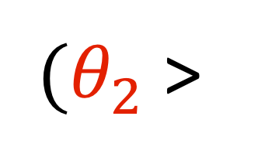
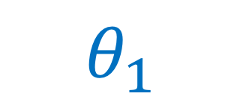
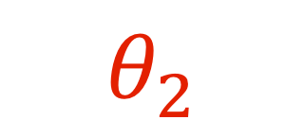
Two atmospheres with equal amounts of heat.
$(θ_{2}$ >
$θ_{1}$)
A)
B)
$$θ_{2}$$
$$θ_{1}$$
$$θ_{2}$$
$$θ_{1}$$
In which one will spontaneous motion occur?

Slide 4
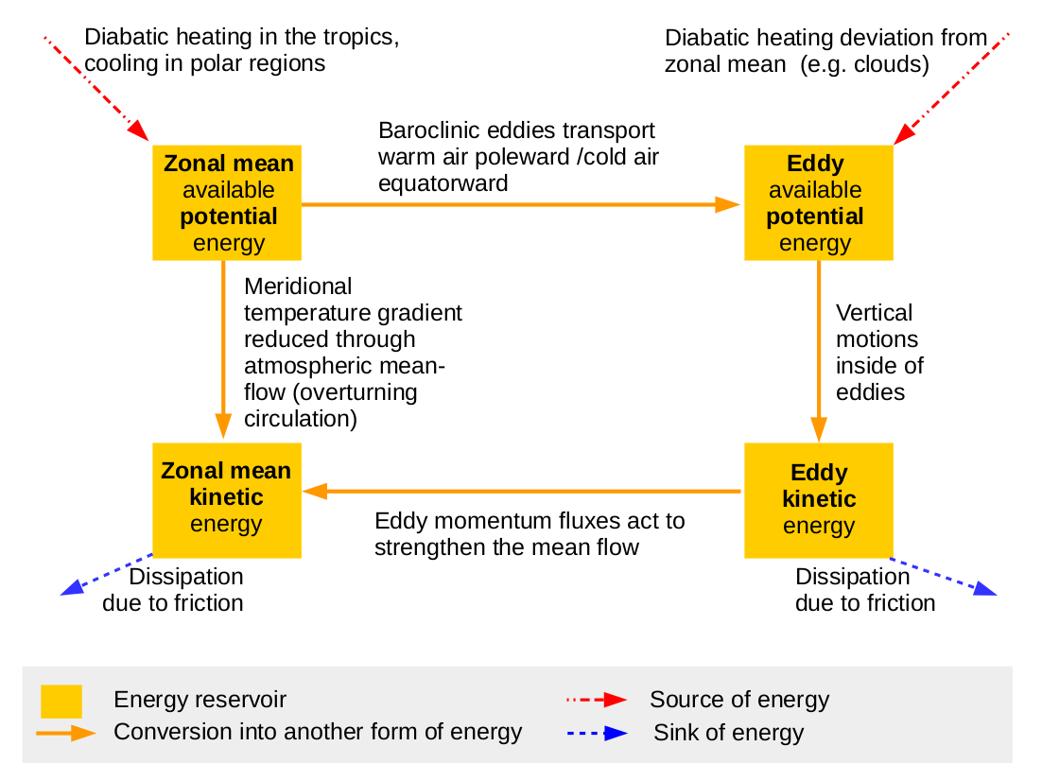
Atmospheric energy cycle

Slide 5
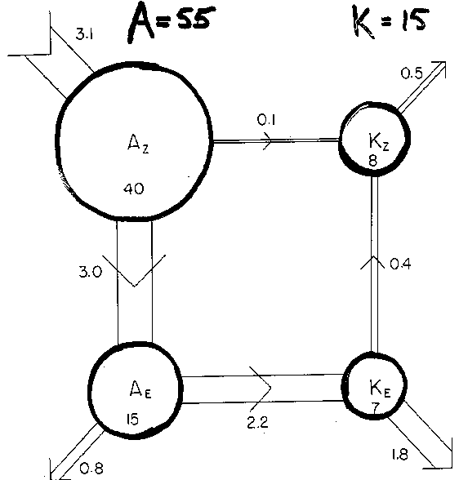
Observed atmospheric energy cycle

Slide 6
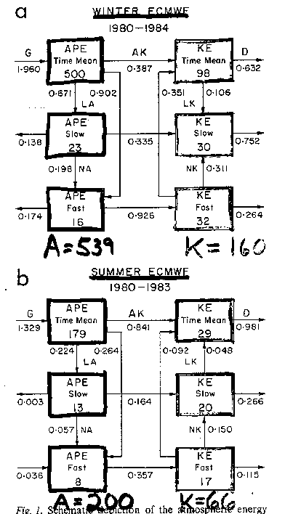
Observed atmospheric energy cycle:
Fast vs slow

Slide 7
Observed atmospheric energy cycle:
Fast vs slow

Slide 8
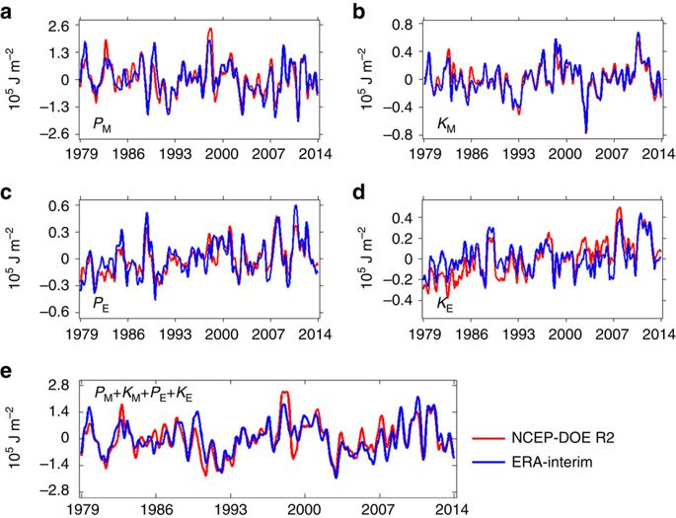
Figure 1: Time series of the global-average atmospheric energies.
The mean available potential energy P_{M}.
The mean kinetic energy K_{M}.
The eddy available potential energy P_{E}.
The eddy kinetic energy K_{E}.
The total mechanical energy (that is, P_{M}+K_{M}+P_{E}+K_{E}).
(Pan et al., 2017, Nature Communications)

Slide 9
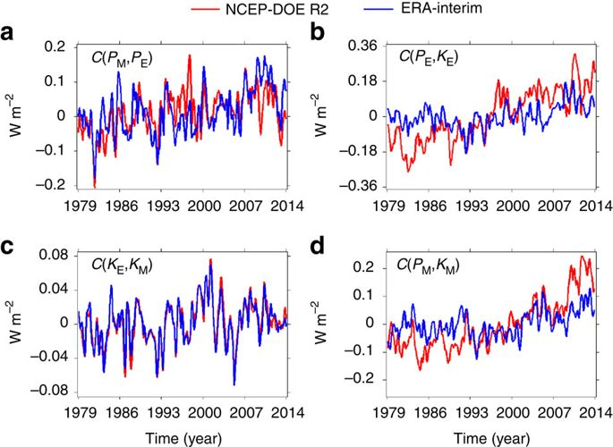
Figure 2: Time series of the global-average conversion rates.
The conversion rate between the mean available potential energy and the eddy available potential energy C(P_{M}, P_{E}).
The conversion rate between the eddy available potential energy and the eddy kinetic energy C(P_{E}, K_{E}).
The conversion rate between the eddy kinetic energy and the mean kinetic energy C(K_{E}, K_{M}).
The conversion rate between the mean available potential energy and mean kinetic energy C(P_{M}, K_{M}).
(Pan et al., 2017, Nature Communications)

Slide 10
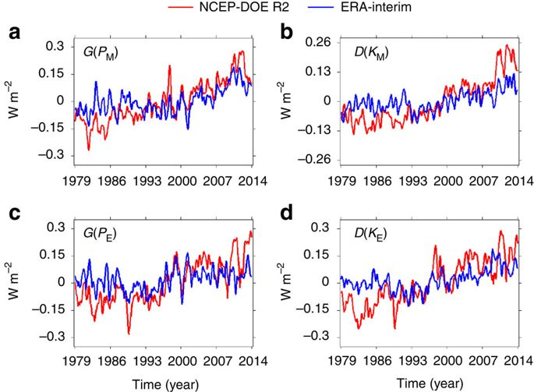
Figure 3: Time series of the global-average generation and dissipation rates.
The generation rate of the mean available potential energy G(P_{M}).
The dissipation rate of the mean kinetic energy D(K_{M}).
The generation rate of the eddy available potential energy G(P_{E}).
The dissipation rate of the eddy kinetic energy D(K_{E}).
(Pan et al., 2017, Nature Communications)

