Slide 1
Some Results EPA (CO₂)_{equivalent} Emissions
Equivalent CH₄ ≈ 21 x CO₂
(lifetime ≈ 12 yr)
Equivalent N₂O ≈ 298 x CO₂
(lifetime ≈ 120 yr)

Slide 2
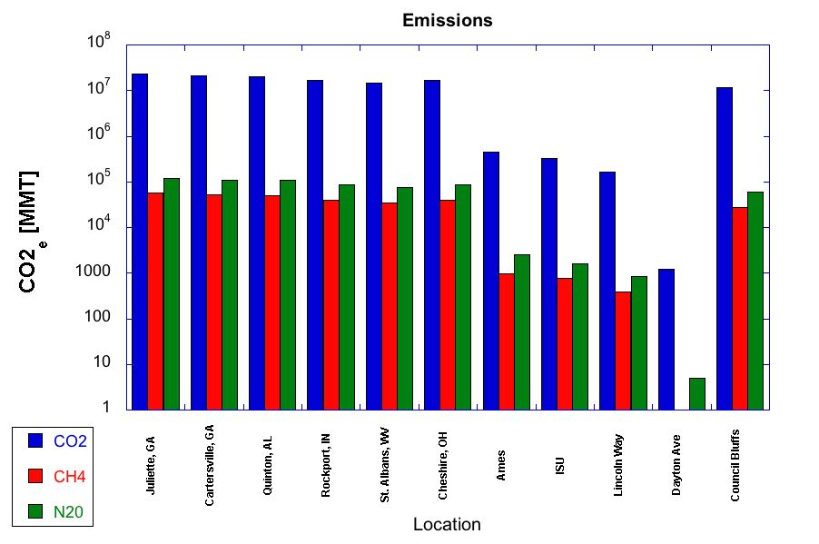

Slide 3
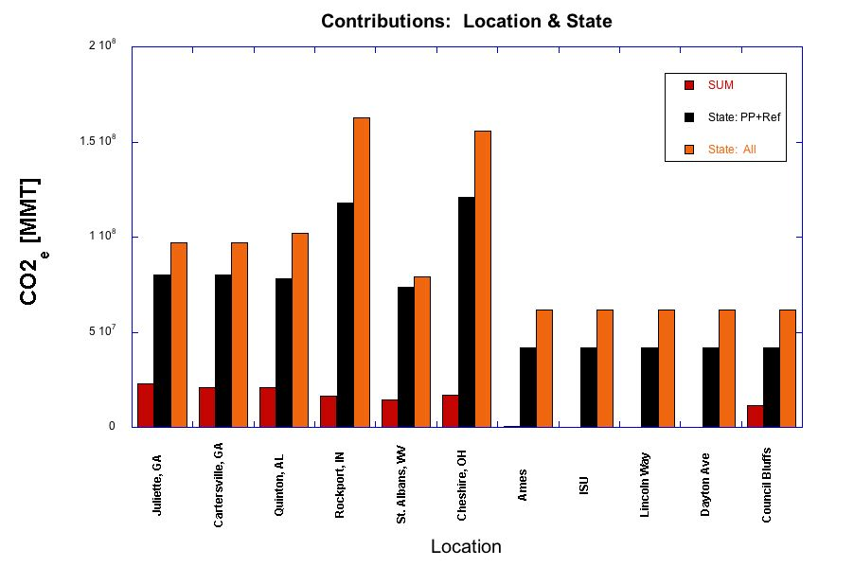

Slide 4
