Slide 1
Hampton University Center for Atmospheric Science REU
Nick Carletta
ncarlett@iastate.edu

Slide 2
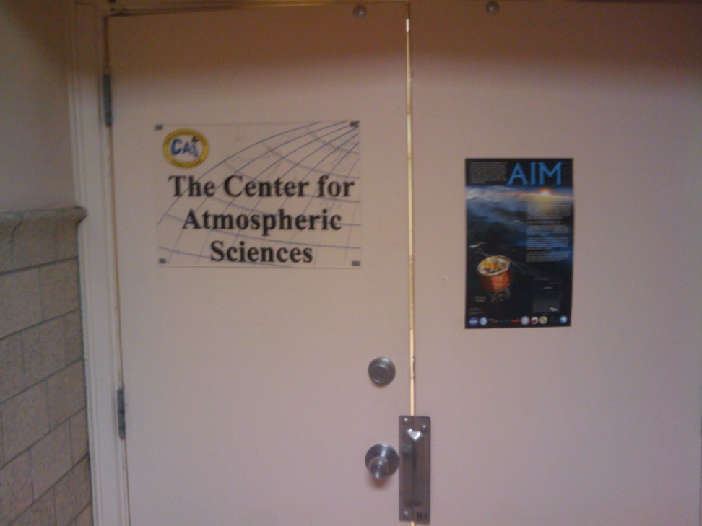
About the Program
Hampton, VA
Works closely with NASA Langley
8 weeks
Food and a dorm room provided
$3600 stipend and up to $500 travel

Slide 3
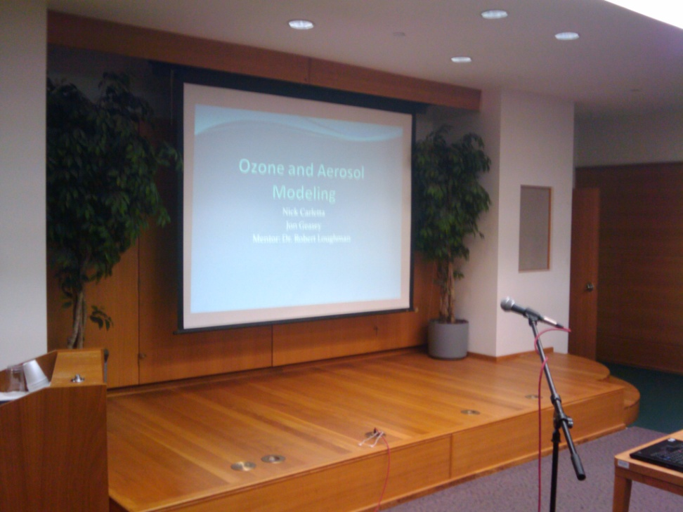
About the Program cont.
Presentation after 5 weeks and final paper at the end
2 to 3 students per mentor
Weekly presentations from the faculty
Monday-Friday 9 to 5

Slide 4
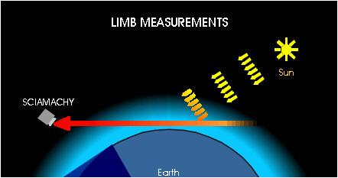
Limb Scattering
Limb Scattering measurements are taken by a satellite looking through the atmosphere but not at the sun
Used to look at specific levels of the atmosphere
http://www.iup.uni-bremen.de/sciamachy/instrument/modes/index.html

Slide 5
Forward and Inverse
With a forward model a radiation field is computed from Atmospheric Data
With an inverse model a profile showing the atmospheric data can be computed from the radiation field
Atmospheric Data
Radiation Field
Ozone/Aerosol Profile

Slide 6
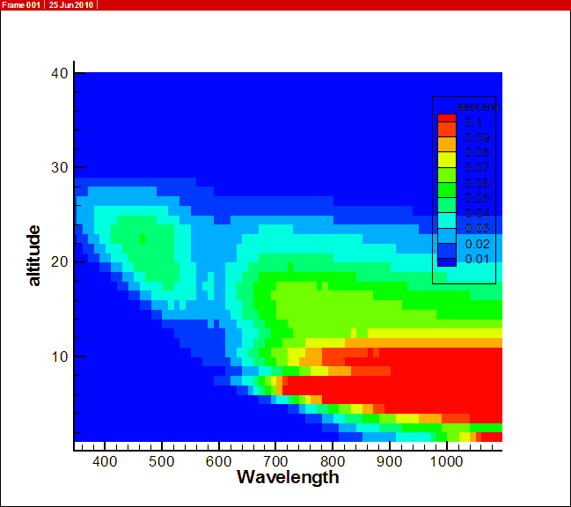
First Project
Started with the data from last year’s project
Made a reader program
Created a visual representation of the scattering of the aerosols with respect to altitude and wavelength

Slide 7
Next Project
Used aerosol scattering model from last year
Same data files from the first project
Modified the program to get scattering angles
scattering angle =arccos[sin(zenith) * cos(azimuth)]
Read zenith and azimuth from data files provided by Dr. Loughman
Used computed scattering angle and compared it to latitude taken at the solstices and equinoxes.

Slide 8
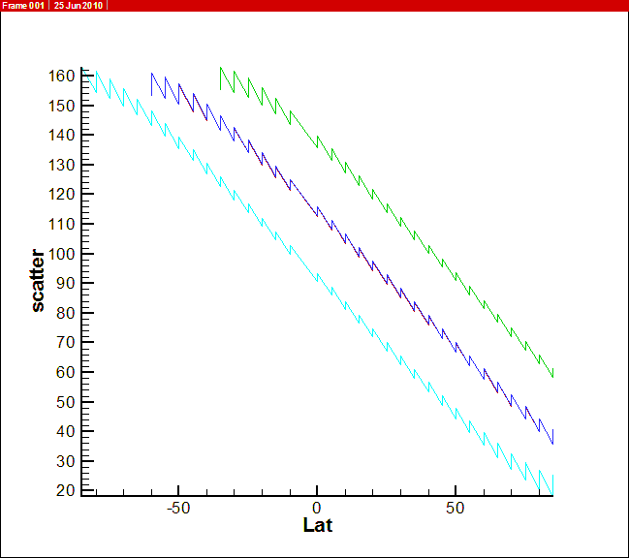
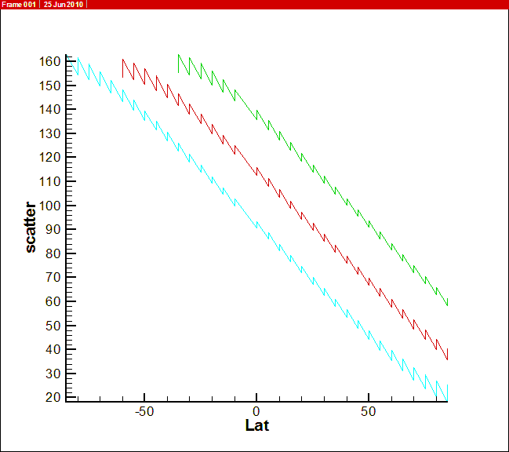
Scattering Angle Comparison
Data with Fall & Spring Equinox
Data without Fall Equinox

Slide 9
Final Project
Data from:
Used FORTRAN to reorganize the data from a 3x1652 matrix to a 177x28 matrix
The goal is to make graphs with the height and extinction axes and a new line for each month and latitude combination
Each wavelength will have its own graph
Previous projects were a single aerosol, orbit, etc and this will incorporate multiple values to create a more complete picture
J. J. Bauman, P. B. Russell, M. A. Geller, and P. Hamill
J. Geophys. Res., 108, 4382, doi:10.1029/2002JD002992, 2003

Slide 10
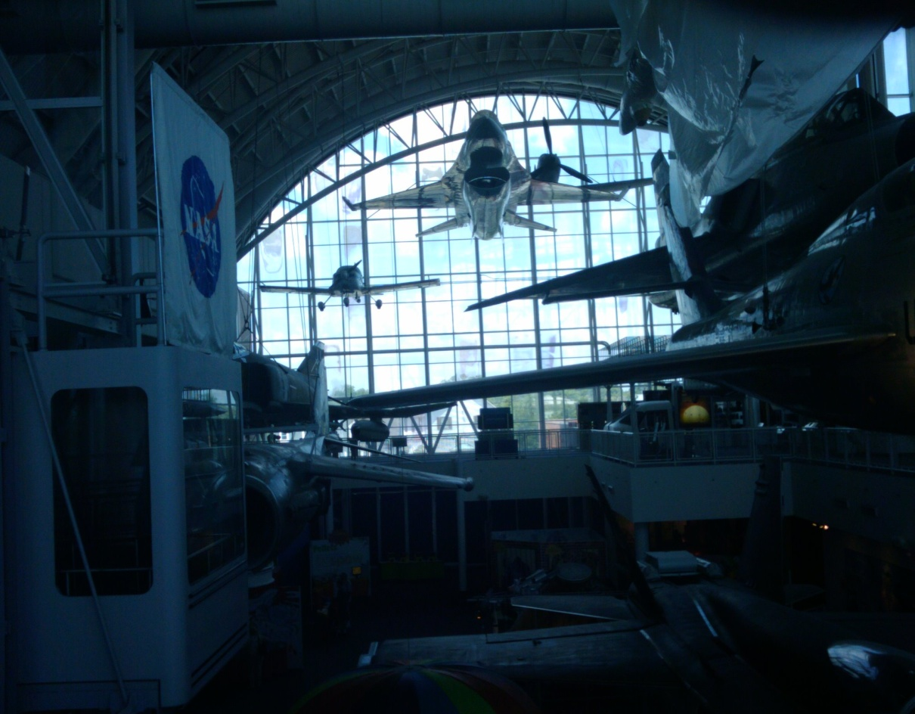
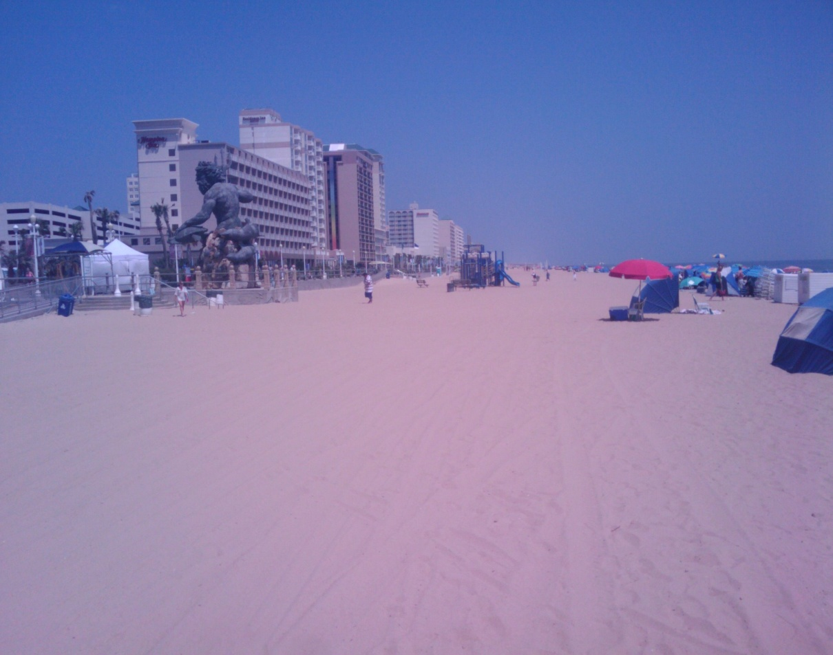
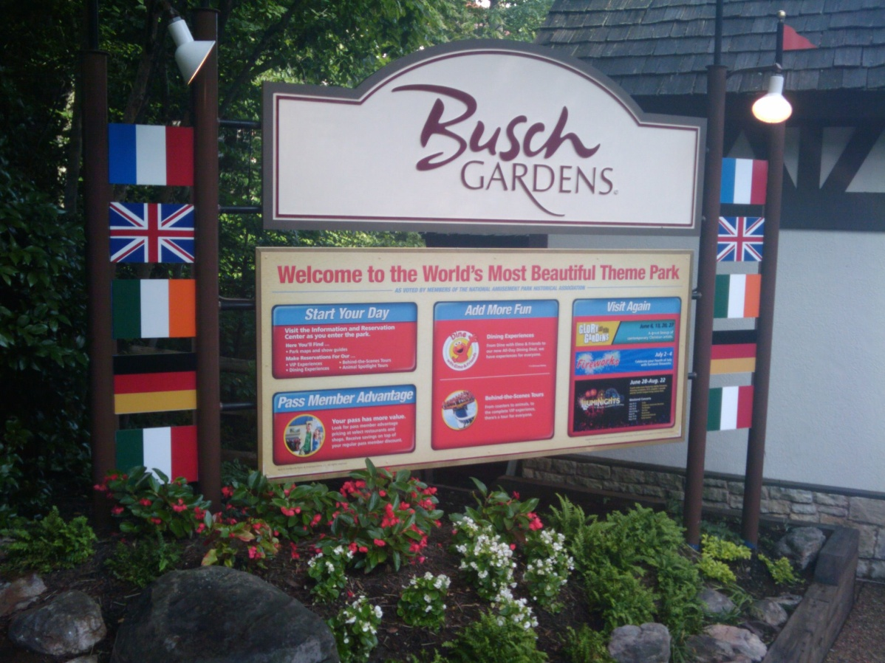
Not all work
Busch Gardens
Virginia Air and Space Center
Jefferson Labs
Virginia Beach
Pool Party

Slide 11
Applying
Online application http://reu.hamptonu.edu/
Statements of career goals, interest in this program, previous research experience, and favorite activities each 250 words or less
Programming experience
Transcript and letter of recommendation
Was due March 1 last year but they are waiting on funding so date TBD

Slide 12
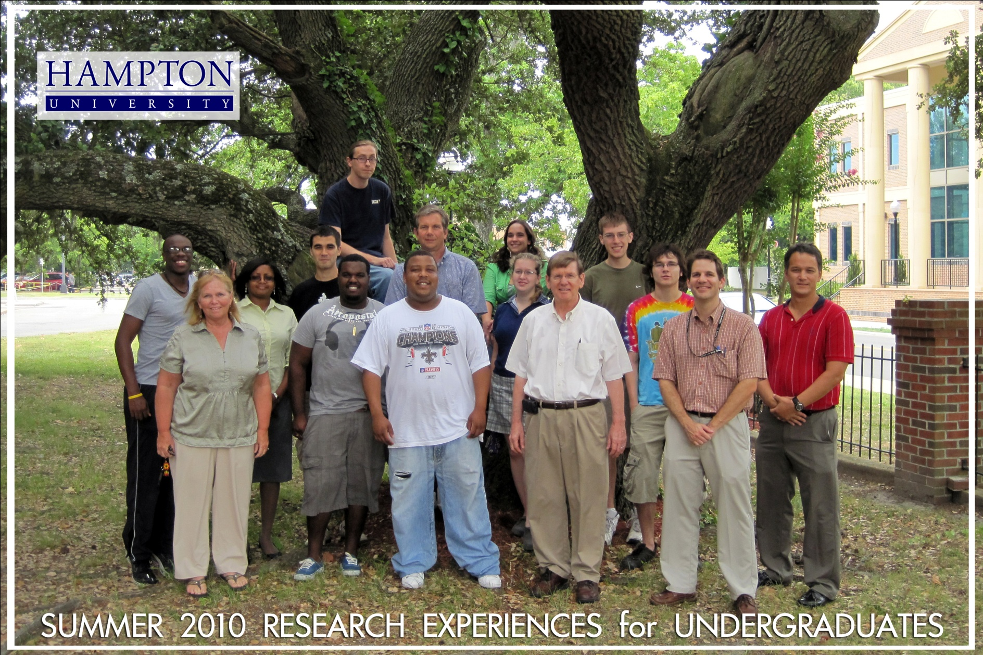
Questions?

